Slide 1
Unit 5 Social Networking
ENHANCED EDITION

Slide 2
Unit Contents
Section A: Social Networking
Section B: Content Communities
Section C: Blogs and More
Section D: Online Communication
Section E: Social Media Values

Slide 3
Section A: Social Networking
The Social Media Mix
Social Networking Evolution
Social Networking Basics
Geosocial Networking
Social Network Analytics

Slide 4
The Social Media Mix
Social media are online services that facilitate communication and interaction among people who want to share information about their lives, issues, and events using a multimedia mix of text, pictures, video, and audio

Slide 5
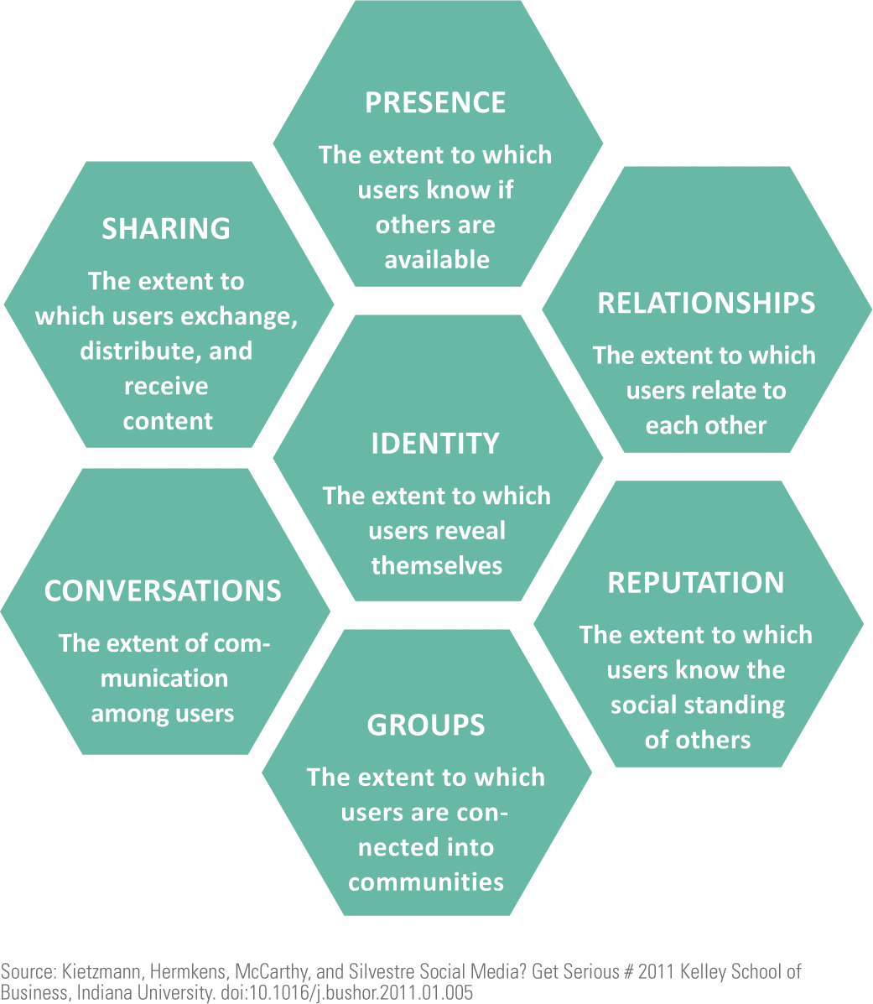
The Social Media Mix
The Social Media Honeycomb provides a visual model for classifying and comparing various social media services
Each hexagon in the honeycomb represents a social media building block

Slide 6
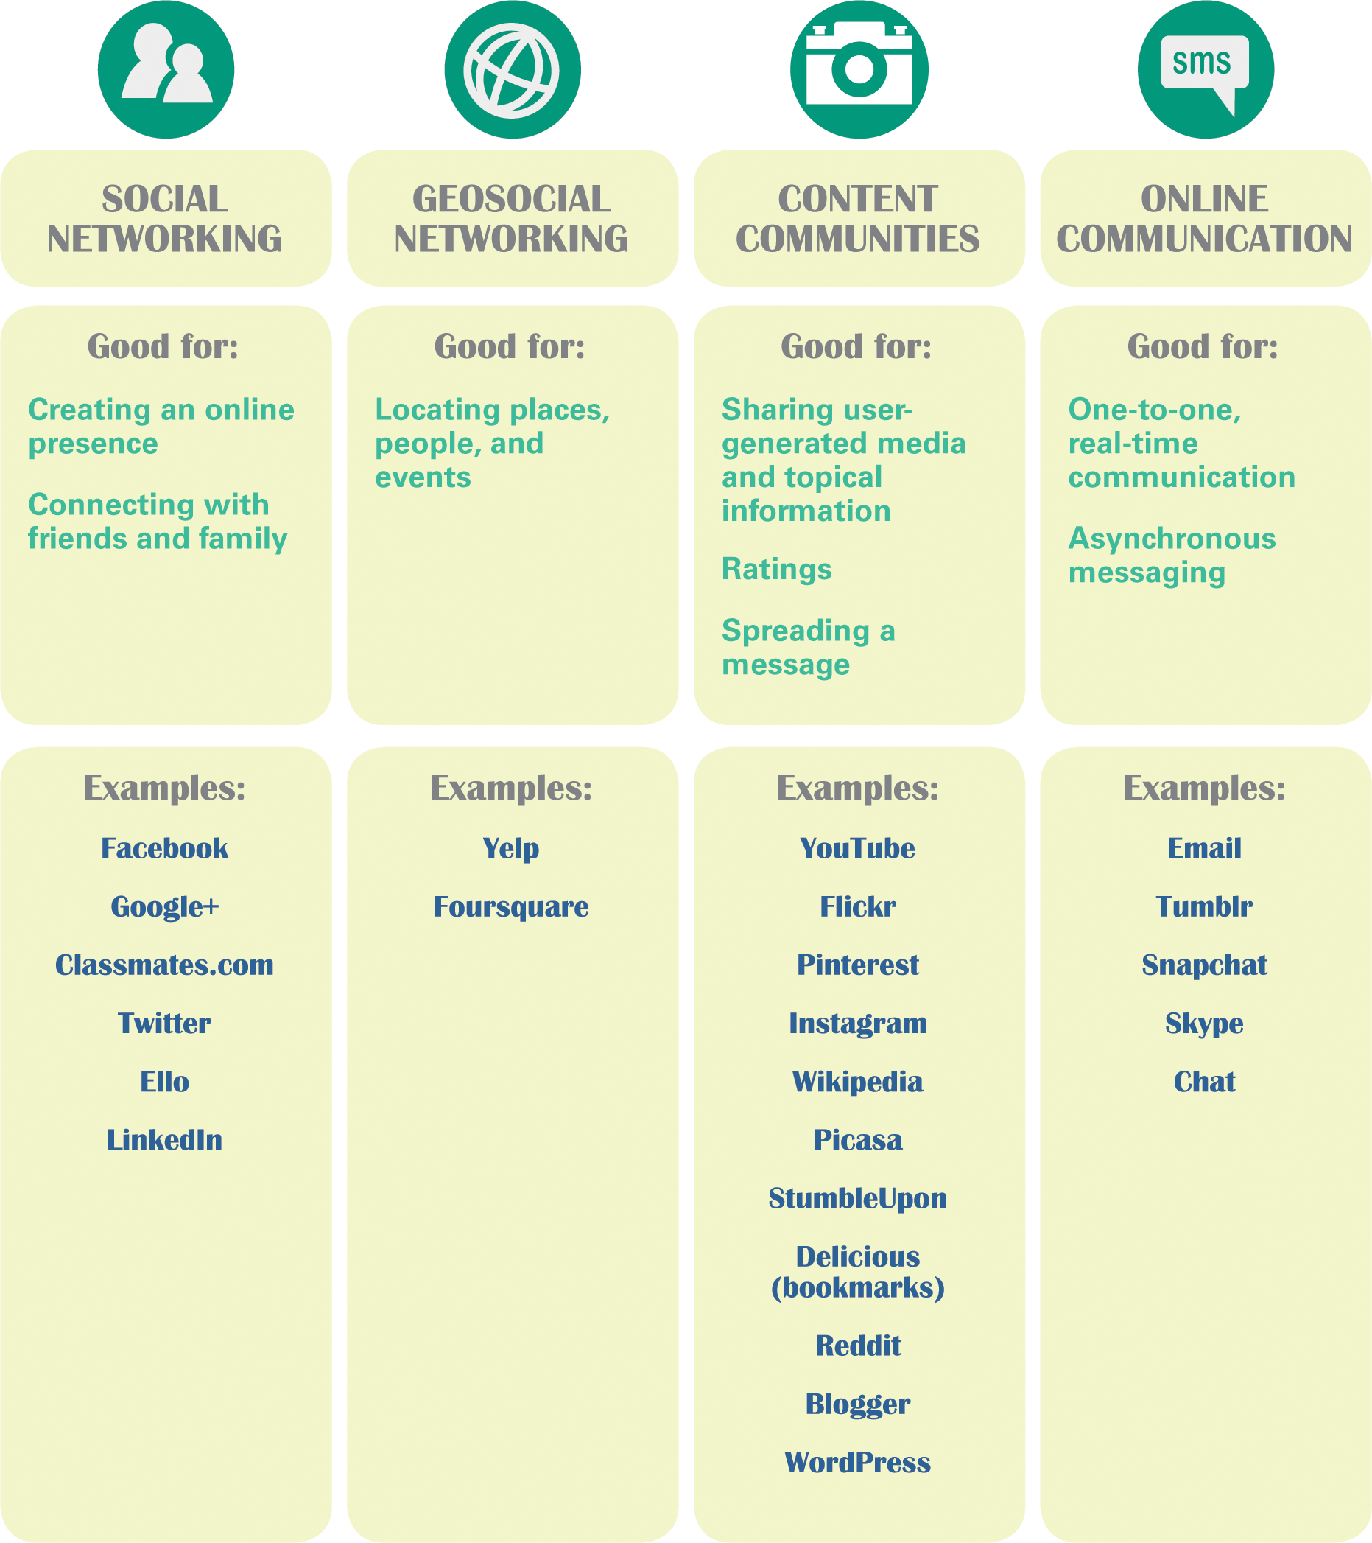
The Social Media Mix
In this unit, social media are categorized into four groups:
Social networking
Geosocial networking
Content communities
Online communications

Slide 7
Social Networking Evolution
A social networking service revolves around personal profiles and interconnections among subscribers who want to share information about themselves
Social networking can be traced back to online services, such as CompuServe, Prodigy, and America Online (AOL), that were not part of the Internet

Slide 8
Social Networking Basics
A person’s presence on a social media service is referred to as an online identity
Each online identity is encapsulated in a profile; a social media profile is the set of information provided to friends, contacts, and the public

Slide 9
Social Networking Basics

Slide 10
Geosocial Networking
Geosocial networking provides a platform for users to carry out interactions based on their current locations
Some of the most popular and well-designed geosocial services include: Yelp, Foursquare, Banjo, and Google Maps
An emerging subset of geosocial networking called social discovery, uses geolocation to meet with people who are nearby and have similar interests

Slide 11
Geosocial Networking

Slide 12
Geosocial Networking
When individuals contribute computer time, expertise, opinions, or money to a defined project, they are participating in crowdsourcing
Yelp, Amazon, Zappos and other online merchants, provide ratings compiled from user reviews; this is an example of crowdsourcing

Slide 13
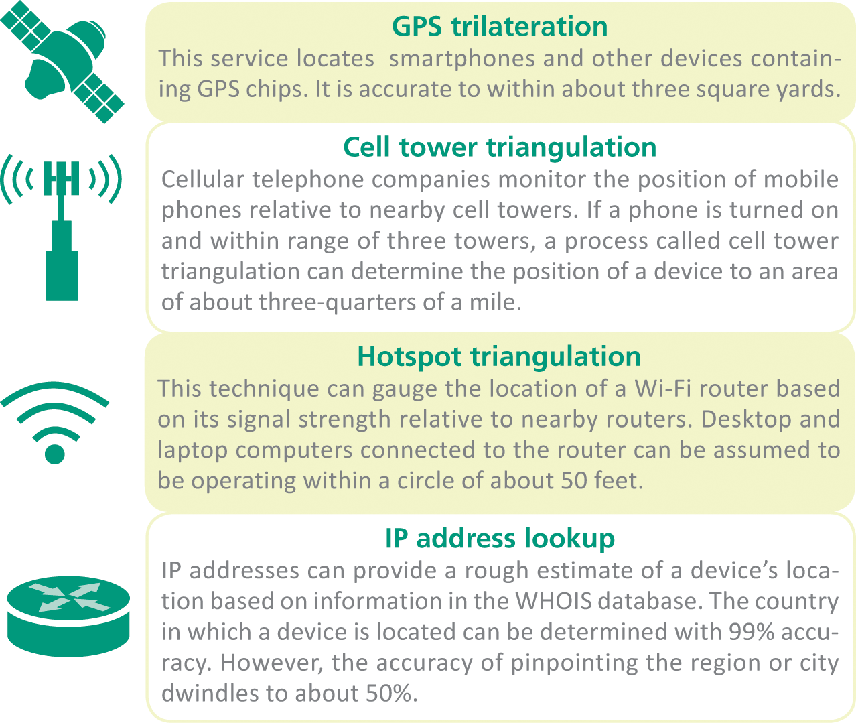
Geosocial Networking
There are four ways that the location of a device can be determined:

Slide 14
Geosocial Networking
Presenting information about what’s nearby requires places and landmarks to be tagged with their location; geotagging and geocoding provide the necessary geographical information:
Geocoding is the process of determining the coordinates of a specific place, such as the street address or the longitude and latitude of a location
Geotagging is the process of adding location data to photos, Web sites, HTML documents, audio files, blog posts, and text messages

Slide 15
Social Network Analytics
Social networks are not exclusively online; sociologists use social network diagrams called sociograms to depict connections between people
The circles in these diagrams are referred to as sociogram nodes
The lines connecting nodes are referred to as sociogram edges
Two-way edges exist when two people consider each other to be friends
One-way edges exist when a relationship is not reciprocal, such as a Twitter follower who does not follow back

Slide 16
Social Network Analytics
Sociograms can get extremely complex, making connections difficult to trace and analyze
An alternative method for depicting social connections is with an adjacency matrix
A binary adjacency matrix is a set of cells containing a 0 if there is no connection between two people and a 1 if there is a connection

Slide 17
Social Network Analytics
Sociograms and other analytic tools help us to discover and understand the quality and quantity of our personal social networks
One odd phenomenon that was discovered is called the “class size paradox” because it is related to the reason students feel that they are always in larger than average classes

Slide 18
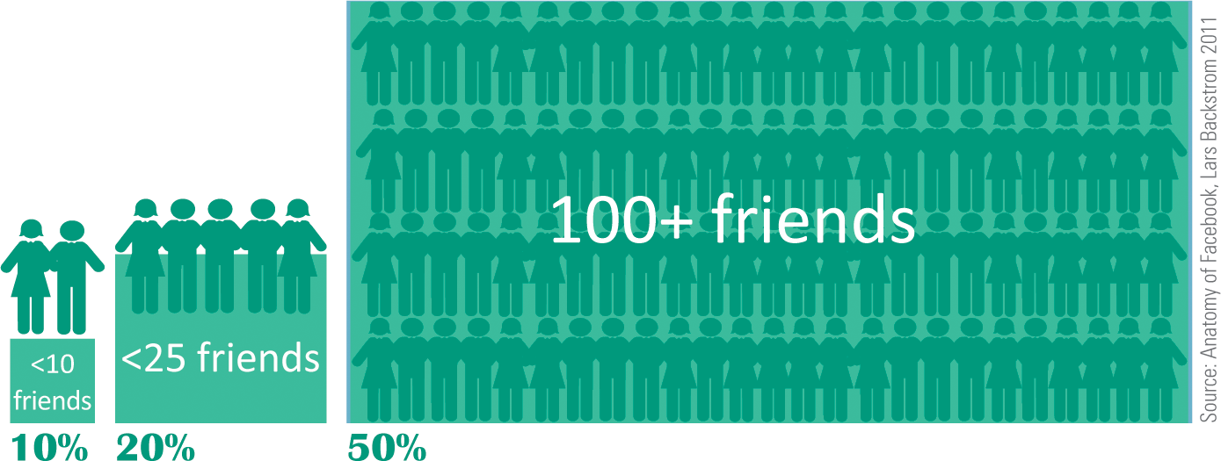
Social Network Analytics
Here’s how it works: Does it seem like most of your friends have more friends than you have? It turns out that is the case with more than 80% of Facebook users; the explanation is that people tend to choose popular classes and friends, and such popularity does indeed mean that the classes are larger and your friends will have more friends than you have

Slide 19
Section B: Content Communities
Evolution
Media Content Communities
Intellectual Property
Creative Commons

Slide 20
Evolution
Many social media sites, such as Wikipedia, YouTube, and Flicker, were designed as repositories for user-generated content
These social media sites are sometimes called content communities
These communities may focus on text-based information, or their focus may be on other media, such as photos, music, or video

Slide 21
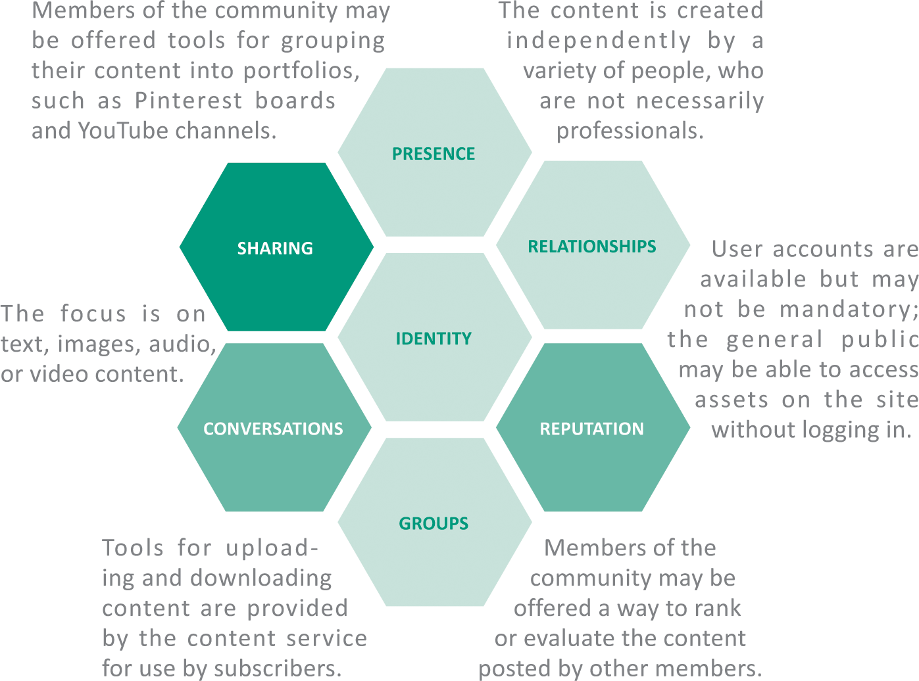
Evolution
Content communities typically have these characteristics:

Slide 22
Evolution
The bulletin board systems (BBSs) of the 1970s contained user-generated content and could be considered forerunners of today’s content communities and social networks
In 2001 a text-based collaborative called Wikipedia was launched and a community of contributors quickly formed around it
Video content communities launched with the founding of YouTube in 2005; that same year was the first instance of an online video going viral
In the context of social media, viral refers to media elements that quickly infiltrate popular culture via social media

Slide 23
Media Content Communities
Media content communities are so popular that most people with an Internet connection have logged in to take a look at videos from YouTube and images from Flickr
Although many content communities allow open access to media, most require registration before files can be uploaded
Content communities offer simple tools for uploading media files from a computer, and most offer apps that handle uploads from mobile devices

Slide 24
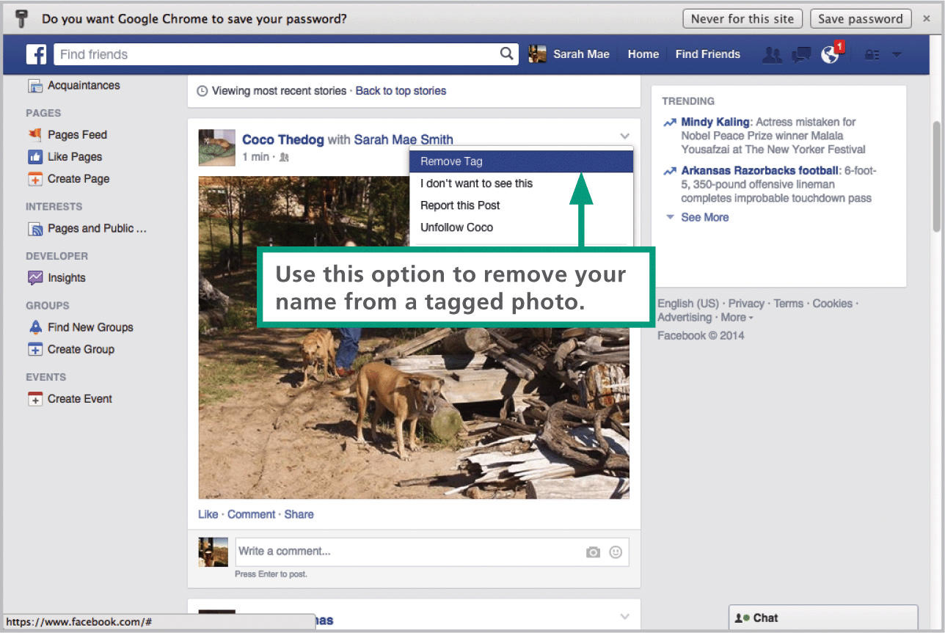
Media Content Communities
A metadata tag is simply a keyword that describes information, such as the content of a media element
Formal tagging methods add information to a tag according to a set of tagging standards

Slide 25
Intellectual Property
All of the creations that materialize from the mind or intellect are considered intellectual property
Inventors, artists, writers, and other creative individuals are the owners of their intellectual property
There are four categories of intellectual property:
Patents
Trademarks
Copyrights
Trade secrets
A trademark is any word, name, symbol, or design used in commerce to identify and distinguish the goods of one company from those of another

Slide 26
Intellectual Property
Copyright is a form of legal protection that grants the author of an original work an exclusive right to copy, distribute, and sell
Public domain refers to the status of works with expired copyrights or whose creators have forfeited their copyright; the works of Shakespeare are in the public domain

Slide 27
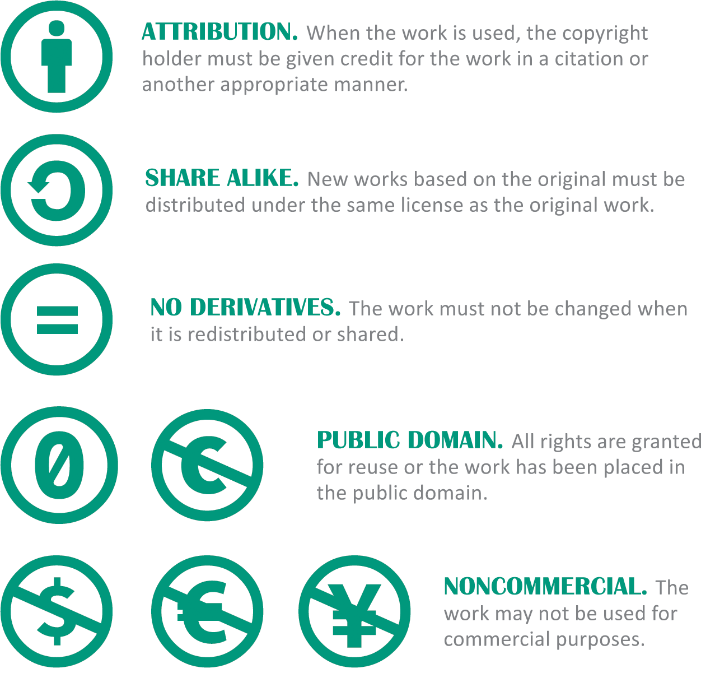
Creative Commons
A Creative Commons license is based on five rights that copyright holders can grant or deny to others:

Slide 28
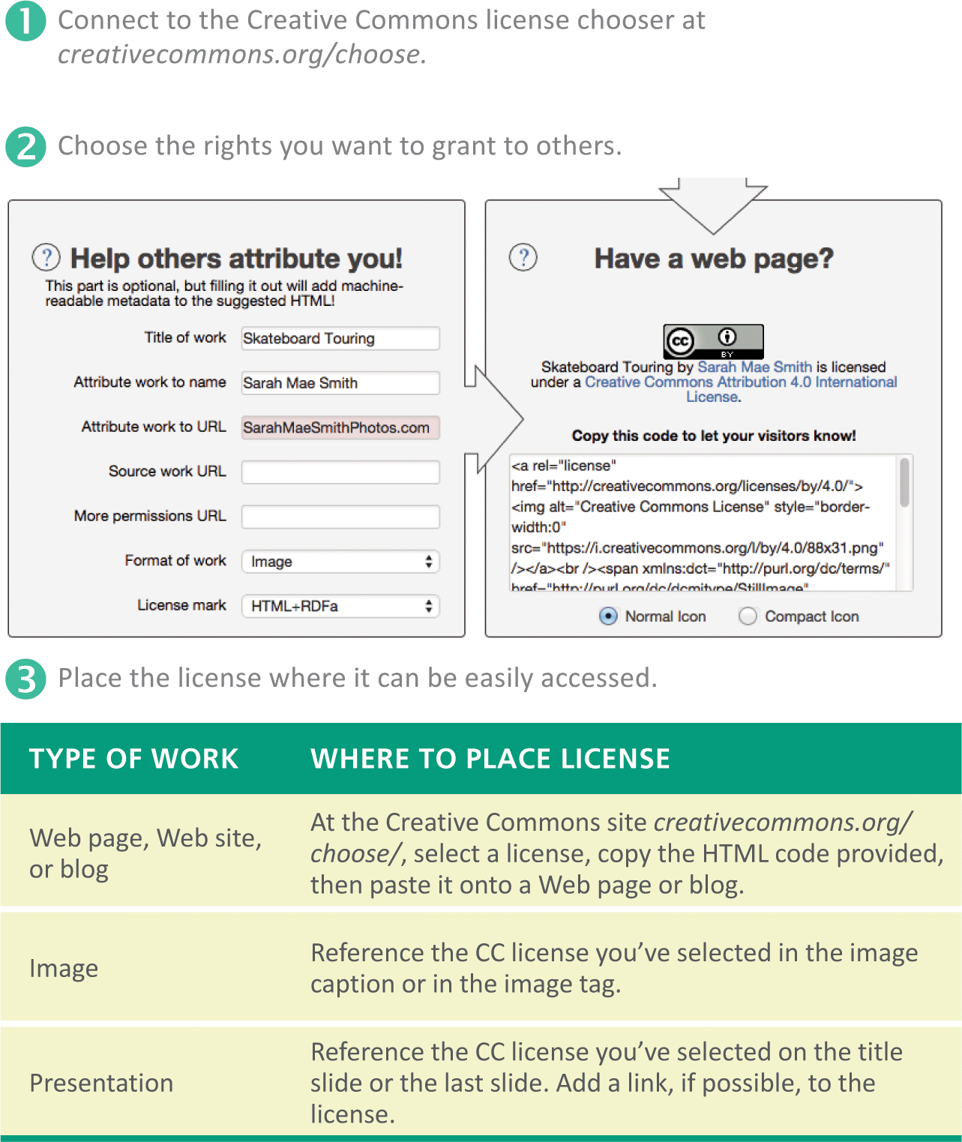
Creative Commons
Whereas copyright is designed to limit the use of a work, copyleft is designed to make a work freely available for distribution and modification under the condition that all derivative works use the same license

Slide 29
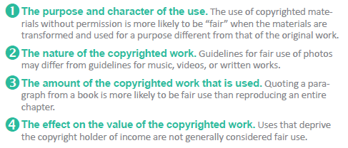
Creative Commons
Fair use allows for the limited use of copyrighted material without obtaining permission from the copyright holder
United states copyright regulations include four factors that characterize fair use:

Slide 30
Creative Commons
A derivative work modifies a copyrighted work but does not substantially change its content or purpose; translations and adaptations are examples of derivative work
A transformative work repackages a copyrighted work to add new meaning or produce a work that is used for a purpose different from the original work; parodies are considered transformative

Slide 31
Section C: Blogs and More
Blogs
Microblogs
Wikis

Slide 32
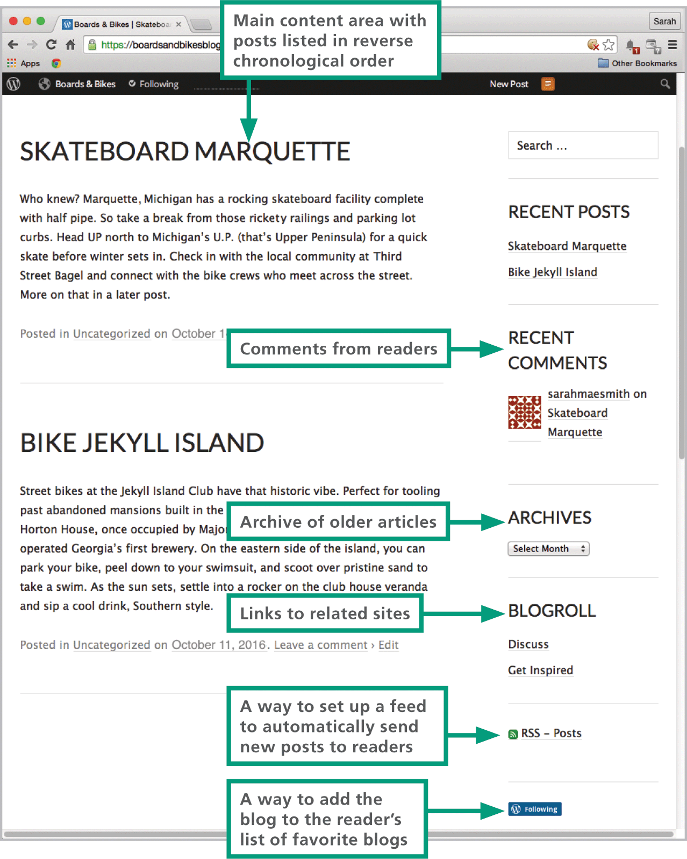
Blogs
A blog (short for Web log) is similar to an online diary; it is maintained by a person, a company, or an organization, and it contains a series of entries on one or more topics

Slide 33
Blogs
Blogger and WordPress are the most popular blogging platforms
You can use an RSS reader or blog aggregator to set up a “feed” that monitors your favorite blogs, collects the latest posts, and displays them
The blogosphere—all the blogs and their interconnections—is influential; blogs and other Internet-based news outlets have the potential to reach mass audience

Slide 34
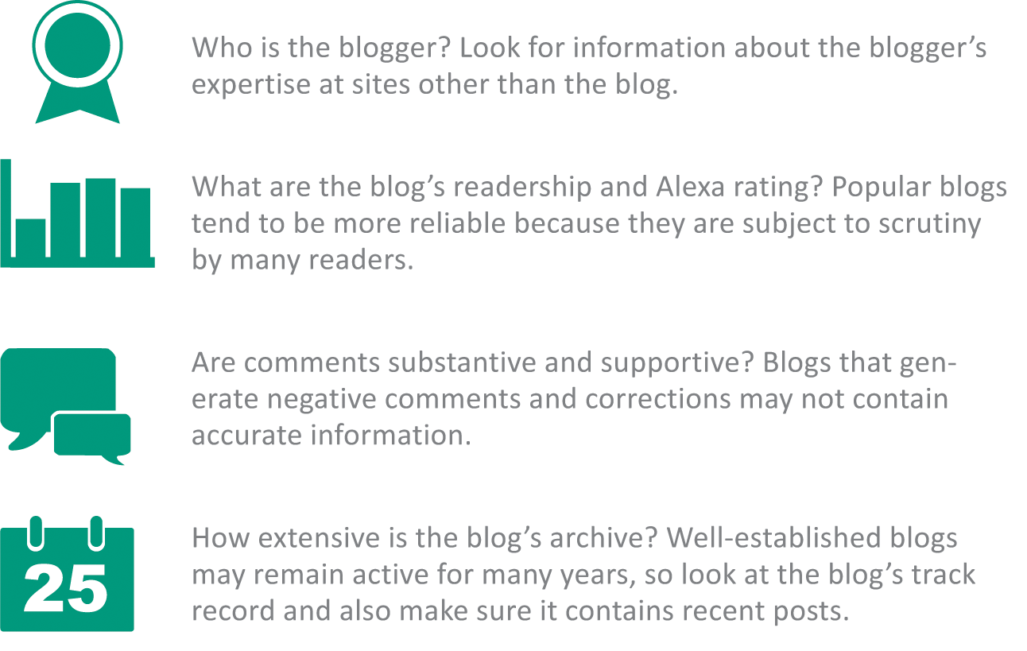
Blogs
Professional journalists and the media companies they represent are guided by a code of ethics that encourages seeking truth, reporting it, minimizing harm, resisting outside influences, and maintaining accountability

Slide 35
Microblogs
Twitter was modeled as a Web-based version of the text messaging services offered on mobile phones; it is an example of a microblogging service
A microblogging service is essentially a short blog post
Twitter messages, called tweets, are limited to 140 characters

Slide 36
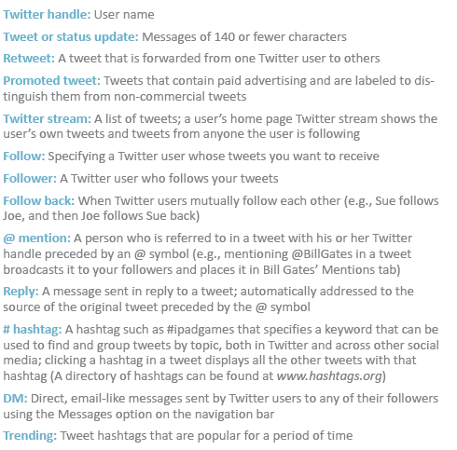
Microblogs
Twitter has a vocabulary all its own, and some of its terminology has spilled over to other social media

Slide 37
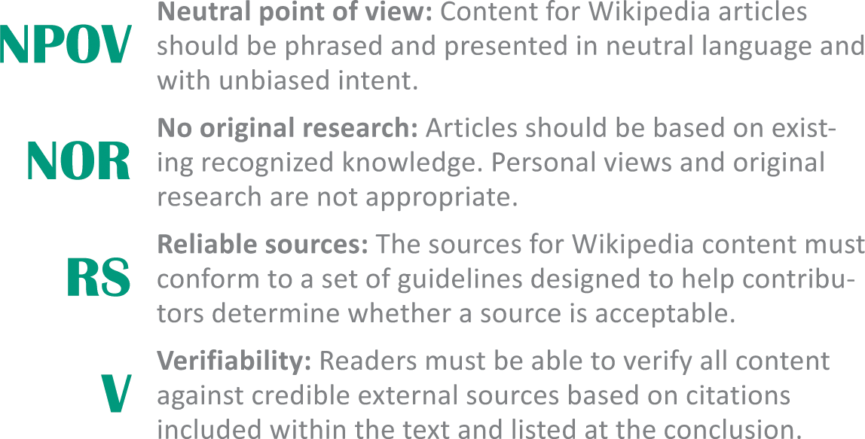
Wikis
A wiki is a collaborative Web application that provides tools that enable contributors to post, read, and modify content
Participants are encouraged to register with the Wikipedia community and become “Wikipedians”
As of 2014, more than 75,000 participants were regular contributors

Slide 38
Wikis

Slide 39
Wikis

Slide 40
Wikis

Slide 41
Section D: Online Communication
Communication Matrix
Email
Online Chat
Voice and Video over IP

Slide 42
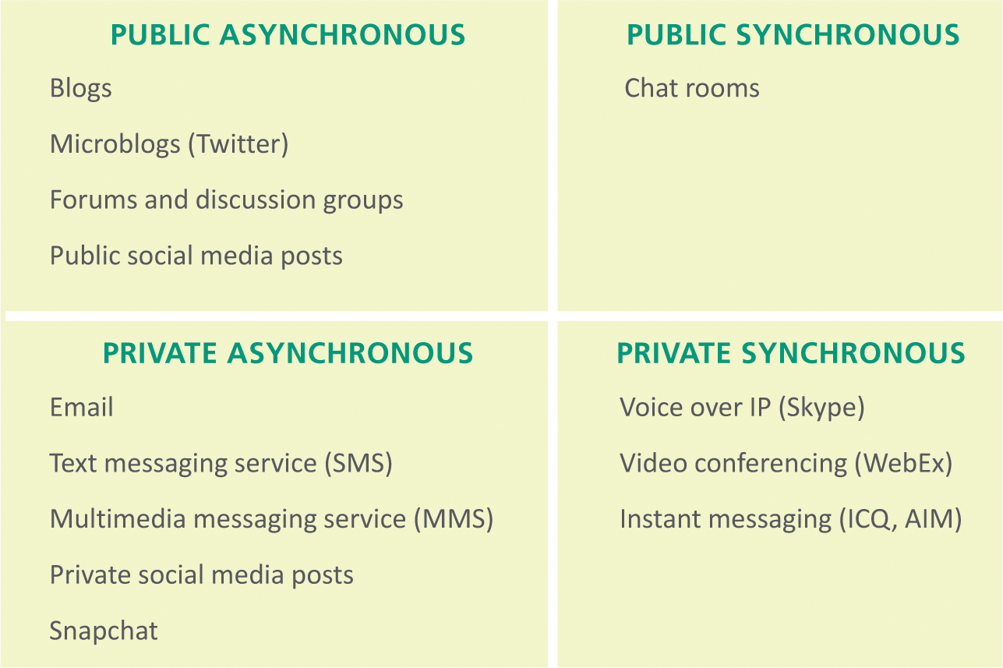
Communication Matrix
The Internet offers many tools for communicating and collaborating; more are appearing every day

Slide 43
Communication Matrix
Synchronous communication – interchanges happen in real time while all parties are online; these communications have the advantage of immediacy
Asynchronous communication – messages are held until the recipient is ready to view them; it offers convenience because information can be gathered whenever you want it

Slide 44
Communication Matrix
Public communications – can be accessed by individuals unknown to the person who created a message; the word posting is associated with this type of communication because it is similar to posting a billboard, sign, or poster
Private communications – communications for which you specify one or more recipients; text messaging is a popular type of private communication

Slide 45
Email
The term email can refer to a single message or to the entire system of computers and software that transmits, receives, and stores email messages
An email message is an electronic document transmitted over a computer network
The computers and software that provide email services form an email system
At the heart of a typical email system is an email server—a computer that essentially acts as a central post office for a group of people
Email messages have a standard format that consists of a message header and the message body; the message header contains the sender and recipient addresses, date, and subject line

Slide 46
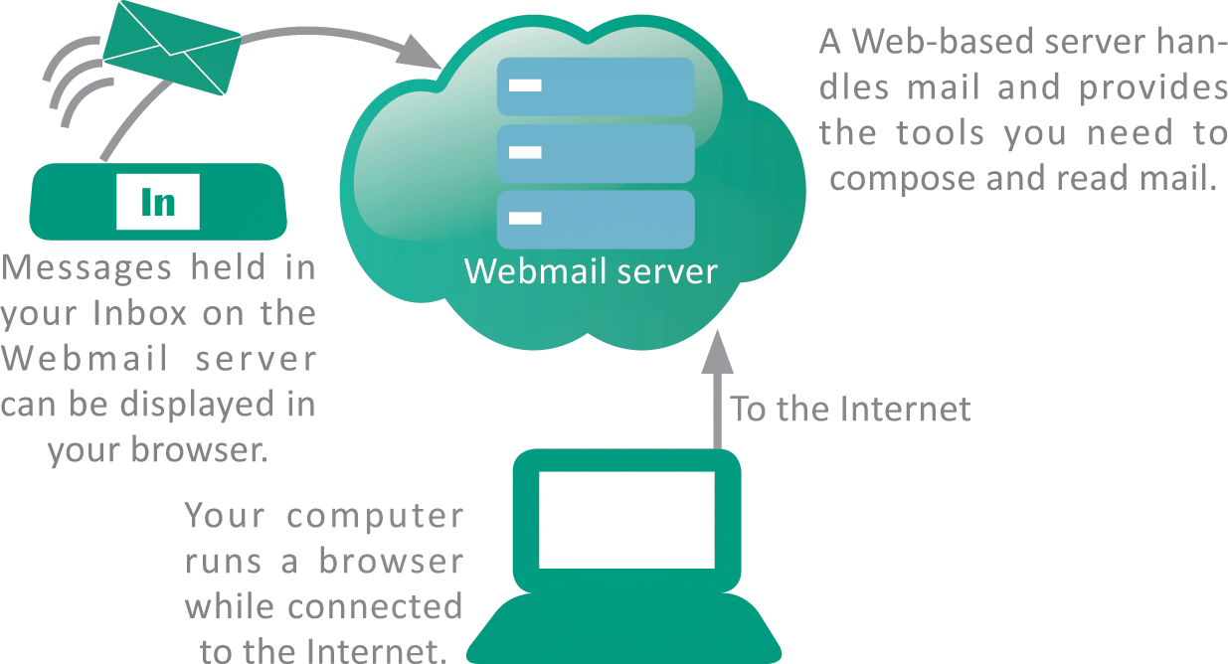
Email
Webmail is typically a free service accessed using a browser

Slide 47
Email
Pros and Cons of Webmail:
Affordable – most Webmail is free; you can easily establish additional accounts
Access from mobile devices – it can be accessed from mobile devices when your computer is not handy
Access anywhere – it’s ideal for people who travel because messages can be accessed from any computer connected to the Internet
Security risks – your email messages are stored on Web servers that can be hacked into
Advertising – free Webmail is supported by advertising, so expect to see ads

Slide 48
Email
When you use local email, an Internet based email server stores your incoming messages until you launch your email client and get your mail
This telecommunications technique is sometimes referred to as store-and-forward
The protocols POP3 (Post Office Protocol version 3) and IMAP (Internet Message Access Protocol) can be used to manage incoming mail
SMTP (Simple Mail Transfer Protocol) handles outgoing mail

Slide 49
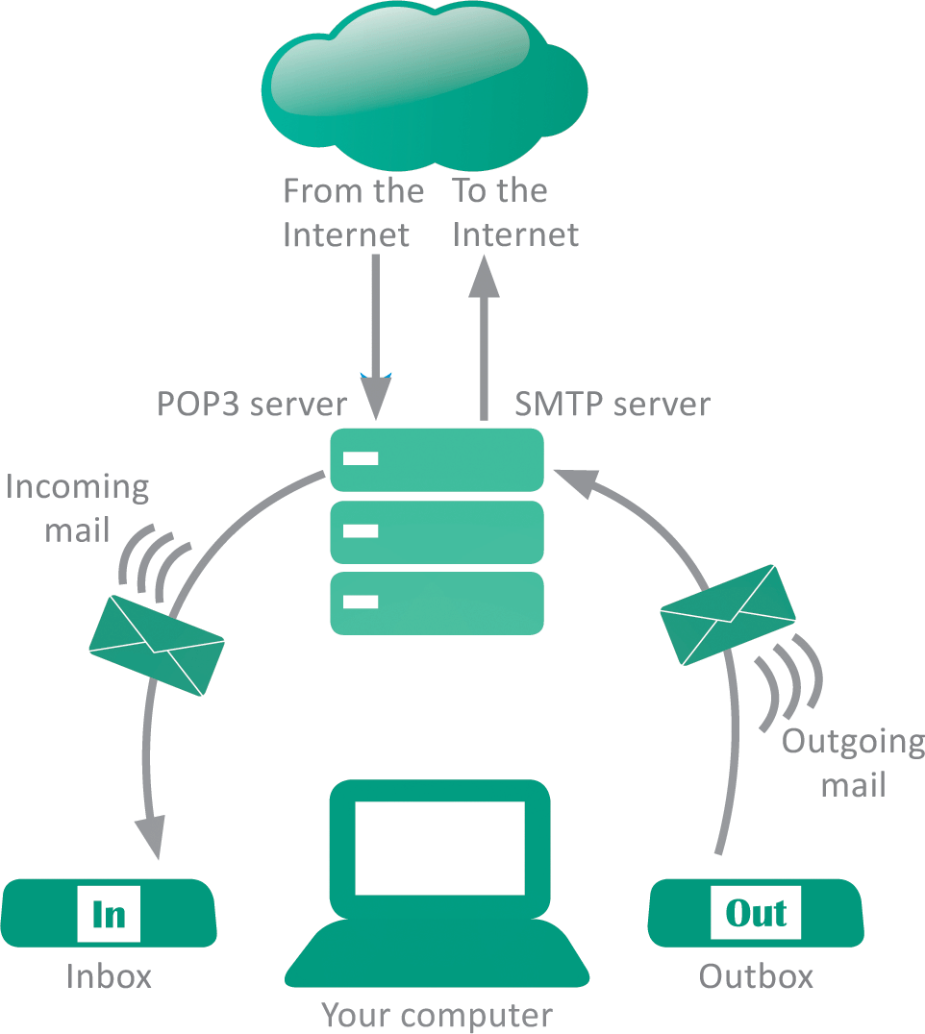
Email
Keep these protocols in mind when setting up local email because the server you specify for outgoing mail might be different from the server for incoming mail

Slide 50
Email
Pros and Cons of Local Email:
Offline access – you can compose and read mail offline; you only need to go online to transfer outgoing mail from your Inbox to the email server and to receive incoming messages
Control – when you use POP3 to collect your mail, your messages are transferred to your computer’s hard disk, where you can control who has access to them

Slide 51
Online Chat
Online chat services are used when you want to establish two-way communication
Instant messaging (IM) is a synchronous, real-time technology for two or more people to type messages back and forth while online
As the Internet grew, online services, such as Yahoo!, MSN, and AOL developed IM systems
Today, IM is popular for customer service at ecommerce sites

Slide 52
Voice and Video over IP
VoIP (Voice over Internet Protocol) is a technology that uses a broadband Internet connection instead of PSTN land lines to place voice and video calls
Skype, Google Talk, and Snapchat are examples of VoIP
VoIPs work when software converts voice communications and video images into data packets using digitized techniques similar to those presented in Unit 1

Slide 53
Section E: Social Media Values
Identity
Reputation
Privacy

Slide 54
Identity
An online identity consists of far more than a photo and a brief autobiographical sketch; the elements that constitute a social media identity include a biographical profile, the set of peole who form connections, and the information supplied as posts
By some estimates, nearly 40% of all online identities are fake
False identities are used for nefarious purposes by cyberbullies, criminals, and stalkers

Slide 55
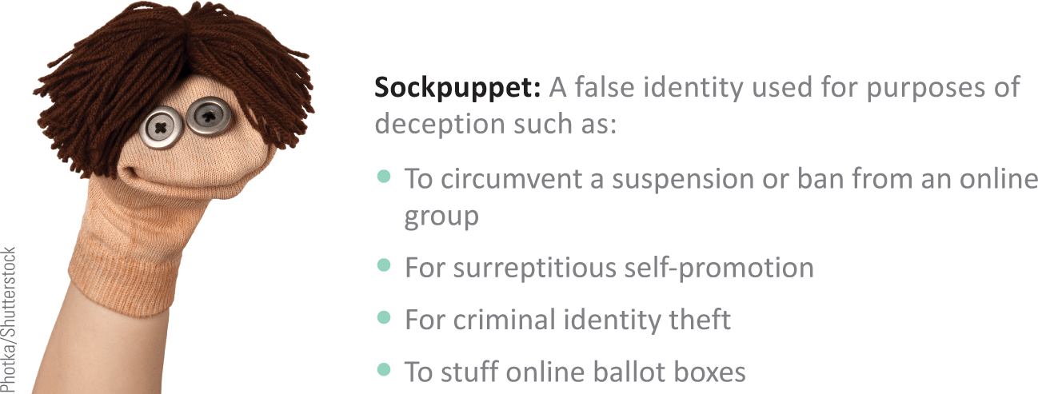
Identity
The use of sockpuppets—any online identity created and used for purposes of deception—is widespread

Slide 56
Identity
Most social media sites provide a generic profile image for users who do not upload a personal photo
Users who retain the generic image tend to be newcomers or spammers
Most social media profiles include a short, publicly viewable tagline
Detailed biographical information is generally viewable only by designated connections, depending on the user’s privacy settings

Slide 57
Identity
Some things to consider when selecting a profile picture:

Slide 58
Reputation
An online reputation is the impression that is generated by an online persona
Many factors can have a negative effect on an individual’s online reputation
Mistakes – you may inadvertently post messages, comments, or photos that could be misinterpreted; these can affect public opinion of you
Defamation – communicating false statements that damage the reputation of another individual is referred to as defamation
Cont…

Slide 59
Reputation
Impersonation – deliberately using the name or avatar of another person without his or her consent and with the intent to harm, defraud, or intimidate is called impersonation
Doppelgangers – Online doppelgangers are two or more online personas with the same name or username; the personas of doppelgangers are sometimes mistaken for each other, and their reputations may become intertwined

Slide 60
Reputation

Slide 61
Reputation

Slide 62
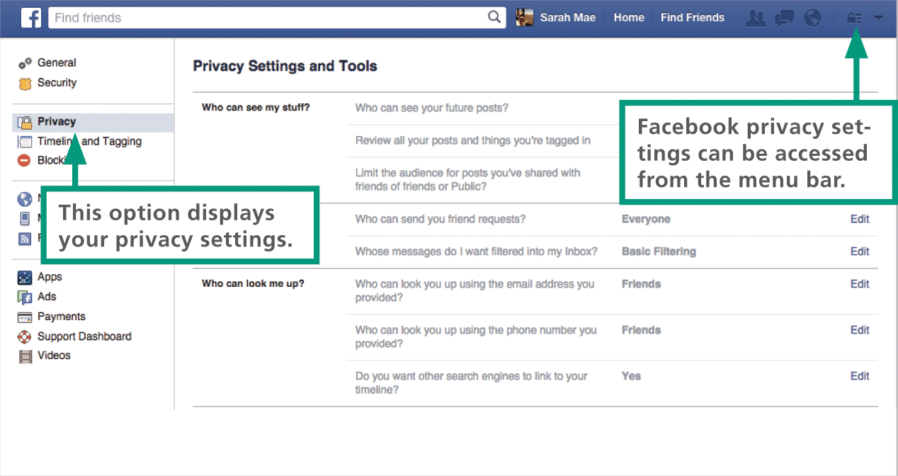
Privacy
Privacy is “the right to be left alone”
Individuals can control their own personally identifiable information (PII) to limit when they can be identified, tracked, or contacted
Most social media services have a written privacy policy that states how PII data is handled and how long it is stored

Slide 63
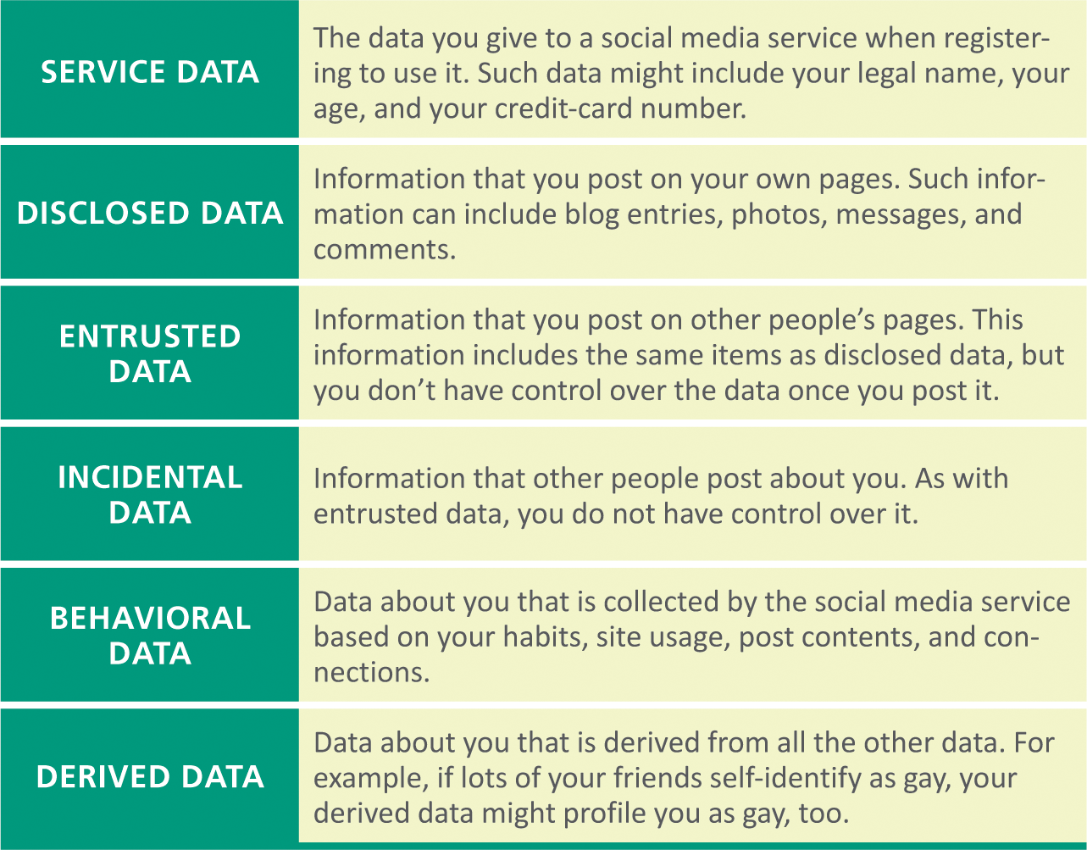
Privacy
Key steps in maintaining online privacy include awareness of the different types of data collected by social media services and the level of privacy appropriate for each type

Slide 64
Privacy
Data “gone rogue” escapes its appropriate privacy setting and somehow goes public
The most common causes of rogue data include:
A user changes his or her global privacy setting to Public
A user designates an item as public when it is posted
Changes in the social media service’s privacy policy result in previously private information becoming public
A user ignores changes in the social media service’s privacy policy
Posted information is reposted publicly
Third-party social networking apps redistribute information collected as the user works with an app

Slide 65
Privacy
Hundreds of third-party social media apps are available and they all collect information from social media profiles, including contact lists
The following aspects of third-party apps may affect your privacy:
Collected data might not be transmitted over secure channels
An excessive amount of personal data could be collected
Data about your contacts might be collected

Slide 66
Privacy

Slide 67
Privacy

Slide 68
Unit 5 Complete

