Slide 1
Unit 8 The ITC Industry
ENHANCED EDITION

Slide 2
Unit Contents
Section A: ICT Industry Basics
Section B: The Computer Industry
Section C: The Telecom Industry
Section D: Tech Careers
Section E: ICT Laws and Ethics

Slide 3
Section A: ICT Industry Basics
ICT Core Industries
ICT Goods and Services
Technology Life Cycles
Disruptive Technology
ICT and Productivity
ICT and National Security

Slide 4
ITC Core Industries
As the computer industry expanded beyond number crunching to data storage and decision support, the IT (Information Technology) industry evolved
The ITC industry is a result of that evolution; a convergence between the IT industry and the telecommunications industry

Slide 5
ICT Core Industries
Companies and businesses create jobs, develop products, and offer services that drive the economy; they are classified into economic sectors according to the types of goods and services they provide
The information industry has three major facets: content, computers, and telecommunications
The focus of Unit 8 is the ICT industry, which is made up of businesses that focus on digital equipment, software, and communications technologies

Slide 6
ICT Core Industries

Slide 7
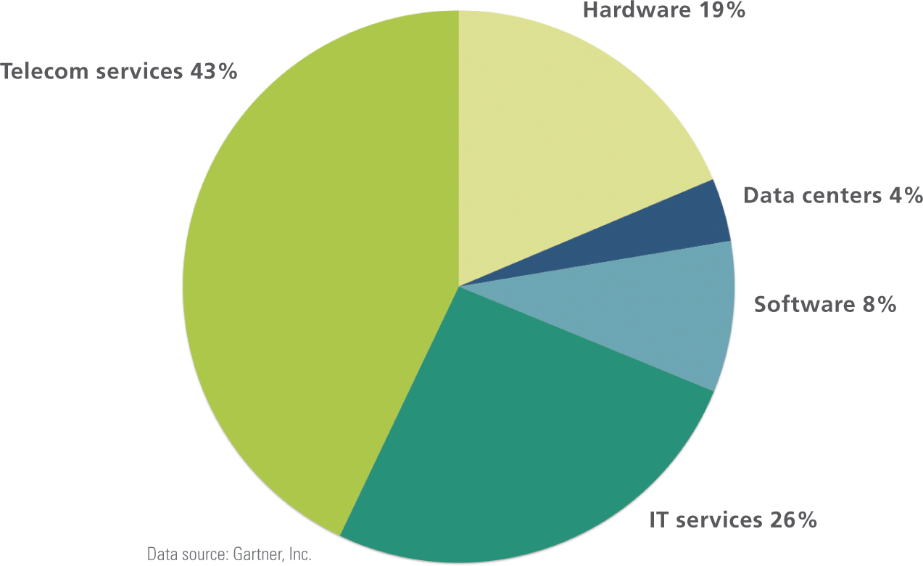
ICT Core Industries
ICT is one of the world’s largest economic sectors; revenues exceed those of the oil and gas industry and the world’s airlines

Slide 8
ICT Core Industries
The ITC industry has fueled the economies of many countries and was not as deeply affected as some sectors of the economy, during the 2009 global recession
The so-called “dot-com bubble” was fueled by a frenzy of online business startups called dot-coms
A dot-com bubble that began in the late 1990s burst with devastating effects on ICT stock values; a stock market bubble refers to a sharp rise in stock values that is later followed by a sudden decline

Slide 9
ICT Goods and Services
In economics, goods are things that can be used or consumed, whereas services are intangible actions performed for a consumer
ICT goods and services can be distributed locally, nationally, or internationally, and are purchased by individuals and corporations
Consumer goods, such as laptops, are purchased by individuals; Capitol goods are raw materials used by businesses to make consumer goods

Slide 10
ICT Goods and Services
The terms outsourcing and offshoring are often used interchangeably, but they are slightly different
Outsourcing is the use of components or labor from outside suppliers
Offshoring relocates business processes, manufacturing and customer support, to lower-cost locations in other countries

Slide 11
ICT Goods and Services
Until the 1990s, ICT companies performed all phases of product development in house
Prototyping and mass production moved to Taiwan, then to China
Outsourcing and manufacturing efficiencies contributed to falling prices of ICT goods and services

Slide 12
ICT Goods and Services

Slide 13
ICT Goods and Services

Slide 14
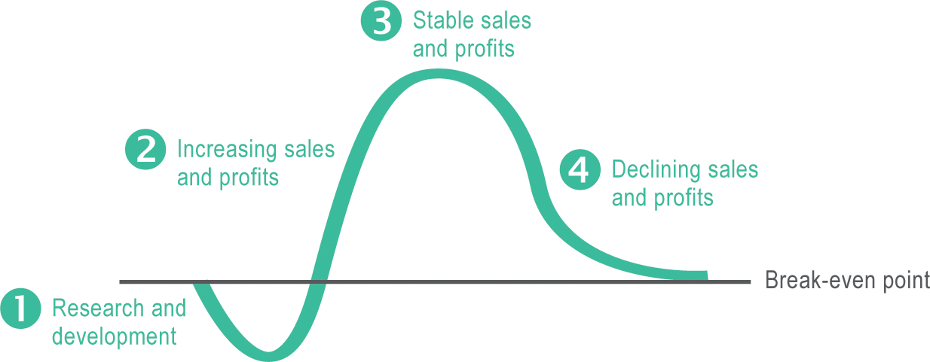
Technology Life Cycles
The product life cycle (PLC) maps the expected profitability of a product from its inception to its demise

Slide 15
Technology Life Cycles
To try and track a product’s life cycle, analysts and sociologists devised the following:
Moore’s law – Gordon Moore, co-founder of Intel Corp., predicted that technological innovation would double the number of transistors in an integrated circuit every two years without raising its cost
Rogers’ bell curve – frequently used to describe patterns in the way consumers adopt technology products; developed by a team of sociologists including Everett M. Rogers
Gartner Hype Cycle – represents the position of a product during its life cycle of publicity or “hype”; developed by analysts at Gartner, Inc.

Slide 16
Technology Life Cycles

Slide 17
Disruptive Technology
Disruptive technology displaces an existing business process, market, industry, or product

Slide 18
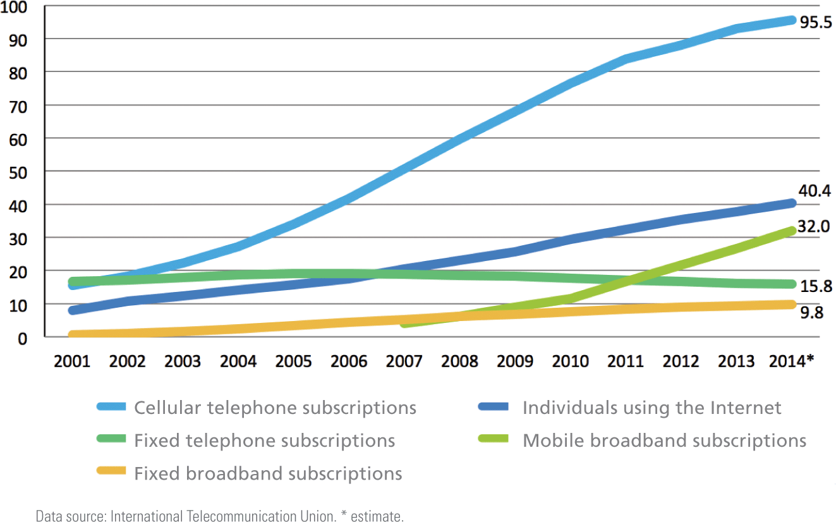
ICT and Productivity
In the context of economics, productivity is a measurement of the amount of output that is produced per unit of input

Slide 19
ICT and Productivity

Slide 20
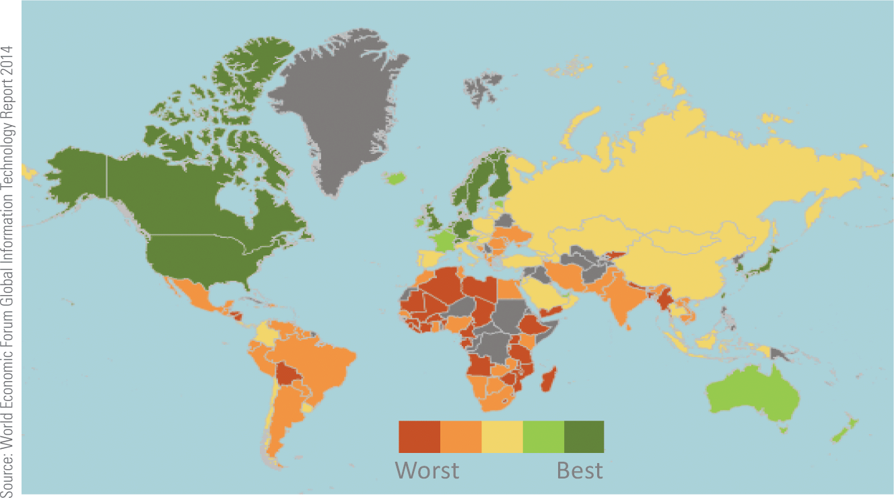
ICT and Productivity
The World Economic Forum produces an annual report on the global influence of the ICT industry and identifies how well countries leverage ICT technologies

Slide 21
ICT and Productivity
Economist use indicators, such as GDP (gross domestic product), to measure the total output of a nation
Between 2011 and 2013 digitization boosted world economic output by US$193 billion and created 6 million jobs during that period
These factors are a compelling argument for national investment in digital technologies

Slide 22
ICT and National Security
Programs of surveillance, espionage and sabotage are carried out today using cyberwarfare hacking tools
The ITC industry plays a major role in national security for countries throughout the world
Infiltrating and disabling computers storing sensitive corporate, government, or military data could create chaos and temporarily weaken military defenses

Slide 23
ICT and National Security

Slide 24
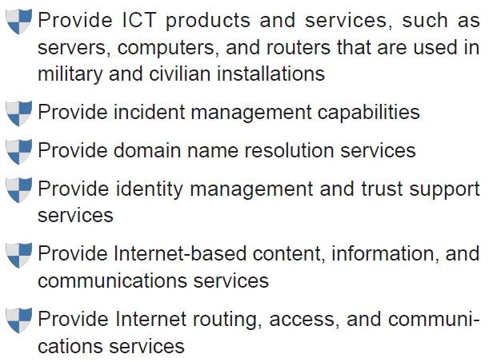
ICT and National Security
The U.S. Department of Homeland Security identifies six national security functions supplied by the ICT sector:

Slide 25
ICT and National Security
Cyberwarfare is the use of ICT technology to carry out politically motivated attacks designed to infiltrate, sabotage, or damage an opponent’s information systems and defensive capabilities
Recent examples of cyberwarfare include the Stuxnet virus that disabled Iranian nuclear centrifuges
The international, non-binding document called the Tallinn Manual, is a cyber equivalent of the Geneva Convention; it sets out rules for conducting and responding to cyberwarfare

Slide 26
Section B: The Computer Industry
Manual Calculators
Mechanical Calculators
Computer Prototypes
Commercial Computers
Personal Computers

Slide 27
Manual Calculators
A manual calculator is a device that assists in the process of numeric calculations but requires the human operator to keep track of the algorithm
An algorithm is the step-by-step process by which numbers are manipulated; even simple paper-and-pencil addition requires an algorithm
A manual calculator called an abacus was used in ancient Rome, Greece, India, China, and Japan; only as the last century came to a close was the abacus replaced by handheld digital calculators

Slide 28
Manual Calculators

Slide 29
Mechanical Calculators
A mechanical calculator implements algorithms autonomously
Mechanical calculators were developed as early as 1623
Schickard’s Calculator had a series of interlocking gears; each of the ten spokes on a gear represented a digit; every time a gear completed a full circle, it moved the next gear one notch to the left to “carry the 1”

Slide 30
Mechanical Calculators
Charles Babbage’s Analytical Engine was an all-purpose computing device; historians believe that its design embodies many of the concepts that define modern computers, including:
Memory
A programmable processor
An output device
User-definable input of programs and data

Slide 31
Mechanical Calculators
In 1890, Herman Hollerith won the U.S. Census Bureau’s competition to find a way to tabulate the census
Hollerith won the competition with a design for an electronic punched card tabulating device
The device used cards with designated areas representing data fields, such as “nationality”; once punched, the cards were fed into a reader that used an array of metal rods to electronically read data from the cards, tabulate the results, and display them on a series of dials

Slide 32
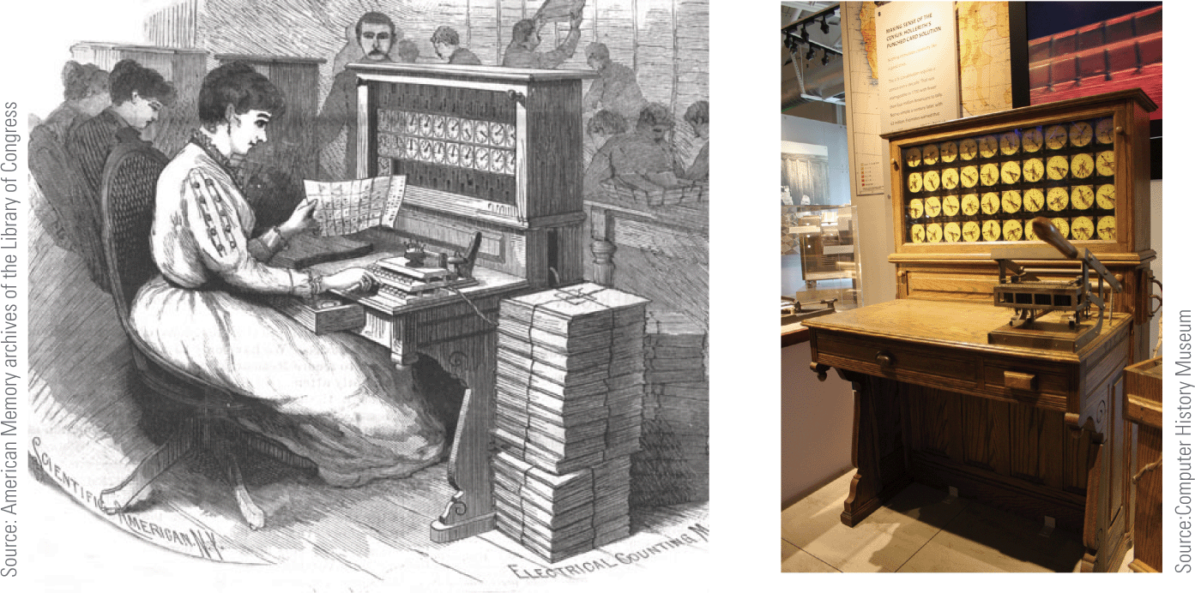
Mechanical Calculators
Hollerith incorporated the Tabulating Machine Company in 1896; in 1924, the name was changed to International Business Machines—better known as IBM

Slide 33
Computer Prototypes
Figuring out who invented the computer isn’t easy because modern digital computers evolved from prototypes developed between 1936 and 1946 by various individuals and teams
The Atanasoff-Berry Computer (ABC) was the first computing device to use vacum tubes instead of mechanical switches as processing circuitry
Its design also incorporated the idea of basing calculations on the binary number system

Slide 34
Computer Prototypes
Even though the ABC is often considered the first electronic digital computer, the work of its inventor was largely ignored
Other computer prototypes followed:
Z3 – used vacuum tubes and was designed to work with binary numbers; built in Nazi Germany during WWII
Harvard Mark I – officially named the IBM Automatic Sequence Controlled Calculator; used decimal rather than binary representation, which is used by today’s computers
Colossus – developed in 1943 by British engineers; an electronic device designed to decode messages that were sent between the German High Command and their field commanders

Slide 35
Commercial Computers

Slide 36
Computer Prototypes
ENIAC (Electronic Numerical Integrator and Computer) was designed for the U.S. Army during WWII, but wasn’t finished until three months after the war ended
ENIAC was over 100 feet long and 10 feet high and weighed 30 tons!
Containing over 18,000 vacuum tubes and consuming over 174,000 watts of power, it was programmed by manually connecting cables and setting 6,000 switches—a process that usually took two days to complete

Slide 37
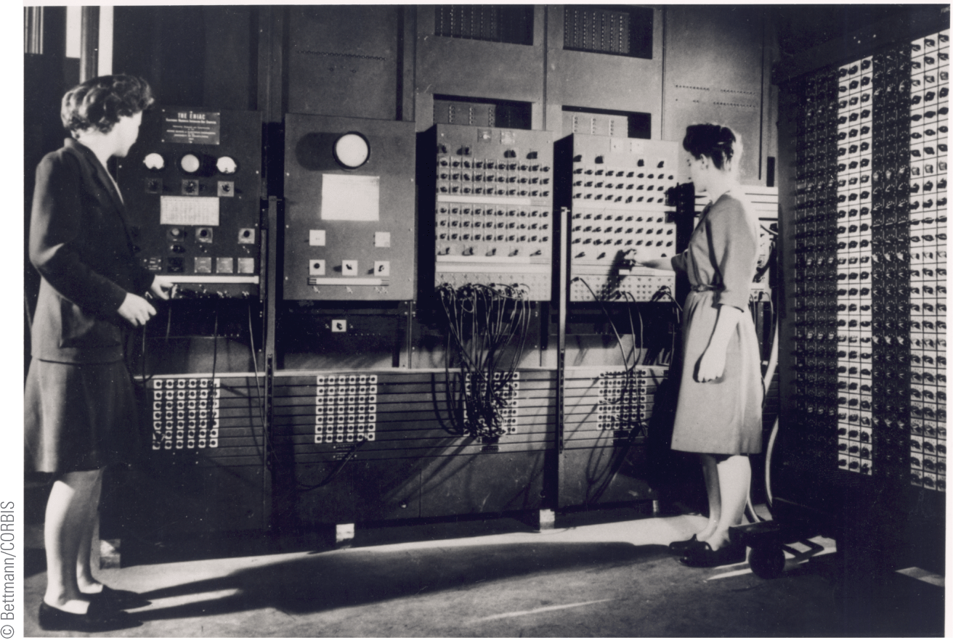
Computer Prototypes
ENIAC’s first programmers were a team of six women

Slide 38
Commercial Computers
A computer called UNIVAC is considered by most historians to be the first commercially successful digital computer
At 14.5 feet long, 7.5 feet high, and 9 feet wide, UNIVAC was physically smaller than ENIAC, but more powerful
As technology evolved, relay switches and vacuum tubes were replaced with smaller, less power-hungry components

Slide 39
Commercial Computers
First-generation computers, such as UNIVAC, can be characterized by their use of vacuum tubes to store individual bits of data
A vacuum tube is an electronic device that controls the flow of electrons in a vacuum
Each tube can be set to one of two states; one state is assigned a value of 0 and the other a value of 1

Slide 40
Commercial Computers

Slide 41
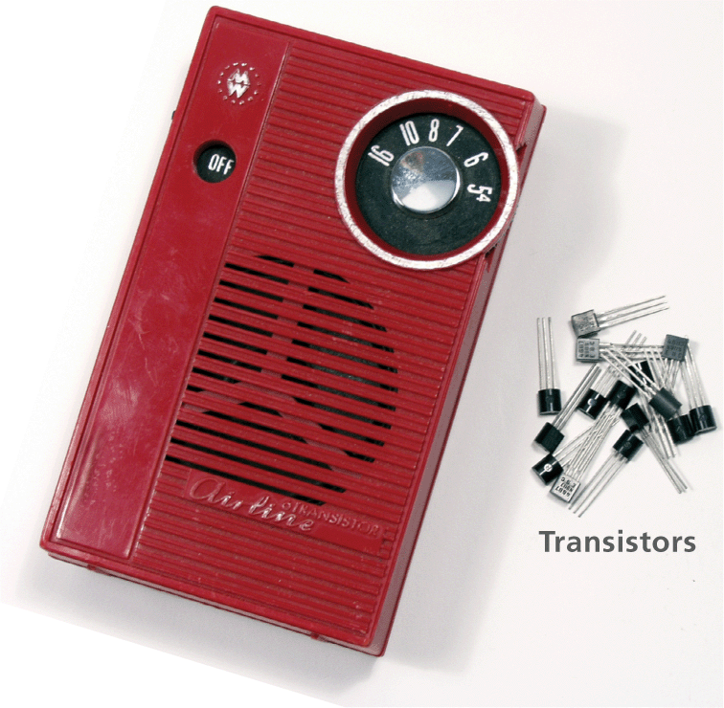
Commercial Computers
Second-generation computers used transistors instead of vacuum tubes
Transistors regulate current or voltage flow and act as a switch for electronic signals
Transistors performed functions similar to vacuum tubes, but they were much smaller, cheaper, less power-hungry, and more reliable

Slide 42
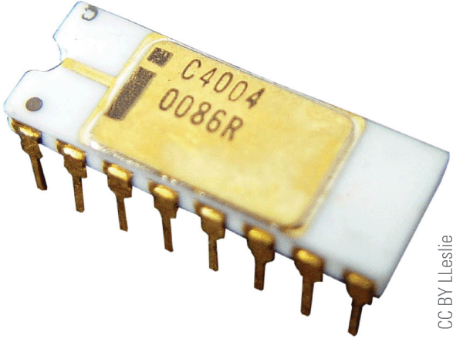
Commercial Computers
Third-generation computers became possible in 1958, when integrated circuits were developed
IBM 360 offered integrated circuit technology; the first orders for these computers were filled in 1965
Fourth-generation computers appeared in 1974 with the development of the first general-purpose microprocessor, called the Intel 4004
Intel’s 4004 was smaller than a cornflake but matched the computing power of ENIAC

Slide 43
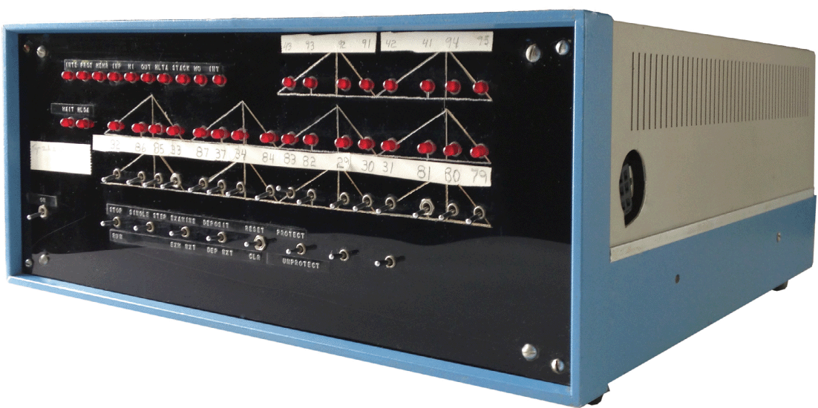
Personal Computers
In the 1970s, many hobbyists built their own computer systems based on integrated circuit and microprocessor technologies
The Mark-8 and the MITS Altair, where some of the first personal computers to be developed
The Altair was sold as a kit for $395; it had no keyboard, no monitor, and no permanent storage device

Slide 44
Personal Computers
In 1976 Apple Computer Co. was founded by Steve Jobs and Steve Wozniak
Apple released several computers during the 1970s & 1980s, including:
Apple I – a kit containing a system board with 4 KB of RAM that sold for $666.66
Apple II – featured color graphics, expansions slots, a disk drive, a 1.07 MHz 6502 processor, and 16 KB of RAM for $1,195
Apple Lisa – introduced in 1983, it made computers even easier for the average person to use; its key feature was a graphical user interface; at $10,000 it proved too expensive for most consumers
Apple Macintosh – featured a graphical user interface; it became the computer of choice for desktop publishing; cost was $2,495

Slide 45
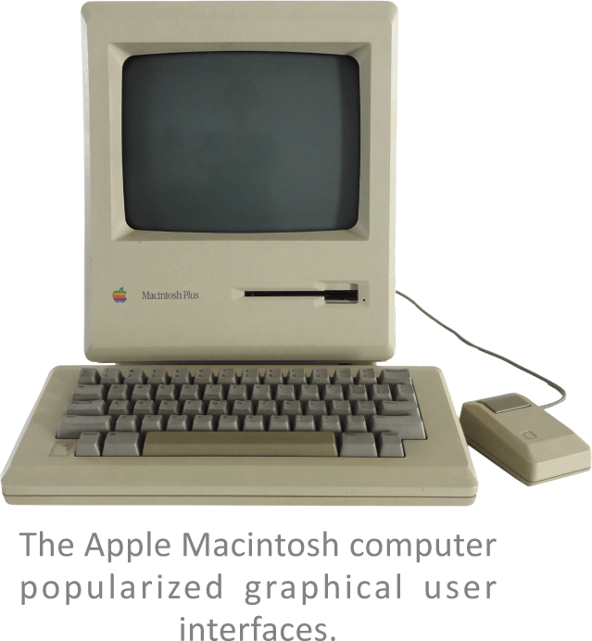
Personal Computers

Slide 46
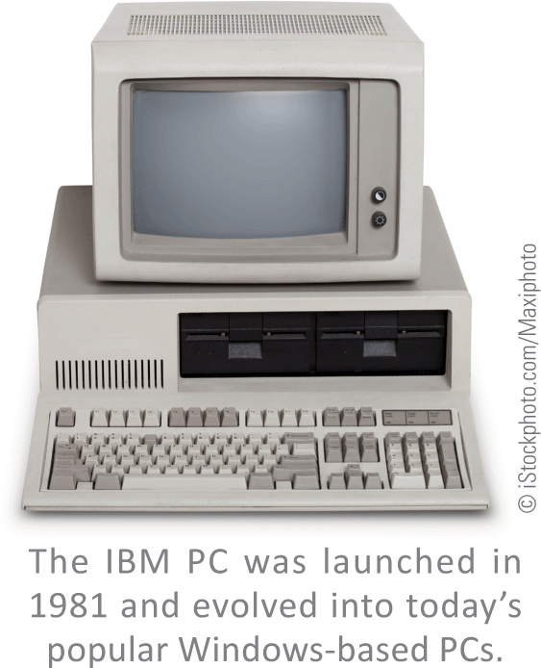
Personal Computers
In 1981, IBM began marketing what it called a personal computer, or PC
The $3,000 IBM PC had a 4.77 MHz Intel 8088 processor, 16 KB of RAM, and floppy disk drives
The operating system used on these computers was called PC-DOS and was created by a young entrepreneur named Bill Gates

Slide 47
Personal Computers

Slide 48
Section C: The Telecom Industry
Telegraph
Telephone
Radio
Cellular Phones
Television

Slide 49
Telegraph
Telegraphy refers to transmitting text or symbolic information over long distances without the use of a living carrier
The telegraph was built in 1816 using a cable connected at either end to dials marked with the letters of the alphabet
In 1837, U.S. inventor Samuel Morse developed a telegraph system that transmitted data using his Morse code alphabet, a binary encoding system based on dots and dashes

Slide 50
Telegraph

Slide 51
Telephone
A telephone is, very simply, a device that transmits human voices over a distance using cables or airborne signals
The first telephone was invented and patented by Alexander Graham Bell in 1876
Telephones evolved through several design form factors, including box phones, and phones with rotary dialers

Slide 52
Telephone

Slide 53
Telephone
A telephone exchange managed connections between callers
The world’s first commercial telephone exchange opened in 1877, in Germany
Its manual switch board was controlled by a switchboard operator
Automated exchanges, developed in 1900, eliminated the need for human operators

Slide 54
Radio
A radio is a device that sends and recieves sound as electromagnetic waves
Like computers, radios originally used vacuum tubes but moved on to new technologies like the transistor
Radio technology is the basis for cell phones, Wi-Fi, Bluetooth, and near-field communications (NFC)—all indispensible tools of the digital age

Slide 55
Cellular Phones
A cellular telephone is a device that uses a low-power radio transmitter to carry out two-way voice communications
Two-way radio technology went portable during WWII
In 1984 Motorola brought to market the first cell phone model named the Motorola DynaTAC 8000X; it weighed almost 2 pounds and was more than 12 inches long

Slide 56
Cellular Phones

Slide 57
Cellular Phones

Slide 58
Television
Television is a technology designed to send moving images over a distance
Beginning with black-and-white sets, televisions progressed to colored programming and eventually transitioned to digital television (DTV)
Pay television is a popular subscription service in which consumers pay to receive a selection of television channels

Slide 59
Television

Slide 60
Section D: Tech Careers
Jobs and Salaries
Education
Certification
Resumes

Slide 61
Jobs and Salaries
Tech sector careers are part of a broad set of information, technology, and communications industries
The classification technology workers encompasses jobs, such as:
Telephone cable installers
Radio broadcasters
Computer programmers
Web designers
Software developers

Slide 62
Jobs and Salaries
A different classification of tech sector careers comes from STEM (science, engineering, technology, and math)
STEM is increasingly used to define an employment sector that includes jobs in:
Biology
Chemistry
Information Technology
Engineering
Math
Physics

Slide 63
Jobs and Salaries
A third classification of tech sector careers focuses on computer professionals
A computer professional is anyone whose primary occupation involves the design, configuration analysis, development, modification, testing, or security of computer hardware or software
Many computer professionals work in an IT department—the wing of a business or organization responsible for computer, data, software, and support services; A chief information-officer (CIO) heads the IT department

Slide 64
Jobs and Salaries

Slide 65
Jobs and Salaries

Slide 66
Jobs and Salaries

Slide 67
Jobs and Salaries

Slide 68
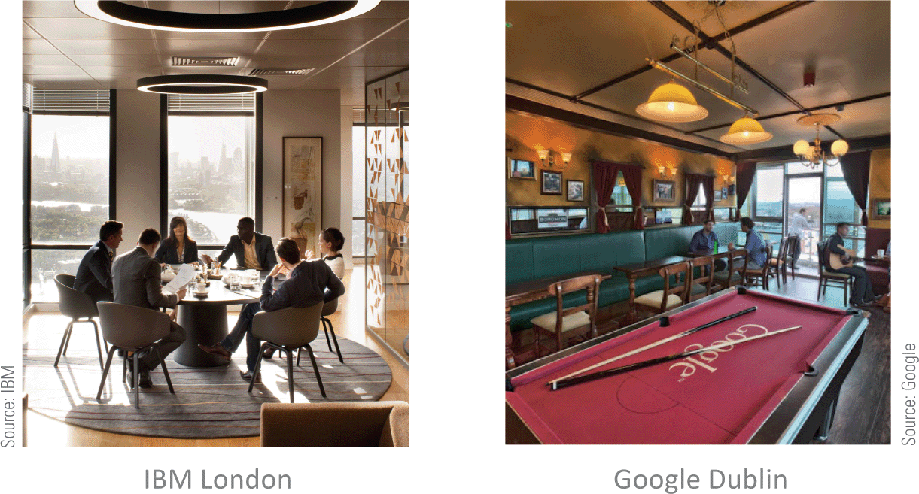
Jobs and Salaries
The U.S. Bureau of Labor and Statistics predicts that in the decade 2012-2022, employment in the information and technology sector could grow by 18%, generating 650,000 new jobs
An unknown number of these jobs will be outsourced, which may negatively affect U.S. workers but will benefit offshore workers

Slide 69
Jobs and Salaries
Workers in many industries are interested in becoming a telecommuter who uses available technology to work from home or an off-site location
Telecommuters tend to be more productive and work longer hours because they have no commute time and are not interrupted by routine office chatter
Finding a job in the IT industry is similar to finding a job in most other industries
Use online job listing sites (Tech Jobs, ComputerJobs.com)
Network (in person or via email)
Use social networking tools (LinkedIn)

Slide 70
Education
Computer science is only one of many computer-related degrees that colleges and universities offer
According to the Association for Computing Machinery (ACM), there are five major computing disciplines:
Computer engineering
Computer science
Information systems
Information technology
Software engineering

Slide 71
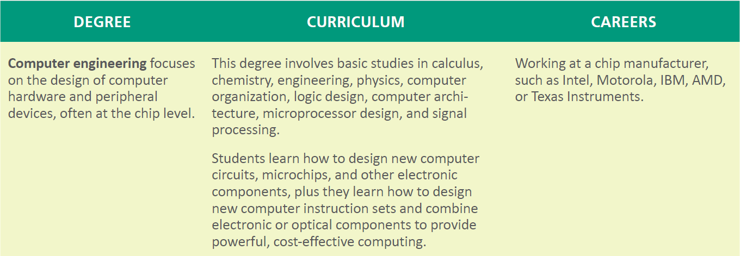
Education

Slide 72
Education

Slide 73
Education

Slide 74
Education

Slide 75
Certification
Approximately 300 computer-related certification exams are offered in areas of specialty that range from desktop publishing to network installation
Certification exams can be divided into several categories, including the following:
General computer knowledge
Software applications
Database administration
Networking
Computer hardware
Computer security

Slide 76
Certification

Slide 77
Certification

Slide 78
Certification

Slide 79
Resumes
Job seekers need to produce resumes in a variety of formats, including the following:
Print
Email
HTML
LinkedIn
Online Job service
Web portfolio (a hypertext version of your resume)

Slide 80
Resumes

Slide 81
Section E: ICT Laws and Ethics
ICT Laws
ICT Ethics
Ethical Decision Making
Whistleblowing

Slide 82
ICT Laws
Information technology law is the legal framework that applies to the collection, storage, and distribution of digital information
Some of the most significant areas of information technology law include the following:
Copyright and intellectual property
Domain names
Patents
Cybercrime
Software and computer contracts
Privacy
Communication

Slide 83
ICT Ethics
The term professional ethics refers to on-the-job choices and actions that reflect a person’s values
Confidentiality is the obligation not to disclose willingly any information that should be kept private
Proprietary information includes knowledge about company finances, procedures, products, and research that competitors would find valuable
A non-compete clause is designed to prevent employees from divulging proprietary information to competitors

Slide 84
ICT Ethics
It’s never a good idea to use facilities at work for personal activities unless you have a specific agreement with your employer and your activities do not breach your employment contract

Slide 85
Ethical Decision Making
Ethical decisions that you make on the job can have long-term consequences for your career and lifestyle, so it is important to approach these decisions seriously
Use the following strategies when making decisions at work:
Talk to people whose judgment you respect
Consider what the most ethical person you know would decide to do
Think about what you would do if your actions were made public
Look at the problem from the opposite perspective
Consult a code of professional ethics

Slide 86
Ethical Decision Making
A code of ethics is a set of guidelines designed to help professionals thread their way through a sometimes tangled web of ethical on-the-job decisions
Some codes of ethics are short and concise, whereas others are long and detailed
Most codes contain principles similar to those from the Computer Ethics Institute (CEI)

Slide 87
Ethical Decision Making

Slide 88
Whistleblowing
A widely accepted definition of whistleblowing is the disclosure by an employee (or professional) of confidential information that relates to some danger, fraud, or other illegal or unethical conduct connected with the workplace
A whistleblower is someone in an organization who decides to speak out against on-the-job activities that are contrary to the mission of the organization or threaten the public interest

Slide 89
Whistleblowing
Employee advocates have the following suggestions for reducing the risk of career repercussions that are often experienced by whistleblowers:
Examine your motives
Try the normal chain of command
Collect evidence to back up your accusations
Cont…

Slide 90
Whistleblowing
Record events as they unfold
Act ethically
Be ready to accept repercussions
Establish a support network
Consult a lawyer
Consider your strategy

Slide 91
Unit 8 Complete

