Slide 1
Unit 9 Information Systems
ENHANCED EDITION

Slide 2
Unit Contents
Section A: Information System Basics
Section B: Enterprise Applications
Section C: Systems Analysis
Section D: Design and Implementation
Section E: System Security

Slide 3
Section A: Information Basics
Enterprise Basics
Transaction Processing Systems
Management Information Systems
Decision Support Systems
Expert Systems

Slide 4
Enterprise Basics
An information system collects, stores, and processes data to provide useful, accurate, and timely information, typically within the context of an organization
An organization is a group of people working together to accomplish a goal
Any organization that seeks profit by providing goods and services is called a business or an enterprise
An organization’s goal or plan is referred to as its mission; its mission statement describes not only an organization’s goals, but also the way in which those goals will be accomplished

Slide 5
Enterprise Basics

Slide 6
Enterprise Basics
Vertical market software is designed for a specific industry or enterprise; the software that controls touchscreen order entry at fast food restaurants is an example of software designed for vertical markets
Horizontal market software is designed for common elements of many businesses

Slide 7
Enterprise Basics
An organizational chart depicts the hierarchy of employees in an organization
Workers are the people who directly carry out the organization’s mission
Managers determine organizational goals and plan how to achieve those goals; managers use the following methods:
Strategic planning – emphasis on long-range and future goals
Tactical planning – setting incremental goals that can be achieved in a year or less
Operational planning – covers activities that make day-to-day operations run smoothly

Slide 8
Enterprise Basics

Slide 9
Transaction Processing Systems
In an information system context, a transaction is an exchange between two parties that is recorded and stored in a computer system
A transaction processing system (TPS) provides a way to collect, process, store, display, modify, or cancel transactions
Transaction processing systems, such as banking, use online processing—a real-time method in which each transaction is processed as it is entered; this system software is often referred to as an OLTP (online transaction processing) system

Slide 10
Transaction Processing Systems

Slide 11
Management Information Systems
The term management information system refers to any computer system that processes data and provides information within a business setting
Managers depend on these reports to make routine business decisions
A summary report combines, groups, or totals data
An exception report contains information that is outside of normal or acceptable ranges

Slide 12
Management Information Systems

Slide 13
Decision Support Systems
A decision support system (DSS) helps people make decisions by directly manipulating data, accessing data from external sources, generating statistical projections, and creating data models of various scenarios
An executive information system (EIS) is a type of decision support system designed to provide senior managers with information relevant to strategic management activities

Slide 14
Decision Support Systems
A decision model is a numerical representation of a realistic situation, such as a cash-flow model of a business that shows how income adds to cash accounts
A decision query is a question or a set of instructions describing data that must be gathered to make a decision

Slide 15
Decision Support Systems

Slide 16
Expert Systems
An expert system, sometimes referred to as a knowledge-based system, is a computer system designed to analyze data and produce a recommendation, diagnosis, or decision based on a set of facts and rules
The facts and rules are incorporated into a knowledge base which is stored in a computer file and can be manipulated by software called an inference engine
The process of designing, entering, and testing the rules in an expert system is referred to as knowledge engineering

Slide 17
Expert Systems

Slide 18
Expert Systems
An expert system shell is a software tool containing an inference engine and a user interface that developers use to enter facts and rules for a knowledge base
These systems are designed to deal with data that is imprecise or problematic; using a technique called fuzzy logic, an expert system can deal with this type of data by working with confidence levels

Slide 19
Expert Systems

Slide 20
Section B: Enterprise Applications
Ecommerce
Supply Chain Management
Customer Relationship Management
Enterprise Resource Planning

Slide 21
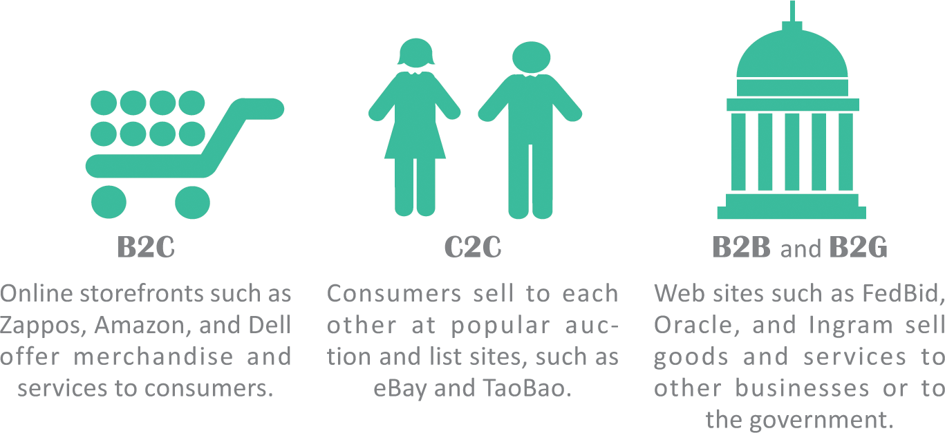
Ecommerce
Ecommerce refers to business transactions that are conducted electronically over a computer network

Slide 22
Ecommerce
An ecommerce application is the software that handles ecommerce transactions
Payment processing is based on an online payment gateway that authorizes credit and debit cards, PayPal, and Apple Pay transactions

Slide 23
Ecommerce

Slide 24
Supply Chain Management
A supply chain is the sequence of organizations, people, activities, information, and resources involved in moving a product or service from supplier to customer
Supply chains are complex, so businesses use SCM (supply chain management) to maximize efficiency and profitability

Slide 25
Customer Relationship Management
The acronym CRM stands for customer relationship management
A major source of data for CRM is produced by loyalty programs, or a rewards program, which is a marketing effort that provides customers with incentives for making purchases

Slide 26
Customer Relationship Management

Slide 27
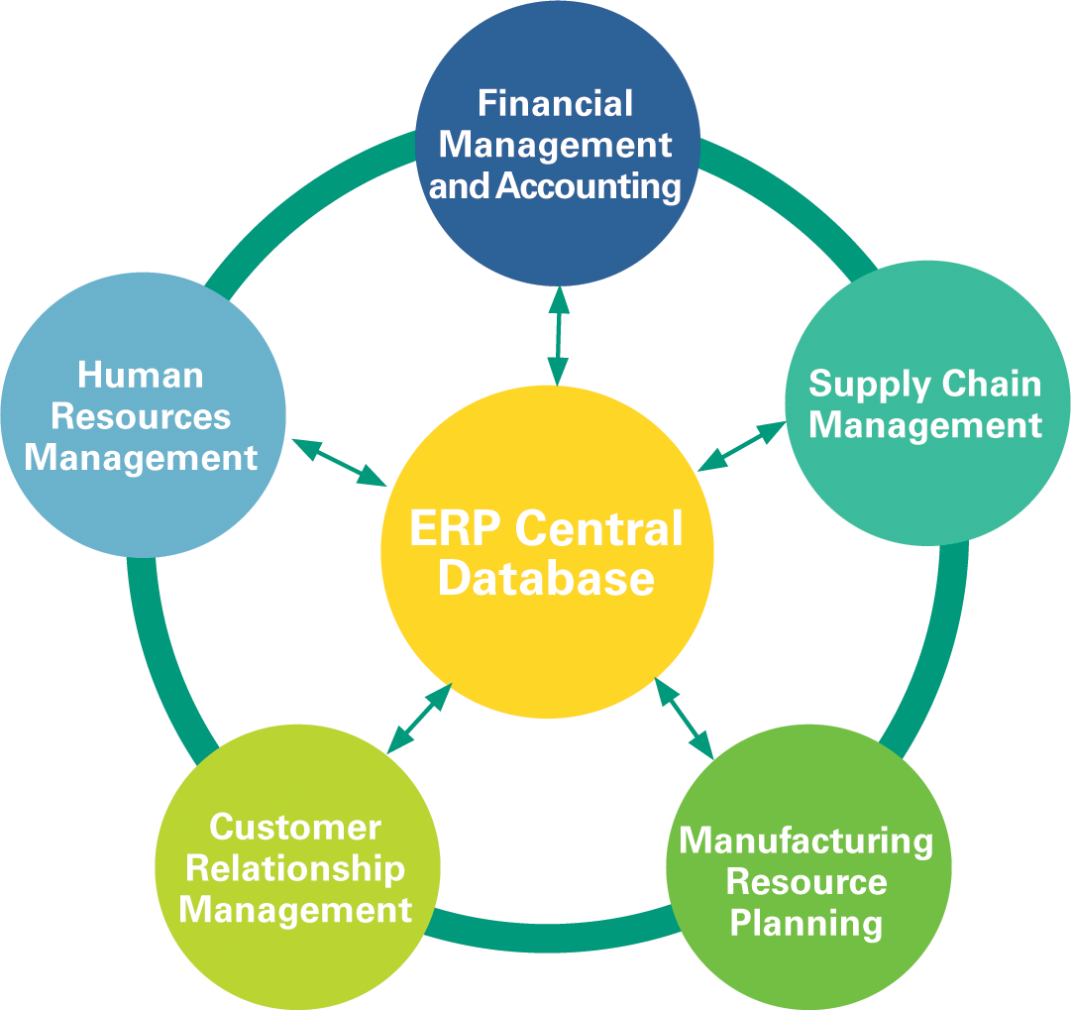
Enterprise Resource Planning
The acronym ERP stands for enterprise resource planning; it is a suite of software modules that integrate major business activities; it is sometimes described as “the central nervous system of an enterprise”

Slide 28
Enterprise Resource Planning
An ERP system can provide the following benefits to an enterprise:
Cont…

Slide 29
Enterprise Resource Planning

Slide 30
Section C: Systems Analysis
System Development Life Cycle
Planning Phase
Analysis Phase
Documentation Tools

Slide 31
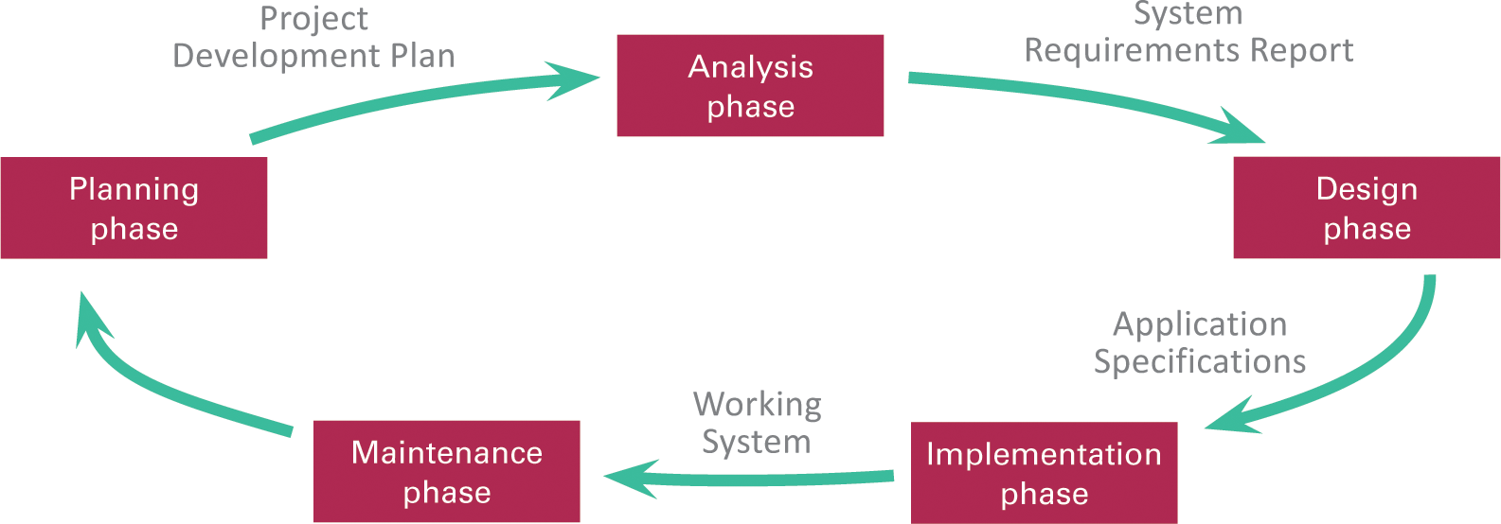
System Development Life Cycle
An information system progresses through several phases as it is developed, used, and retired; these phases encompass as system development life cycle, or SDLC

Slide 32
System Development Life Cycle
Systems analysis and design is a discipline that focuses on developing information systems according to the phases of an SDLC
The scope of systems analysis and design encompasses the people, procedures, computers, communications networks, and software involved with handling information in an organization

Slide 33
Planning Phase
The planning phase for an information system project includes:
Assembling the project team
Justifying the project
Choosing a development methodology
Developing a project schedule
Producing a project development plan

Slide 34
Planning Phase
The goal of these activities is to create a project development plan; this planning document includes:
A short description of the project including its scope
An estimate of the project costs and potential financial benefits
A list of project team participants
A schedule for the project, including an outline of its phases

Slide 35
Planning Phase
Project team members can identify problems and opportunities using a variety of techniques, such as interviews and data analysis
The PIECES framework helps classify problems in an information system; each letter of PIECES stands for a potential problem

Slide 36
Planning Phase

Slide 37
Planning Phase
There are many standard system development methodologies:
Structured methodology focuses on the processes that take place within an information system
Information engineering methodology focuses on the data an information system collects before working out ways to process that data
Object-oriented methodology treats an information system as a collection of objects that interact to accomplish tasks

Slide 38
Planning Phase
Project management software is an effective tool for planning and scheduling
Industry standard tools for scheduling and project management include:
PERT (Program Evaluation and Review Technique) – used for analyzing the time needed to complete each project task
WBS (work breakdown structure) – breaks a complete task into a series of subtasks
Gantt charts – shows the duration of development tasks as they occur over time

Slide 39
Analysis Phase
The goal of the analysis phase is to produce a list of requirements for a new or revised information system; tasks for this phase include:
Studying the current system
Determining system requirements
Writing a requirements report

Slide 40
Analysis Phase
System requirements are the criteria for successfully solving problems identified in an information system
They also serve as an evaluation checklist at the end of a project, so they are sometimes referred to as success factors
System requirements are incorporated into a document called a system requirements report that describes the objectives for the information system

Slide 41
Documentation Tools
The core documentation tool for project teams using structured methodology is the data flow diagram (DFD), which graphically illustrates how data moves through an information system
In DFD terminology:
An external entity is a person, organization, or device used outside the information system that originates or receives data
A data store is a medium that holds data
A process is a routine that changes data by performing a calculation
An arrow symbolizes a data flow and indicates how data travels

Slide 42
Documentation Tools

Slide 43
Documentation Tools
The current standard for object-oriented documentation is referred to as UML (Unified Modeling Language)
Three of the most frequently used UML tools include use case diagrams, sequence diagrams, and class diagrams
A use case diagram documents the users of an information system and the functions they perform
In object-oriented jargon, the people who use the system are called actors; any task an actor performs is called a use case

Slide 44
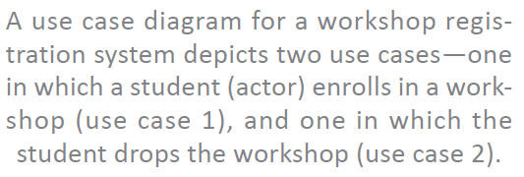
Documentation Tools

Slide 45
Documentation Tools
A class diagram provides the name of each object, a list of each object’s attributes, a list of methods, and an indication of the associations between objects
A sequence diagram depicts the detailed sequence of interactions that take place for a use case
A CASE tool (computer-aided software engineering tool) is a software application designed for documenting system requirements, diagramming current and proposed information systems, scheduling development tasks, and developing computer programs

Slide 46
Documentation Tools

Slide 47
Section D: Design and Implementation
Design Phase
Evaluation and Selection
Application Specifications
Implementation Phase
Documentation and Training
Conversion and Cutover
Maintenance Phase

Slide 48
Design Phase
In the design phase of the SDLC, the project team must figure out how the new system will fulfill the requirements specified in the system requirements report
Activities that take place during the design phase:
Identify potential solutions
Evaluate solutions and select the best one
Select hardware and software
Develop application specifications
Obtain approval

Slide 49
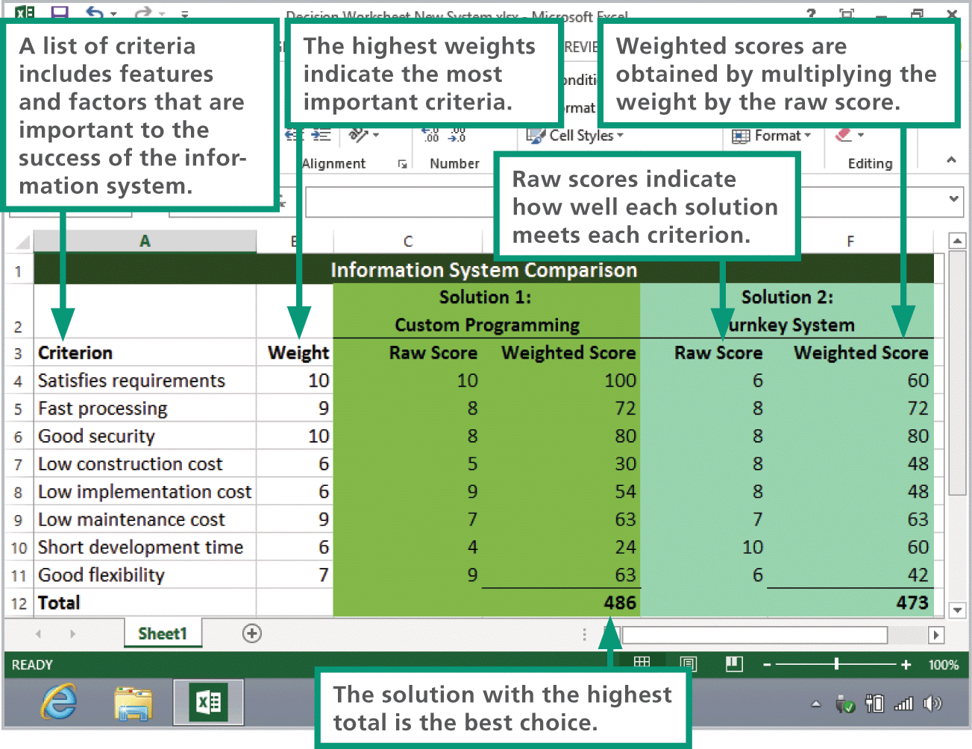
Evaluation and Selection
Using a decision support worksheet, the project team can assign scores to each criterion, weigh them, and compare totals for all solutions

Slide 50
Application Specifications
The team’s systems analysts will create a set of application specifications that describe the way information system’s software should interact with users, store data, process data, and format reports
The goal of the detailed design phase is to create very detailed specifications for the complete information system

Slide 51
Implementation Phase
During the implementation phase of the SDLC, the project team supervises the tasks necessary to construct the new information system
Tasks that take place during this phase include:
Purchase or contract for hardware/software
Create applications
Test applications
Finalize documentation
Train users
Convert data
Initiate new system

Slide 52
Implementation Phase
Software customization is the process of modifying a commercial application to reflect an organization's needs
Application testing is the process of trying out various sequences of input values and checking the results to verify that the application works as it was designed
As each application module is completed, it undergoes unit testing to ensure that it operates reliably and correctly
When all modules have been completed and tested, integration testing is performed to ensure that the modules operate together correctly
System testing ensures that all the hardware and software components work together

Slide 53
Implementation Phase

Slide 54
Documentation and Training
System documentation describes a system’s features, hardware architecture, and programming
User documentation describes how to interact with the system to accomplish specific tasks
A procedure handbook is a type of user documentation that contains step-by-step instructions for performing tasks

Slide 55
Conversion and Cutover
System conversion refers to the process of deactivating an old information system and activating a new one; it is also referred to as a “cutover” or “to go live”
Acceptance testing is designed to verify that the new information system works as required

Slide 56
Maintenance Phase
The maintenance phase of the SDLC involves the day-to-day operation of the system, making modifications to improve performance, and correcting problems
Changes during the maintenance phase can include the following:
Updates to the operating system and application software
User interface revisions to make the system easier to use
Hardware replacements necessary to retire defective equipment or enhance performance
Security upgrades
Quality-of-service enhancements

Slide 57
Maintenance Phase
The term quality of service (QoS) refers to the level of performance a computer system provides
A quality-of-service metric is a technique used for measuring a specific QoS characteristic
Many organizations establish a help desk to handle end-user problems; it is staffed by technical support specialists

Slide 58
Maintenance Phase

Slide 59
Section E: System Security
Systems at Risk
Data Centers
Disaster Recovery Planning
Data Breaches
Security Measures

Slide 60
Systems at Risk
The kinds of disasters that put information systems at risk include:
Natural disasters
Power outages
Equipment failures
Human errors
Software failures
Acts of war
Sabotage and vandalism

Slide 61
Data Centers
A data center is a specialized facility designed to hold and protect computer systems and data
These centers may be dedicated to information systems for a single company, or they may be a colocation center in which several corporations lease space and equipment

Slide 62
Data Centers

Slide 63
Data Centers

Slide 64
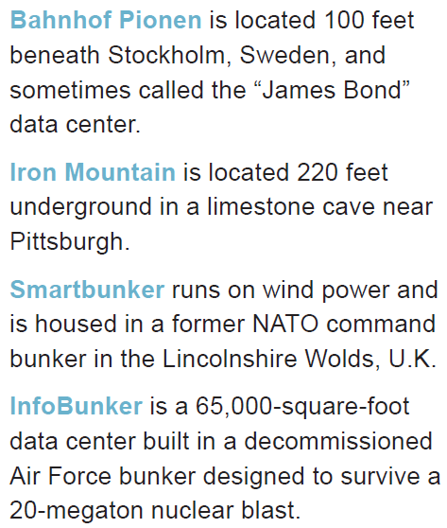
Data Centers

Slide 65
Disaster Recovery Planning
A disaster recovery plan is a step-by-step description of the methods used to secure data against disaster and a set of guidelines for how an organization will recover lost data and resume operations if and when a disaster occurs
Disaster recovery plans should:
Ensure the safety of people on the premises
Continue critical business operations
Minimize disruptions to operations
Minimize immediate damage and prevent additional loss
Establish a management chain
Facilitate effective recovery tasks coordination

Slide 66
Data Breaches
A data breach is an incident in which personal data is viewed, accessed, or retrieved without authorization
Data breaches can be caused by the following:
Malware attacks
Employee negligence
Insider theft
Device theft
System glitches

Slide 67
Data Breaches
Identity theft is the fraudulent use of someone’s personal information to carry out transactions, such as applying for loans, making purchases, collecting tax refunds, or obtaining false identity documents

Slide 68
Security Measures
Measures that protect information systems can be grouped into four categories: deterrents, preventative countermeasures, corrective procedures, and detection activities
Cont…

Slide 69
Security Measures

Slide 70
Security Measures
To minimize the risk of identify theft customers should be vigilant about the information they divulge, for example:
Know when data is being collected
Find out how data is being used
Find out what data is retained
Don’t trade your privacy

Slide 71
Unit 9 Complete

