Slide 1
Unit 10 Databases
ENHANCED EDITION

Slide 2
Unit Contents
Section A: Database Basics
Section B: Database Tools
Section C: Database Design
Section D: SQL
Section E: Big Data

Slide 3
Section A: Database Basics
Operational and Analytical Databases
Database Models

Slide 4
Operational and Analytical Databases
An operational database is used to collect, modify, and maintain data on a daily basis
An analytical database is used to collect data that will be used for spotting trends that offer insights for tactical and strategic business decisions

Slide 5
Operational and Analytical Databases

Slide 6
Operational and Analytical Databases
Operational databases perform the following:
Collect and store data
View data
Find data
Update data
Organize data
Distribute data
Move or remove data

Slide 7
Operational and Analytical Databases
Analytical databases store data that is used by corporate executives, strategic planners, and other workers to examine business metrics
Decision makers can access analytical databases using an executive dashboard, provided by software such as iDashboards, which uses tools for visually displaying query results

Slide 8
Operational and Analytical Databases

Slide 9
Operational and Analytical Databases
Analytical databases perform the following:
Find relationships and patterns using data mining
Make predictions using predictive analytics
Examine multiple factors using OLAP (online analytical processing)

Slide 10
Database Models
The underlying structure of a database is referred to as a database model
One of the simplest models for storing data is a flat file that consists of a single, two-dimensional table of data elements
A structured file uses a uniform format to store data for each person or thing in the file

Slide 11
Database Models
A field contains the smallest unit of meaningful information; it is the basic building block for a structured file or database
A variable-length field is like an accordion—it expands to fit the data you enter
A fixed-length field contains a predetermined number of characters (bytes)
In the world of databases, a record refers to a collection of data fields; the template for a record is a record type

Slide 12
Database Models
In database jargon, a relationship is an association between data that’s sorted in different record types
An important aspect of the relationship between record types is cardinality, which refers to the number of associations that can exist between two record types
The relationship between record types can be depicted graphically with an entity-relationship diagram (sometimes called an ER diagram or ERD)

Slide 13
Database Models
Many database models keep track of relationships among data, but there are different techniques for doing so
A hierarchical database allows one-to-one and one-to-many relationships which are linked in a hierarchical structure

Slide 14
Database Models

Slide 15
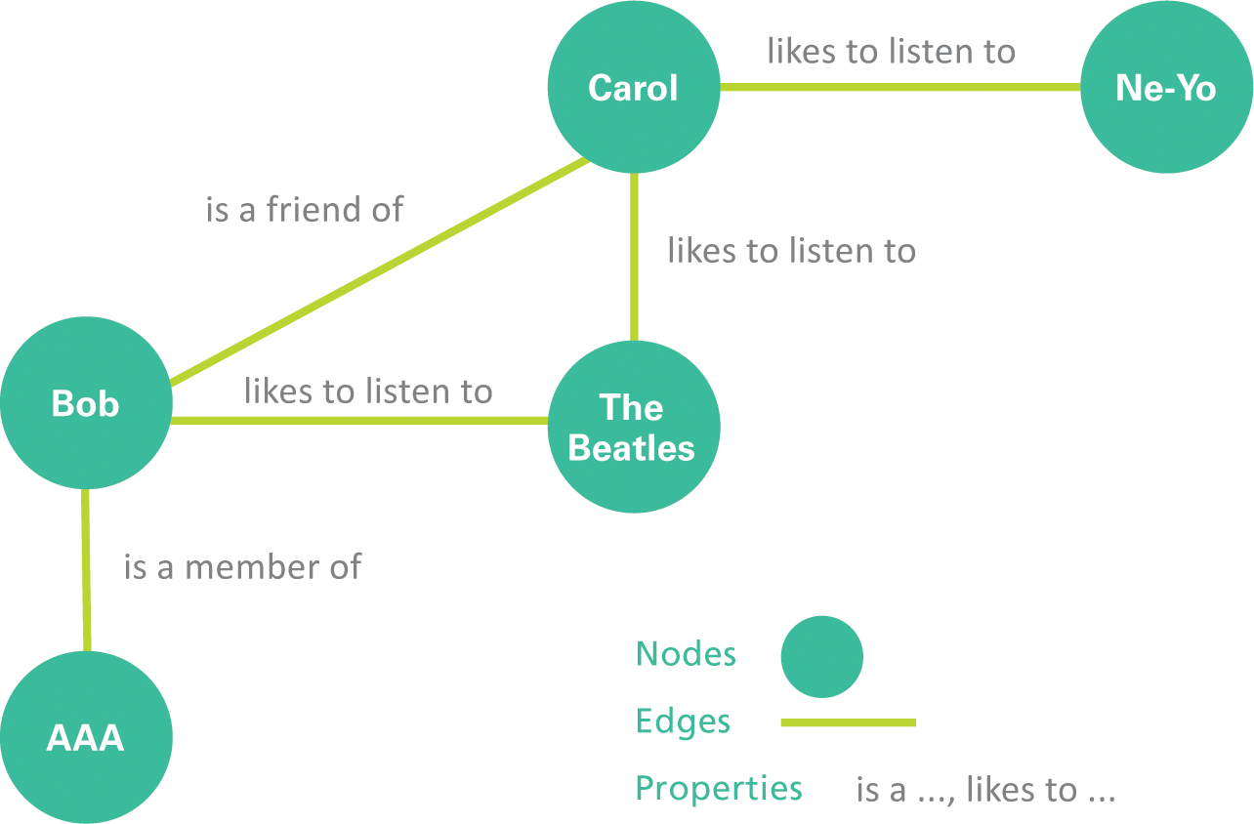
Database Models
A graph database offers an alternative way to track relationships; its structure resembles sociograms with their interlinked nodes

Slide 16
Database Models
A relational database stores data in a collection of related tables
Each table is a sequence of records, similar to a flat file
A multidimensional database organizes relationships over three or more dimensions; in the context of databases, a dimension is a layer based on a data element, such as a product, place, or customer, that can be used to categorize data

Slide 17
Database Models

Slide 18
Database Models
An object database, also called an object-oriented database, stores data as objects, which can be grouped into classes and defined by attributes and methods
Object databases excel at representing objects that have slightly different attributes, which is the case in many real-world business applications
A document-oriented database stores unstructured data, such as the text of a speech
XML (eXtensible Markup Language) is a popular tool used to format document databases

Slide 19
Section B: Database Tools
Database Tool Basics
Dedicated Applications
Word Processor Data Tools
Spreadsheet Data Tools
Database Management Systems

Slide 20
Database Tool Basics
Data dependence is a term that refers to data and program modules being so tightly interrelated that they become difficult to modify
Modern database tools support data independence, which entails separating data from the programs that manipulate it

Slide 21
Database Tool Basics

Slide 22
Dedicated Applications
The simplest tools for managing data are dedicated applications for specific data management tasks, such as keeping track of appointments or maintaining an address book
To use one of these tools, simply enter your data; the software includes menus that allow you to manipulate your data once it is entered
Dedicated applications are easy to use, however they generally don’t allow users to add fields or change field names

Slide 23
Dedicated Applications

Slide 24
Word Processor Data Tools
Word processing software may include tools for working with unstructured or structured data; these tools can sort a list or create a file of data for mail merges
Most word processing software includes a sort feature that can be used to arrange a simple list in alphabetical or numeric order
A single-level sort uses only one field to arrange records
A multi-level sort arranges information by more than one field

Slide 25
Word Processor Data Tools

Slide 26
Spreadsheet Data Tools
Spreadsheets are organized in table format, so it makes sense that they can be used for sorting data
Depending on the spreadsheet software, it may be possible to sort records, validate data, search for records, perform simple statistical functions, and generate graphs

Slide 27
Spreadsheet Data Tools

Slide 28
Database Management Systems
When a word processor or spreadsheet isn’t sufficient to handle a data set, a DBMS is an option that offers a set of development tools for creating and accessing databases
The term DBMS (database management system) refers to software that manages data stored in a database
Filemaker Pro and Microsoft Access are easy-to-use DBMSs that are a good fit for small businesses and individuals

Slide 29
Database Management Systems
Modern DBMSs work with many kinds of data including text, numbers, images, PDFs, and audio files
Today, databases might reside on a in-house server, or on a cloud based server, or on distributed servers scattered throughout the world
DBMSs handle the details of how to most efficiently arrange data on a storage medium for optimal access speed

Slide 30
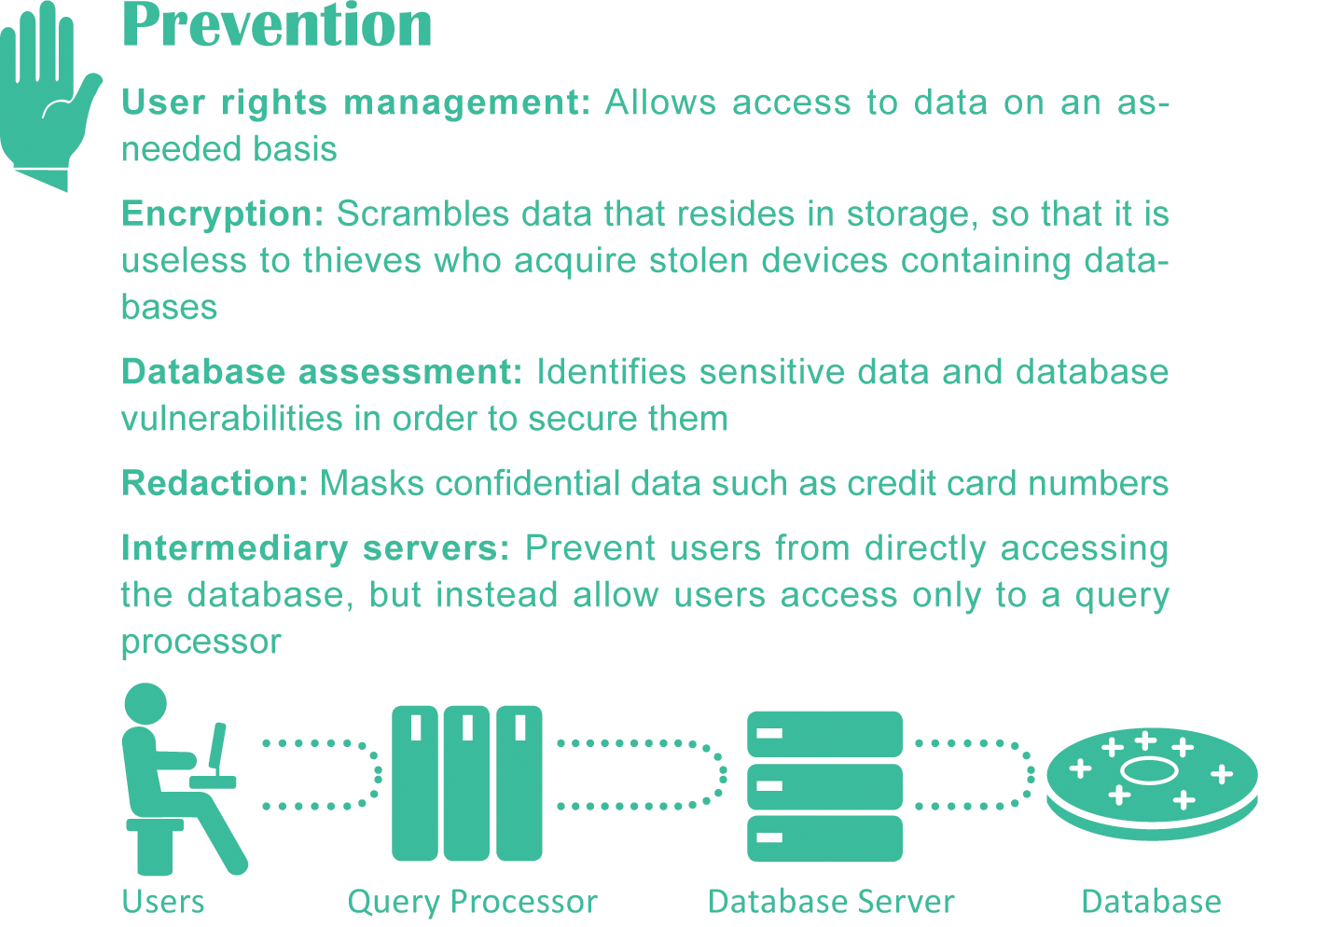
Database Management Systems
DBMSs require security features to ensure data confidentiality, protect against insider threats, and block unauthorized access

Slide 31
Section C: Database Design
Defining Fields
Data Types
Normalization
Sorting and Indexing
Designing the Interface
Designing Report Templates

Slide 32
Defining Fields
There are three core elements in a relational database: fields, tables, and relationships
The term database structure refers to the arrangement of fields, tables, and relationships in a database
The first step in structuring a relational database is to determine what data should be collected and stored

Slide 33
Defining Fields
A computed field is a calculation that a DBMS performs, similar to the way a spreadsheet computes a formula
A field format is a template that adds the correct formatting as data is entered
A field validation rule is a specification that the database designer sets up to filter data entered into a particular field
A lookup routine validates a field entry by checking data in an in-house or third-party database

Slide 34
Data Types
The data that can be entered into a field depends on the field’s data type
A data type specifies the way data is represented on physical storage media and RAM
Data types:
Real – used for fields that contain numbers with decimal places
Integer – used for fields that contain whole numbers
Date – stores dates in a format that allows them to be manipulated
Cont…

Slide 35
Data Types
Text – assigned to fixed-length fields that hold character data
Memo – provides a variable-length field for user comments
Logical (Boolean) – used for true/false and yes/no data
BLOB (binary language object) – can be any type of data
Hyperlink – stores URLs used to link from a database to a Web page

Slide 36
Normalization
A process called normalization helps database designers create a database structure that minimizes storage space and increases processing efficiency
The goal of normalization is to minimize data redundancy—the amount of data that is duplicated in a database

Slide 37
Sorting and Indexing
A table’s physical sort order is the order in which data are arranged on storage devices
A sort key is the column of data that is used as the basis for rearranging the data
Sorted tables produce faster queries and updates using clever algorithms to find data
A database index contains a list of keys, and each key provides a pointer to the data that contains the rest of the fields related to that key

Slide 38
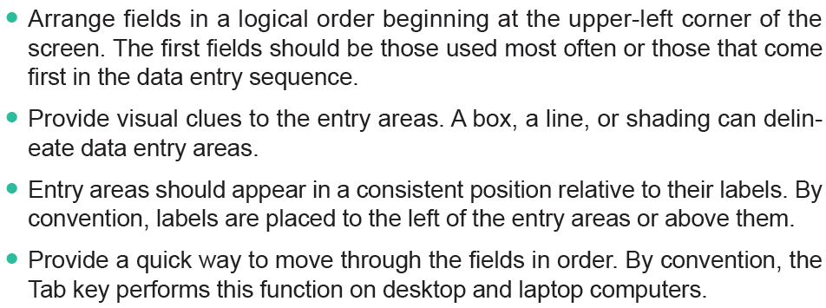
Designing the Interface
The following guidelines list strategies for producing well designed database interfaces:
Cont…

Slide 39
Designing the Interface

Slide 40
Designing the Interface

Slide 41
Designing Report Templates
A report is a printed or screen-based list of some or all of the data in a database
Most DBMSs include a report generator, which is a software tool for specifying the content and format for a database report
A report template contains the outline or general specifications for a report

Slide 42
Section D: SQL
SQL Basics
Adding Records
Searching for Information
Updating Fields
Joining Tables

Slide 43
SQL Basics
Commands processed by the DBMS are issued using computer programming languages designed for databases
These languages are sometimes called query languages because one of their main capabilities is to request data from a database
The database client software collects input from the user and then converts it into an SQL query, which can operate directly on the database to carry out the user’s instructions

Slide 44
SQL Basics
The SQL query language provides a collection of special command words called SQL keywords, such as SELECT, FROM, INSERT, and WHERE
Most SQL queries can be divided into three simple elements that specify an action, the name of a database table, and a set of parameters
An SQL query begins with an action keyword, or command, which specifies the operation you want carried out
Parameters are detailed specifications for a command

Slide 45
SQL Basics

Slide 46
Adding Records
A database record contains information about an entity, such as a customer, an online purchase, an ATM withdrawal, or a social media post
The data is bundled into an SQL statement that is handled by the DBMS
Using the INSERT command, a user can add data to a record

Slide 47
Searching for Information
One of the most common database operations is to query for particular record or a group of records by using the SELECT command
The database client software uses a search specification to create the SQL query; a result is generated for this query
SQL uses Boolean operators such as AND, OR, and NOT to form complex queries

Slide 48
Updating Fields
Updates and modifications to the contents of a database field are made by using the SQL UPDATE command
The UPDATE function works only for records that have similar characteristics
Custom programming is required to perform global operations on information that does not have any similar characteristics

Slide 49
Joining Tables
In SQL terminology, creating a relationship between tables is referred to as joining tables
The SQL JOIN command allows users to temporarily join and simultaneously access the data in more than one table
When joining two tables, the convention is to use dot notation for field names; SQL uses dot notation to make distinctions between data

Slide 50
Section E: Big Data
Big Data Basics
Big Data Analytics
NoSQL

Slide 51
Big Data Basics
Big data refers to the huge collections of data that are difficult to process, analyze, and manage using conventional database tools
An example of big data is the 1 million transactions generated by Walmart sales registers every hour
Big data is a relatively new phenomenon that businesses are just beginning to deal with

Slide 52
Big Data Basics
Big data is characterized as having:
High Volume
High Velocity
Diversified Variety
Unknown Veracity
Low-density Value (low-density data refers to large volumes of data containing unimportant details)

Slide 53
Big Data Analytics
Mainstream big data exploration produces commercial benefits
A high percentage of today’s expenditures on big data are for technologies that enhance the customer experience and provide targeted marketing solutions
Real-time analysis and decision making are popular reasons to invest in big data technologies

Slide 54
Big Data Analytics

Slide 55
NoSQL
The term NoSQL is used to refer to a group of technologies for managing databases that do not adhere to the relational model and standard SQL query language
NoSQL technologies are effective for building and managing non-relational databases containing big data that may be unstructured and may be distributed across multiple servers

Slide 56
NoSQL

Slide 57
NoSQL
Unstructured and semi-structured data—such as tweets, email messages, blog posts, and videos—are difficult to mold into fixed structures
Relational databases are organized according to a schema, which is a blueprint for its structure; rows, columns, and tables of a database are part of its schema
NoSQL tools create schema-less databases, allowing data structures such as fields to be added

Slide 58
NoSQL
The simplest structure for storing data in a NoSQL database is the key-value data model; each data item has a key that is a unique identifier similar to a relational database key such as CustomerID
The column-oriented data model stores data in columns, rather than in rows, so it works well in situations where the focus is on analysis of chunks of data

Slide 59
NoSQL
Popular NoSQL tools include:
MongoDB
Cassandra
Hbase
Neo4j
SimpleDB
Hive
Google Big Table
Voldemort

Slide 60
Unit 10 Complete

