Slide 1
Chapter 1 Computers and Digital Basics

Slide 2
Chapter Contents
Section A: All Things Digital
Section B: Digital Devices
Section C: Digital Data Representation
Section D: Digital Processing
Section E: Password Security

Slide 3
FastPoll True/False Questions Answer A for True and B for False
010100 Cloud computing characterized the first phase of the digital revolution.
010200 A computer’s operating system is a type of application software.
010300 Microcontrollers are special purpose microprocessors that can be embedded in devices such as refrigerators, cars, and washing machines.
010400 A bit is a binary digit, such as a 1 or 0.
3

Slide 4
FastPoll True/False Questions Answer A for True and B for False
010500 ASCII and Unicode are used to represent character data.
010600 A megabyte is 1024 bits.
010700 Microprocessors are a type of integrated circuit.
010800 C, COBOL, and Java are examples of programming languages.
4

Slide 5
FastPoll True/False Questions Answer A for True and B for False
010900 A compiler converts source code to object code.
011000 The list of codes for a microprocessor’s instruction set is called machine language.
011100 A microprocessor holds data in the interpreter register.
011200 A dictionary attack is a virus that hides out in the spelling checker for your word processing software.
5

Slide 6
Section A: All Things Digital
The Digital Revolution
Data Processing
Personal Computing
Network Computing
Cloud Computing
Digital Society

Slide 7
Question
012100 Computers and the digital revolution have changed our lives in many fundamental ways. If you were on the front lines of the digital revolution when computers were first developed to break codes and calculate missile trajectories, you were most likely living in what time period?
A. World War I
B. The Roaring Twenties
C. World War II
D. The 1960s

Slide 8
The Digital Revolution
The digital revolution is an ongoing process of social, political, and economic change brought about by digital technology, such as computers and the Internet
The technology driving the digital revolution is based on digital electronics and the idea that electrical signals can represent data, such as numbers, words, pictures, and music

Slide 9
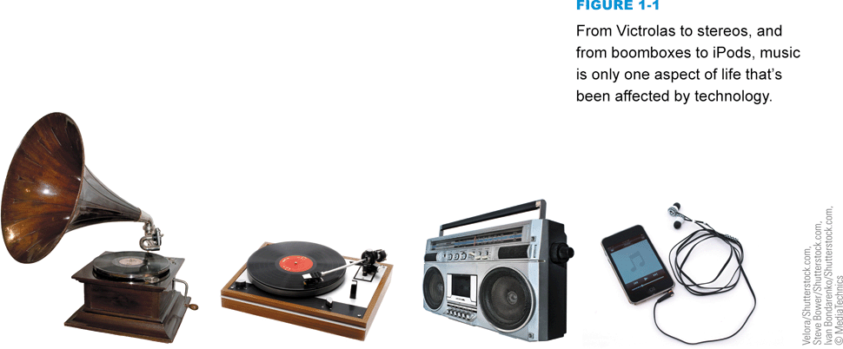
The Digital Revolution
Digitization is the process of converting text, numbers, sound, photos, and video into data that can be processed by digital devices
The digital revolution has evolved through four phases, beginning with big, expensive, standalone computers, and progressing to today’s digital world in which small, inexpensive digital devices are everywhere
Notes:
Figure 1-1

Slide 10
The Digital Revolution
Notes:
Figure 1-2

Slide 11
Data Processing
Some historians mark the 1980s as the beginning of the digital revolution, but engineers built the first digital computers during World War II for breaking codes and calculating missile trajectories
Computers were operated by trained technicians
Back then, processing components for computers were housed in closet-sized cabinets that did not usually include a keyboard or display device

Slide 12
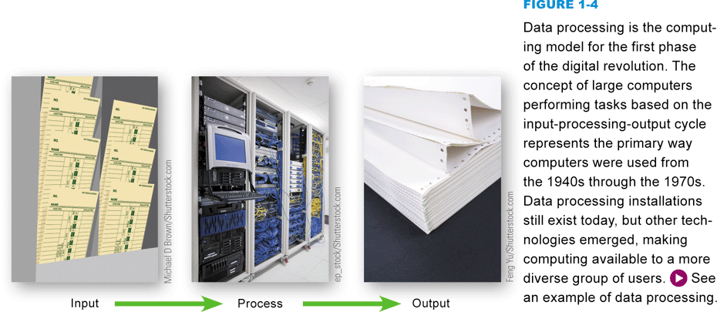
Data Processing
Data processing is based on an input-processing-output cycle
Data goes into a computer, it is processed, and then it is output
Notes:
Figure 1-4

Slide 13
Personal Computing
The model for the second phase of the digital revolution, personal computing is characterized by small, standalone computers powered by local software
Local software refers to any software that is installed on a computer’s hard drive

Slide 14
Personal Computing
Notes:
Figure 1-5

Slide 15
Network Computing
The third phase of the digital revolution materialized as computers became networked and when the Internet was opened to public use
A computer network is a group of computers linked together to share data and resources
The Internet is a global computer network originally developed as a military project, and was then handed over to the National Science Foundation for research and academic use

Slide 16
Network Computing
The Web (short for World Wide Web) is a collection of linked documents, graphics, and sounds that can be accessed over the Internet
During the period from 1995–2010, computing was characterized by the Web, e-mail, multiplayer games, music downloads, and enormous software applications, such as Microsoft Office, Norton’s Internet Security Suite, and Corel Digital Studio

Slide 17
Cloud Computing
Local applications are being eclipsed by cloud computing, which characterizes the fourth phase of the digital revolution
Cloud computing provides access to information, applications, communications, and storage over the Internet
The expansion of cloud computing is due in part to convergence, a process by which several technologies with distinct functionalities evolve to form a single product

Slide 18
Cloud Computing
Notes:
Figure 1-7

Slide 19
Cloud Computing
Convergence is important to the digital revolution because it created sophisticated mobile devices whose owners demand access to the same services available from full-size computers on their desks
Social media are cloud-based applications designed for social interaction and consumer-generated content

Slide 20
Cloud Computing
Notes:
Figure 1-9

Slide 21
Digital Society
Digital technologies and communications networks make it easy to cross cultural and geographic boundaries
Anonymous Internet sites, such as Freenet, and anonymizer tools that cloak a person’s identity, even make it possible to exercise freedom of speech in situations where reprisals might repress it
Citizens of free societies have an expectation of privacy
Intellectual property refers to the ownership of certain types of information, ideas, or representations

Slide 22
Digital Society
Digital technology is an important factor in global and national economies, in addition to affecting the economic status of individuals
Globalization can be defined as the worldwide economic interdependence of countries that occurs as cross-border commerce increases and as money flows more freely among countries
Some individuals are affected by the digital divide, a term that refers to the gap between people who have access to technology and those who do not
Digital technology permeates the very core of modern life

Slide 23
Section B: Digital Devices
Computer Basics
Computer Types and Uses
Microcontrollers

Slide 24
Question
012200 Today, consumers can choose from a wide variety of digital devices, including personal computers, workstations, videogame consoles, smartphones, and iPods. Knowing the strengths of these devices helps you make the right choice. What is the fundamental difference between videogame consoles, personal computers, and smartphones?
A. Video game consoles and smartphones are not classified as computers because they don’t have stored program capabilities like real computers.
B. Videogame consoles and smartphones fill specialized niches and are not replacements for personal computers.
C. Personal computers and smartphones can be used to access the Internet, whereas videogame consoles cannot.
D. Personal computers and smartphones have better graphics than videogame consoles.
24

Slide 25
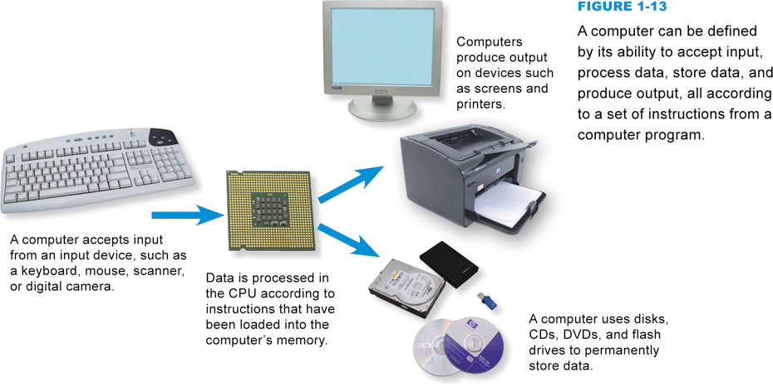
Computer Basics
A computer is a multipurpose device that accepts input, processes data, stores data, and produces output, all according to a series of stored instructions
Notes:
Figure 1-13

Slide 26
Computer Basics
Computer input is whatever is typed, submitted, or transmitted to a computer system
Output is the result produced by a computer
Data refers to the symbols that represent facts, objects, and ideas
Computers manipulate data in many ways, and this manipulation is called processing
Central Processing Unit (CPU)
Microprocessor
Notes:
Figure 1-14

Slide 27
Computer Basics
Memory is an area of a computer that temporarily holds data waiting to be processed, stored, or output
Storage is the area where data can be left on a permanent basis when it is not immediately needed for processing
A file is a named collection of data that exists on a storage medium
The series of instructions that tells a computer how to carry out processing tasks is referred to as a computer program
Software

Slide 28
Computer Basics
A stored program means that a series of instructions for a computing task can be loaded into a computer’s memory
Allows you to switch tasks
Distinguishes a computer from other simpler and less versatile digital devices

Slide 29
Computer Basics
Application software is a set of computer programs that helps a person carry out a task
Software applications are sometimes referred to as apps, especially in the context of handheld devices
The primary purpose of system software is to help the computer system monitor itself in order to function efficiently
Operating system (OS)

Slide 30
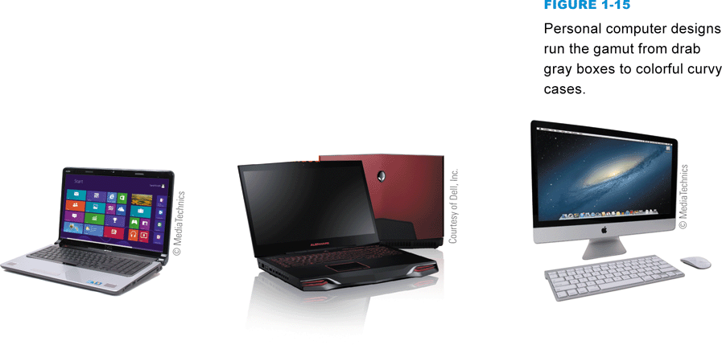
Computer Types and Uses
A personal computer is a microprocessor-based computing device designed to meet the computing needs of an individual
Notes:
Figure 1-15

Slide 31
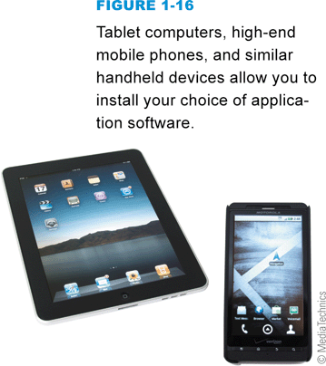
Computer Types and Uses
Handheld digital devices include familiar gadgets such as iPhones, iPads, iPods, Garmin GPSs, Droids, and Kindles
These devices incorporate many computer characteristics
Handheld devices can be divided into two broad categories: those that allow users to install software applications (apps) and those that do not
Notes:
Figure 1-16

Slide 32
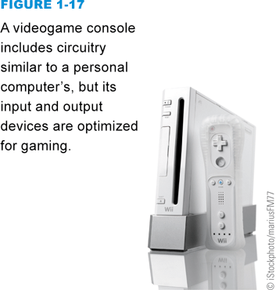
Computer Types and Uses
A videogame console, such as Nintendo’s Wii, Sony’s PlayStation, or Microsoft’s Xbox, is not generally referred to as personal computer because of their history as dedicated game devices
Notes:
Figure 1-17

Slide 33
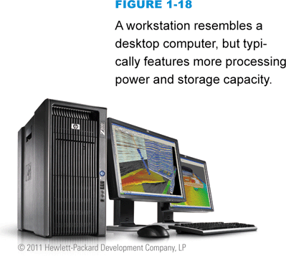
Computer Types and Uses
The term workstation has two meanings:
An ordinary personal computer that is connected to a network
A powerful desktop computer used for high-performance tasks
Notes:
Figure 1-18

Slide 34
Computer Types and Uses
The purpose of a server is to serve computers on a network (such as the Internet or a home network) by supplying them with data
A mainframe computer (or simply a mainframe) is a large and expensive computer capable of simultaneously processing data for hundreds or thousands of users
A computer falls into the supercomputer category if it is, at the time of construction, one of the fastest computers in the world
A compute-intensive problem is one that requires massive amounts of data to be processed using complex mathematical calculations

Slide 35
Computer Types and Uses
Notes:
Figures 1-20 and 1-21

Slide 36
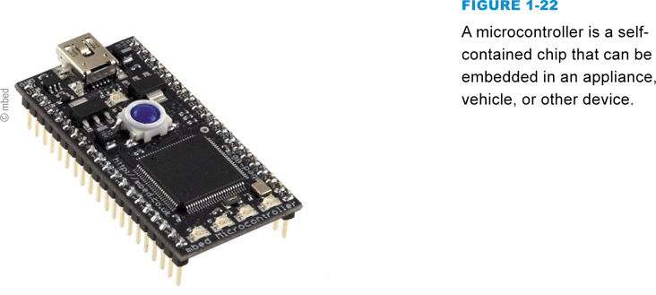
Microcontrollers
A microcontroller is a special-purpose microprocessor that is built into the machine it controls
Microcontrollers can be embedded in all sorts of everyday devices
Notes:
Figure 1-22

Slide 37
Section C: Digital Data Representation
Data Representation Basics
Representing Numbers, Text, Images, and Sound
Quantifying Bits and Bytes
Circuits and Chips

Slide 38
Question
012300 When you shop for digital devices, their capabilities are often touted in terms of speed and capacity. Suppose you’re shopping for a USB Flash drive. A friend recommends one that’s 64 GB. What does that mean?
A. It operates at 64 gigabits per second.
B. It holds 64 billion bytes of data.
C. It holds 64 million 0s and 1s to represent data.
D. It uses 64-bit ASCII code to hold data.
38

Slide 39
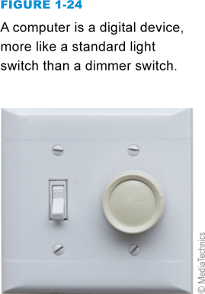
Data Representation Basics
Data representation refers to the form in which data is stored, processed, and transmitted
Digital data is text, numbers, graphics, sound, and video that has been converted into discrete digits such as 0s and 1s
Analog data is represented using an infinite scale of values
Notes:
Figure 1-24

Slide 40
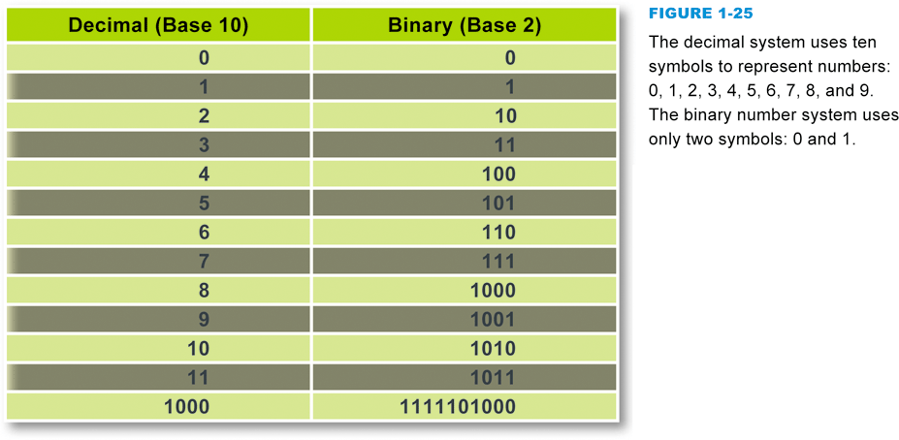
Representing Numbers, Text, Images, and Sound
Numeric data
Binary number system
Character data
ASCII, EBCDIC, Extended ASCII, and Unicode
Notes:
Figure 1-25

Slide 41
Representing Numbers, Text, Images, and Sound
Notes:
Figure 1-26

Slide 42
Quantifying Bits and Bytes
Notes:
Figure 1-29

Slide 43
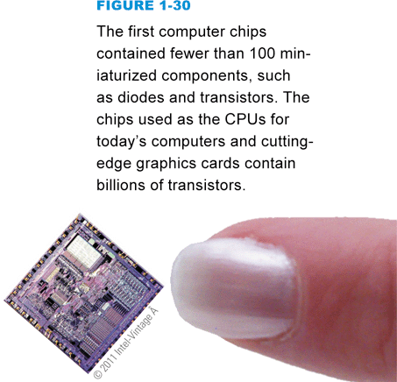
Circuits and Chips
An integrated circuit (IC) is a super-thin slice of semiconducting material packed with microscopic circuit elements
Notes:
Figure 1-30 – 1-31

Slide 44
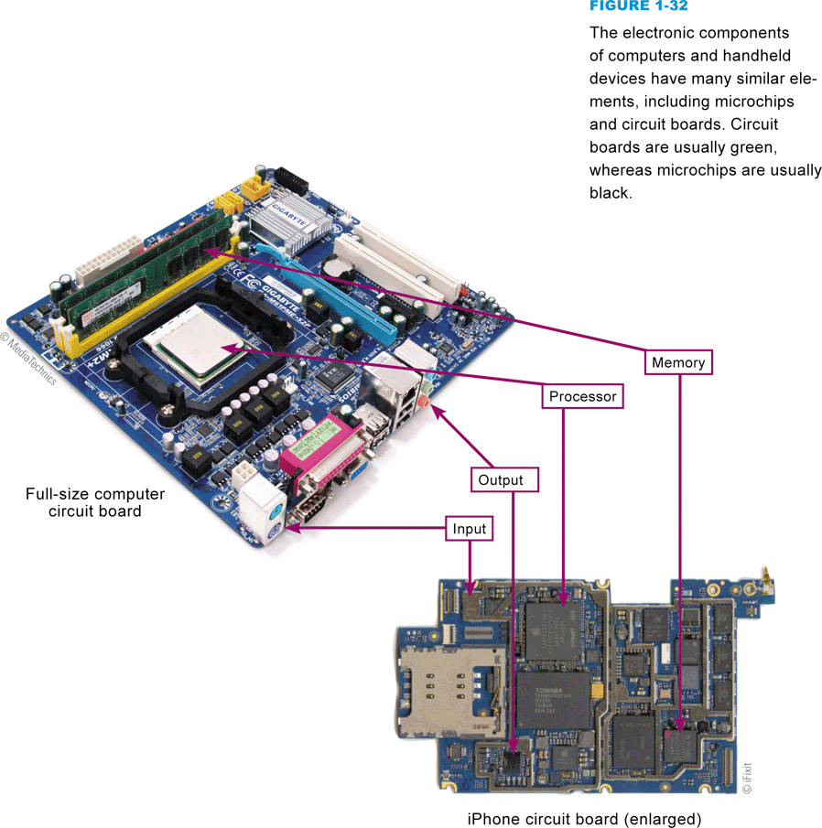
Circuits and Chips
The electronic components of most digital devices are mounted on a circuit board called a system board, motherboard, or main board
Notes:
Figure 1-32

Slide 45
Section D: Digital Processing
Programs and Instruction Sets
Processor Logic

Slide 46
Question
012400 Programmers write computer programs for word processing, displaying photos, playing music, and showing movies. What programmers write, however, is not what a computer actually processes. Why is this the case?
A. Because programmers usually write programs using high-level programming languages that have to be converted into machine language that computers can work with.
B. Because programs are basically outlines that programmers have to fill out using op codes.
C. Because high-level languages are too detailed for computers to process, so programs written in these languages have to be simplified.
D. Because computer programmers make too many errors for programs to run successfully.
46

Slide 47
Programs and Instruction Sets
Computers and dedicated handheld devices all work with digital data under the control of a computer program
Computer programmers create programs that control digital devices. These programs are usually written in a high-level programming language
The human-readable version of a program created in a high-level language by a programmer is called source code

Slide 48
Programs and Instruction Sets
Notes:
Figure 1-34 – 1-35

Slide 49
Programs and Instruction Sets
A microprocessor is hard-wired to perform a limited set of activities, such as addition, subtraction, counting, and comparisons, called an instruction set
Each instruction has a corresponding sequence of 0s and 1s
The end product is called machine code
An op code (short for operation code) is a command word for an operation such as add, compare, or jump
The operand for an instruction specifies the data, or the address of the data, for the operation

Slide 50
Programs and Instruction Sets
Notes:
Figure 1-36

Slide 51
Processor Logic
The ALU (arithmetic logic unit) is the part of the microprocessor that performs arithmetic operations
The ALU uses registers to hold data that is being processed
The microprocessor’s control unit fetches each instruction, just as you get each ingredient out of a cupboard or the refrigerator
The term instruction cycle refers to the process in which a computer executes a single instruction

Slide 52
Processor Logic
Notes:
Figure 1-37 – 1-38

Slide 53
Processor Logic
Notes:
Figure 1-39

Slide 54
Section E: Password Security
Authentication Protocols
Password Hacks
Secure Passwords

Slide 55
Question
012500 Security experts stress that the use of “strong” passwords can prevent identity theft and help to keep your computer files secure. Which of the following passwords is likely to be the most secure?
A. 12345 because it is all numbers.
B. Hippocampus, because it is a long and unusual word.
C. Il2baomw, because it combines numbers with a nonsense word.
D. Football88, because it combines a word and numbers.
55

Slide 56
Authentication Protocols
Security experts use the term authentication protocol to refer to any method that confirms a person’s identity using something the person knows, something the person possesses, or something the person is
A person can be identified by biometrics, such as a fingerprint, facial features (photo), or retinal pattern
A user ID is a series of characters—letters and possibly numbers or special symbols—that becomes a person’s unique identifier
A password is a series of characters that verifies a user ID and guarantees that you are the person you claim to be

Slide 57
Authentication Protocols
Notes:
Figure 1-41

Slide 58
Password Hacks
When someone gains unauthorized access to your personal data and uses it illegally, it is called identity theft
Hackers employ a whole range of ways to steal passwords
A dictionary attack helps hackers guess your password by stepping through a dictionary containing thousands of the most commonly used passwords
The brute force attack uses password-cracking software, but its range is much more extensive than the dictionary attack

Slide 59
Password Hacks
If hackers can’t guess a password, they can use another technique called sniffing, which intercepts information sent out over computer networks
An even more sophisticated approach to password theft is phishing
A keylogger is software that secretly records a user’s keystrokes and sends the information to a hacker

Slide 60
Secure Passwords

Slide 61
Secure Passwords
Strive to select a unique user ID that you can use for more than one site
Maintain two or three tiers of passwords
Notes:
Figure 1-45

Slide 62
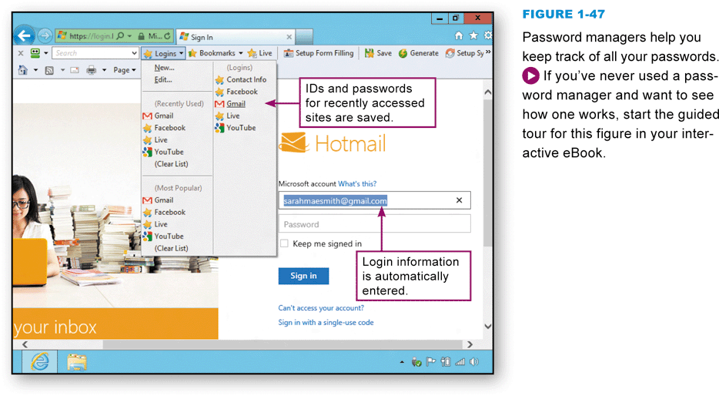
Secure Passwords
A password manager (sometimes called a keychain) stores user IDs with their corresponding passwords and automatically fills in login forms
Notes:
Figures 1-47 – 1-48

Slide 63
What Do You Think?
013100 From what you have learned, do you think that academic research articles should be available for free?
A. Yes B. No C. Not sure
013200 Do you agree with magazine and news companies that quality content requires a paywall?
A. Yes B. No C. Not sure
013300 Do you support efforts to make information accessible through back channels such as WikiLeaks?
A. Yes B. No C. Not sure
63

Slide 64
Chapter 1 Complete

