Slide 1
Chapter 2 Computer Hardware

Slide 2
Chapter Contents
Section A: Personal Computer Basics
Section B: Microprocessors and Memory
Section C: Storage Devices
Section D: Input and Output Devices
Section E: Hardware Security

Slide 3
FastPoll True/False Questions Answer A for True and B for False
020100 An all-in-one is a type of desktop computer.
020200 Small business computers have better sound and graphics capabilities than home or game computers.
020300 PCs, Macs, and Linux are three computer platforms.
020400 Today’s Macs can be configured to run Windows.
020500 Pentium, Core, ARM7, and Athlon are types of microprocessors.
3

Slide 4
FastPoll True/False Questions Answer A for True and B for False
020600 Today’s computers typically process 8 bits at a time.
020700 Serial processing is when a processor begins executing one instruction before it completes the previous instruction.
020800 In RAM microscopic electronic parts called capacitors hold the bits that represent data.
020900 ROM is a type of memory that holds the computer’s startup routine.
4

Slide 5
FastPoll True/False Questions Answer A for True and B for False
021000 Hard disk drives, optical drives, and solid state drives are random access devices.
021100 CD-RWs allow you to record data, but data cannot be changed once it is recorded.
021200 1080p is a measure of resolution.
021300 A surge strip allows you to use your desktop computer during a power outage.
5

Slide 6
Section A: Personal Computer Basics
Desktop Computer Systems
Portable Computers
Buying a Computer
Home, Game, and Small Business Systems

Slide 7
Question
022100 In the interest of being ecological, many consumers consider upgrading their computers instead of disposing of them and buying a new one. Which one of the following upgrades is best left to professional technicians?
A. Replacing the microprocessor with a newer model
B. Adding an external hard drive for backup
C. Swapping out a graphics card for a more powerful one
D. Adding RAM

Slide 8
Desktop Computer Systems
A desktop computer fits on a desk and runs on power from an electrical wall outlet
The main component of a typical desktop computer is a system unit that houses the processor, memory, storage devices, display circuitry, and sound circuitry
The term peripheral device designates input, output, and storage equipment that might be added to a computer system to enhance its functionality

Slide 9
Desktop Computer Systems
Notes:
Figure 2-1

Slide 10
Desktop Computer Systems
A typical desktop computer system includes several components
System unit
Keyboard
Mouse
Hard disk drive
Optical drive
Removable storage
Sound system
Display system
Network and Internet access
Printer

Slide 11
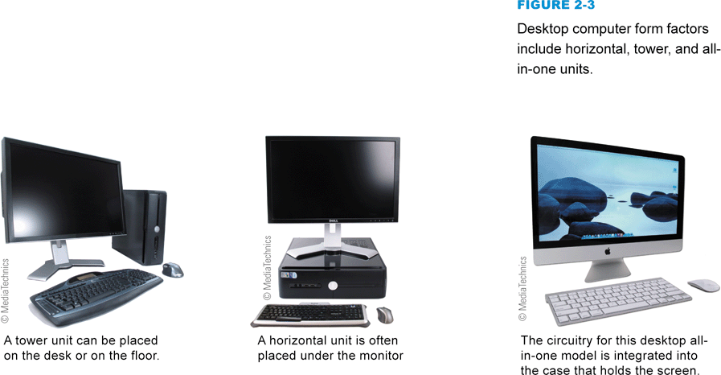
Desktop Computer Systems
In the computer industry, the term form factor refers to the size and dimensions of a component, such as a system board or system unit
Notes:
Figure 2-3

Slide 12
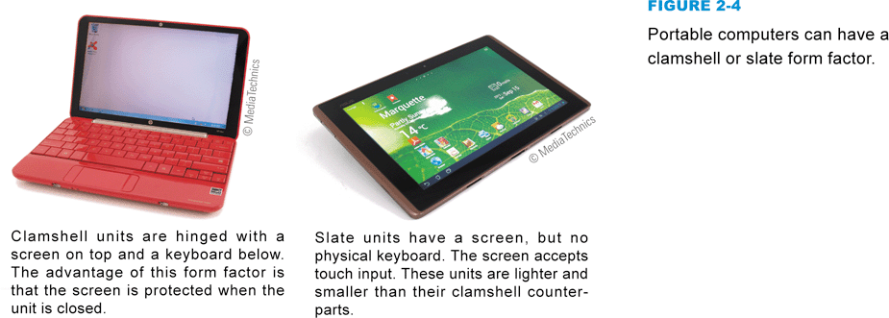
Portable Computers
A portable computer is a small, lightweight personal computer
Portable computer form factors include clamshell styles and slate styles
A laptop computer (also referred to as a notebook computer) is a small, lightweight portable computer that opens like a clamshell to reveal a screen and keyboard
Notes:
Figure 2-4

Slide 13
Portable Computers
Notes:
Figure 2-5

Slide 14
Portable Computers
Three types of computers are available in the slate form factor: enhanced media players, smartphones, and tablets
An enhanced media player is a handheld device designed for playing music and videos, and offers a camera, access to the Internet, and a variety of apps
A smartphone is an enhanced mobile phone that typically also functions as a portable media player and has the capability to access the Internet
A tablet computer is a handheld computer that is essentially a large version of an enhanced media player

Slide 15
Portable Computers
Notes:
Figure 2-6 – 2-7

Slide 16
Buying a Computer
Browse through computer magazines and online computer stores to get a general idea of features and prices
Decide on a budget and stick to it
Make a list of the ways you plan to use your computer
Select a platform
Decide on a form factor
Select peripherals, software, and accessories

Slide 17
Buying a Computer
Notes:
Figure 2-9

Slide 18
Home, Game, and Small Business Systems
Today, the term home computer system encompasses a vast array of computer configurations designed to accommodate consumers who use computers for personal tasks
Some of the most cutting-edge computers are designed for gaming
Computers marketed for small business applications tend to be middle-of-the-line models pared down to essentials

Slide 19
Section B: Microprocessors and Memory
Microprocessor Basics
Today’s Microprocessors
Random Access Memory
ROM and EEPROM

Slide 20
Question
022200 Some computers are suitable for e-mail, word processing, and similar low-key operations, whereas other computers have the power to keep up while you play complex action games, edit high-resolution videos, and prepare multi-track sound recordings. Which of the following computers is the most powerful?
A. Intel Core 7 quad-core processor; 48 GB RAM
B. AMD Phenom Quad core processor; 4 GB RAM
C. Intel Core 2 Quad processor; 2 GB RAM
D. ARM7processor; 4 GB RAM

Slide 21
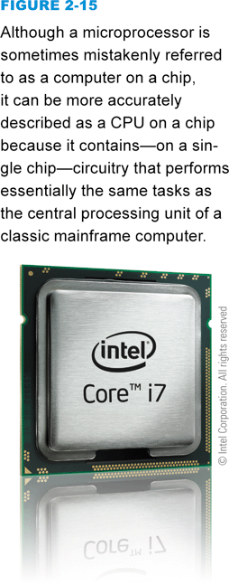
Microprocessor Basics
A microprocessor is an integrated circuit designed to process instructions
Usually the most expensive component of a computer
Notes:
Figure 2-15

Slide 22
Microprocessor Basics
Microprocessor clock
Gigahertz
Multicore processor
Front side bus
CPU Cache
Level 1 cache (L1)
Level 2 cache (L2)
Level 3 cache (L3)
Word size
Notes:
Figure 2-16

Slide 23
Microprocessor Basics
CISC vs. RISC technology
Serial processing
Pipelining
Parallel processing
Benchmarks
Notes:
Figure 2-17

Slide 24
Today’s Microprocessors
Notes:
Figure 2-19

Slide 25
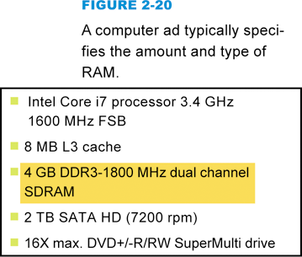
Random Access Memory
RAM (random access memory) is a temporary holding area for data, application program instructions, and the operating system
Notes:
Figure 2-20

Slide 26
Random Access Memory
Microscopic capacitors hold the bits that represent data
Most RAM is volatile
Requires electrical power to hold data
Notes:
Figure 2-21

Slide 27
Random Access Memory
RAM capacity is expressed in gigabytes
Personal computers typically feature between 2 GB and 8 GB of RAM
If a program exceeds its allocated space, the operating system uses an area of the hard disk, called virtual memory, to store parts of programs or data files until they are needed
Notes:
Figure 2-23

Slide 28
ROM and EEPROM
ROM is a type of memory circuitry that that is housed in a single integrated circuit
Permanent and non-volatile
EEPROM (Electrically Erasable Programmable Read-Only Memory)
Non-volatile but user-modifiable
ROM contains a small set of instructions and data called the bootstrap loader
Sometimes referred to as the BIOS
Tells the computer how to access the hard disk, find the operating system, and load it into RAM

Slide 29
ROM and EEPROM
Notes:
Figure 2-24

Slide 30
Section C: Storage Devices
Storage Basics
Magnetic Storage Technology
Optical Storage Technology
Solid State Storage Technology
Storage Wrap-up

Slide 31
Question
022300 Storage devices have varying levels of versatility, durability, speed, and capacity. For a student who owns a computer, but sometimes needs to use computers in the school lab, which storage device is most versatile?
A. Hard disk drive
B. CD-R
C. Solid state drive
D. USB flash drive

Slide 32
Storage Basics
A storage medium contains data
A storage device records and retrieves data from a storage medium
Data gets copied from a storage device into RAM, where it waits to be processed
Processed data is held temporarily in RAM before it is copied to a storage medium
Vertical vs. horizontal storage
Notes:
Figure 2-25

Slide 33
Magnetic Storage Technology
Magnetic storage stores data by magnetizing microscopic particles on the disk or tape surface
Notes:
Figure 2-26

Slide 34
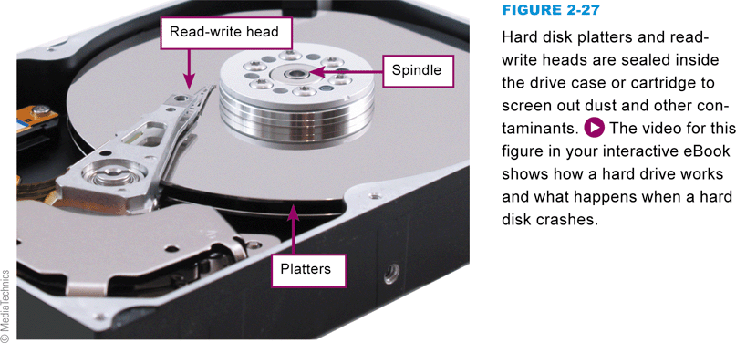
Magnetic Storage Technology
Hard disk technology is the preferred type of main storage for most personal computers
Not as durable as many other storage technologies
Head crash
Notes:
Figure 2-27

Slide 35
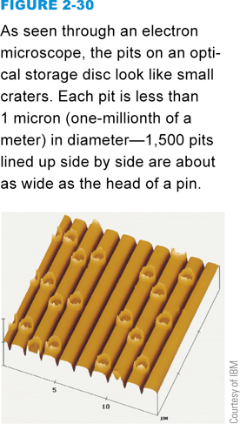
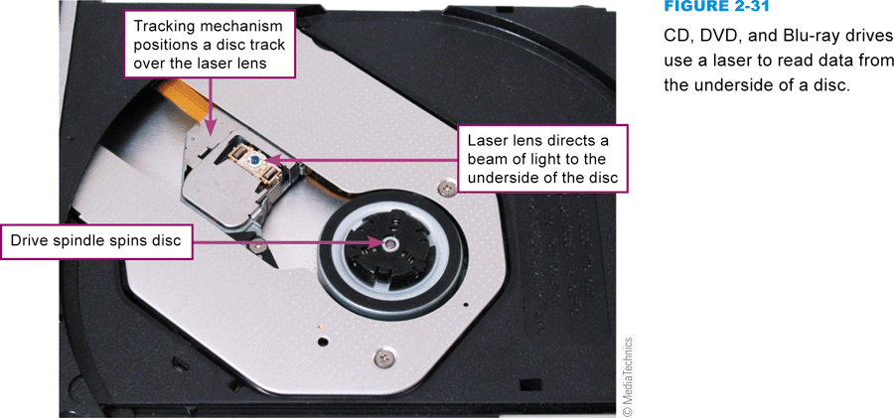
Optical Storage Technology
Optical storage stores data as microscopic light and dark spots on the disk surface
CD, DVD, and Blu-ray storage technologies
Notes:
Figure 2-30 and 2-31

Slide 36
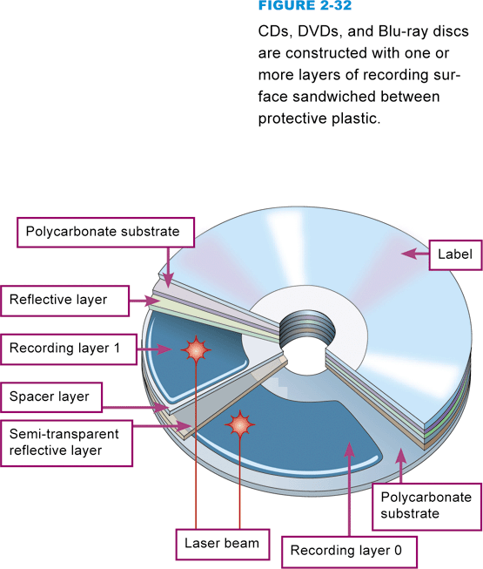
Optical Storage Technology
Three categories of optical technologies
Read-only (ROM)
Recordable (R)
Rewritable (RW)
Notes:
Figure 2-32

Slide 37
Optical Storage Technology
CDDA
DVD-Video
CD-ROM
DVD-ROM
CD-R
DVD+R or DVD-R
CD-RW
DVD+RW or DVD-RW
BD-ROM, BD-R, and BD-RE

Slide 38
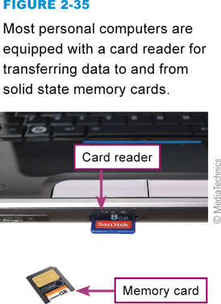
Solid State Storage Technology
Solid state storage technology stores data in an erasable, rewritable circuitry
Non-volatile
A card reader is a device that reads and writes data on solid state storage
Notes:
Figure 2-35

Slide 39
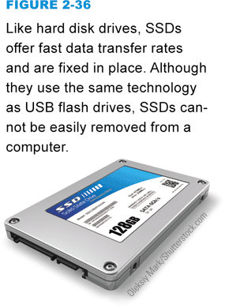
Solid State Storage Technology
A solid state drive (SSD) is a package of flash memory that can be used as a substitute for a hard disk drive
A USB flash drive is a portable storage device that plugs directly into a computer’s system unit using a built-in connector
Notes:
Figures 2-36 and 2-37

Slide 40
Storage Wrap-up
Notes:
Figure 2-38

Slide 41
Storage Wrap-up
Notes:
Figure 2-39

Slide 42
Section D: Input and Output Devices
Basic Input Devices
Display Devices
Printers
Installing Peripheral Devices

Slide 43
Question
022400 Computer owners usually want to add various peripheral devices to their computers. Suppose you have a notebook computer and you want to add an external hard drive, but you’ve run out of USB ports. What can you do?
A. Use the HDMI port instead.
B. Plug directly into the expansion bus.
C. Swap in a USB hub for one of the currently connected peripherals.
D. Use an Ethernet-to-USB converter.

Slide 44
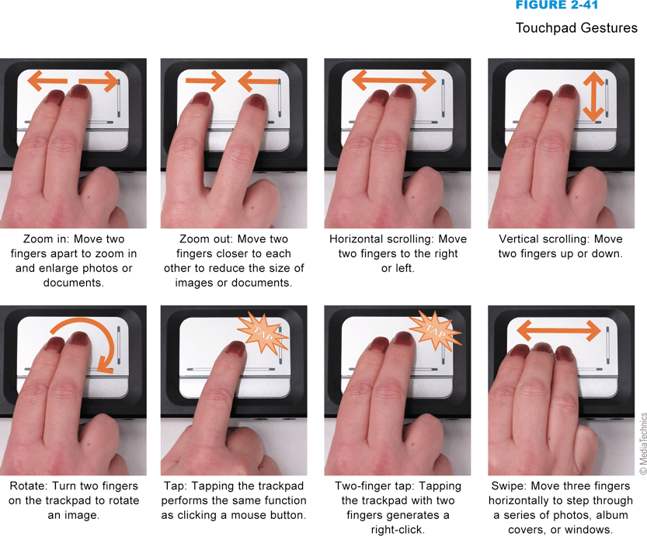
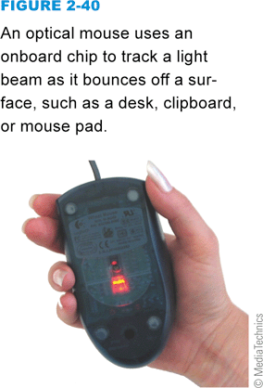
Basic Input Devices
Keyboard
Pointing device
Mouse
Game controller
Trackpad
Touchscreen
Notes:
Figures 2-40 and 2-41

Slide 45
Display Devices
An LCD display produces an image by filtering light through a layer of liquid crystal cells
Gradually, CCFL backlighting technology is being replaced by low-power light-emitting diodes (LEDs)
Notes:
Figure 2-43

Slide 46
Display Devices
Screen size
Dot pitch
Width of viewing angle
Response rate
Resolution
Color depth
Notes:
Figure 2-44

Slide 47
Display Devices
Notes:
Figure 2-45

Slide 48
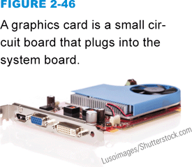
Display Devices
Graphics circuitry generates the signals for displaying an image on the screen
Integrated graphics
Dedicated graphics
Graphics card
Graphics processing unit (GPU)
Notes:
Figure 2-46

Slide 49
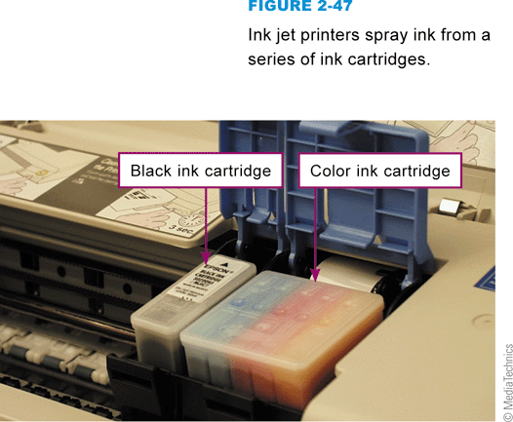
Printers
An ink-jet printer has a nozzle-like print head that sprays ink onto paper
A laser printer uses the same technology as a photocopier
Notes:
Figure 2-47

Slide 50
Printers
Notes:
FIGURE 2-48

Slide 51
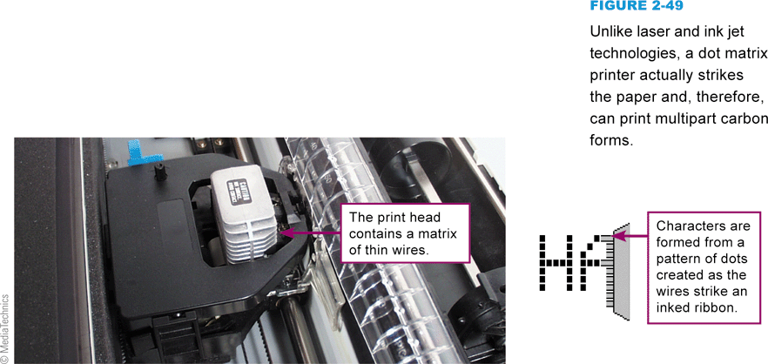
Printers
Dot matrix printers produce characters and graphics by using a grid of fine wires
The wires strike a ribbon and paper
Notes:
Figure 2-49

Slide 52
Printers
Printer features
Resolution
Print speed
Duty cycle
Operating costs
Duplex capability
Memory
Networkability

Slide 53
Installing Peripheral Devices
The data bus moves data between RAM and the microprocessor
The segment of the data bus to which peripheral devices connect is called the expansion bus
An expansion slot is a long, narrow socket on the system board into which you can plug an expansion card
Expansion cards are small circuit boards that give the computer additional capabilities
Expansion slot
Expansion port
Notes:
Figure 2-48

Slide 54
Installing Peripheral Devices
Notes:
Figure 2-51

Slide 55
Installing Peripheral Devices
Notes:
Figure 2-52

Slide 56
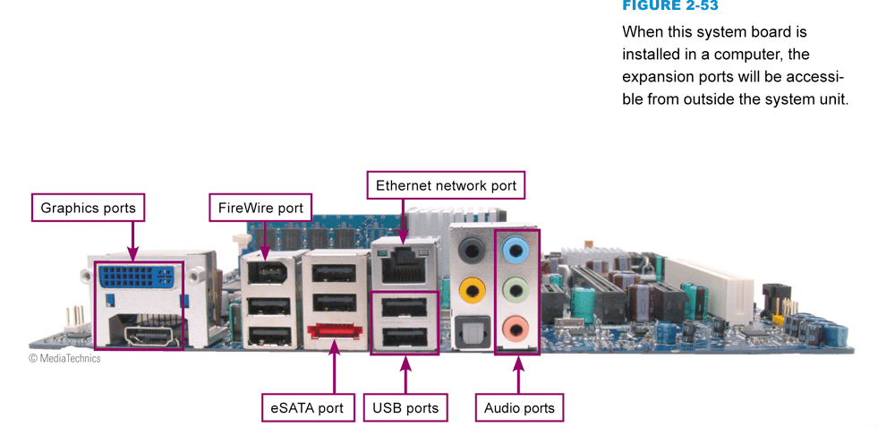
Installing Peripheral Devices
An expansion port passes data in and out of a computer or peripheral device
Notes:
Figure 2-53

Slide 57
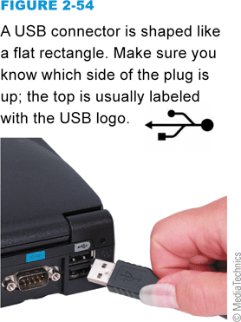
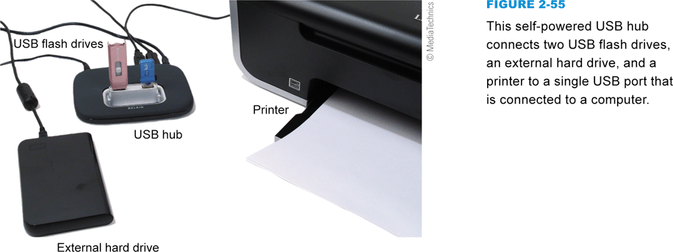
Installing Peripheral Devices
Most peripherals connect to an external USB port
You can easily add USB ports to your computer by using a USB hub
Notes:
Figure 2-54 and 2-55

Slide 58
Installing Peripheral Devices
Other kinds of ports
When you connect or disconnect a peripheral device while the computer is operating, you are hot-plugging, a practice that’s allowed with USB and FireWire devices
Notes:
Figure 2-56

Slide 59
Section E: Hardware Security
Anti-theft Devices
Surge Protection and Battery Backup
Basic Maintenance
Troubleshooting and Repair

Slide 60
Question
022500 When you treat your computer carefully and perform basic maintenance, you can avoid many hardware problems, However, if you encounter the blue screen of death, what has gone wrong?
A. The operating system has encountered an error from which it cannot recover.
B. Your computer has contracted a virus.
C. Your hard disk is full.
D. Your display device has malfunctioned.

Slide 61
Anti-Theft Devices
Notes:
Figures 2-58

Slide 62
Anti-Theft Devices
Notes:
Figures 2-59, 2-60

Slide 63
Surge Protection and Battery Backup
A power surge is a sudden increase in electrical energy, affecting the current that flows to electrical outlets
A surge strip is a device that contains electrical outlets protected by circuitry that blocks surges
A UPS is a device that not only provides surge protection, but also furnishes your computer with battery backup power during a power outage

Slide 64
Surge Protection and Battery Backup
Notes:
Figures 2-61 and 2-62

Slide 65
Basic Maintenance
Computer component failures can be caused by manufacturing defects and other circumstances beyond your control
Keep the keyboard clean
Clean your computer screen on a regular basis
Make sure fans are free of dust

Slide 66
Basic Maintenance
Notes:
Figure 2-63 (movie)

Slide 67
Troubleshooting and Repair
There are several telltale signs that your computer is in trouble
Failure to power up
Loud beep
Blank screens and/or error messages
Blue screen of death
Troubleshooting and diagnostic tools
Safe Mode

Slide 68
Troubleshooting and Repair
Notes:
Figure 2-68

Slide 69
What Do You Think?
023100 Have you ever thrown away an old computer or other electronic device?
A. Yes B. No C. Not sure
203200 Do you research products before you purchase them to find out if they are environmentally friendly throughout their life cycle?
A. Yes B. No C. Not sure
023300 Would it be fair for consumers to pay a recycling tax on any electronic equipment that they purchase?
A. Yes B. No C. Not sure

Slide 70
Chapter 2 Complete

