Slide 1
Chapter 3 Software

Slide 2
Chapter Contents
Section A: Software Basics
Section B: Office Suites
Section C: Installing Software and Upgrades
Section D: Buying Software
Section E: Security Software

Slide 3
FastPoll True/False Questions Answer A for True and B for False
030100 The two main categories of software are application software and system software.
030200 Location-based software can pinpoint its location by using the device’s built-in GPS or by triangulating the distance from nearby cell towers.
030300 Screen readers are an example of adaptive utility software.
030400 The software you install to help a printer communicate with a computer is called a device driver.
030500 Spreadsheet software is particularly useful for what-if analyses.

Slide 4
FastPoll True/False Questions Answer A for True and B for False
030600 Database software stores information in HTML codes.
030700 Web apps typically are installed on your computer’s local hard disk.
030800 Downloaded software is usually zipped to decrease download time.
030900 If the main screen of a software product does not contain a copyright notice, it is legal to make copies and share them with your friends.
031000 A EULA is a license agreement that specifies how to legally use a software product.

Slide 5
FastPoll True/False Questions Answer A for True and B for False
031100 Open source software is public domain.
031200 A software worm can replicate itself.
031300 Botnets offer effective security protection from spyware.
031400 To keep your antivirus software up to date, it is important to get updates of the rootkit.

Slide 6
Section A: Software Basics
Software Categories
Music Software
Video Software
Graphics Software
Mapping and Location-based Software

Slide 7
Section A: Software Basics
Business and “Number Crunching” Software
Desktop Publishing Software
Personal Finance Software
Utility Software
Device Drivers

Slide 8
Question
032100 Software publishers offer a huge variety of products for personal computer owners. From which of the following categories does the typical computer owner purchase add-on software?
A. System software and operating systems
B. Application software and utilities
C. Device drivers and application software
D. System software and antivirus software

Slide 9
Software Categories
Software is categorized in two main categories:
System software
Designed for computer-centric tasks
Application software
Designed to help people accomplish real-world tasks
Notes:
Figure 3-1

Slide 10
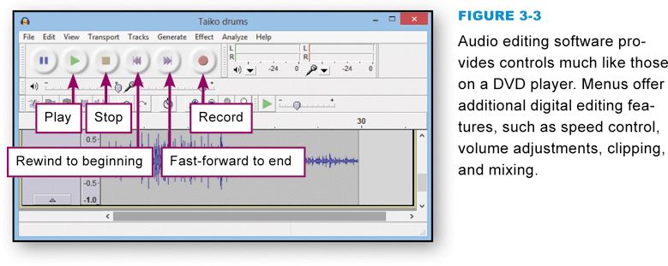
Music Software
Offers many ways to work with music, sound effects, and narration from your desktop, laptop, or handheld computer
iTunes
Audio editing software
Notes:
Figure 3-3

Slide 11
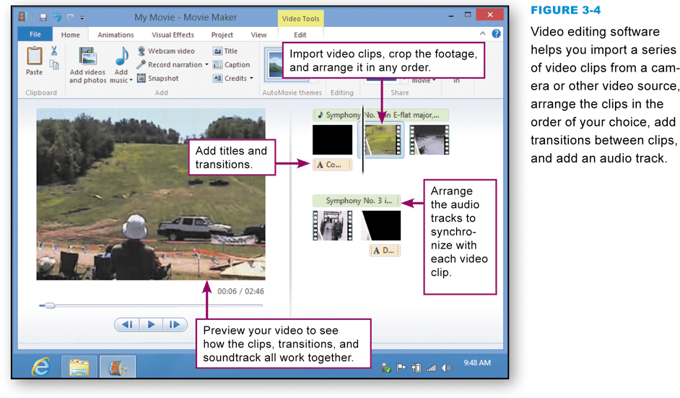
Video Software
Provides a set of tools for creating video productions from raw footage
Consumer-level video editing software
Windows Movie Maker
Apple iMovie
DVD authoring software
Notes:
Figure 3-4

Slide 12
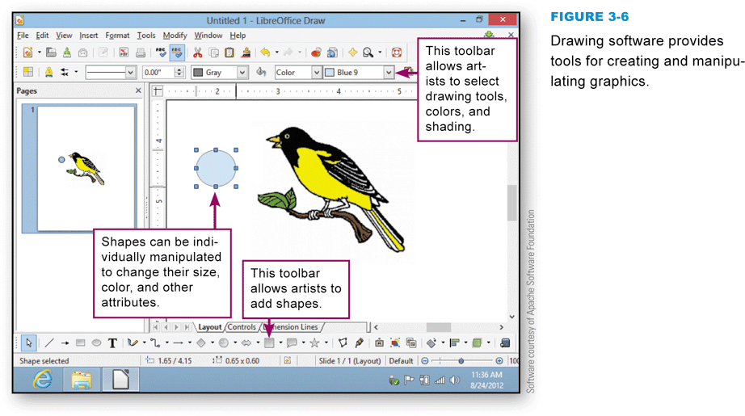
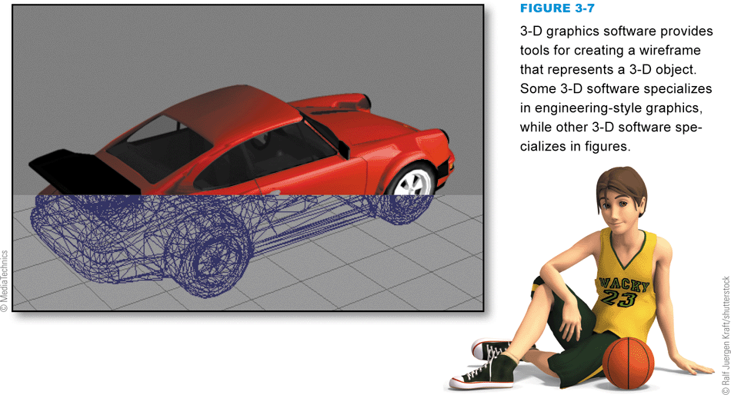
Graphics Software
Designed to help you create, manipulate, and print graphics
Paint software
Photo editing software
Drawing software
3-D graphics software
CAD software
Notes:
Figure 3-6 and 3-7

Slide 13
Mapping and Location-Based Software
A mapping application typically displays satellite, aerial, or street maps used to locate places and get directions between two addresses
Google Maps
Location-based software is able to access your current location and use it to show you the closest shops, restaurants, and theaters, as well as information about each location
Stay alert for devices and software applications that track your location

Slide 14
Mapping and Location-Based Software
Notes:
Figure 3-9 – 3-10

Slide 15
Business and “Number Crunching” Software
Vertical market software is designed to automate specialized tasks in a specific market or business
Horizontal market software is generic software that just about any kind of business can use
Payroll software
Accounting software
Project management software

Slide 16
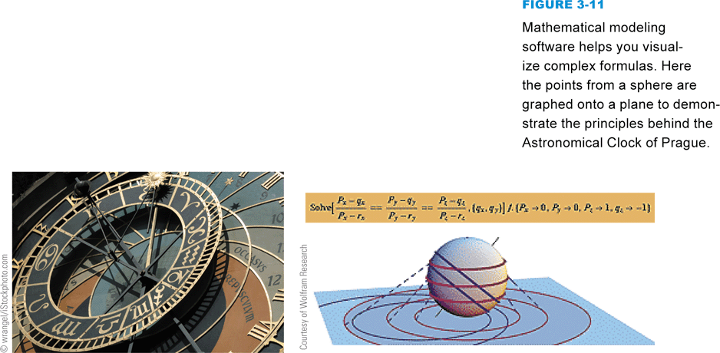
Business and “Number Crunching” Software
Businesses use a variety of “number crunching” software applications for planning and analysis
Statistical software
Mathematical modeling software
Notes:
Figure 3-11

Slide 17
Desktop Publishing Software
Desktop publishing software (DTP software) takes word processing to the next level by providing professional tools for producing typeset-quality documents
DTP software is available in consumer-level and professional-level versions
DTP software allows you to create a page using multiple frames; some frames can hold text, while other frames can hold titles, graphics, and tables
Today’s word processing software typically provides an adequate feature set for the document production needs of most individuals
Notes:
Figure 3-7

Slide 18
Desktop Publishing Software
Notes:
Figure 3-12

Slide 19
Personal Finance Software
Money management software offers a variety of tools for tracking cash flow and investments
Personal finance software, such as Intuit Quicken, is designed to keep track of income, expenses, assets, and liabilities using a simple checkbook-like user interface
Tax preparation software is a specialized type of personal finance software designed to help you gather your annual income and expense data, identify deductions, and calculate tax payments

Slide 20
Personal Finance Software
Notes:
Figure 3-13

Slide 21
Utility Software
Utility software is designed to help you monitor and configure settings for your digital gear, its operating system, or application software
Third-party software companies offer additional products that extend and improve upon those supplied by the operating system
A PDF reader, such as Adobe Reader, is an essential utility that displays documents stored in standard PDF files

Slide 22
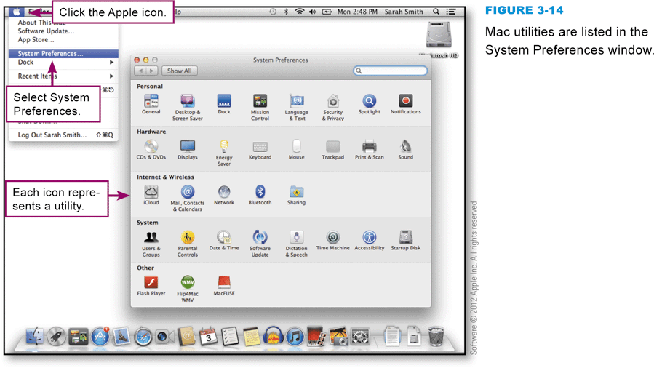
Utility Software
Adaptive utilities alter a device’s user interface to create an accessible environment by providing closed captions, text-to-speech, speech-to-text, or large screen text
System utilities can track down and fix disk errors, repair corrupted files, and give your device a performance-enhancing tune-up
Notes:
Figure 3-14

Slide 23
Device Drivers
A device driver is software that helps a peripheral device establish communication with a computer
On a Mac, you can click the Apple icon, select About this Mac, and then select More info to look at a list of devices connected to your computer
On a PC, if you need to update a device driver or change its settings, you can usually view driver information by accessing the Control Panel and selecting System (or System and Security)

Slide 24
Device Drivers
Notes:
Figure 3-18

Slide 25
Section B: Office Suites
Office Suite Basics
Word Processing
Spreadsheets
Databases
Presentations

Slide 26
Question
032200 Just about everyone has used iTunes software to download music. iTunes software also allows you to list the songs you’ve downloaded, delete songs, find songs, and organize your music into play lists. These features of iTunes are similar to what type of software?
A. Word processing software
B. Spreadsheet software
C. Database software
D. Groupware

Slide 27
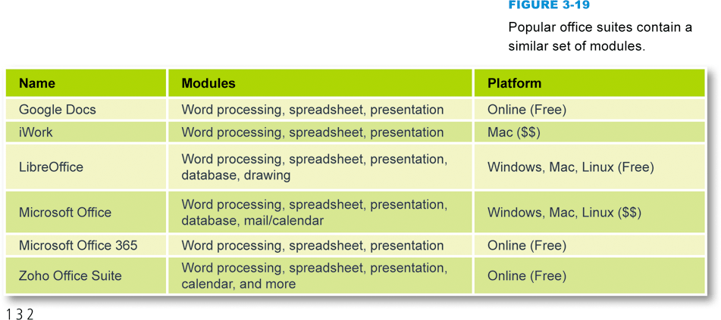
Office Suite Basics
An office suite is a collection of programs that typically include word processing, spreadsheet, presentation, and database modules
Notes:
Figure 3-19

Slide 28
Word Processing
Word processing software has replaced typewriters for producing many types of documents, including reports, letters, memos, papers, and book manuscripts
A typical word processor window displays a work area, called a workspace, that represents a blank piece of paper

Slide 29
Word Processing
Notes:
Figure 3-20

Slide 30
Word Processing
Word processing features include:
Word wrap
Search and Replace
Thesaurus
Grammar checker
Readability formula
Spelling checker
Spelling dictionary

Slide 31
Word Processing
Notes:
Figure 3-21

Slide 32
Word Processing
The final format of your document depends on several formatting factors, such as page layout, paragraph style, and font
Page layout refers to the physical position of each element on a page
Paragraph style includes the alignment of text within the margins and the space between each line of text
A font is a set of letters that share a unified design

Slide 33
Word Processing
Notes:
Figure 3-23

Slide 34
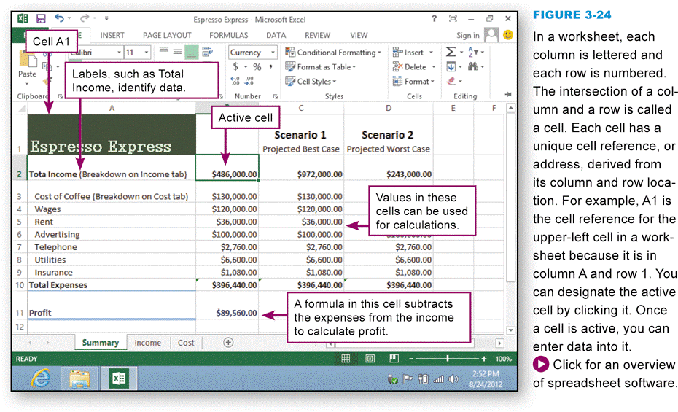
Spreadsheets
A spreadsheet uses rows and columns of numbers to create a model or representation of a real solution
Spreadsheet software, such as Microsoft Excel, iWork Numbers, Google Docs Spreadsheets, or LibreOffice Calc, provides tools to create electronic spreadsheets
Notes:
Figure 3-24

Slide 35
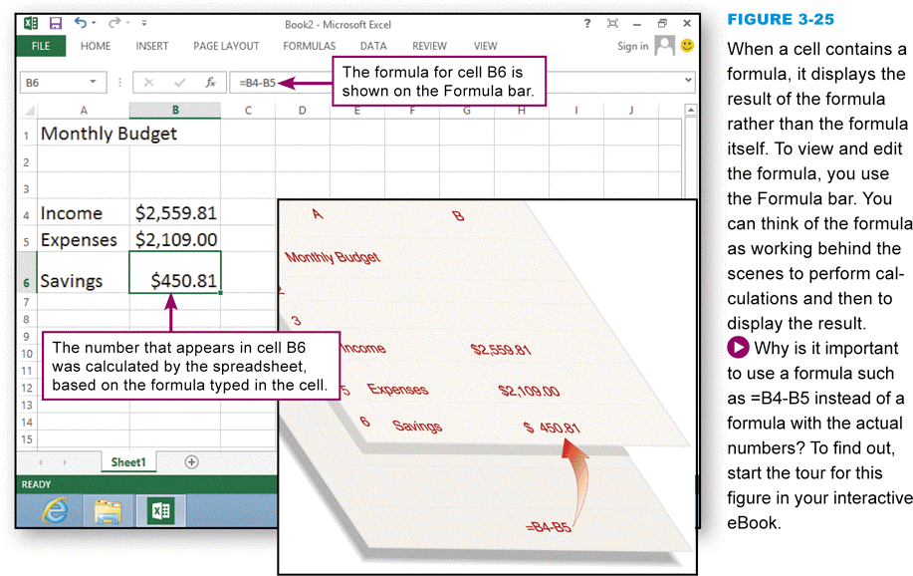
Spreadsheets
A formula tells the computer how to use the contents of cells in calculations
Cell references
Relative reference
Absolute reference
Mathematical operators
Functions
Automatic recalculations
Notes:
Figure 3-25

Slide 36
Spreadsheets
Notes:
Figure 3-26

Slide 37
Spreadsheets
Notes:
Figure 3-27

Slide 38
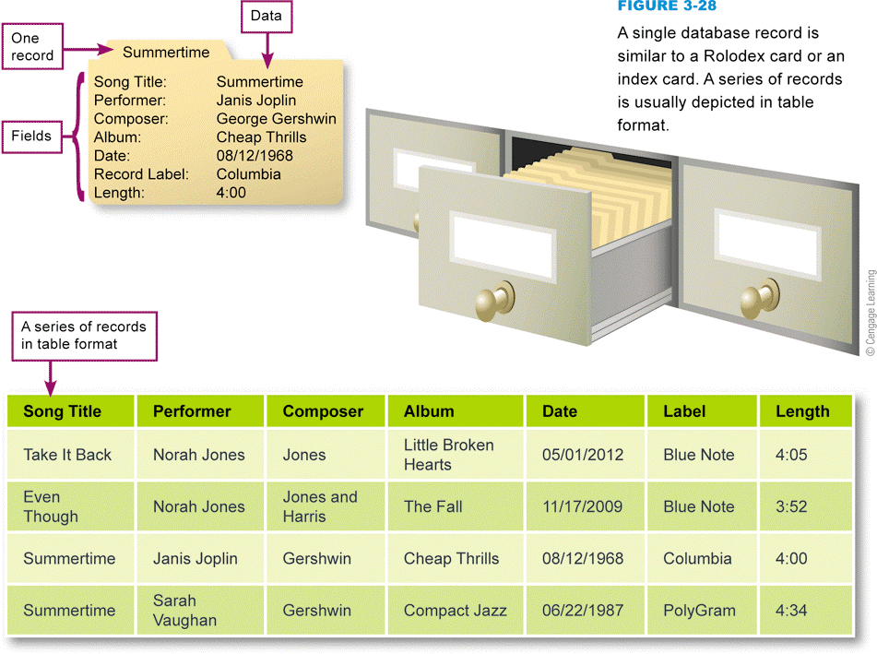
Databases
A database is a collection of data
Database software helps you enter, find, organize, update, and report information stored in a database
Notes:
Figure 3-28

Slide 39
Databases
Notes:
Figure 3-30

Slide 40
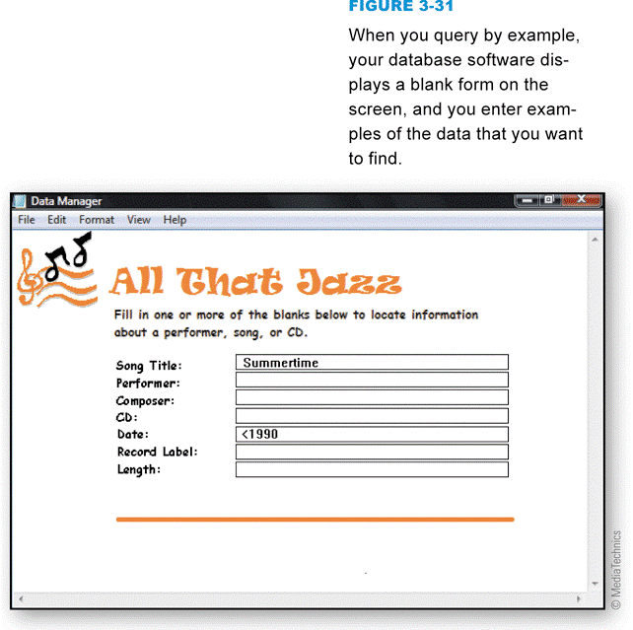
Databases
A query language such as SQL (Structured Query Language) provides a set of commands for locating and manipulating data
Natural language query
Keyword search
Query by example
Notes:
Figure 3-31

Slide 41
Presentations
Presentation software supplies the tools for combining text, photos, clip art, graphs, animations, and sound into a series of electronic slides that can be shown on a computer screen or projector

Slide 42
Presentations
Notes:
Figure 3-32

Slide 43
Section C: Installing Software and Upgrades
Web Apps
Mobile Apps
Local Applications
Portable Software
Software Upgrades and Updates
Uninstalling Software

Slide 44
Question
032300 Suppose that you’re looking for software to convert a YouTube video into a format you can use with Windows Media Player or iMovie. You don’t want to bother downloading or installing any software on your computer. What should you look for?
A. A Web app
B. Open source software
C. A .zip file
D. A portable app

Slide 45
Web Apps
Software installation is a process that places a program into a computer so that it can be run or executed
A Web application, or Web App, is software that is accessed with a Web browser
Example of cloud computing
Many are associated with consumer sites
Most require no installation at all on your local computer or handheld device

Slide 46
Web Apps
Notes:
Figure 3-33

Slide 47
Mobile Apps
A mobile app is designed for a handheld device, such as a smartphone, tablet computer, or enhanced media player
Most handheld devices can use both Web apps and mobile apps
Mobile apps can be purchased from an app store
Apple App Store
Android Market
Apps are available from other sources, but using them requires an unauthorized change to the device’s software called a jailbreak

Slide 48
Mobile Apps
Notes:
Figure 3-34

Slide 49
Local Applications
Most local applications contain a setup program that guides you through the installation process
At least one of the files included in a software package is an executable file designed to be started by users or automatically launched by the operating system

Slide 50
Local Applications
Notes:
Figure 3-37

Slide 51
Local Applications
Notes:
Figure 3-40

Slide 52
Local Applications
Notes:
Figure 3-41

Slide 53
Portable Software
Portable software is designed to run from removable storage, such as a CD or USB flash drive
Installation is simply a matter of getting program files to the media on which they are supposed to run

Slide 54
Portable Software
Notes:
Figure 3-42

Slide 55
Software Upgrades and Updates
Periodically, software publishers replace older versions of a software product with a new version that’s sometimes referred to as a software upgrade
A software update is a small section of program code that replaces part of the software you currently have installed
Service packs

Slide 56
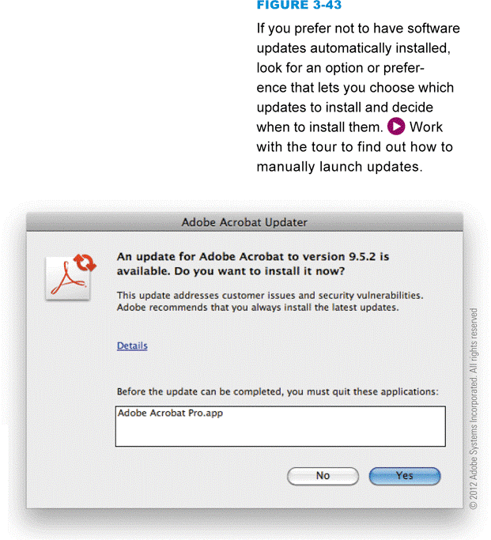
Software Upgrades and Updates
Many software applications allow you to set your preferences for how you would like to receive notifications and updates
It is always a good idea to install updates and service packs when they become available
Notes:
Figure 3-43

Slide 57
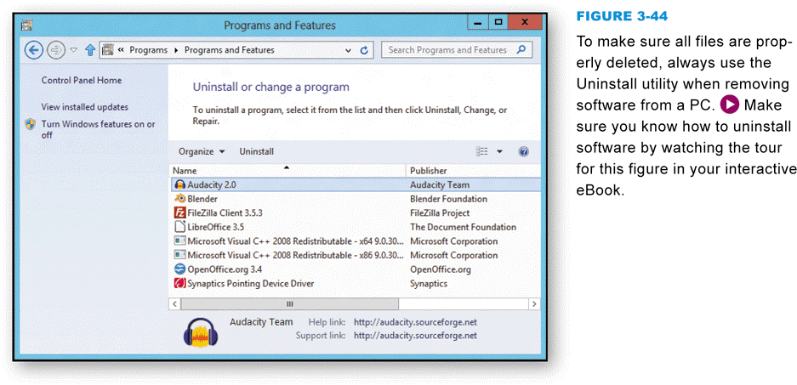
Uninstalling Software
Uninstall routines delete the software’s files from the various folders on your computer’s hard disk
Notes:
Figure 3-44

Slide 58
Section D: Buying Software
Consumer Basics
Software Copyrights and Licenses

Slide 59
Question
032400 Suppose you purchase a new computer and it comes with Microsoft Office installed. After using this software for 30 days, it displays a message indicating that to keep using it, you will have to pay. This software is an example of all of the following EXCEPT:
A. Proprietary software
B. Open source software
C. Commercial software
D. Demoware

Slide 60
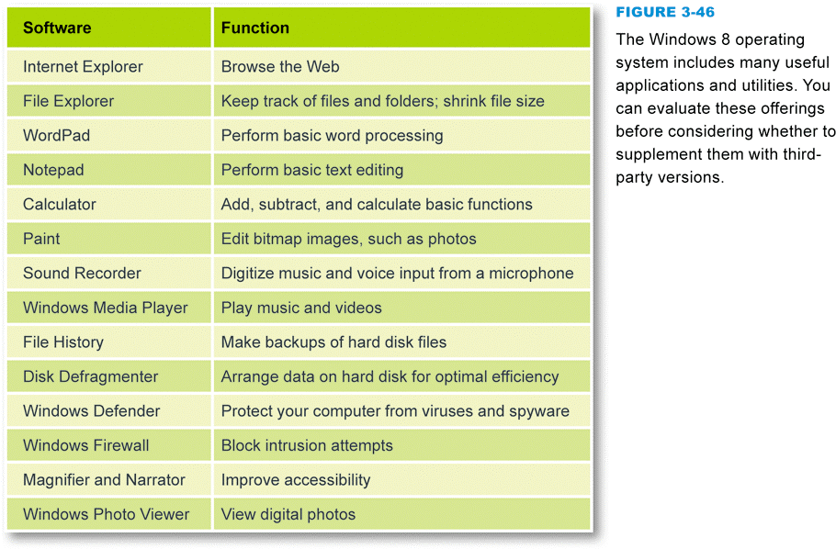
Consumer Basics
Most operating systems include a handful of small applications and a good variety of useful utility software
Notes:
Figure 3-46

Slide 61
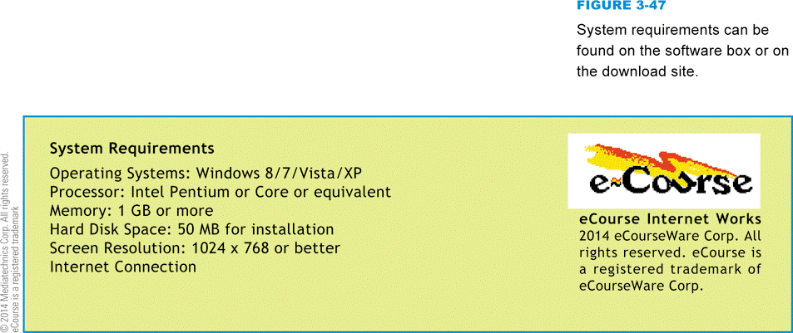
Consumer Basics
System requirements specify the operating system and minimum hardware capacities necessary for a software product to work correctly
Notes:
Figure 3-47

Slide 62
Software Copyrights and Licenses
A copyright is a form of legal protection that grants the author of an original work exclusive rights
Copyright notice
Software licenses, also called license agreements, define the ways in which you may use a computer program
Single-user license
Site license
Multiple-user
Shrink-wrap license

Slide 63
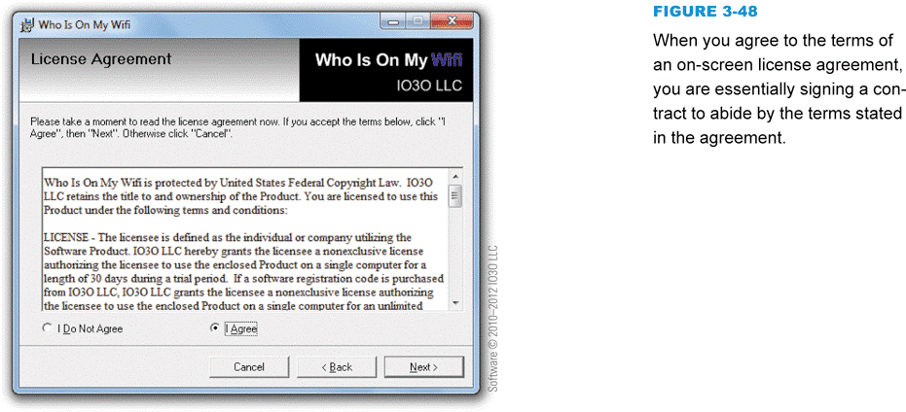
Software Copyrights and Licenses
EULA (End-User License Agreement)
Different types of software licenses
Public domain
Proprietary
Commercial software
Demoware
Shareware
Open source
BSD
GPL
Notes:
Figure 3-48

Slide 64
Software Copyrights and Licenses
Notes:
Figure 3-49 – 3-50

Slide 65
Software Copyrights and Licenses
Freeware is copyrighted software that is available for free
Product activation is a means of protecting software from illegal copying by requiring users to enter a product key or activation code before the software can be used
A hash value is a unique number derived from encoding one or more data sets, such as names, serial numbers, and validation codes

Slide 66
Section E: Security Software
Security Software Basics
Security Suites
Antivirus Modules

Slide 67
Question
032500 Let’s assume that you have antivirus software installed on your computer and it is up to date. You can trust it to do a pretty good job of protecting your computer from viruses and:
A. Bots, worms, Trojans, keyloggers, and rootkits
B. RATs, spoofs, and defective Web apps
C. Operating system security holes
D. Fake e-commerce sites

Slide 68
Security Software Basics
Security software is designed to protect computers from various forms of destructive software and unauthorized intrusions
The terms malicious software and malware refer to any computer program designed to surreptitiously enter a computer, gain unauthorized access to data, or disrupt normal processing operations

Slide 69
Security Software Basics
Computer virus
Computer worm
Mass-mailing worm
Trojan horse
Remote Access Trojan (RAT)
Bot
Spider
Botnet
Spyware

Slide 70
Security Software Basics
Notes:
Figure 3-52

Slide 71
Security Software Basics
Notes:
Figure 3-53

Slide 72
Security Software Basics
The term rootkit refers to software tools used to conceal malware and backdoors that have been installed on a victim’s computer
A virus hoax usually arrives as an email message containing dire warnings about a supposedly new virus on the loose

Slide 73
Security Suites
A security suite integrates several security modules to protect against the most common types of malware, unauthorized access, and spam
A security suite costs less than purchasing standalone security modules

Slide 74
Security Suites
Notes:
Figure 3-55

Slide 75
Antivirus Modules
Antivirus software is a type of utility software that looks for and eradicates viruses, Trojan horses, worms, and bots
A virus signature is a section of program code, such as a unique series of instructions, that can be used to identify a known malicious program, much as a fingerprint is used to identify an individual
Virus signatures and other information that antivirus software uses to identify and eradicate malware is stored in one or more files usually referred to as virus definitions

Slide 76
Antivirus Modules
Most experts recommend that you configure your antivirus software to periodically scan all the files on your computer
If, during the scanning process, your virus protection software identifies a virus, worm, Trojan horse, or bot in a file or attachment, it can try to remove the infection, put the file into quarantine, or simply delete the file
Notes:
Figure 3-57

Slide 77
What Do You Think?
033100 Do you believe that software piracy is a serious issue?
A. Yes B. No C. Not sure
033200 Do you know of any instances of software piracy?
A. Yes B. No C. Not sure
033300 Do you think that most software pirates understand that they are doing something illegal?
A. Yes B. No C. Not sure
033400 Should software publishers try to adjust software pricing for local markets?
A. Yes B. No C. Not sure

Slide 78
Chapter 3 Complete

