Slide 1
Chapter 5 Local Area Networks

Slide 2
Chapter Contents
Section A: Network Building Blocks
Section B: Wired and Wireless Technologies
Section C: Network Setup
Section D: Sharing Files
Section E: Wireless Security

Slide 3
FastPoll True/False Questions Answer A for True and B for False
050100 The networks typically installed by individuals in homes are classified as LANs.
050200 High bandwidth networks, such as cable TV and DSL are referred to as broadband.
050300 When you send an e-mail message over a network, it is chopped up into packets.
050400 The IP address assigned to your computer on the Internet is derived from your computer’s MAC address.
050500 Wired network connections can offer higher speeds than wireless connections.

Slide 4
FastPoll True/False Questions Answer A for True and B for False
050600 The most popular type of wired connection is Ethernet.
050700 Network speeds are measured in megabytes and gigabytes.
050800 Many wireless connections use radio waves to transmit data.
050900 Bluetooth is a wireless technology used for WANs.

Slide 5
FastPoll True/False Questions Answer A for True and B for False
051000 A wireless infrastructure network uses a centralized broadcasting device, such as a wireless access point or router.
051100 Wireless connections are less secure than wired networks.
051200 A hub can be used to extend a network by adding additional wired devices.
051300 To configure a router, you usually have to start a browser and enter the router’s IP address.

Slide 6
FastPoll True/False Questions Answer A for True and B for False
051400 A homegroup is a temporary network of handheld computers.
051500 Public key encryption uses a public key to encrypt messages, but a private key is required to decrypt messages.

Slide 7
Section A: Network Building Blocks
Network Classifications
LAN Advantages and Disadvantages
Network Devices
Network Links
Communications Protocols

Slide 8
Question
052100 Networks come in many sizes and use many different technologies, yet they all need to communicate with each other. What is the key to network intercommunication?
A. Circuit switching
B. Network protocols
C. Network topology
D. Peer-to-peer technology

Slide 9
Network Classifications
Personal Area Network (PAN) – interconnection of personal digital devices or consumer electronics
Local Area Network (LAN) – connects computers in a limited geographical area
Metropolitan Area Network (MAN) – public high-speed network with range of about 50 miles
Wide Area Network (WAN) – covers a large geographical area and typically consists of several smaller networks

Slide 10
LAN Advantages and Disadvantages
LANs enable people to work together
Sharing networked software can reduce costs
Sharing data on a LAN can increase productivity
Sharing networked hardware can reduce costs
Sharing an Internet connection can be cost-effective and convenient
Sharing networked hardware can provide access to a wide range of services and specialized peripheral devices

Slide 11
LAN Advantages and Disadvantages
One disadvantage of LANs is that when a network malfunctions, all the resources you’re accustomed to accessing are unavailable until the network is repaired
LANs are vulnerable to unauthorized access
LANs are vulnerable to malicious code

Slide 12
Network Devices
Each connection point on a network is a node
To connect to a LAN, a computer requires network circuitry, sometimes referred to as a network interface card (NIC)
A networked peripheral, or network-enabled peripheral, is any device that contains network circuitry to directly connect to a network
A storage device that directly connects to a network is called network attached storage (NAS)
A network device, or network appliance, is any electronic device that broadcasts network data, boosts signals, or routes data to its destination

Slide 13
Network Devices
Notes:
Figure 5-5

Slide 14
Network Links
A communications channel, or link, is a physical path or frequency for signal transmissions
Bandwidth is the transmission capacity of a communications channel
Broadband
Narrowband
Notes:
Figure 5-6

Slide 15
Communications Protocols
Rules for efficiently transmitting data from one network node to another:
Divide messages into packets
Affix addresses to packets
Initiate transmission
Regulate flow of data
Check for transmission errors
Acknowledge receipt of transmitted data

Slide 16
Communications Protocols
A packet is a “parcel” of data that is sent across a computer network
Circuit-switching technology vs. packet switching technology
Notes:
Figure 5-10

Slide 17
Communications Protocols
Every packet that travels over a network includes the address of its destination device
A MAC address is a unique number assigned to a network interface card when it is manufactured
An IP address is a series of numbers used to identify a network device
IP addresses can be obtained through DHCP

Slide 18
Section B: Wired and Wireless Technologies
Wired Basics
Ethernet
Wireless Basics
Bluetooth
Wi-Fi

Slide 19
Question
052200 Suppose your friend has a home office and usually does most work on a desktop computer. Your friend also has a smartphone and tablet computer that could benefit from Internet access. What kind of network would you recommend?
A. A network that has a wireless router that provides wireless and wired connections as well as Internet access
B. A cloud network that can be accessed from a bridge device
C. A file server
D. A 100 gigabit Ethernet network

Slide 20
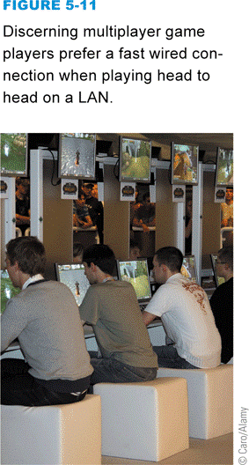
Wired Basics
A wired network uses cables to connect network devices
Wired networks are fast, secure, and simple to configure
Wired connections are more secure than their wireless counterparts
Devices tethered to cables have limited mobility
Notes:
Figure 5-11

Slide 21
Ethernet
Ethernet is a wired network technology that is defined by IEEE 802.3 standards
Simultaneously broadcasts data packets to all network devices
Vary in speed from 10Mbps to 100Gbps
Notes:
Figure 5-13

Slide 22
Ethernet
Notes:
Figure 5-14 – 5-15

Slide 23
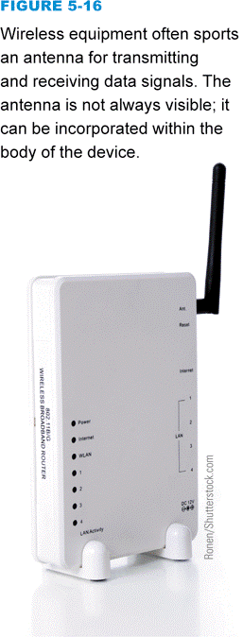
Wireless Basics
Wireless network technology transports data from one device to another without cables or wires
RF signals
Transceiver
Microwaves
Infrared light
Slower than wired networks
Security concerns
Notes:
Figure 5-16

Slide 24
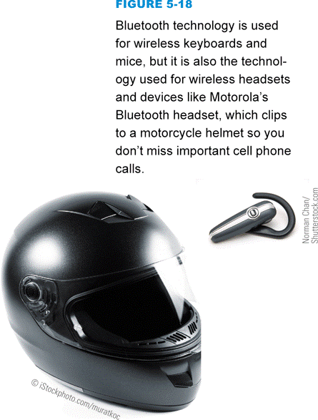
Bluetooth
Bluetooth is a short-range, wireless network technology designed to make its own connections between two devices
Notes:
Figures 5-18 and 5-19

Slide 25
Wi-Fi
Wi-Fi refers to a set of wireless networking technologies defined by IEEE 802.11 standards
Wireless ad-hoc protocol
Wireless infrastructure protocol

Slide 26
Wi-Fi
Notes:
Figure 5-20 – 5-21

Slide 27
Section C: Network Setup
Setup Overview
Router Installation
Router Configuration
Internet Connection
Device Connection

Slide 28
Question
052300 When you’re setting up a wireless network, you see an option asking if you want to broadcast the network SSID. You should:
A. Change the default SSID and broadcast it.
B. Turn SSID broadcasting off so that hackers don’t know the network’s encryption key.
C. Make sure SSID is broadcasting so that your network is protected by strong encryption.
D. Activate SSID broadcasting or else the network devices won’t be able to send data to the router.

Slide 29
Setup Overview
Plug in the router
Connect the router to a computer
Configure the router
Access the router setup utility
Create a new router password

Slide 30
Setup Overview
Enter an SSID for the network
Activate WEP, WPA, or PSK and create an encryption key
Connect an Internet access device
Set up the wireless workstations

Slide 31
Router Installation
Look for a Wireless-N router that includes a Gigabit Ethernet switch
Wired and wireless connections
Make sure the number of Ethernet ports is sufficient for the number of wired devices that you intend to connect
Notes:
Figure 5-25

Slide 32
Router Installation
Notes:
Figure 5-26

Slide 33
Router Configuration
Before using your network, you should adjust the router’s configuration settings to make sure your network is secure
Stored in router’s EEPROM
You must connect a computer to the router
You can use your computer’s browser to access the router configuration utility

Slide 34
Router Configuration
Notes:
Figure 5-29

Slide 35
Router Configuration
An SSID (service set identifier) is the name of a wireless network
Use the router configuration software to change the default SSID
Notes:
Figure 5-30

Slide 36
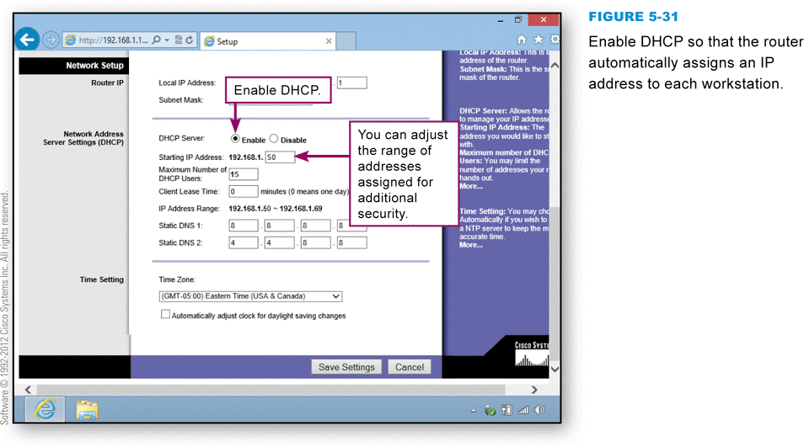
Router Configuration
Each workstation requires a unique address for sending and receiving data
Notes:
Figure 5-31

Slide 37
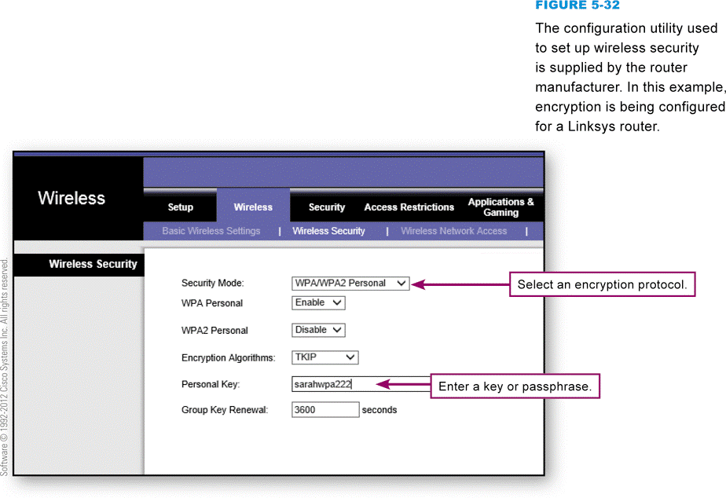
Router Configuration
Wireless encryption scrambles the data transmitted between wireless devices and then unscrambles the data only on devices that have a valid encryption key
WEP
WPA
PSK
Notes:
Figure 5-32

Slide 38
Internet Connection
Your Internet service provider supplies a device called a modem that is designed to carry data to and from the Internet
This device typically has a standard Ethernet port that can be connected to a router
Most routers supply a WAN port designed for an Internet connection
Plug a standard network cable into the router’s WAN port and connect the other end of the cable into the Internet modem

Slide 39
Internet Connection
Notes:
Figure 5-33 – 5-34

Slide 40
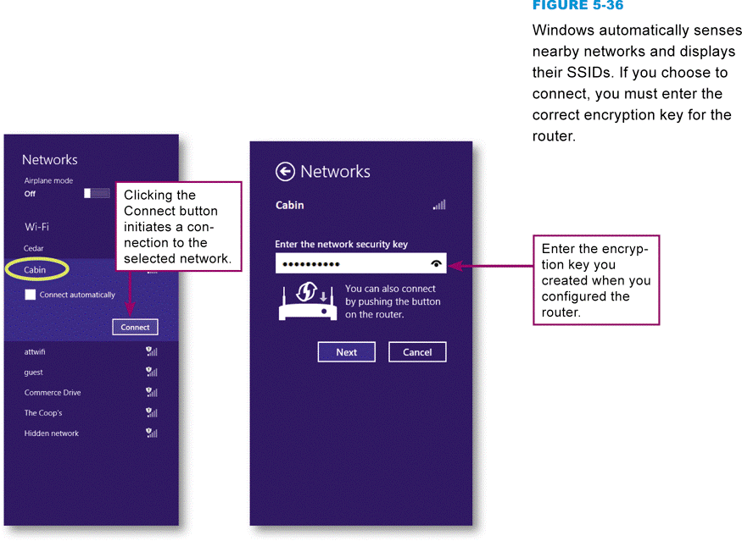
Device Connection
Simply turn on any Windows computer with wireless capability and make sure that it is in range of your router
Notes:
Figure 5-36

Slide 41
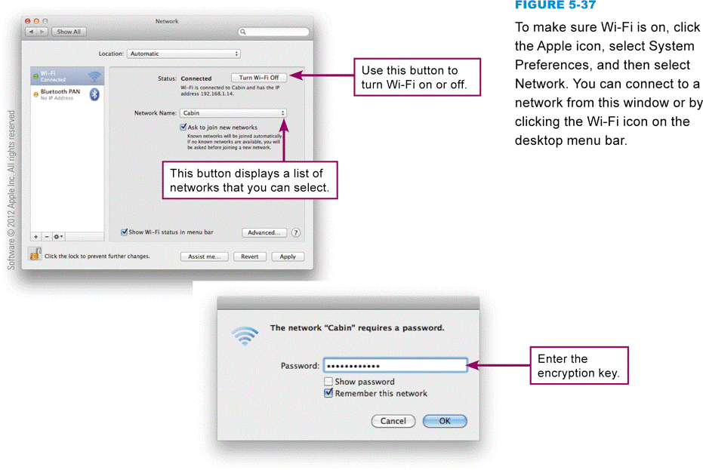
Device Connection
Macs automatically sense available networks and give you the option of connecting to them
Notes:
Figure 5-37

Slide 42
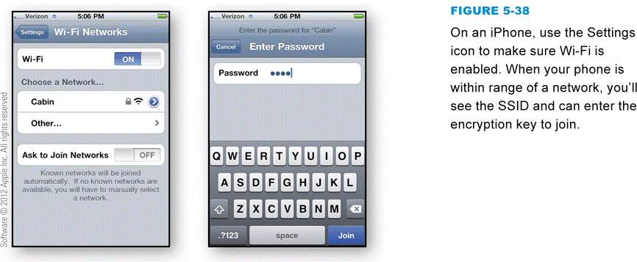
Device Connection
Any device that has Wi-Fi capability should be able to connect to your network
Notes:
Figure 5-38

Slide 43
Device Connection
Notes:
Figure 5-39

Slide 44
Section D: Sharing Files
File Sharing Basics
Accessing Shared Files
Sharing Your Files
File Servers
Network Troubleshooting

Slide 45
Question
052400 There are many ways to share files among the computers on a network. Which one of the following is the LEAST secure way to share files?
A. Use a file server.
B. Activate file sharing for the root directory of all the computers in the network.
C. Designate specific folders on your computer as shared.
D. Put files you want to share in the Public folder.

Slide 46
File Sharing Basics
File sharing allows files containing documents, photos, music, and other data to be accessed from computers other than the one on which they are stored
Once your network gives you access to other computers on the network, you can view a list of files stored there

Slide 47
Accessing Shared Files
To see a list of devices on your network, you can use your operating system’s file management utility
Network discovery is a setting that affects whether your computer can see other computers on a network, and whether your computer can be seen by others

Slide 48
Accessing Shared Files
Notes:
Figure 5-40

Slide 49
Sharing Your Files
Notes:
Figure 5-41

Slide 50
Sharing Your Files
When you activate file sharing, files in Public folders can be accessed by other network users
You also can make specific files shareable
If you want the convenience of sharing files, limit what you share and who you share it with:
Assign permissions to files
Limit sharing to specific people
Remove sharing from files you no longer want to share
Use a homegroup if your network is composed of Windows computers
A homegroup is a collection of trusted Windows computers that automatically share files and folders

Slide 51
Sharing Your Files
Notes:
Figure 5-42

Slide 52
Sharing Your Files

Slide 53
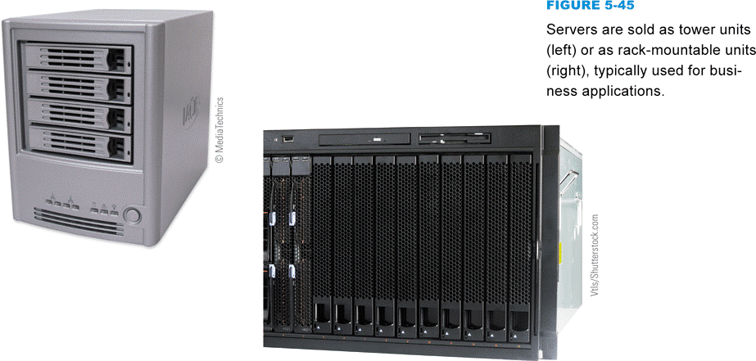
File Servers
A file server is a computer whose primary purpose is to be a repository for files that can be accessed by network workstations
Notes:
Figure 5-45

Slide 54
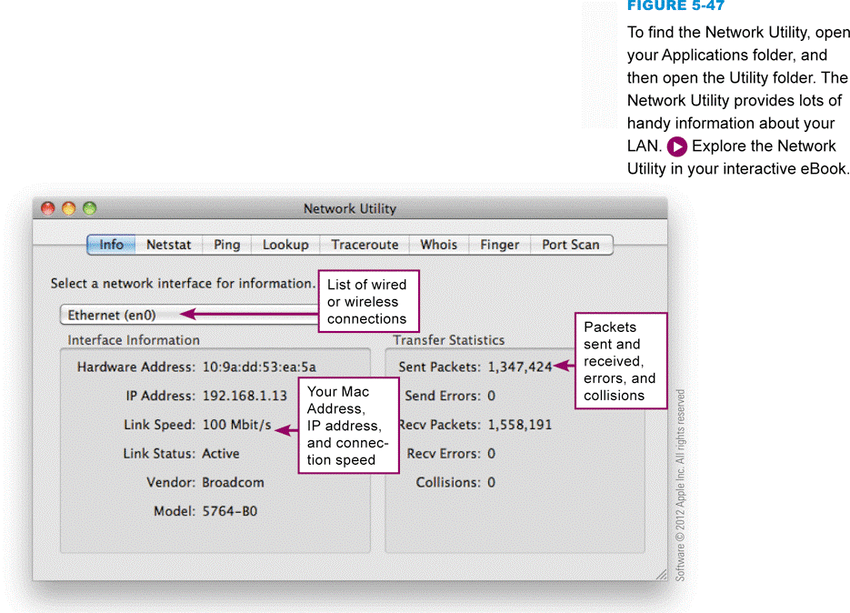
Network Troubleshooting
Network problems can stem from a variety of sources
Cables
Security
Interference
Settings
Switches
Signal strength
Network devices
Notes:
Figure 5-47

Slide 55
Section E: Wireless Security
Wi-Fi Security
Encryption

Slide 56
Question
052500 How can you tell if someone is hacking your network?
A. Assign an IP address to each network device.
B. Scan your router for viruses that might have been left by hackers.
C. Set up your router software to maintain a log of network activity.
D. Disable the SSID.

Slide 57
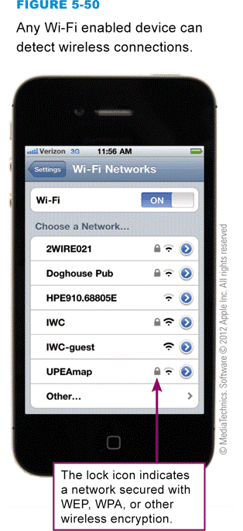
Wi-Fi Security
Networks with wired or wireless connections are vulnerable to a variety of threats
Wireless signals are broadcast through the air; and like the signals from a radio station, they can be picked up by any device equipped with a receiver tuned to the right frequency
Notes:
Figure 5-50

Slide 58
Wi-Fi Security
Notes:
Figure 5-51

Slide 59
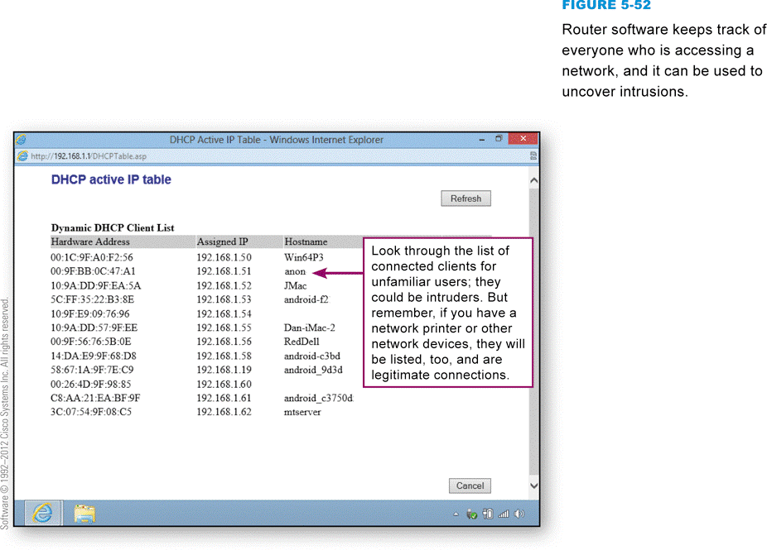
Wi-Fi Security
Your network router maintains a list of clients that are accessing your network using wired or wireless connections
Notes:
Figure 5-52

Slide 60
Encryption
Encryption transforms a message so that its contents are hidden from unauthorized readers
Plaintext has not yet been encrypted
An encrypted message is referred to as ciphertext
Decryption is the opposite of encryption
Cryptographic algorithm
Cryptographic key

Slide 61
Encryption
Weak vs. strong encryption
AES (Advanced Encryption Standard)
Encryption methods can be broken by the use of expensive, specialized, code-breaking computers

Slide 62
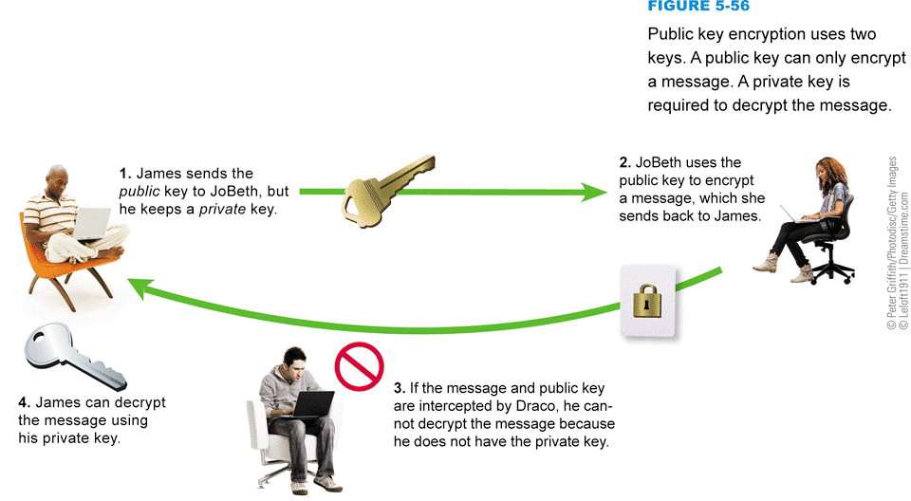
Encryption
Public key encryption (PKE) eliminates key-distribution problem, by using one key to encrypt a message and another key to decrypt the message
Notes:
Figure 5-56

Slide 63
Encryption
When personal computer users want to encrypt e-mail or other documents, they turn to public key encryption software such as PGP (Pretty Good Privacy), GnuPG, or AxCrypt
Notes:
Figure 5-57

Slide 64
What Do You Think?
053100 Do you worry about behavioral tracking based on your Internet use?
A. Yes B. No C. Not sure
053200 Do you have a device that can track your physical location?
A. Yes B. No C. Not sure
053300 Do you support efforts to institute Do Not Track?
A. Yes B. No C. Not sure

Slide 65
Chapter 5 Complete

