Slide 1
Chapter 6 The Internet

Slide 2
Chapter Contents
Section A: Internet Technology
Section B: Fixed Internet Access
Section C: Portable and Mobile Internet Access
Section D: Internet Services
Section E: Internet Security

Slide 3
FastPoll True/False Questions Answer A for True and B for False
060100 NAPs such as Earthlink and Comcast offer dial-up and cable Internet access.
060200 TCP, IP, UDP, HTTP, and FTP are examples of protocols used on the Internet.
060300 204.127.129.100 is an example of an IP address.
060400 .edu and .ca are examples of top-level domains.
060500 The Domain Name System stores IP addresses and their equivalent domain names.

Slide 4
FastPoll True/False Questions Answer A for True and B for False
060600 Utilities such as Ping and Traceroute help you gauge the speed of your Internet connection.
060700 10 Mbps is a narrowband Internet connection.
060800 Dial-up and DSL provide Internet access using telephone cabling.
060900 Cable Internet service is fast because it has lots of latency.
061000 WiMAX uses low-earth orbiting satellites to transport data to the Internet.

Slide 5
FastPoll True/False Questions Answer A for True and B for False
061100 Public Wi-Fi hotspots provide mobile Internet access.
061200 With mobile broadband, you can use a cell phone to set up a mobile Internet connection.
061300 Cloud computing uses distributed grid computing to predict weather.
061400 VoIP uses circuit switching technology to send analog data.
061500 SETI@home is a popular Wi-Fi service provider for non-business consumers.

Slide 6
FastPoll True/False Questions Answer A for True and B for False
061600 FTP makes it easy to anonymously use a search engine.
061700 BitTorrent is an Internet security protocol.
061800 Consumers should use port probes to encrypt data sent over the Internet.
061900 NATs are used by hackers to intercept packets traveling over the Internet.

Slide 7
Section A: Internet Technology
Background
Internet Infrastructure
Internet Protocols, Addresses, and Domains
Connection Speed

Slide 8
Question
062100 One reason the Internet works is because TCP/IP offers a global addressing standard. Which one of the following is accurate in the context of Internet addresses?
A. IPv6 addresses such as 204.127.129.1 are dedicated to educational institutions.
B. Top level domains like EarthLink or AOL are adequate for most consumers.
C. A domain name, such as amazon.com corresponds to a unique IP address.
D. A dynamic IP address begins with www.

Slide 9
Background
The ARPANET, created in 1969, connected computers at UCLA, Stanford Research Institute, University of Utah, and University of California at Santa Barbara
Early Internet pioneers used primitive command-line user interfaces to send e-mail, transfer files, and run scientific calculations on Internet supercomputers
With an estimated 500 million nodes and more than 2 billion users, the Internet is huge
Notes:
Figure 6-1

Slide 10
Internet Infrastructure
The Internet is not owned or operated by any single corporation or government
The Internet backbone is a network of high-capacity routers and fiber-optic communications links that provides the main routes for data traffic across the Internet
Backbone links and routers are maintained by network service providers (NSPs)
NSP equipment and links are tied together by network access points (NAPs)
An Internet service provider (ISP) is a company that offers Internet access to individuals, businesses, and smaller ISPs

Slide 11
Internet Infrastructure
Notes:
Figures 6-2 and 6-3

Slide 12
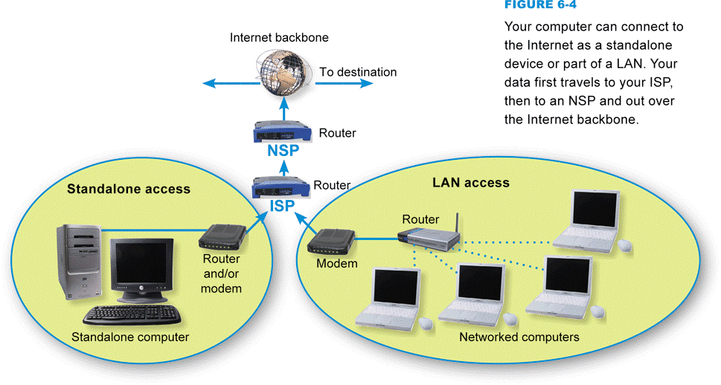
Internet Infrastructure
To communicate with an ISP, your computer uses some type of communications device, such as a modem
Notes:
Figure 6-4

Slide 13
Internet Protocols, Addresses, and Domains
A computer can have a permanently assigned static IP address or a temporarily assigned dynamic IP address
Notes:
Figure 6-6

Slide 14
Internet Protocols, Addresses, and Domains
A domain name is a key component of Web page addresses and e-mail addresses
Notes:
Figure 6-7

Slide 15
Internet Protocols, Addresses, and Domains
Notes:
Figure 6-9

Slide 16
Internet Protocols, Addresses, and Domains
Notes:
Figure 6-11

Slide 17
Connection Speed
Data travels over the Internet at an incredible speed
The elapsed time for data to make a round trip from point A to point B and back to point A is referred to as latency
Ping
Traceroute
Upstream vs. downstream speed

Slide 18
Connection Speed
Notes:
Figure 6-12

Slide 19
Connection Speed
When upstream speeds differ from downstream speeds, you have an asymmetric Internet connection
When upstream and downstream speeds are the same, you have a symmetric Internet connection
Internet connection options
Fixed Internet access
Portable Internet access
Mobile Internet access

Slide 20
Connection Speed
Notes:
Figure 6-13

Slide 21
Section B: Fixed Internet Access
Dial-up Connections
DSL
Cable Internet Service
Satellite Internet Service
Fixed Wireless Service
Fixed Internet Connection Roundup

Slide 22
Question
062200 Although ISPs offer Internet access though dial-up, satellites, WiMAX, and DSL, cable Internet is currently the preferred access method. Why?
A. It is the least expensive.
B. It is the fastest and most widely available technology.
C. It has the highest latency.
D. It was the original Internet access technology.

Slide 23
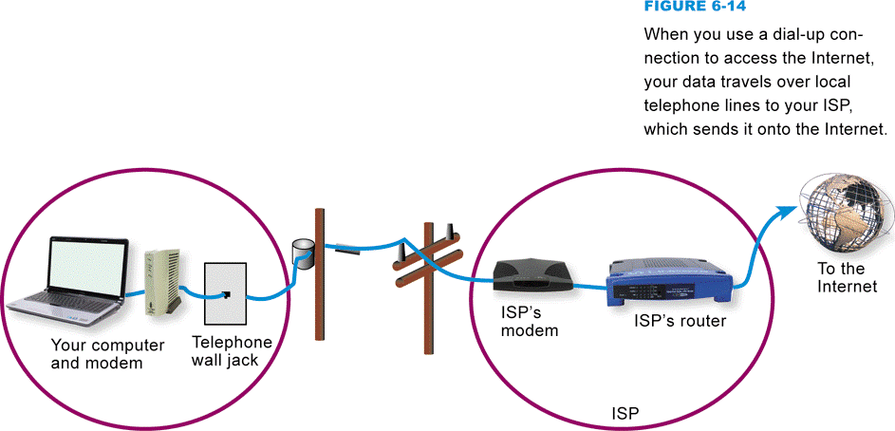
Dial-up Connections
A dial-up connection is a fixed Internet connection that uses a voiceband modem and telephone lines to transport data between your computer and your ISP
Notes:
Figure 6-14

Slide 24
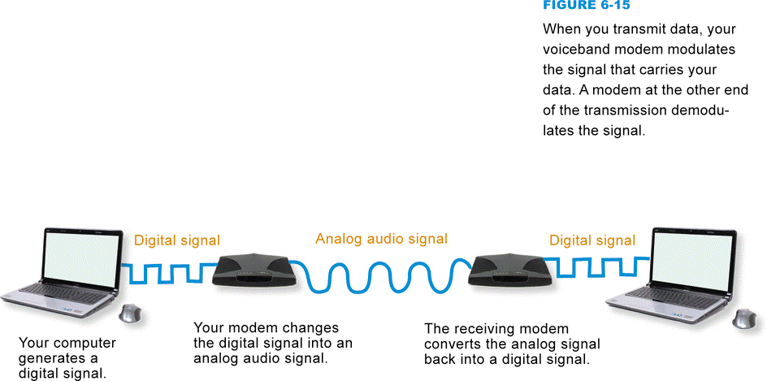
Dial-up Connections
A voiceband modem converts the signals from your computer into audible analog signals that can travel over telephone lines
Modem speed is measured in bits per second
Notes:
Figure 6-15

Slide 25
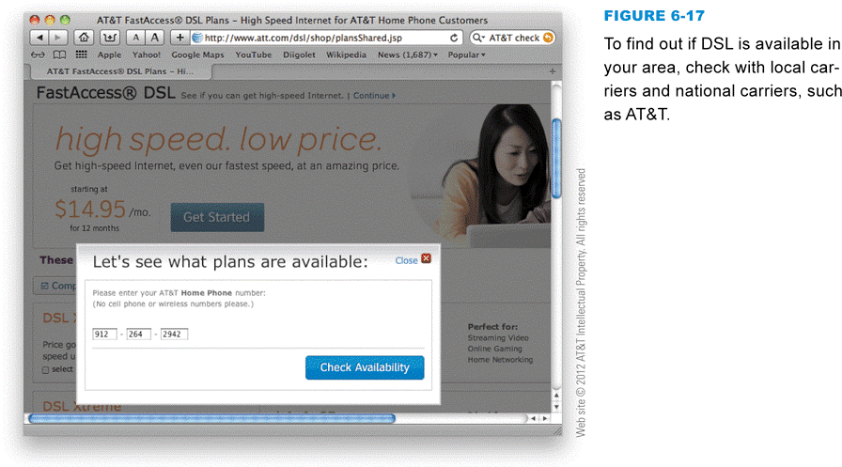
DSL
DSL is a high-speed, digital, always-on Internet access technology that runs over standard phone lines
The speed of a DSL connection varies
DSL modem
DSL filter
Notes:
Figure 6-17

Slide 26
DSL
Notes:
Figures 6-16 and 6-18

Slide 27
Cable Internet Service
Cable Internet service is a means of distributing always-on broadband Internet access over the same infrastructure that offers cable television service
Notes:
Figure 6-20

Slide 28
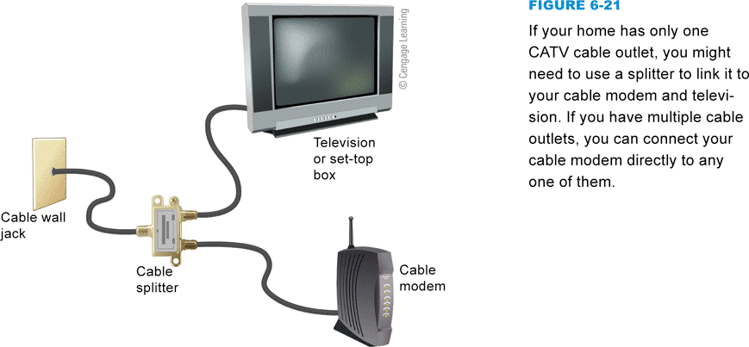
Cable Internet Service
Cable modems convert your computer’s signal into one that can travel over the CATV network
Always-on connection
DOCSIS-compliant cable modems
Notes:
Figure 6-21

Slide 29
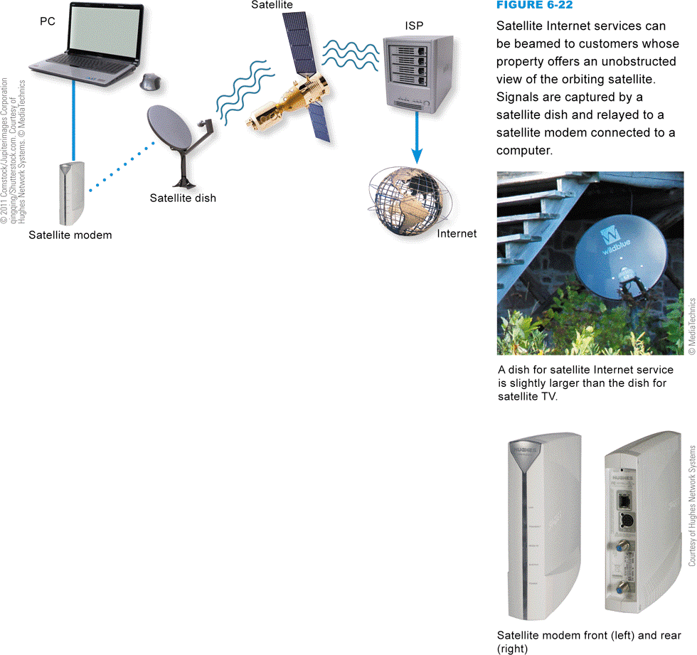
Satellite Internet Service
Satellite Internet service distributes always-on, high-speed asymmetric Internet access by broadcasting signals to and from a personal satellite dish
A satellite modem is a device that modulates data signals from a computer into a frequency band that can be carried to the satellite dish where it is converted to another frequency, amplified, and transmitted
Notes:
Figure 6-22

Slide 30
Fixed Wireless Service
Fixed wireless Internet service broadcasts signals in order to offer Internet access to large areas
WiMAX
A WiMAX system transmits data to and from WiMAX antennas mounted on towers
Under ideal conditions, WiMAX can transmit data at 70 Mbps
Notes:
Figure 6-23

Slide 31
Fixed Internet Connection Roundup
Notes:
Figure 6-24

Slide 32
Section C: Portable and Mobile Internet Access
Internet to Go
Wi-Fi Hotspots
Portable and Mobile WiMAX
Portable Satellite Service
Cellular Data Service

Slide 33
Question
062300 What is the difference between portable Internet access and mobile Internet access?
A. With portable access you cannot work online while moving very far.
B. Mobile access is less expensive than portable access.
C. Portable access requires cables, whereas mobile access does not.
D. Portable access requires a cell phone, whereas mobile access requires a notebook computer.

Slide 34
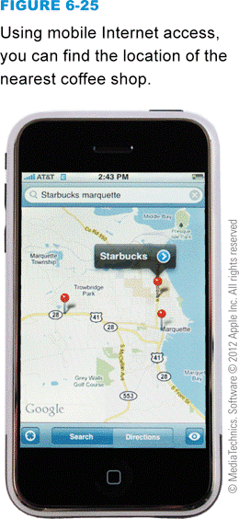
Internet To Go
Portable Internet access can be defined as the ability to easily move your Internet service from one location to another
Mobile Internet access offers a continuous Internet connection as you are walking or riding in a bus, car, train, or plane
Notes:
Figure 6-25

Slide 35
Wi-Fi Hotspots
A Wi-Fi hotspot is an area in which the public can access a Wi-Fi network that offers Internet service
Wi-Fi does not typically provide acceptable mobile Internet access because you can only remain connected within range of the network’s hotspot
Notes:
Figure 6-27

Slide 36
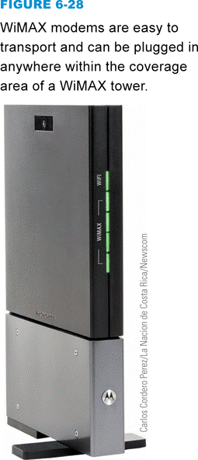
Portable and Mobile WiMAX
WiMAX can be used as a portable technology because Internet access is available to subscribers anywhere within a tower’s coverage area
You use the same Internet service provider whether you are at home or on the road
Mobile WiMAX
Notes:
Figure 6-28

Slide 37
Portable Satellite Service
Notes:
Figure 6-29

Slide 38
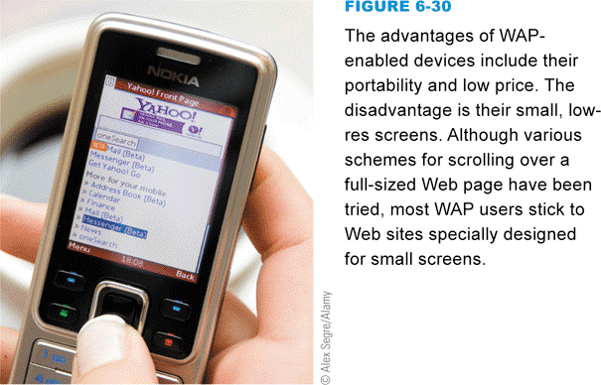
Cellular Data Services
Using cell phone technology to access the Internet offers mobility that is not yet possible with most of today’s wired or wireless computer network technologies
Notes:
Figure 6-30

Slide 39
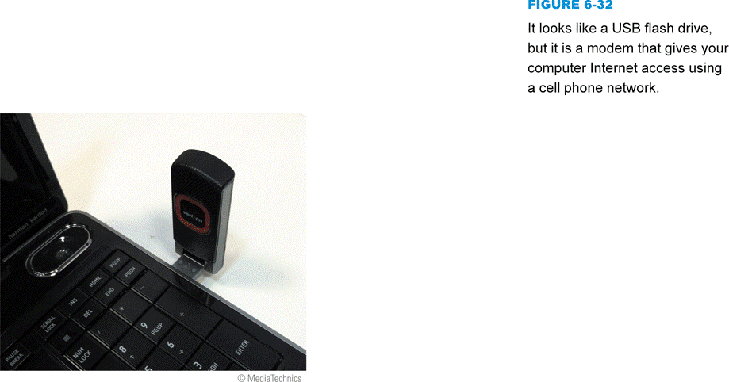
Cellular Data Services
4G technology provides peak data rates of 100 Mbps while a device is in motion, or 1 Gbps rates when a device is stationary
WAP (Wireless Application Protocol) is a communications protocol that provides Internet access from handheld devices
For the real Internet, cellular service providers offer data services, sometimes referred to as mobile broadband
Most cellular service providers offer wireless modems for broadband data access
Notes:
Figures 6-31 – 6-32

Slide 40
Cellular Data Services
MiFi is a brand name for a compact, mobile, wireless router offered by Novatel Wireless
Some cell phones, such as the Droids and iPhones, can act as a Wi-Fi hotspot by becoming the router for a wireless network
Tethering
Notes:
Figure 6-35

Slide 41
Section D: Internet Services
Cloud Computing
Real-Time Messaging
Voice over IP
Forums, Wikis, Blogs, and Tweets
Grid Computing
FTP
File Sharing Networks

Slide 42
Question
062400 On the Internet, application protocols provide consumers with many useful services. Which one of the following correctly describes an Internet-based application protocol?
A. Chat and Instant messaging use Internet VoIP protocol.
B. Files can be shared over the Internet using FTP or BitTorrent protocols.
C. Cloud protocols such as SETI control distributed processing grids.
D. P2P is used to encrypt personal information to keep it private.

Slide 43
Cloud Computing
Cloud computing depends on a grid of servers, storage devices, and protocols that offer Internet-accessible computing services ranging from consumer-level media sharing to office productivity applications and complex corporate data processing
Software as a Service (SaaS)

Slide 44
Cloud Computing
Notes:
Figure 6-37

Slide 45
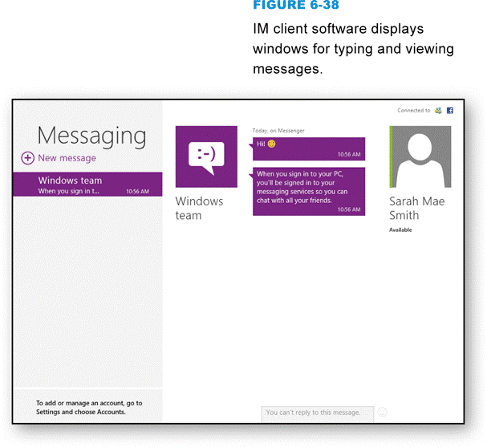
Real-Time Messaging
A networked-based, real-time messaging system allows people to exchange short messages while they are online
Instant messaging (IM)
Chat
Notes:
Figure 6-38

Slide 46
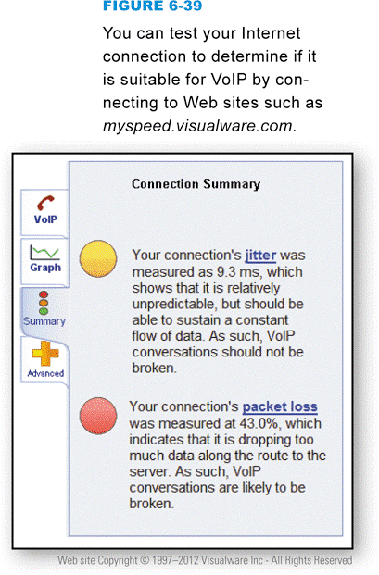
Voice over IP
VoIP (Voice over Internet Protocol) or Voice over IP, is a technology in which a broadband Internet connection is used to place telephone calls instead of the regular phone system
If you want to set up free computer-to-computer VoIP, you and the people you communicate with can download and install freeware or open source VoIP clients
Notes:
Figure 6-39

Slide 47
Forums, Wikis, Blogs, and Tweets
An Internet forum is a Web-based online discussion site where participants post comments to discussion threads
A wiki allows participants to modify posted material
A blog (short for Web log) is similar to an online diary; it is maintained by one person and contains a series of entries on one or more topics
A tweet is a short message of 140 characters or less, posted to the Twitter Web site

Slide 48
Forums, Wikis, Blogs, and Tweets
Notes:
Figure 6-41

Slide 49
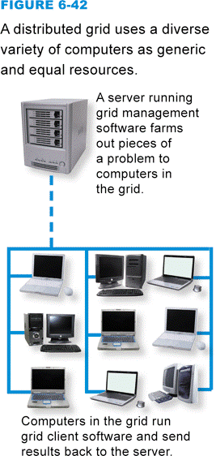
Grid Computing
A grid computing system is a network of computers harnessed together to perform processing tasks
SETI@home project
Notes:
Figure 6-42

Slide 50
FTP
Notes:
Figure 6-44

Slide 51
FTP
Notes:
Figure 6-45

Slide 52
File Sharing Networks
File sharing, sometimes called P2P file sharing, allows users to obtain files from other users located anywhere on the Internet
BitTorrent is a file sharing protocol that distributes the role of file server across a collection of dispersed computers
Notes:
Figure 6-46

Slide 53
Section E: Internet Security
Intrusion Attempts
Securing Ports
NAT
Virtual Private Networks

Slide 54
Question
062500 Protecting your computer from Internet-based intrusions is an important aspect of computer security. Which one of the following is NOT a useful security technique?
A. Setting up NAT on a router
B. Activating firewall software
C. Checking the status of software ports
D. Activating your computer’s file sharing options

Slide 55
Intrusion Attempts
An intrusion is any access to data or programs by hackers, criminals, or other unauthorized persons
A communications port is the doorway that allows a computer to exchange data with other devices
A port probe (or port scan) uses automated software to locate computers that have open ports and are vulnerable to unauthorized access

Slide 56
Intrusion Attempts
Notes:
Figure 6-48

Slide 57
Securing Ports
Notes:
Figure 6-49

Slide 58
Securing Ports
A firewall is software or hardware designed to filter out suspicious packets attempting to enter or leave a computer
Sharing printers or files on a LAN or the Internet requires open ports so the data can be transferred to and from your computer
Notes:
Figure 6-51

Slide 59
NAT
Routers are intended to work within LANs to monitor and direct packets being transported from one device to another
A routable IP address is one that can be accessed by packets on the Internet
A private IP address is a non-routable IP address that can be used within a LAN, but not for Internet data transport

Slide 60
NAT
Notes:
Figure 6-52

Slide 61
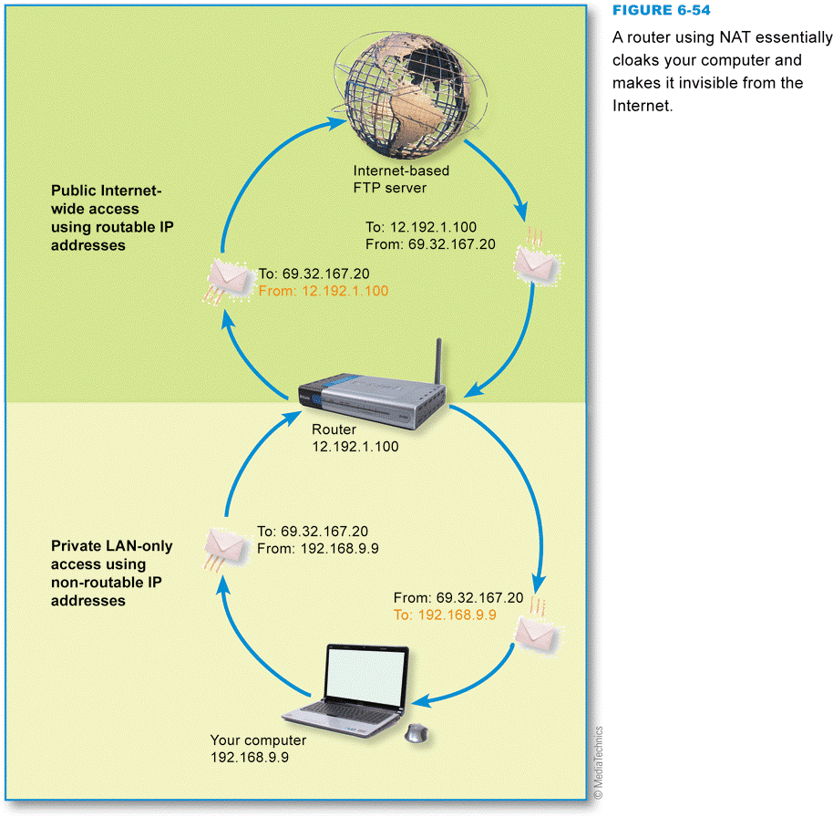
NAT
Network address translation (NAT) is the process your router uses to keep track of packets and their corresponding private or public IP addresses
Notes:
Figure 6-54

Slide 62
Virtual Private Networks
It is possible to secure remote connections by setting up virtual private network (VPN) access to a remote access server in the corporate office
Access to a VPN is usually by invitation only; employees who need to access a VPN are given the necessary instructions, addresses, and passwords to make connections

Slide 63
Virtual Private Networks
Notes:
Figure 6-55

Slide 64
What Do You Think?
063100 Does it seem plausible that your government would attempt to shut down the Internet to curtail civil unrest?
A. Yes B. No C. Not sure
063200 Do you use the Internet to access political news?
A. Yes B. No C. Not sure
063300 Should your government have legal power to shut down the Internet?
A. Yes B. No C. Not sure
063400 Have you experienced an Internet outage that lasted longer than 24 hours?
A. Yes B. No C. Not sure

Slide 65
Chapter 6 Complete

