Slide 1
Chapter 8 Digital Media

Slide 2
Chapter Contents
Section A: Digital Sound
Section B: Bitmap Graphics
Section C: Vector and 3-D Graphics
Section D: Digital Video
Section E: Digital Rights Management

Slide 3
FastPoll True/False Questions Answer A for True and B for False
080100 Audio is digitized by dividing a sound wave into samples and storing the numbers that represent the height of each sample.
080200 A higher sampling rate produces higher quality sound than lower sampling rates.
080300 MP3 and BMP are examples of two popular digital music formats.
080400 WAV is a format for synthesized sound.
080500 Software with speech synthesis capabilities can convert your spoken dictation into a digital document.

Slide 4
FastPoll True/False Questions Answer A for True and B for False
080600 RAW, PNG, TIFF, and JPEG formats store graphics as bitmaps.
080700 Bitmap graphics are resolution dependent.
080800 When bitmaps are enlarged, pixel interpolation can result in the graphic becoming pixilated.
080900 Images that have been compressed with lossless compression can be reconstituted to their original appearance without any data loss.
081000 Vector graphics maintain their quality better than bitmaps when resized.

Slide 5
FastPoll True/False Questions Answer A for True and B for False
081100 The technique for adding light and shadows to a 3-D graphic is called rasterizing.
081200 Videos with a low compression rate tend to be small, low-quality files.
081300 A video with a bitrate of 340 will have less compression and better quality than a video with a bitrate of 150.
081400 Recording a television show to watch at a later time is an example of digital rights management.
081500 Digital watermarks, HDCP, and broadcast flags rely on compliant hardware devices to protect content.

Slide 6
Section A: Digital Sound
Digital Audio Basics
Digital Audio File Formats
MIDI Music
Speech Recognition and Synthesis

Slide 7
Question
082100 Computers can work with digital audio as well as MIDI music. Which is the more prevalent format and why?
A. Digital audio is more prevalent because it is used for music downloads.
B. Digital audio is more prevalent because it is a far more compact format than MIDI.
C. MIDI is more prevalent because browsers can play it without a plug-in.
D. MIDI is more prevalent because the Americans with Disabilities Act mandates its use for reading computer screens.

Slide 8
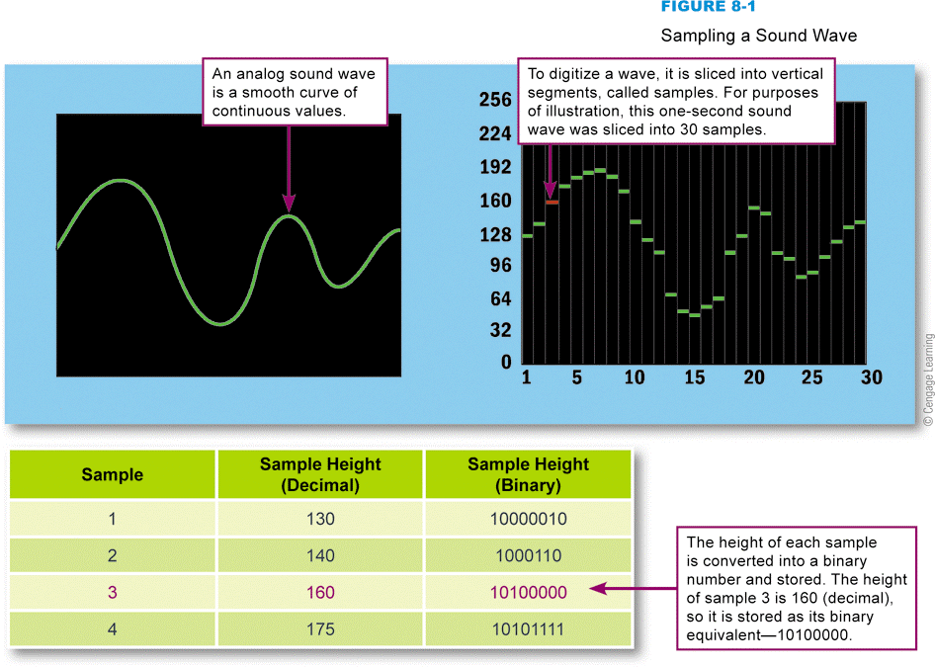
Digital Audio Basics
Sampling a sound wave
Notes:
Figure 8-1

Slide 9
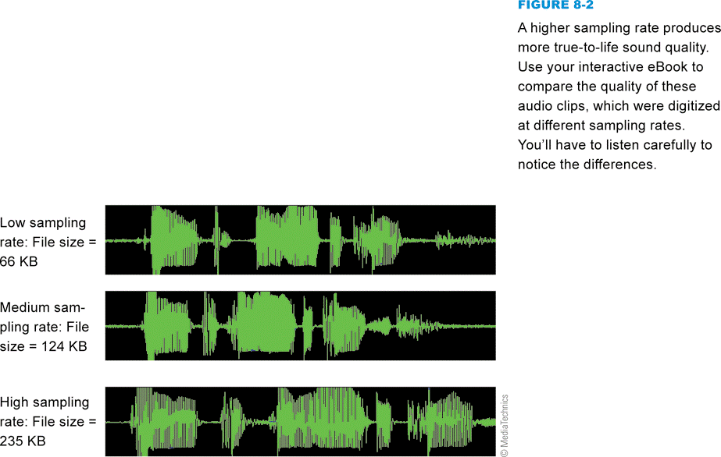
Digital Audio Basics
Sampling rate refers to number of times per second that a sound is measured during the recording process
Notes:
Figure 8-2

Slide 10
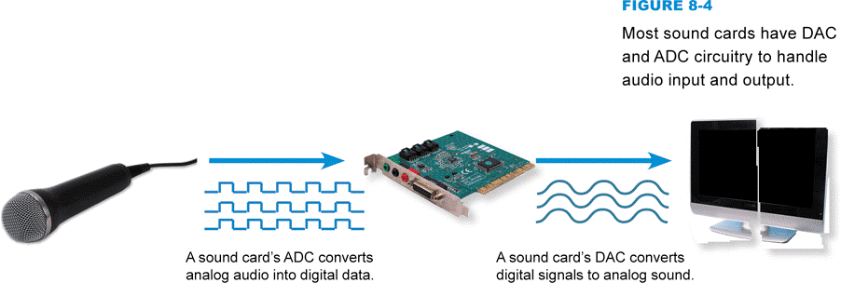
Digital Audio Basics
A sound card is a device that contains a variety of input and output jacks, plus audio-processing circuitry
Integrated audio
Digital-to-analog converter
Analog-to-digital converter
Notes:
Figure 8-4

Slide 11
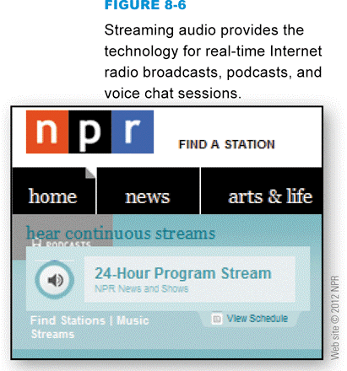
Digital Audio File Formats
The most popular digital audio formats include AAC, MP3, Ogg Vorbis, WAV, and WMA
Audio or media player software allows you to play digital audio files
You can embed digital audio files into a Web page using the HTML5 <audio> tag
Streaming audio plays as its file is downloaded
Notes:
Figure 8-6

Slide 12
MIDI Music
MIDI (Musical Instrument Digital Interface) specifies a standard way to store music data for synthesizers, electronic MIDI instruments, and computers
MIDI music is encoded as a MIDI sequence
MIDI-capable sound cards contain a wavetable
Set of prerecorded musical instrument sounds
Does not produce high-quality vocals
Does not have full resonance of real sound

Slide 13
MIDI Music
Notes:
Figure 8-8

Slide 14
MIDI Music
Notes:
Figure 8-9

Slide 15
Speech Recognition and Synthesis
Speech synthesis is the process by which machines produce sound resembling spoken words
Text-to-speech software
Speech recognition refers to the ability of a machine to understand spoken words
Speech recognition software

Slide 16
Speech Recognition and Synthesis
Notes:
Figure 8-10

Slide 17
Section B: Bitmap Graphics
Bitmap Basics
Scanners and Cameras
Image Resolution
Color Depth and Palettes
Image Compression

Slide 18
Question
082200 Bitmap files are typically quite large and so it is handy to compress them before FTPing or e-mailing them. However, some bitmap files don’t seem to shrink very much when you use a compression utility, such as WinZip. Why?
A. The files are already as small as they can get.
B. Compression utilities use lossless compression, which won’t allow you shrink the size of a file without losing data.
C. Some types of files are already in compressed format, which can’t be further compressed.
D. The files have a small color palette that doesn’t allow compression.

Slide 19
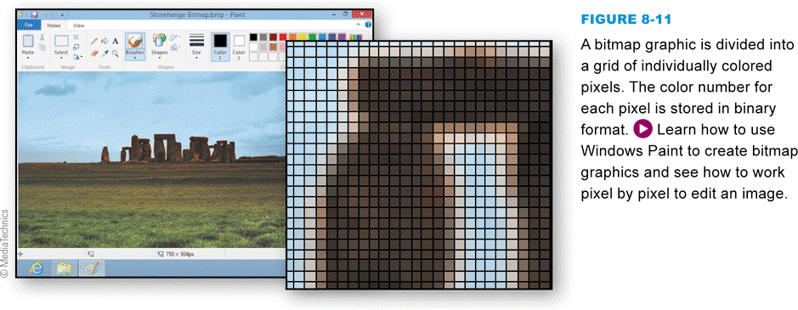
Bitmap Basics
Composed of a grid of dots
Color of each dot is stored as a binary number
Notes:
Figure 8-11

Slide 20
Bitmap Basics
Notes:
Figure 8-12

Slide 21
Scanners and Cameras
Notes:
Figure 8-13

Slide 22
Scanners and Cameras
Notes:
Figure 8-14

Slide 23
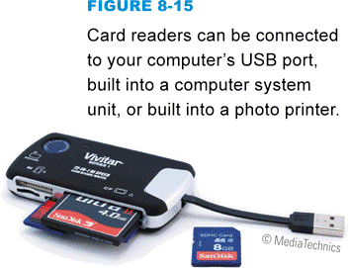
Scanners and Cameras
Digital cameras use storage medium
Solid state memory cards
Transfer images using:
Card readers
Direct cable transfer
Infrared port
Media transfer
Docking station
E-mail
Notes:
Figure 8-15

Slide 24
Scanners and Cameras
Graphics software is used to modify or edit bitmap graphics
Modify individual pixels to:
Wipe out red eye
Erase rabbit ears
Retouch photographs
Require a bit of storage space
Notes:
Figure 8-16

Slide 25
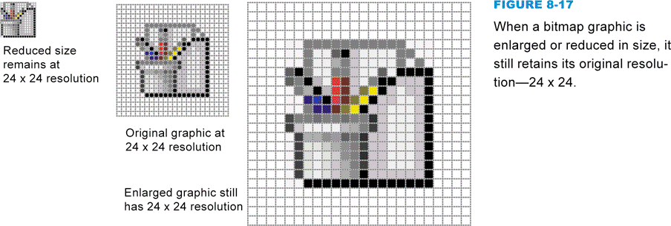
Image Resolution
Expressed as the number of horizontal and vertical pixels
Higher resolutions contain more data (larger file size) and are higher quality
Bitmaps do not have a fixed physical size
Notes:
Figure 8-17

Slide 26
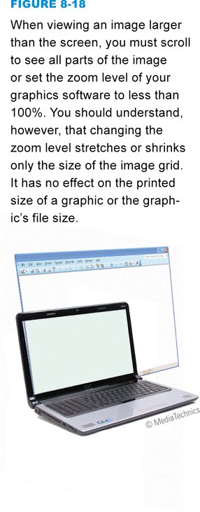
Image Resolution
File size of bitmaps can be reduced by cropping
Bitmaps are resolution dependent
Notes:
Figure 8-18

Slide 27
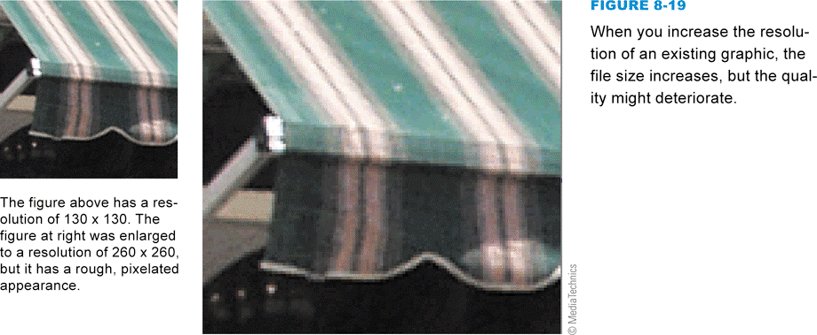
Image Resolution
When you increase the resolution of a bitmap, pixel interpolation may occur
Some images may appear pixilated
Notes:
Figure 8-19

Slide 28
Color Depth and Palettes
Color depth is the number of colors available for use in an image
Monochrome bitmap
Increasing color depth increases file size
Color palettes are used to control color depth
Grayscale palette
System palette
Web palette

Slide 29
Color Depth and Palettes
Notes:
Figures 8-20

Slide 30
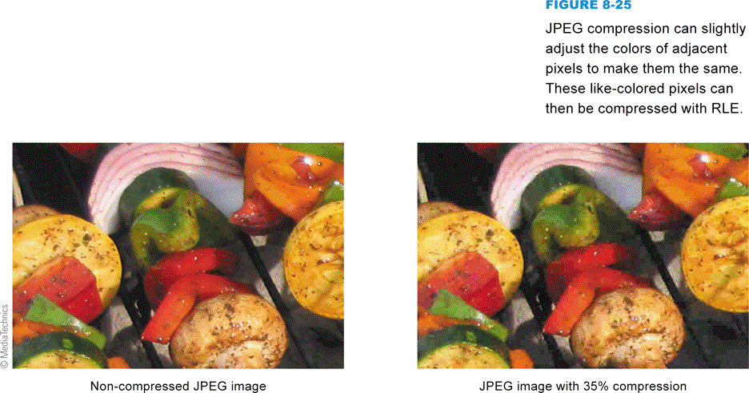
Image Compression
Any technique that recodes data in an image file so that it contains fewer bits
Lossless compression
Lossy compression
Run-length encoding
File compression utility
Notes:
Figure 8-25

Slide 31
Image Compression
Notes:
Figure 8-27

Slide 32
Image Compression
Notes:
Figure 8-28

Slide 33
Section C: Vector and 3-D Graphics
Vector Graphics Basics
Vector-to-Bitmap Conversion
Vector Graphics on the Web
3-D Graphics

Slide 34
Question
082300 2-D vectors don’t look very realistic, whereas 3-D vectors tend to look very realistic. Why is this the case?
A. 3-D images use a more realistic color palette than 2-D images.
B. 3-D images constructed using a wireframe can be rendered with surface textures and lighted with realistic ray tracing.
C. 3-D images can be enlarged or shrunk more realistically than 2-D images.
D. 3-D images can be animated, whereas 2-D images cannot.

Slide 35
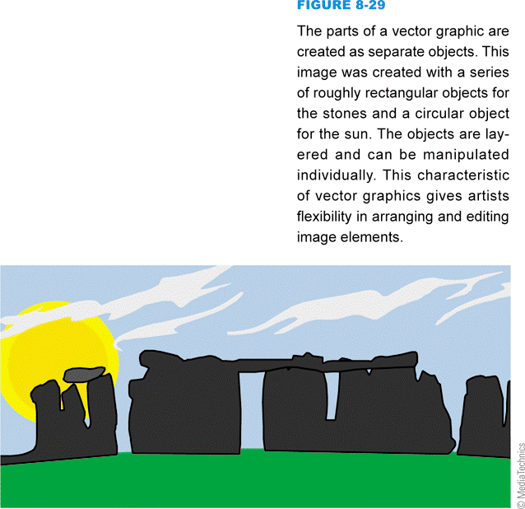
Vector Graphic Basics
Contain instructions for re-creating a picture
Notes:
Figure 8-29

Slide 36
Vector Graphic Basics
Vector graphics resize better than bitmaps
Vector graphics usually require less storage space than bitmaps
Vector graphics are not usually as realistic as bitmap images
It is easier to edit an object in a vector graphic than an object in a bitmap graphic

Slide 37
Vector Graphic Basics
Notes:
Figure 8-32

Slide 38
Vector-to-Bitmap Conversion
Rasterization superimposes a grid over a vector image and determines the color for each pixel
Tracing software locates the edges of objects in a bitmap image and converts the resulting shapes into vector graphic objects
Notes:
Figure 8-34

Slide 39
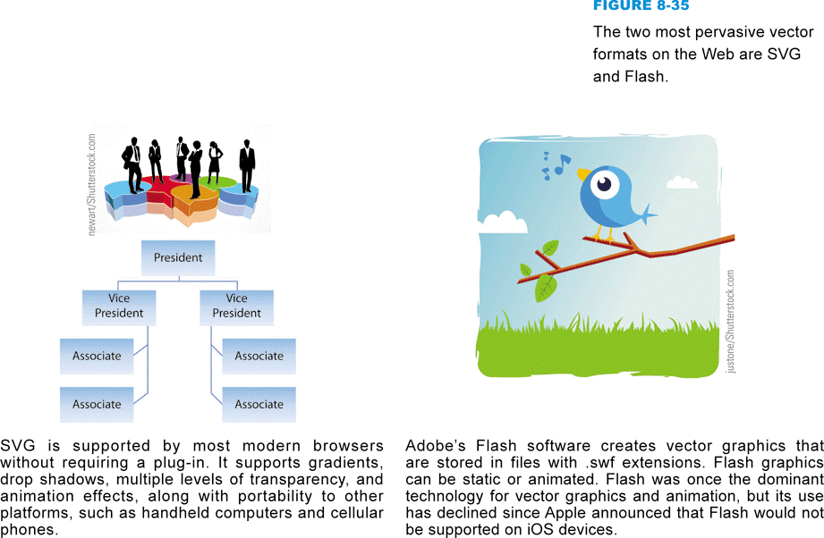
Vector Graphics on the Web
SVG (Scalable Vector Graphics) and Flash are vector graphic formats for the Web
Advantages of using vector graphics
Consistent quality
Searchable
Compact file size
Notes:
Figure 8-35

Slide 40
3-D Graphics
Stored as a set of instructions
Contain locations and lengths of lines forming a wireframe
Rendering covers a wireframe with surface color and texture
Ray tracing adds light and shadows to a 3-D image

Slide 41
3-D Graphics
Notes:
Figure 8-36

Slide 42
3-D Graphics
Notes:
Figure 8-38

Slide 43
Section D: Digital Video
Digital Video Basics
Producing Video Footage
Video Transfer
Video Editing
Video Output
Web Video
DVD-Video

Slide 44
Question
082400 YouTube is popular video site. Which one of the following statements is NOT true about these videos?
A. YouTube supports streaming video.
B. You need the UTube Show browser plug-in to view videos on the YouTube site.
C. YouTube videos have a low compression ratio and a high bitrate.
D. Each YouTube video has a unique URL.

Slide 45
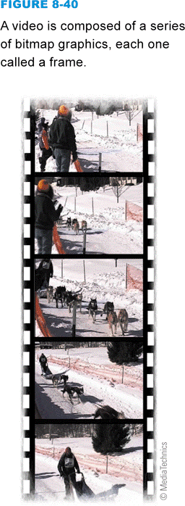
Digital Video Basics
Uses bits to store color and brightness data for each video frame
The color for each pixel is represented by a binary number
Footage for digital videos can be supplied from a digital source, or from an analog source that requires conversion
Notes:
Figure 8-40

Slide 46
Digital Video Basics
Notes:
Figure 8-41

Slide 47
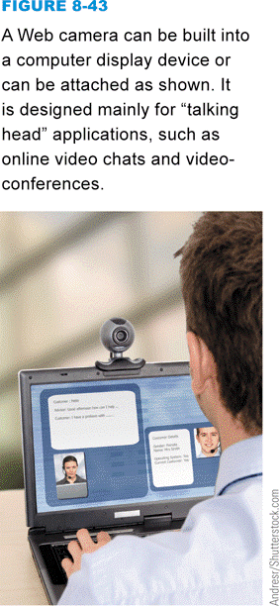
Producing Video Footage
Use digital or analog video camera to shoot video footage
Digital video cameras store footage as a series of bits
Analog video cameras store video signals as a continuous track of magnetic patterns
Another option for shooting video footage is a small, inexpensive webcam that is built in over the screen of a notebook computer or attached as a peripheral device
Notes:
Figure 8-43

Slide 48
Producing Video Footage
Notes:
Figure 8-44

Slide 49
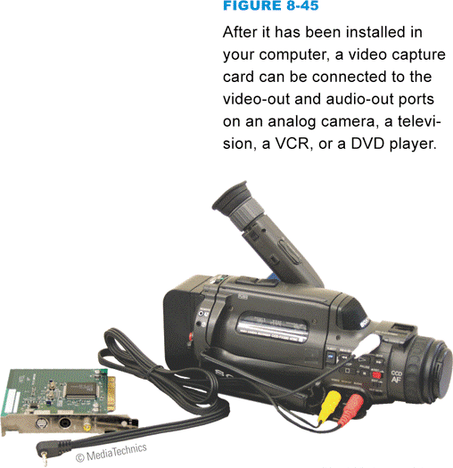
Video Transfer
The basic method for transferring digital video footage to your computer’s hard disk for editing is to remove the SD card from the camera and insert it into a card reader on your computer
Video capture converts analog video signals into digital format
Notes:
Figure 8-45

Slide 50
Video Editing
Linear editing
Requires at least two VCRs
Nonlinear editing
Requires a computer hard disk and video editing software
Notes:
Figure 8-46

Slide 51
Video Output
Notes:
Figure 8-47

Slide 52
Video Output
Notes:
Figure 8-49

Slide 53
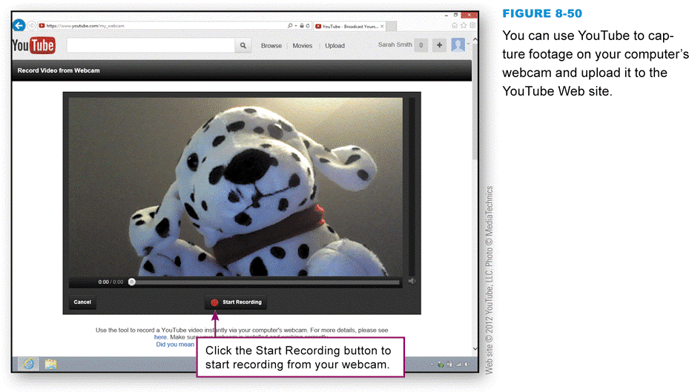
Web Video
A video for a Web page is stored on a Web server in a file
Streaming video
YouTube is a video-sharing Web site that encourages members to upload, view, and rate video clips
Notes:
Figure 8-50

Slide 54
Web Video
On today’s Web, most videos are embedded in Web pages so that they appear to play in place
The HTML5 <video> tag supports several video formats, but it does not designate a common video format for all HTML5-compliant browsers
Several ways to reuse & share Web videos
Video sharing sites
E-mailing videos

Slide 55
Web Video
Notes:
Figure 8-51

Slide 56
DVD-Video
Incorporate digital videos onto DVDs with interactive menus
DVD authoring software
Notes:
Figure 8-52

Slide 57
DVD-Video
With advance planning, menus are easy to create
Output video in DVD-Video format
A DVD image is a prototype of your DVD
Stored on your computer’s hard disk
Thoroughly test DVD on your computer before you burn it
Recordable vs. rewritable DVDs

Slide 58
Section E: Digital Rights Management
Content Basics
DRM Technologies
Music DRM
Movie DRM
Ebook DRM
Enforcement

Slide 59
Question
082500 Digital rights management is an important aspect of protecting digital music and movies from illegal distribution. Opponents believe that:
A. Digital rights management is too hard to break.
B. Digital rights management has not been effective for preventing large-scale piracy.
C. Digital right management for movies is effective, but it is not effective for music.
D. Digital rights management should apply to CDs and DVDs, but not to downloads.

Slide 60
Content Basics
Media content (or simply content) includes television shows, movies, music, and books.
Digital content is a term used for movies and other content that is stored digitally
Consumers expect to be able to manipulate media content so that they can use it on multiple devices at a convenient time and place
Time shifting
Place shifting
Format shifting

Slide 61
Content Basics
Notes:
Figure 8-54

Slide 62
DRM Technologies
Digital rights management (DRM) is a collection of techniques used by copyright holders to limit access to and use of digital content
Apple’s FairPlay
Microsoft’s Windows Media DRM
Authentication is a very simple form of digital rights management that allows content to be accessed only by authorized individuals
A digital watermark is a pattern of bits, inserted at various places in an image or a content stream, that can be used to track, identify, verify, and control content use

Slide 63
Music DRM
Between 2000 and 2005, the recording industry produced copy protected CDs that did not play correctly on computers or when copied
Ripping tracks from these CDs is difficult, but not impossible
It is easier to protect streamed content than downloaded content

Slide 64
Movie DRM
CSS (Content Scramble System) is a digital rights management technology designed to encrypt and control the use of content stored on DVDs
The primary DRM technology for Blu-ray discs is AACS (Advanced Access Content System)

Slide 65
Movie DRM
Notes:
Figure 8-60

Slide 66
Movie DRM
Movie downloads tend to have more rigorous DRM protection than music downloads
Streaming movie DRM technologies
Encryption
HDCP
HDCP (High-bandwidth Digital Content Protection) is a hardware-based DRM technology that requires compliant devices for content playback

Slide 67
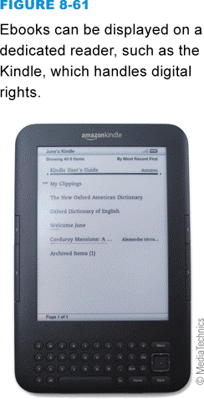
Ebook DRM
Early DRM efforts for ebooks tied books to dedicated ebook readers
In response to consumer demand, ebook distributors expanded the platforms on which digital books can be read
Notes:
Figure 8-61

Slide 68
Enforcement
When using digital content, make sure you know the rules
The copyright owner is entitled to recover monetary damages resulting from infringement, and any profits made from illegal sales of the work
Copyright holders periodically crack down on infringers

Slide 69
What Do You Think?
083100 Have you had trouble using software, music CDs, or movie DVDs because of copy protection?
A. Yes B. No C. Not sure
083200 In your opinion, do sites like the iTunes Music Store provide consumers with enough flexibility for copying files and creating playlists?
A. Yes B. No C. Not sure
083300 Do you think digital rights management technologies are justified because of the high rate of piracy?
A. Yes B. No C. Not sure

Slide 70
Chapter 8 Complete

