Slide 1
Chapter 9 The Computer Industry: History, Careers, and Ethics

Slide 2
Chapter Contents
Section A: Computer History
Section B: The Computer and IT Industries
Section C: Careers for Computer Professionals
Section D: Professional Ethics
Section E: Work Area Safety and Ergonomics

Slide 3
FastPoll True/False Questions Answer A for True and B for False
090100 Charles Babbage invented the first digital circuits.
090200 The ABC, Harvard Mark I, COLOSSUS, and ENIAC can be classified as computer prototypes.
090300 UNIVAC was one of the first personal computers.
090400 Transistors were an important technology in radios and second-generation computers.
090500 Integrated circuits were a key technology in third-generation computers.
090600 The dot com bubble refers to the period when domain names were added to the Internet.

Slide 4
FastPoll True/False Questions Answer A for True and B for False
090700 VARs are online discount computer dealers.
090800 The Internet is regulated in the U.S. by the FDIC.
090900 Many computer professionals work in IT departments.
091000 The computer industry employs very few contract workers.
091100 The Association for Computing Machinery has identified five major computing disciplines.
091200 In the computer industry, certification works just as well as a 4-year degree.

Slide 5
FastPoll True/False Questions Answer A for True and B for False
091300 A metasearch tool can search more than one online database at a time.
091400 The Digital Millennium Copyright Act was replaced by the USA Patriot Act.
091500 CRTs are safer to use than LCDs.
091600 Carpal Tunnel Syndrome is classified as a sedentary lifestyle risk factor.

Slide 6
Section A: Computer History
Manual Calculators
Mechanical Calculators
Computer Prototypes
Generations of Computers
Personal Computers

Slide 7
Question
092100 If you were around when third-generation computers were invented, you would have been listening to what type of popular music?
A. Grateful Dead
B. Beatles
C. Elvis
D. Aerosmith

Slide 8
Manual Calculators
Devices that assist in the process of numeric calculations, but require the human operator to keep track of the algorithm
Notes:
Figure 9-1

Slide 9
Manual Calculators
Notes:
Figure 9-2

Slide 10
Mechanical Calculators
Implement algorithms autonomously
Schickard’s Calculator
Pascaline
Leibniz Calculator
de Colmar’s Arithmometer
Difference Engine
Analytical Engine
Hollerith Tabulating Machine

Slide 11
Mechanical Calculators
Notes:
Figure 9-3

Slide 12
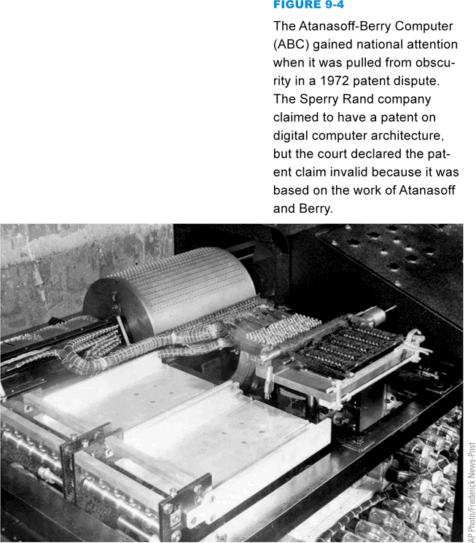
Computer Prototypes
Experimental devices that typically must be further developed and perfected
Atanasoff-Berry Computer (ABC)
Z3
Notes:
Figure 9-4

Slide 13
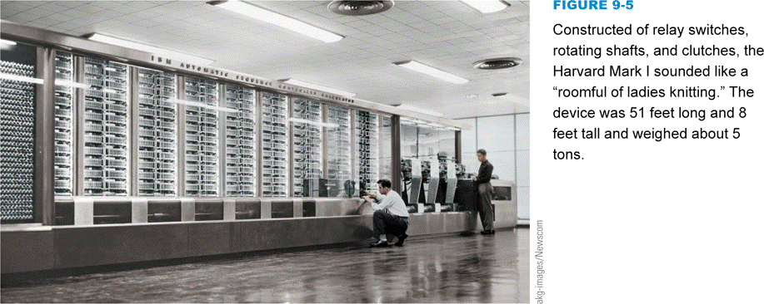
Computer Prototypes
Harvard Mark I (IBM Automatic Sequence Controlled Calculator) COLOSSUS
ENIAC
Notes:
Figure 9-5

Slide 14
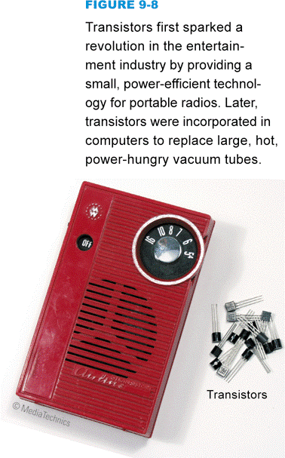
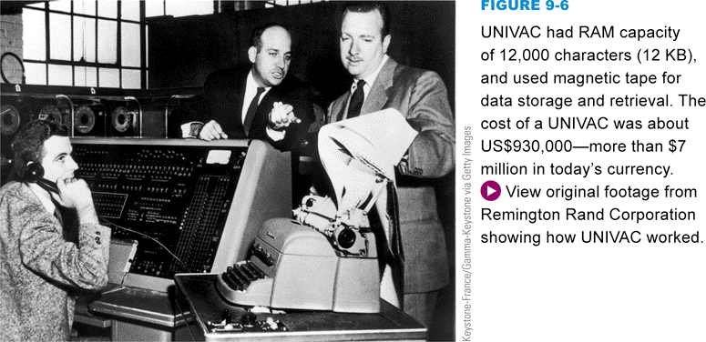
Generations of Computers
UNIVAC is considered the first commercially successful digital computer
First-generation computers
Vacuum tubes
Second-generation computers
Transistors
Notes:
Figures 9-6 and 9-8

Slide 15
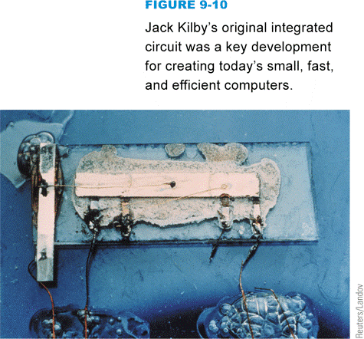
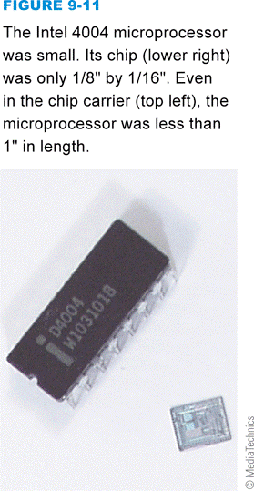
Generations of Computers
Third-generation computers
Integrated circuits
RCA Spectra 70
IBM 360
DEC PDP-8
IBM AS/400
Fourth-generation computers
Microprocessor
Notes:
Figure 9-10, 9-11

Slide 16
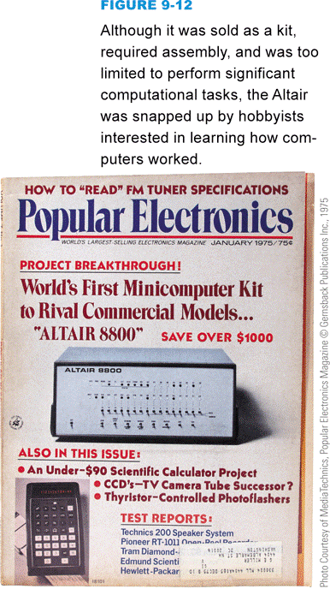
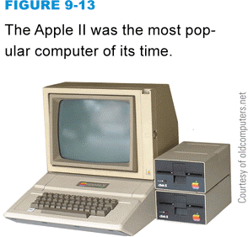
Personal Computers
Mark-8
MITS Altair
Apple I / Apple II
VisiCalc
Notes:
Figure 9-12, 9-13

Slide 17
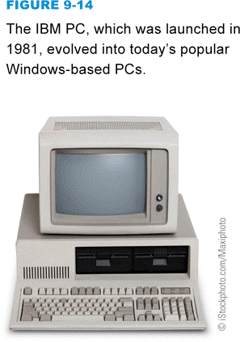
Personal Computers
IBM PC
IBM PC XT
Apple Lisa
Xerox Alto
Apple Macintosh
Notes:
Figure 9-14, 9-15

Slide 18
Section B: The Computer and IT Industries
Industry Overview
Economic Factors
Product Life Cycles
Market Share
Marketing Channels
Industry Regulation

Slide 19
Question
092200 Understanding the computer industry can be useful when purchasing a computer or making investment decisions. Which one of the following is the LEAST important aspect of the computer marketplace for consumers and investors?
A. Market share
B. Market valuation
C. Market channels
D. Market synthesis

Slide 20
Industry Overview
The computer industry encompasses companies that manufacture computers and computer components
The information technology industry refers to companies that develop, produce, sell, or support computers, software, and computer-related products
Equipment manufacturers, chipmakers, software publishers, IT service companies, and computer retailers

Slide 21
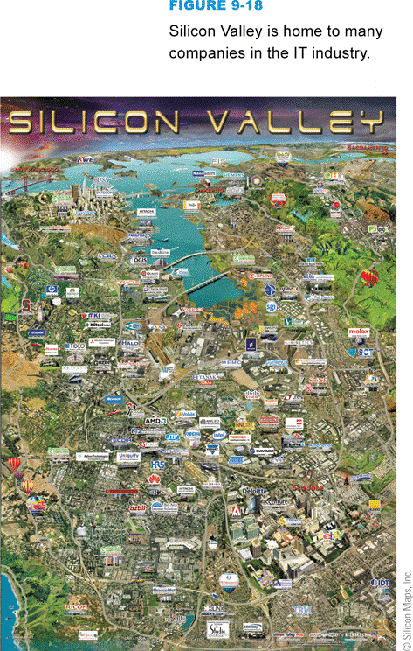
Industry Overview
Dot coms refer to the group of Internet-based companies
Silicon Valley was the birthplace of integrated circuits, microprocessors, and personal computers
Outsourcing vs. offshoring
Notes:
Figure 9-18

Slide 22
Economic Factors
The IT industry is dynamic, prosperous, and economically beneficial
The dot com business failures in 2001 and 2002
Population growth and business globalization contributed to the success of the IT industry

Slide 23
Product Life Cycles
Notes:
Figure 9-22

Slide 24
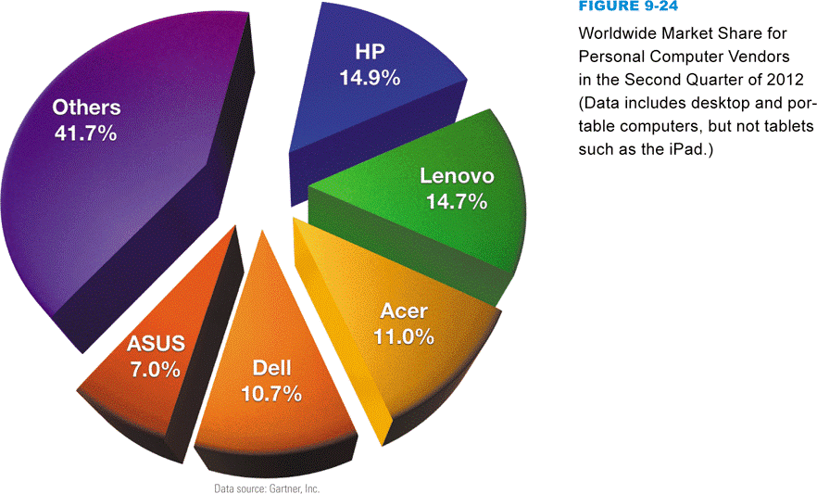
Market Share
Refers to a company’s share, or total percentage, of the total market
Notes:
Figure 9-24

Slide 25
Marketing Channels
Notes:
Figure 9-25

Slide 26
Marketing Channels
Notes:
Figure 9-26

Slide 27
Marketing Channels
Value-added resellers (VARs) combine commercially available products with specialty hardware or software
Consumers can benefit from a variety of channels
Channel conflict occurs when vendors within the channel find other channel vendors pirating their sales

Slide 28
Industry Regulation
Some aspects regulated by government agencies
FCC
FTC
Most IT industry leaders oppose further regulation
Notes:
Figure 9-27

Slide 29
Section C: Careers for Computer Professionals
Jobs and Salaries
Education and Certification
Job Hunting Basics
Resumes and Web Portfolios
Professional Networking Sites
Job Listings

Slide 30
Question
092300 Suppose you’re considering a computing career. Which one of the following would give you the LEAST marketable resume for a career in the computer industry?
A. An associate degree in computer information systems and a network certificate
B. A Ph. D. in information technology with 4 years of work experience at Apple
C. A four-year degree in software engineering
D. An MBA with an emphasis on information systems

Slide 31
Jobs and Salaries
Information Systems department
Chief Information Officer
Systems Analyst
Computer Programmer
Security Specialist
Database Administrator
Network Specialist/Administrator
Computer Operator
Technical Support Specialist
Web site designer

Slide 32
Jobs and Salaries
Outside the IS department
Technical Writer
Computer Salesperson
Quality Assurance Specialist
Computer Engineer
Manufacturing Technician

Slide 33
Jobs and Salaries
Contract workers are typically hired as consultants and are not official employees
Telecommuting allows workers in many industries to work from home and makes financial sense

Slide 34
Education and Certification
Computer engineering
Computer science
Information systems
Information technology
Software engineering
The Peterson’s Web site is a comprehensive resource for educational services
www.petersons.com

Slide 35
Education and Certification
A certification exam is an objective test that verifies your level of knowledge about a particular technology or subject
General computer knowledge
Software applications
Database administration
Networking
Computer hardware
Computer security
Notes:
Figure 9-33

Slide 36
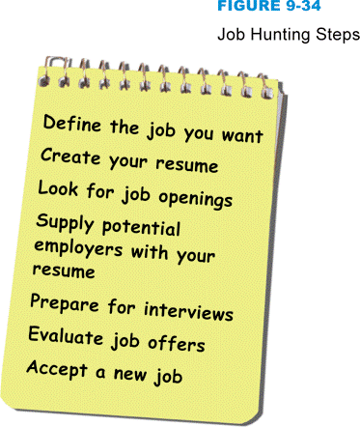
Job Hunting Basics
Job hunting steps
The Internet is a great resource for finding a job
Notes:
Figure 9-34

Slide 37
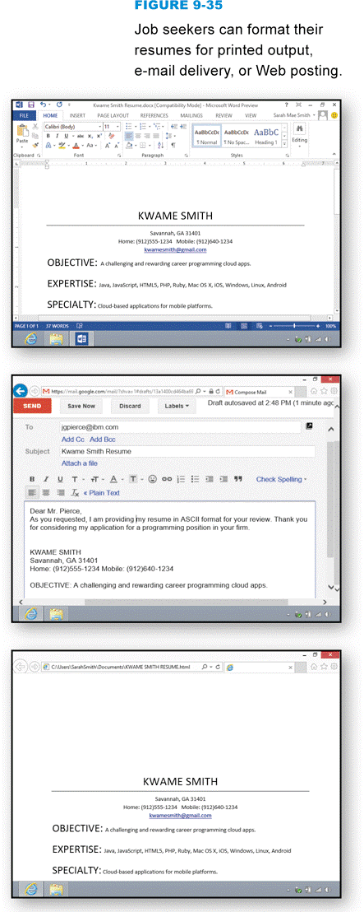
Resumes and Web Portfolios
You can prepare your resume in formats suitable for different computer platforms and delivery methods
Print
E-mail
HTML
Notes:
Figure 9-35

Slide 38
Resumes and Web Portfolios
Notes:
Figure 9-36

Slide 39
Resumes and Web Portfolios
A Web portfolio is a hypertext version of your resume, which might contain links to relevant Web sites
You can post your Web portfolio on your personal Web site

Slide 40
Professional Networking Sites
Every person who has serious career ambitions should have a LinkedIn account
Complete your profile
Request recommendations
Add connections
Join groups

Slide 41
Job Listings
Sources of job listings
Newspaper’s Help Wanted section
School’s career placement office
Local state employment agency
Online newspapers
Company Web sites
Employment services

Slide 42
Job Listings
Notes:
Figure 9-38

Slide 43
Section D: Professional Ethics
Ethics Basics
IT Ethics
Ethical Decision Making
Whistleblowing

Slide 44
Question
092400 It is not unusual to encounter situations at work that call for ethical decisions. Which one of the following is the LEAST useful way to prepare for such situations?
A. Accumulate as much proprietary information as possible that pertains to your company and its employees.
B. Become familiar with relevant laws and legal decisions.
C. Take time to look at one or more codes of ethics.
D. Get to know your employer’s policies.

Slide 45
Ethics Basics
Professional ethics refers to on-the-job choices and actions that reflect a person’s values
Laws try to promote ethical behavior
Laws and ethics are not necessarily the same
Ethical values apply to any career field
Ethical decisions can vary from one field to another

Slide 46
IT Ethics
Situations that require computer professionals to make ethical decisions often involve
Software copyrights
Privacy
Conflict of interest
Use of work computers
Software quality
Hacking
Social responsibility
Notes:
Figure 9-42

Slide 47
IT Ethics
Confidentiality is the obligation not to disclose willingly any information that should be kept private
Applies to individuals and organizations
Proprietary information
It is never good practice to use facilities at work for personal activities

Slide 48
IT Ethics
Computer professionals have to keep up with the latest threats from viruses and intrusion attempts
Hacking
Computer professionals should consider the repercussions of shortened software test cycles
Software developers should consider whether they will be responsible for how their software is used

Slide 49
Ethical Decision Making
Talk to people whose judgment you respect
Consider what the most ethical person you know would decide to do
Think about what you would do if your actions were made public
Look at the problem from the opposite perspective
Consult a code of professional ethics

Slide 50
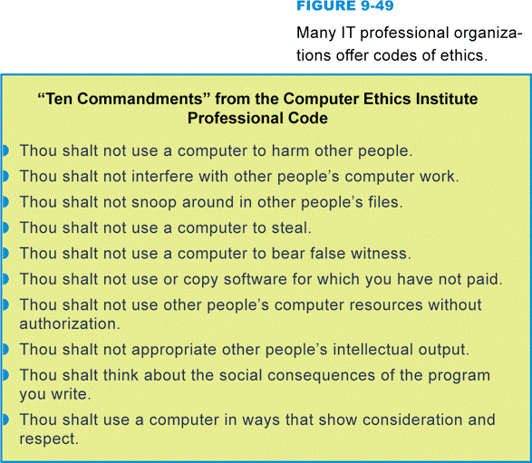
Ethical Decision Making
A code of ethics is a set of guidelines designed to help professionals make decisions
Notes:
Figure 9-49

Slide 51
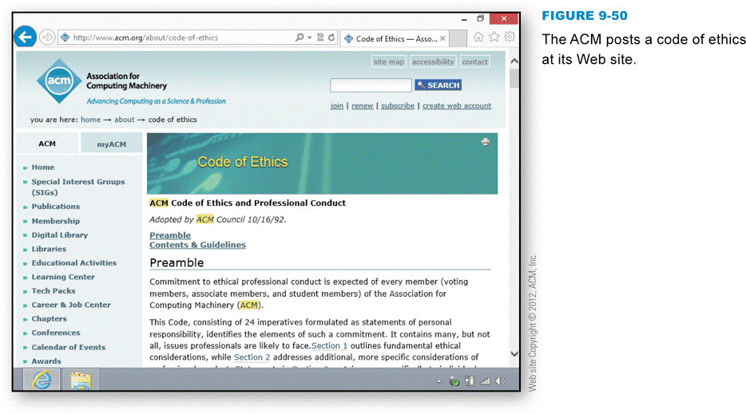
Ethical Decision Making
Codes of ethics are published online and are available to the public
Notes:
Figure 9-50

Slide 52
Whistleblowing
Disclosure by an employee of confidential information which relates to some danger, fraud, or other illegal or unethical conduct
Speaks out against on-the-job activities
Whistleblowers are often fired or forced out of their jobs

Slide 53
Whistleblowing
Before whistleblowing:
Examine your motives
Try the normal chain of command
Collect evidence to back up your accusations
Record events as they unfold
Act ethically
Be ready to accept repercussions
Establish a support network
Consult a lawyer
Consider your strategy

Slide 54
Section E: Work Area Safety and Ergonomics
Radiation Risks
Repetitive Stress Injuries
Eye Strain
Back Pain
Sedentary Lifestyle

Slide 55
Question
092500 Which one of the following is the best way to avoid health hazards while working with computers?
A. Use a CRT display.
B. Take frequent breaks.
C. Move your display to a position lower than your chin.
D. Elevate your keyboard to chest height.

Slide 56
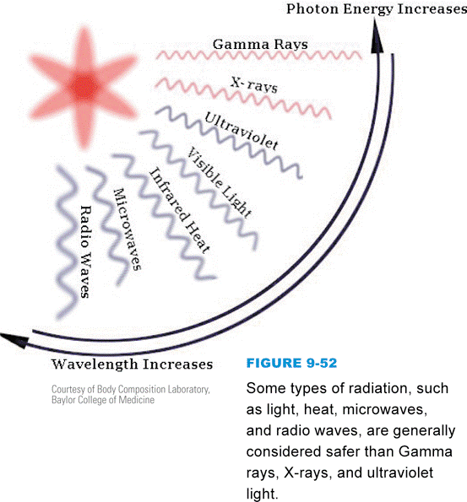
Radiation Risks
Every electronic device emits some type of radiation
Notes:
Figures 9-52

Slide 57
Radiation Risks
CRTs and LCD screens emit radiation
LCD screens emit low levels
Cell phones emit RF energy
The scientific community continues to study and debate the amount of RF radiation that should be considered safe for long-term use
Use a hands-free headset to reduce exposure

Slide 58
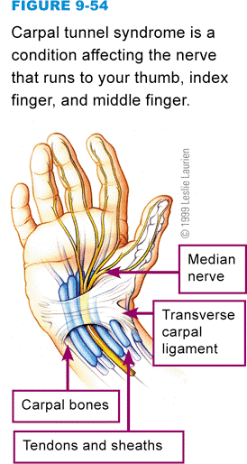
Repetitive Stress Injuries
A repetitive stress injury (RSI) is not a specific disease but a group of similar overuse disorders that affect the tendons, muscles, and nerves
Carpal tunnel syndrome
Notes:
Figure 9-54

Slide 59
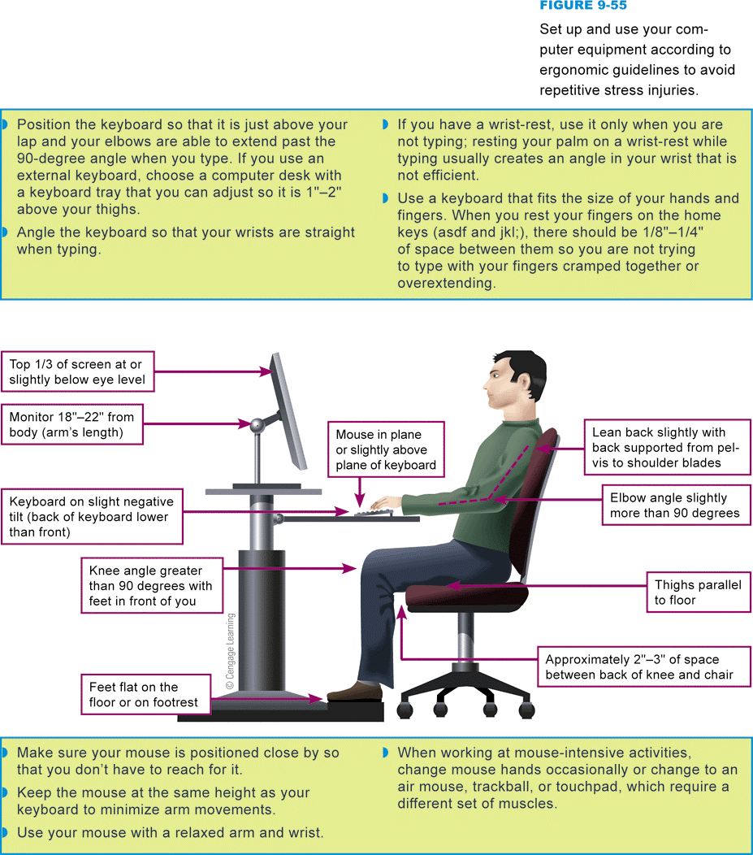
Repetitive Stress Injuries
Ergonomics is the study of safe and efficient environments, particularly working environments
Notes:
Figure 9-55

Slide 60
Eye Strain
Studies have found links between computer use and eye problems
Notes:
Figure 9-56

Slide 61
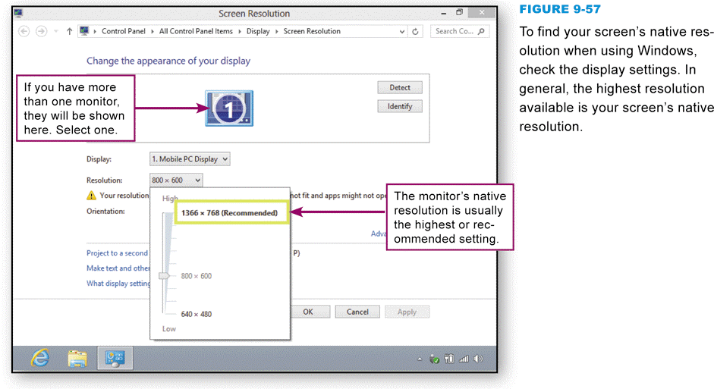
Eye Strain
Adjust screen resolution to a comfortable level
Native resolution
Notes:
Figure 9-57

Slide 62
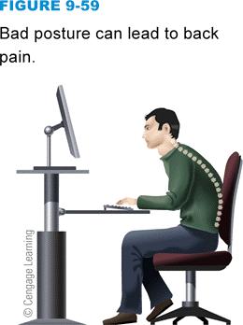
Back Pain
Back pain can be caused by many factors, including poor posture and careless lifting of heavy objects
The key to comfort while working on a computer is keeping your shoulders relaxed so that tense muscles don’t generate headaches and stiffness
Notes:
Figure 9-59

Slide 63
Sedentary Lifestyle
People who live and work in digital cultures tend to spend many hours each day in sedentary pursuits, such as watching television and using computers
Sitting still for long periods of time, especially in positions that limit blood circulation can be a health risk
Your chair should not prevent good circulation to your legs

Slide 64
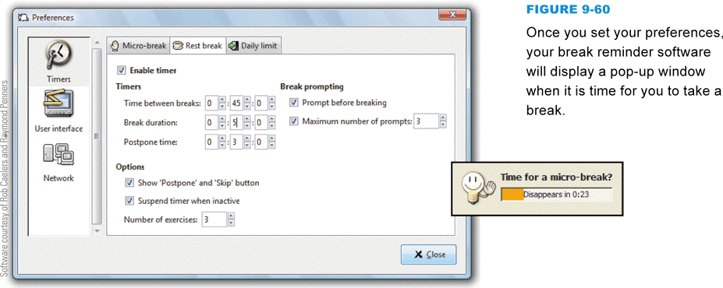
Sedentary Lifestyle
Try to take breaks periodically
Break reminder software can help you remember when it is time to take a break from your work
Notes:
Figure 9-60

Slide 65
What Do You Think?
093100 Does the Turing Test of machine intelligence make sense to you?
A. Yes B. No C. Not sure
093200 If a computer can beat human contestants in Jeopardy!, is it showing signs of intelligence?
A. Yes B. No C. Not sure
093300 Do you believe that computers might someday have the capacity to think?
A. Yes B. No C. Not sure

Slide 66
Chapter 9 Complete

