Slide 1
Chapter 4 Operating Systems and File Management

Slide 2
Chapter Contents
Section A: Operating System Basics
Section B: Today’s Operating Systems
Section C: File Basics
Section D: File Management
Section E: Backup Security

Slide 3
FastPoll True/False Questions Answer A for True and B for False
040100 An operating system manages a computer’s resources such as the processor, RAM, and storage space.
040200 Multithreading provides process and memory management services that allow two or more tasks, jobs, or programs to run simultaneously.
040300 GUI stands for “graphic usability icons.”
040400 A bootstrap program is a popular type of application software.
040500 During a computing session, the operating system is executed from RAM.

Slide 4
FastPoll True/False Questions Answer A for True and B for False
040600 The Windows kernel is the same as the Mac OS kernel.
040700 Macs featured a graphical user interface before PCs.
040800 Boot Camp is a dual boot utility for Macs.
040900 Mac files have a data fork and a resource fork.
041000 Fedora, Ubuntu, and openSUSE are Linux distributions.
041100 A disk partition is basically a folder.

Slide 5
FastPoll True/False Questions Answer A for True and B for False
041200 A file specification is also called a path.
041300 Windows File Explorer is a file management utility.
041400 Hard disks, CDs, and DVDs are formatted into tracks and sectors.
041500 Time Machine is synchronization software used for backup on Macs.
041600 To repopulate a new hard disk from an incremental backup, you have to first restore a full backup.
041700 A boot disk contains a complete copy of your computer’s hard disk as it existed when the computer was new.

Slide 6
Section A: Operating System Basics
Operating System Tasks
The Boot Process
User Interfaces

Slide 7
Question
042100 A computer handles many tasks simultaneously. Which one of the following refers to the processor’s ability to handle multiple tasks, rather than the operating system’s ability to do so?
A. Multi-core
B. Multitasking
C. Multithreading
D. Multiprocessing

Slide 8
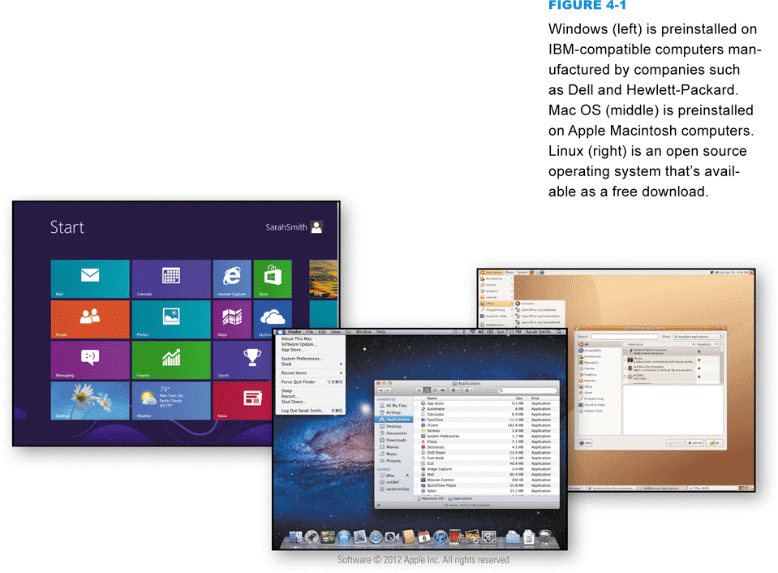
Operating System Tasks
An operating system is a type of system software that acts as the master controller for all activities that take place within a computer system
Notes:
Figure 4-1

Slide 9
Operating System Tasks
Notes:
Figures 4-2 and 4-3

Slide 10
Operating System Tasks
Multitasking provides process and memory management services that allow two or more tasks, jobs, or programs to run simultaneously
Within a single program, multithreading allows multiple parts, or threads, to run simultaneously
A multiprocessing capability supports a division of labor among all the processing units
A memory leak is when an application requests memory but never releases it
Can cause an application not to function properly

Slide 11
Operating System Tasks
Operating System Categories
Single-user operating system
Multiuser operating system
Server operating system
Desktop operating system
Mobile operating system

Slide 12
The Boot Process
During the boot process, the operating system kernel is loaded into RAM
The kernel provides essential operating system services
Your computer’s small bootstrap program is built into special ROM circuitry housed in the computer’s system unit

Slide 13
The Boot Process
Notes:
Figure 4-6

Slide 14
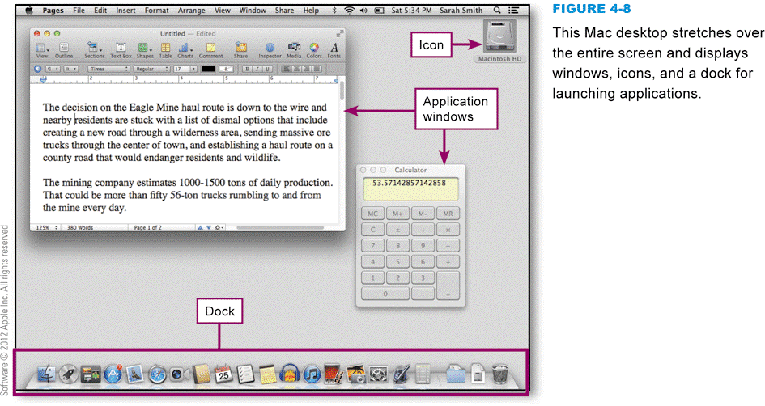
User Interfaces
The combination of hardware and software that helps people and computers communicate with each other
Notes:
Figures 4-7 and 4-8

Slide 15
User Interfaces
Basic control elements of a GUI
Desktop
Taskbar or dock
Application window
Start screen
Icon
Tile
Button
Toolbar
Menu
Menu bar
Ribbon
Submenu
Dialog box

Slide 16
User Interfaces
Notes:
Figure 4-8 – 4-9

Slide 17
User Interfaces
Notes:
Figure 4-10 – 4-13

Slide 18
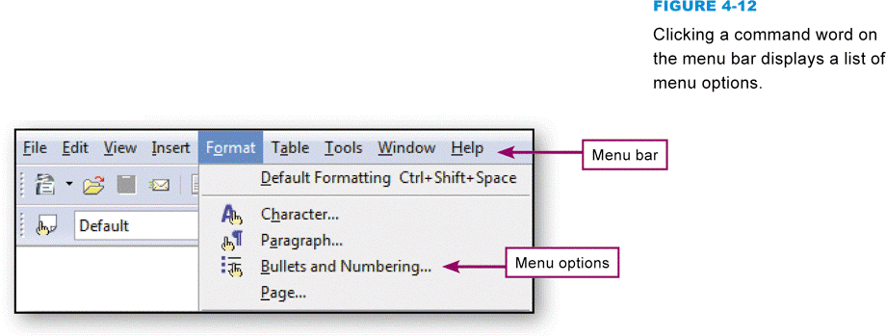
User Interfaces
Notes:
Figure 4-10 – 4-13

Slide 19
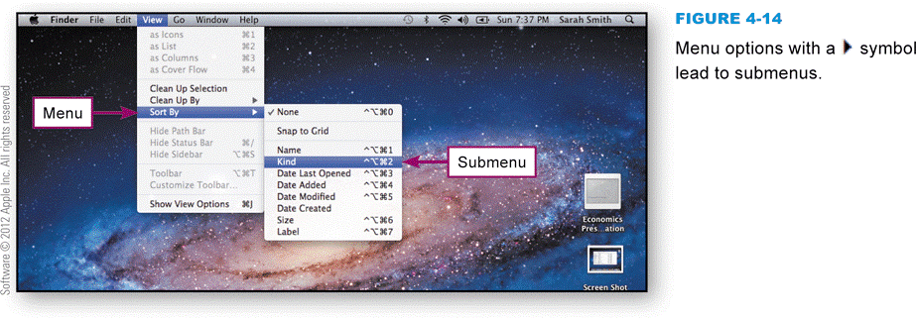
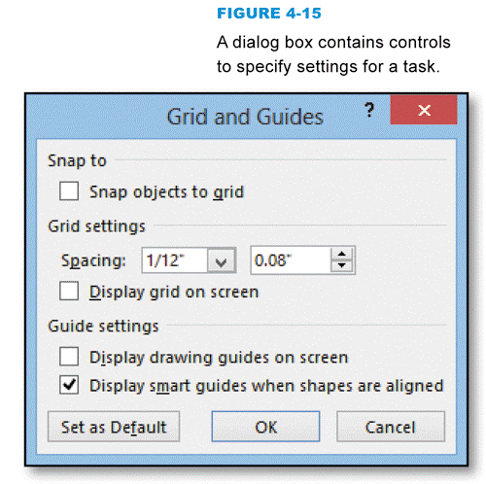
User Interfaces
Menus, submenus, and dialog boxes
Notes:
Figures 4-14 and 4-15

Slide 20
Section B: Today’s Operating Systems
Microsoft Windows
Mac OS
iOS
Android
UNIX and Linux
BlackBerry OS

Slide 21
Question
042200 Today’s popular operating systems include Windows, Mac OS, Linux, Android, and iOS. Each has strengths and weaknesses that are important to understand. Which of the following statements is correct?
A. iOS is built on the Windows kernel, so it is ideal for smartphones because it has good resistance to malware.
B. If you don’t like the user interface for Windows but want to run the vast variety of Windows software, you can install Linux.
C. Linux and Mac OS have a reputation for being more stable than Windows.
D. Windows includes software called Boot Camp that allows PCs to boot into different operating systems, such as Mac OS, Linux, iOS, and Android.

Slide 22
Microsoft Windows
Notes:
Figure 4-16

Slide 23
Mac OS
Notes:
Figures 4-21

Slide 24
Mac OS
Notes:
Figure 4-23

Slide 25
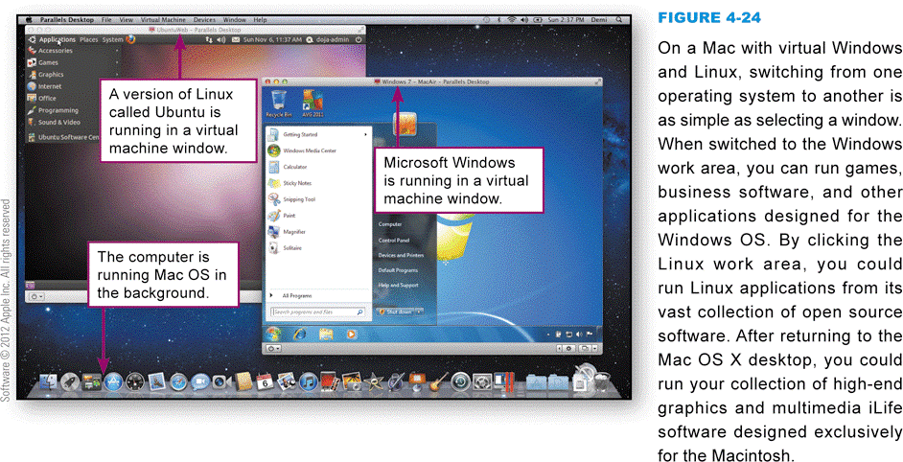
Mac OS
Popular virtual machine software such as VMware and Parallels Desktop can run on most computers with Intel microprocessors, including Intel Macs, PCs, and generic Linux computers
Notes:
Figure 4-24

Slide 26
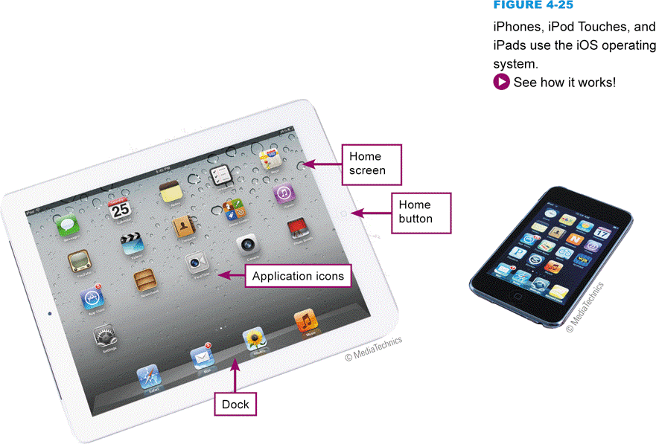
iOS
iOS is an operating system for the Apple iPhone, and was derived from the Mac OS X code
Notes:
Figure 4-25

Slide 27
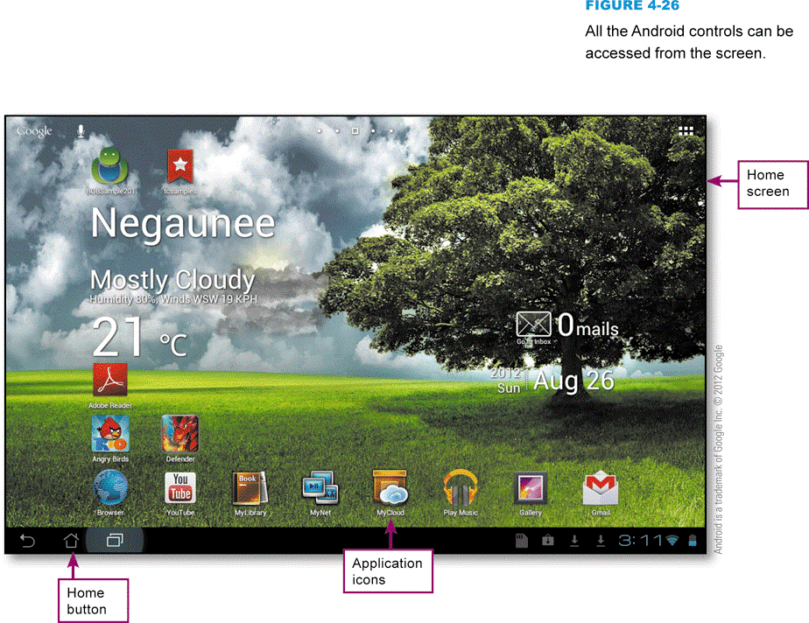
Android
Android is a mobile operating system that is a popular platform for tablet computers, smartphones, and ebook readers
Notes:
Figure 4-26

Slide 28
UNIX and Linux
The UNIX operating system was developed in 1969 at AT&T’s Bell Labs
Dependable in multiuser environments
Linux is an operating system distributed along with its source code under the terms of a GPL (General Public License)
A Linux distribution is a download that contains the Linux kernel, system utilities, graphical user interface, applications, and an installation routine

Slide 29
UNIX and Linux
Notes:
Figure 4-27

Slide 30
BlackBerry OS
BlackBerry OS is a proprietary operating system produced by RIM
Key feature is the ability to work with corporate e-mail software systems produced by Microsoft and IBM
RIM pioneered push technology, in which notifications are automatically sent to a device
Notes:
Figure 4-28

Slide 31
Section C: File Basics
File Names and Extensions
File Directories and Folders
File Formats

Slide 32
Question
042300 Suppose a friend sends you a file called Twain.dll. From the file name, what can you deduce?
A. That it is a word processing document, probably about Mark Twain.
B. That you should be able to open it using Microsoft Word.
C. That the file extension makes it a virus.
D. That it is a support program file, perhaps part of the device driver for your scanner.

Slide 33
File Names and Extensions
You must adhere to file-naming conventions when saving files
Case sensitivity
Maximum length
Spaces allowed
Numbers allowed
Characters not allowed
File names not allowed
File extensions provide clues to the file contents
Notes:
Figure 4-24

Slide 34
File Directories and Folders
To designate a file’s location, you must first specify the device where the file is stored
The main hard disk usually is referred to as drive C
Macs do not use drive letters
A disk partition is a section of hard disk drive that is treated as a separate storage unit
Partitions can be assigned drive letters
Partitions are not the same as folders
Notes:
Figure 4-25

Slide 35
File Directories and Folders

Slide 36
File Directories and Folders
Every storage device has a directory containing a list of its files
Root directory
Subdirectory
Depicted as folders
A computer’s file location is defined by a file specification, or path
Notes:
Figure 4-31

Slide 37
File Formats
A file format refers to the organization and layout of data that is stored in a file
The format of a file usually includes a header, data, and possibly an end-of-file marker
A file header is a section of data at the beginning of a file that contains information about a file
A file extension does not really define the format of a file

Slide 38
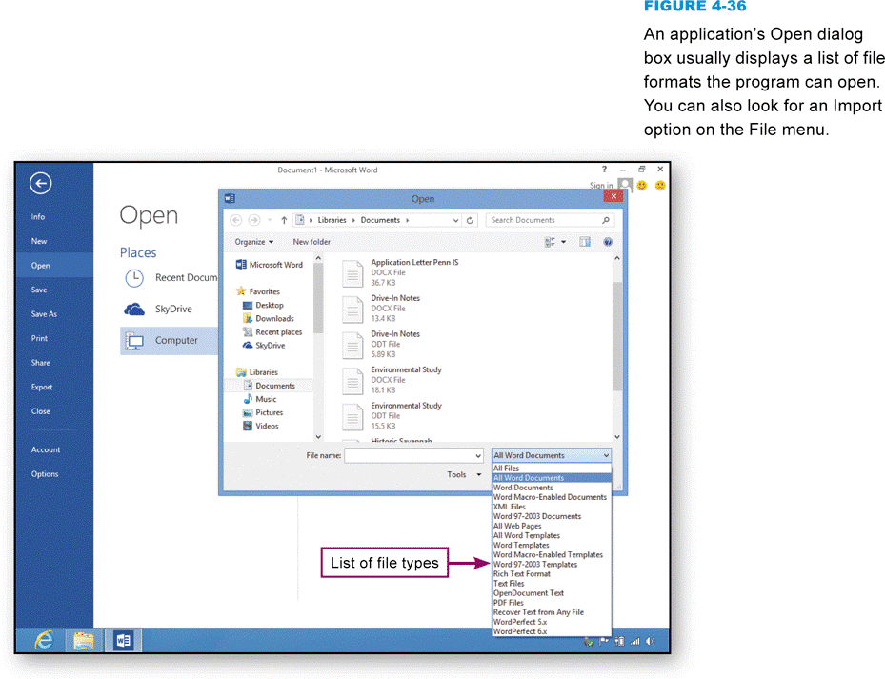
File Formats
A software application can open files that exist in its native file format, plus several additional file formats
Notes:
Figure 4-36

Slide 39
File Formats
Notes:
Figure 4-38 (movie)

Slide 40
Section D: File Management
Application-based File Management
File Management Metaphors
File Explorer
File Management Tips
Physical File Storage

Slide 41
Question
042400 Before donating your computer to a charitable organization, you can make sure your personal data cannot be accessed from the hard disk by:
A. Deleting any files that contain personal data.
B. Deleting files containing personal data and then emptying the Recycle Bin or Trash.
C. Deleting all the files and folders on your computer’s hard disk.
D. Deleting all files and folders and then using file shredder software.

Slide 42
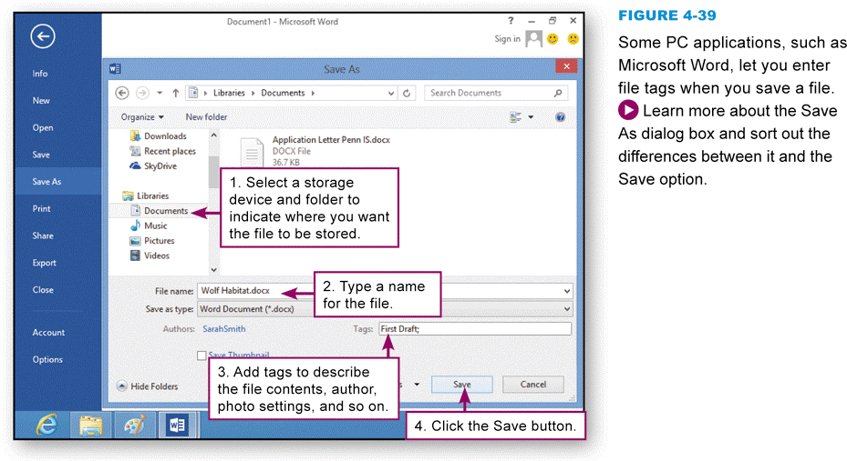
Application-Based File Management
Applications generally provide a way to open files and save them in a specific folder on a designated storage device
Notes:
Figures 4-39

Slide 43
Application-Based File Management
Notes:
Figure 4-40 and 4-42

Slide 44
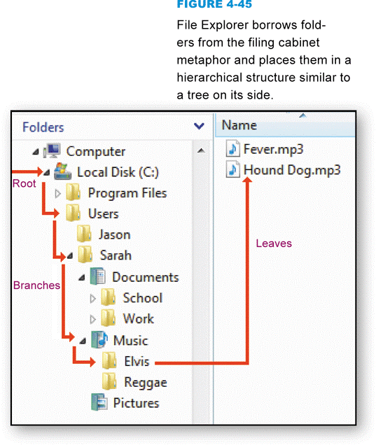
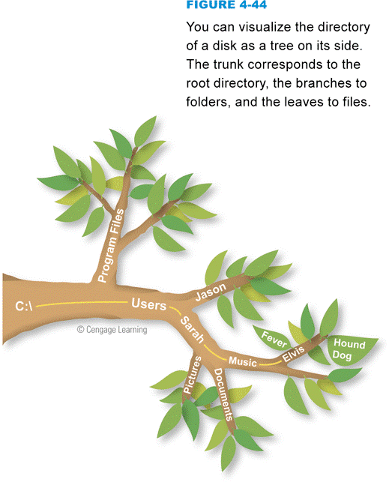
File Management Metaphors
A file management utility helps you manage files in your operating system
Storage metaphors help you visualize and mentally organize the files on your disks and other storage devices
Logical storage models
Notes:
Figures 4-44 and 4-45

Slide 45
File Explorer
Notes:
Figure 4-46

Slide 46
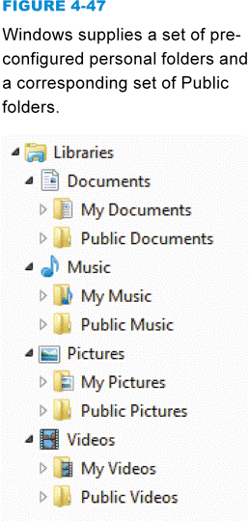
File Explorer
File Explorer helps you manipulate files and folders in the following ways:
Rename
Copy
Move
Delete
Windows offers a set of preconfigured personal folders, such as My Documents and My Music, for storing your personal data files
Notes:
Figure 4-47

Slide 47
File Explorer
Notes:
Figure 4-48

Slide 48
File Management Tips
Use descriptive names
Maintain file extensions
Group similar files
Organize your folders from the top down
Consider using default folders
Use Public folders for files you want to share
Do not mix data files and program files

Slide 49
File Management Tips
Don’t store files in the root directory
Access files from the hard disk
Follow copyright rules
Delete or archive files you no longer need
Be aware of storage locations
Back up

Slide 50
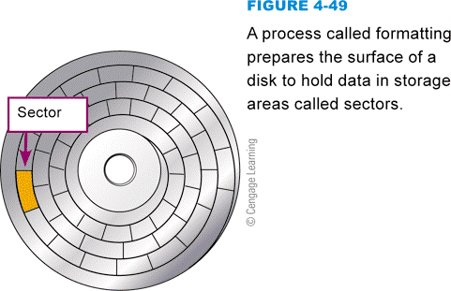
Physical File Storage
The physical storage model describes what happens on the disks and in the circuits
Storage media must be formatted before it can store files
The formatting process divides the disk into tracks and sectors
Notes:
Figure 4-49

Slide 51
Physical File Storage
Notes:
Figure 4-50

Slide 52
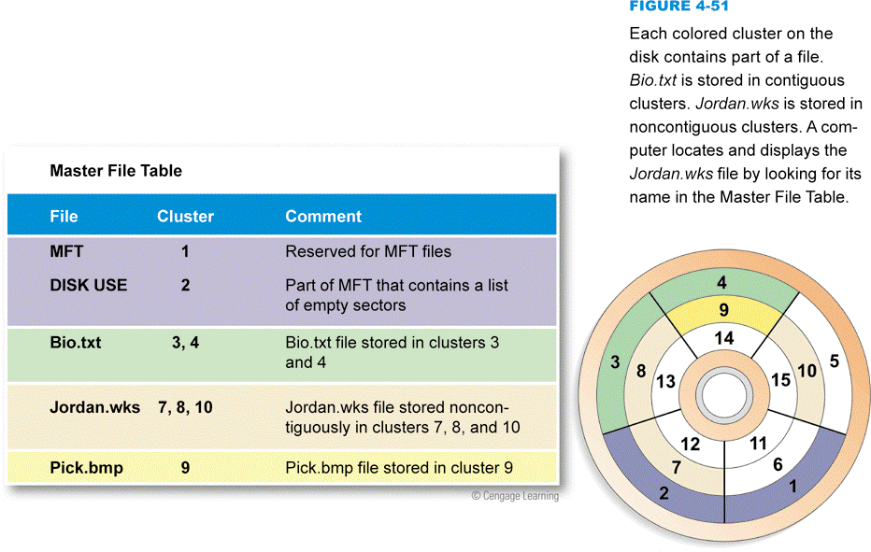
Physical File Storage
The file system keeps track of the names and locations of files
NTFS
Master File Table (MFT)
Notes:
Figure 4-51

Slide 53
Physical File Storage
Deleting a file changes the status of that file’s clusters to empty and removes the file name from the index file
The file’s data is still there
File shredder software overwrites “empty” sectors with random 1s and 0s
Files in the Windows Recycle Bin and similar utilities can be undeleted

Slide 54
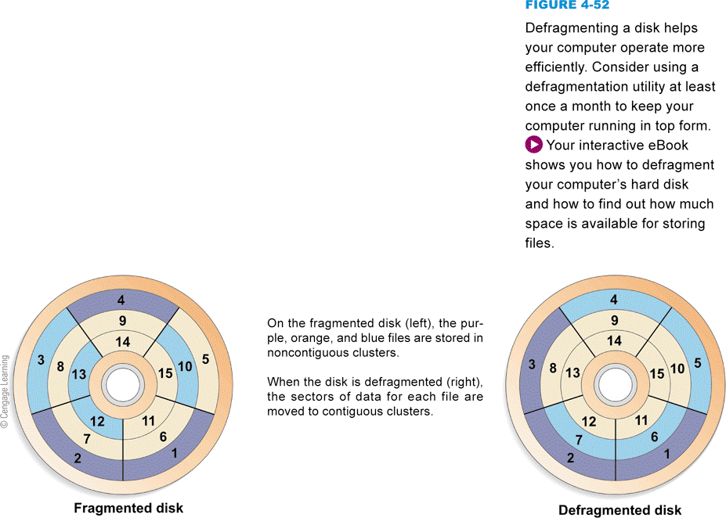
Physical File Storage
Fragmented files are stored in noncontiguous clusters and decrease performance
Defragmentation utilities rearrange files so that they are stored in contiguous clusters
Notes:
Figure 4-52

Slide 55
Section E: Backup Security
Backup Basics
File Copies
Synchronization
Windows Backup
Backup Software
Virtual Machines
Tablet and Smartphone Backup

Slide 56
Question
042500 Copying important data files from your computer’s hard disk to an optical disk or flash drive is a simple way to back up data. It is not a total backup solution, however. Why not?
A. You cannot restore these files to a new hard disk without the activation codes.
B. The backup is bootable, but it won’t start your computer if the hard disk fails.
C. You have not backed up your programs or your personal settings.
D. You have not backed up the restore points needed to reconfigure the Windows Registry for a new hard disk.

Slide 57
Backup Basics
A backup stores the files needed to recover data that’s been wiped out by operator error, viruses, or hardware failures
Your backup schedule depends on how much data you can afford to lose
You should test your backup by trying to restore one file
The backup device you select depends on the value of your data, your current equipment, and your budget
Online backup services
Notes:
Figure 4-53

Slide 58
Backup Basics
Notes:
Figure 4-53

Slide 59
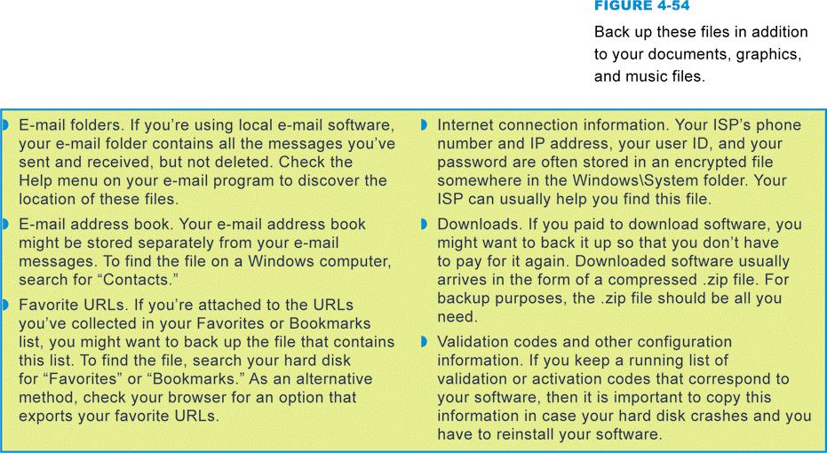
File Copies
Unique files are difficult to reproduce
Manually copying and pasting requires you to select the files and destination device each time
Notes:
Figure 4-54

Slide 60
Synchronization
Synchronization compares the content of files on two devices and makes them the same
A program called Time Machine supplied with Mac OS X is a good example of synchronization software
Synchronizes every hour

Slide 61
Synchronization
Notes:
Figure 4-55

Slide 62
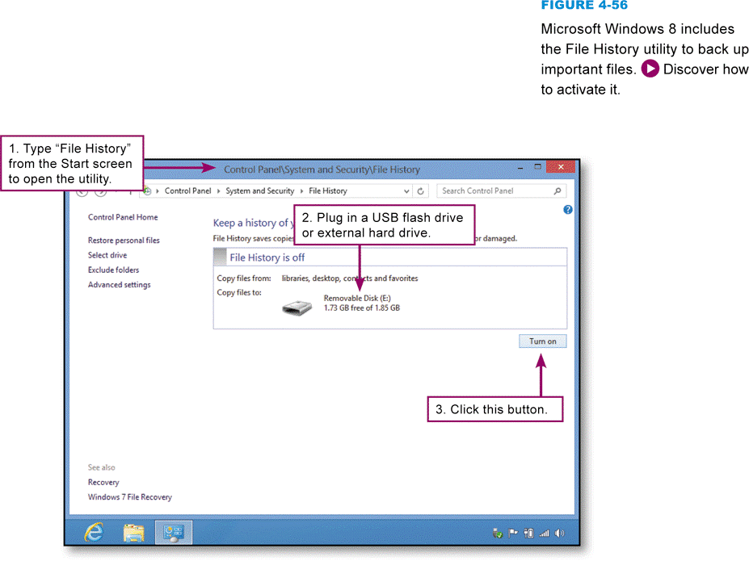
Windows Backup
Windows 8 includes a synchronization utility called File History
Notes:
Figure 4-56

Slide 63
Windows Backup
A full system backup includes a copy of every file stored on your computer’s hard drive
A boot disk is a removable storage medium containing the operating system files needed to boot your computer without accessing the hard disk
A recovery disk is a bootable CD, DVD, or other media that contains a complete copy of your computer’s hard disk as it existed when the computer was new

Slide 64
Windows Backup
A recovery partition is located on the computer’s hard disk and contains the necessary files to restore a computer to its original state
The Windows Registry is an important group of files used by the Windows operating sytsem to store configuration information about all the devices and software installed on a computer system
A restore point is a snapshot of your computer settings

Slide 65
Windows Backup
Notes:
Figure 4-57

Slide 66
Backup Software
Backup software is a set of utility programs designed to back up and restore some or all of the files on a computer’s primary storage device
A backup made by copying all the files to a backup device is called a full backup
A differential backup makes a backup of only those files that were added or changed since your last full backup session
An incremental backup makes a backup of the files that were added or changed since the last backup—not necessarily the files that changed from the last full backup

Slide 67
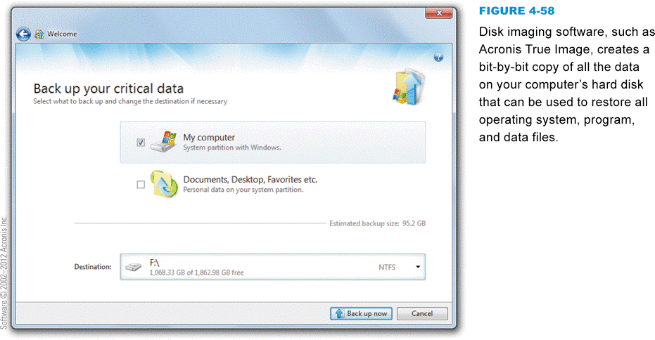
Backup Software
Restoring a computer usually entails several steps
A bare-metal restore restores the computer in a single step
A disk image is a bit-by-bit copy of the data from all sectors of a disk
Notes:
Figure 4-58

Slide 68
Virtual Machines
Notes:
Figure 4-59

Slide 69
Tablet and Smartphone Backup
Handheld devices are usually backed up by synching them to a desktop or laptop computer
Synching is usually initiated by tethering your handheld device to a full-size computer using a USB cable
iPhones, iPods, and iPads synch with iTunes software, and you have the option to encrypt the backup to prevent your data from exposure if your computer falls victim to an unauthorized intrusion
Many Android devices include backup software, usually accessible from the Settings icon

Slide 70
Tablet and Smartphone Backup
Notes:
Figure 4-60

Slide 71
What Do You Think?
043100 Should a computer virus distribution sentence carry the same penalty as manslaughter?
A. Yes B. No C. Not sure
043200 Should it be a crime to steal a copy of computer data while leaving the original data in place and unaltered?
A. Yes B. No C. Not sure
043300 Should hackers be sent to jail if they cannot pay restitution to companies and individuals who lost money as the result of a prank?
A. Yes B. No C. Not sure
043400 Do you think that a hacker would make a good consultant on computer security?
A. Yes B. No C. Not sure

Slide 72
Chapter 4 Complete

