Slide 1
Chapter 7 The Web and E-mail

Slide 2
Chapter Contents
Section A: Web Technology
Section B: Search Engines
Section C: E-commerce
Section D: E-mail
Section E: Web and E-mail Security

Slide 3
FastPoll True/False Questions Answer A for True and B for False
070100 http://www.cnn.com is an example of a URL.
070200 The Web uses WEP as its main protocol
070300 If your browser can’t open PDF files, you can download the Adobe Reader plug-in.
070400 The Web uses cookies because HTTP is stateless.
070500 [/ left] is an example of an HTML tag.

Slide 4
FastPoll True/False Questions Answer A for True and B for False
070600 A Web designer who wants to create interactive pages can use scripts, JavasScript and HTML5.
070700 A Web crawler is type of virus that affects cookies.
070800 Keyword stuffing is a technique for collecting user IDs from Web site logins.
070900 Most e-commerce shopping carts use cookies to keep track of the items you are purchasing.

Slide 5
FastPoll True/False Questions Answer A for True and B for False
071000 Secure connections typically begin with https.
071100 POP, IMAP, and SMTP are Web page protocols.
071200 E-mail attachments are converted with MIME into ASCII code.
071300 Blocking third-party cookies helps eliminate Web bugs.

Slide 6
Section A: Web Technology
Web Basics
HTML
HTTP
Web Browsers
Cookies
Web Page Authoring
Interactive Web Pages

Slide 7
Question
072100 The Web requires many technologies. Which one of the following statements is accurate about these technologies?
A. HTML, XHTML, and Ajax extend basic Web scripts so that Web designers can create pages with videos and interactive questions.
B. Explorer, Safari, Firefox, and Chrome are examples of Web browsers.
C. Cookies and HTML codes are stateless Web protocols.
D. Text editors like ActiveX and Notepad can be used to create HTML documents.

Slide 8
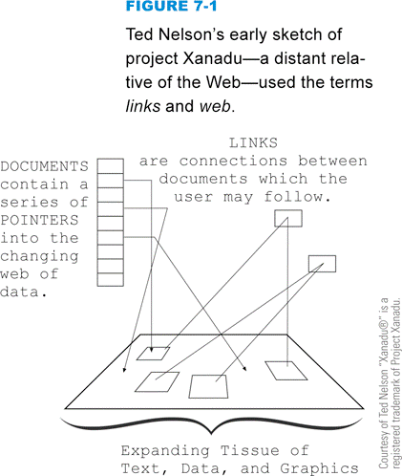
Web Basics
The Web is a collection of document, image, video, and sound files
Web 2.0
Web 3.0
A Web site contains a collection of related information
Notes:
Figure 7-1

Slide 9
Web Basics
A Web server accepts requests from browsers
A Web page is the product or output of one or more Web-based files displayed in a format similar to a page in a book
A Web browser is client software that displays Web page elements and handles links between pages
Every Web page has a unique address called a URL
Notes:
Figure 7-3

Slide 10
HTML
Set of specifications for creating documents that a browser can display as a Web page
Markup language
HTML tags
HTML 5
XHTML
Source document

Slide 11
HTML
Notes:
Figure 7-4

Slide 12
HTTP
Notes:
Figure 7-5

Slide 13
Web Browsers
Popular browsers:
Mozilla Firefox
Microsoft Internet Explorer
Apple Safari
Google Chrome
It is a good idea to upgrade when a new version of your browser becomes available
Notes:
Figure 7-7

Slide 14
Web Browsers
If your browser does not have built-in support for a file format required to display or play a Web page element, you can download the necessary software
A plug-in is a program that extends a browser’s ability to work with file formats
Notes:
Figure 7-8

Slide 15
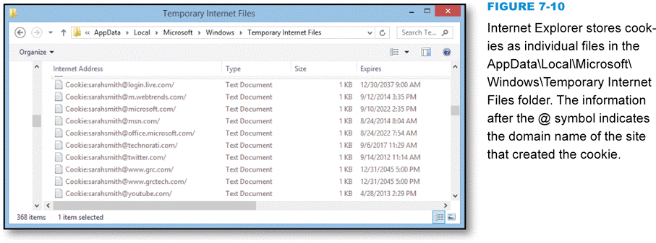
Cookies
Small chunk of data generated by a Web server and stored in a text file on computer’s hard disk
Fix problems caused by HTTP’s stateless protocol
Notes:
Figure 7-10

Slide 16
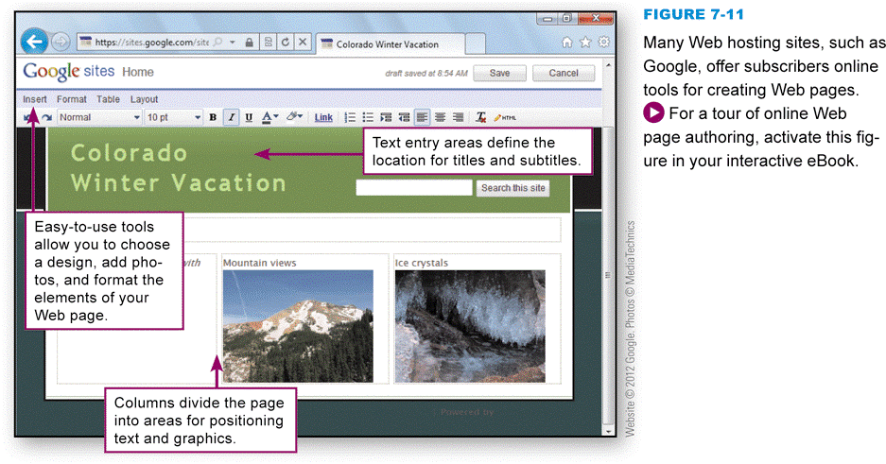
Web Page Authoring
HTML conversion utility
Online Web page authoring tools
Web authoring software
Adobe Dreamweaver
Text editor
Notes:
Figure 7-11

Slide 17
Interactive Web Pages
Interactive and dynamic Web sites are possible when programming and scripting technologies supplement native HTML features
An HTML form uses the <form> tag to accept typed input
Client-side and server-side processes
A computer scripting language called JavaScript is commonly used to add logic and other programmable elements to a Web page

Slide 18
Interactive Web Pages
Notes:
Figure 7-16

Slide 19
Section B: Search Engines
Search Engine Basics
Formulating Searches
Citing Web-based Source Material

Slide 20
Question
072200 Search engines are a key Web technology. When you use a search engine, you can be confident that:
A. Your searches will remain confidential.
B. Information accessed by a search engine is in the public domain.
C. Search engine results are totally impartial.
D. You can usually narrow a search by adding more key words.

Slide 21
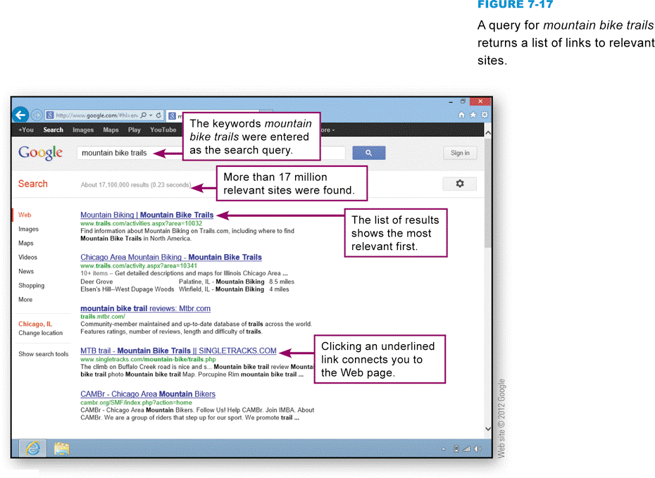
Search Engine Basics
A Web search engine is a program designed to help people locate information on the Web by formulating simple keyword queries
Notes:
Figure 7-17

Slide 22
Search Engine Basics
A Web crawler is a computer program that is automated to methodically visit Web sites
A search engine indexer is software that pulls keywords from a Web page and stores them in an index database
A search engine’s query processor looks for your search terms in search engine’s indexed database and returns a list of relevant Web sites
Link popularity is measured by quality and quantity of links from one Web page to others
A meta keyword is entered into a header section of a Web page when it is created and is supposed to describe the page contents
Keyword stuffing

Slide 23
Formulating Searches
Most search engines work with keyword queries in which you enter one or more words, called search terms
Notes:
Figure 7-22

Slide 24
Formulating Searches
A search operator is a word or symbol that describes a relationship between search terms and thereby helps you create a more focused query
Notes:
Figure 7-23

Slide 25
Using Web-Based Source Material
Notes:
Figure 7-27

Slide 26
Section C: E-commerce
E-commerce Basics
E-commerce Site Technology
Online Payment

Slide 27
Question
072300 Online shoppers are justifiably worried that personal information and credit card numbers supplied in the course of an e-commerce transaction might be hijacked and used inappropriately. What technology can hackers use to hijack credit card numbers?
A. A packet sniffer
B. S-HTTP
C. HTML
D. SSL

Slide 28
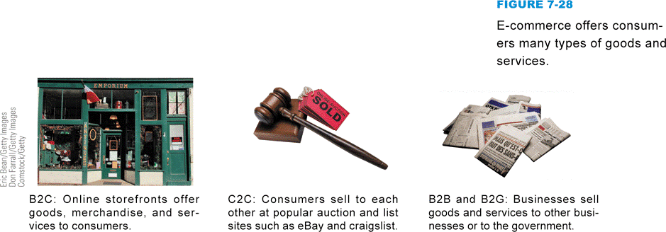
E-commerce Basics
Business transactions conducted electronically over a computer network
B2C (business-to-consumer)
C2C (consumer-to-consumer)
B2B (business-to-business)
B2G (business-to-government)
Notes:
Figure 7-28

Slide 29
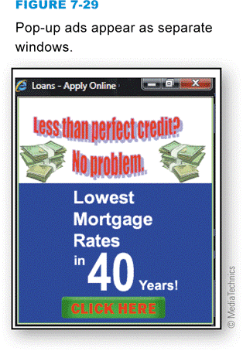
E-commerce Basics
Enhances traditional business models
Styles of online advertisements
Banner ad
Hover ad
Pop-up ad
Click-through rate
Ad-blocking software prevents ads from appearing on screens
Notes:
Figure 7-29

Slide 30
E-commerce Site Technology
E-commerce offers some unique advantages over brick-and-mortar stores and mail-order catalogs
Easily search for merchandise
Easily compare prices and products
Two popular models
B2C
C2C

Slide 31
E-commerce Site Technology
Notes:
Figure 7-31

Slide 32
E-commerce Site Technology
Notes:
Figure 7-32

Slide 33
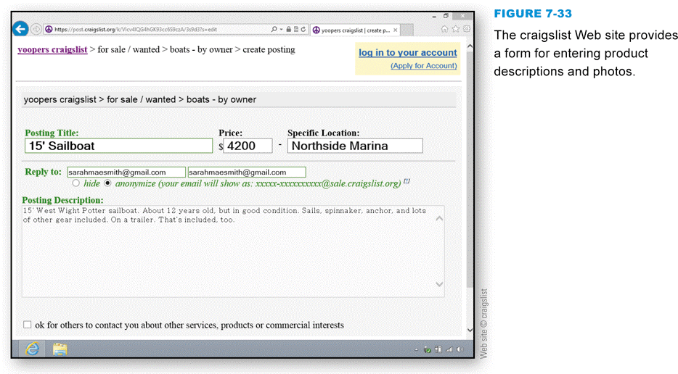
E-commerce Site Technology
At C2C auction and online classified advertising e-commerce sites, consumers offer goods and services to other consumers
C2C sites are hosted by an e-commerce provider such as eBay or craigslist
Notes:
Figure 7-33

Slide 34
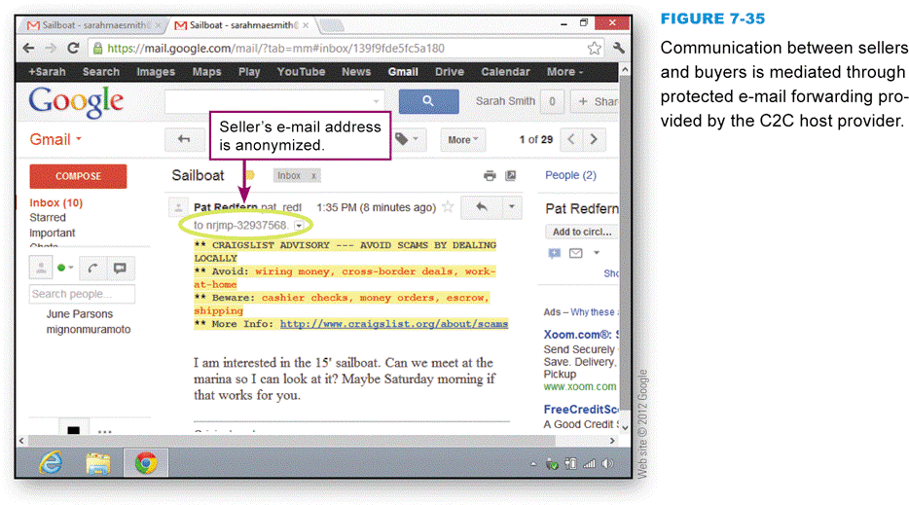
E-commerce Site Technology
Many C2C sites uses e-mail forwarding to protect participants’ privacy
Notes:
Figure 7-35

Slide 35
Online Payment
The most popular ways to make online payments include submitting your credit card number directly to a merchant and using a third-party payment service such as PayPal
Online shoppers are justifiably worried that personal information and credit card numbers supplied in the course of an e-commerce transaction might be hijacked and used inappropriately

Slide 36
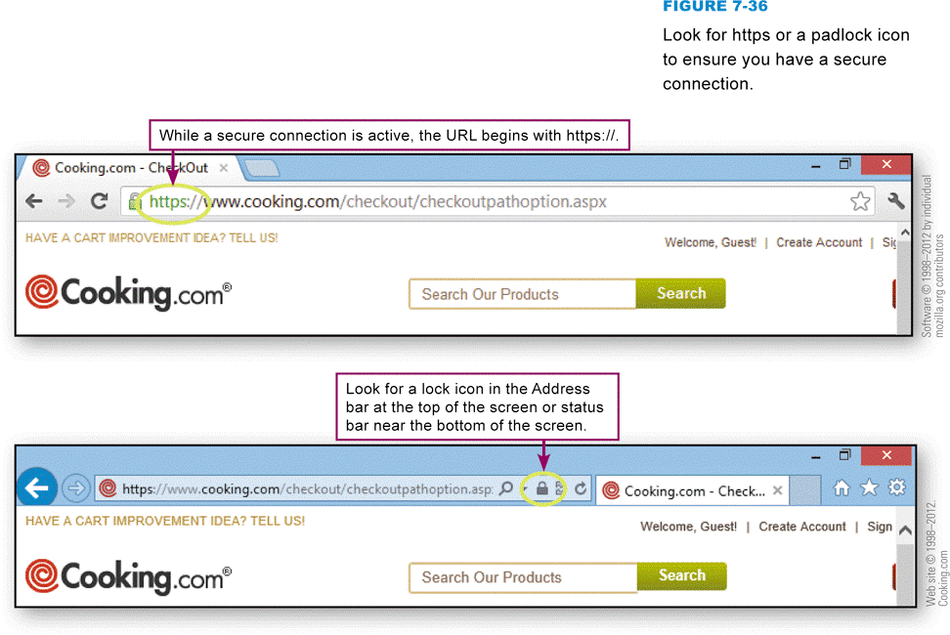
Online Payment
A secure connection encrypts the data transmitted between your computer and a Web site
SSL (Secure Sockets Layer)
TLS (Transport Layer Security)
HTTPS (Hypertext Transfer Protocol Secure)
Notes:
Figure 7-36

Slide 37
Online Payment
Person-to-person payments are an alternative to credit cards
The payment service is the only entity that sees your credit card number
Notes:
Figure 7-38

Slide 38
Section D: E-mail
E-mail Overview
Local E-mail
Webmail
E-mail Attachments
Netiquette

Slide 39
Question
072400 There are two main types of e-mail, each with advantages and disadvantages. If you are using Microsoft Mail, Mozilla Thunderbird, or a similar e-mail client, which type of mail does that software handle?
A. Webmail
B. Indexed mail
C. POP mail
D. HTTP mail

Slide 40
E-Mail Overview
An e-mail message is an electronic document transmitted over a computer network
The computers and software that provide e-mail services form an e-mail system
An e-mail server acts as a central post office for a group of people
A message header is divided into fields that contain the sender’s e-mail address, the recipient’s address, a subject line, and the date and time the message was written
Notes:
Figure 7-38

Slide 41
E-Mail Overview

Slide 42
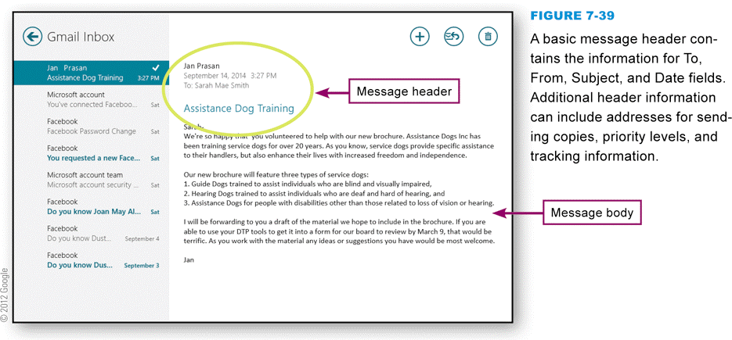
E-Mail Overview
To use an e-mail system, you need:
Internet connection
E-mail account
E-mail software
E-mail client software
Webmail
Notes:
Figure 7-39

Slide 43
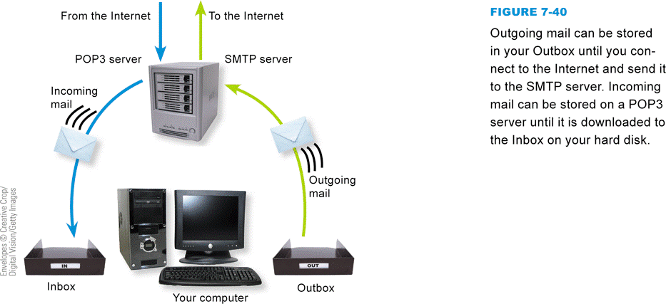
Local E-mail
When you use local e-mail, an e-mail server stores your incoming messages until you launch your e-mail client and get your mail
Based on store-and-forward technology
E-mail protocols
POP3
IMAP
SMTP
Notes:
Figure 7-40

Slide 44
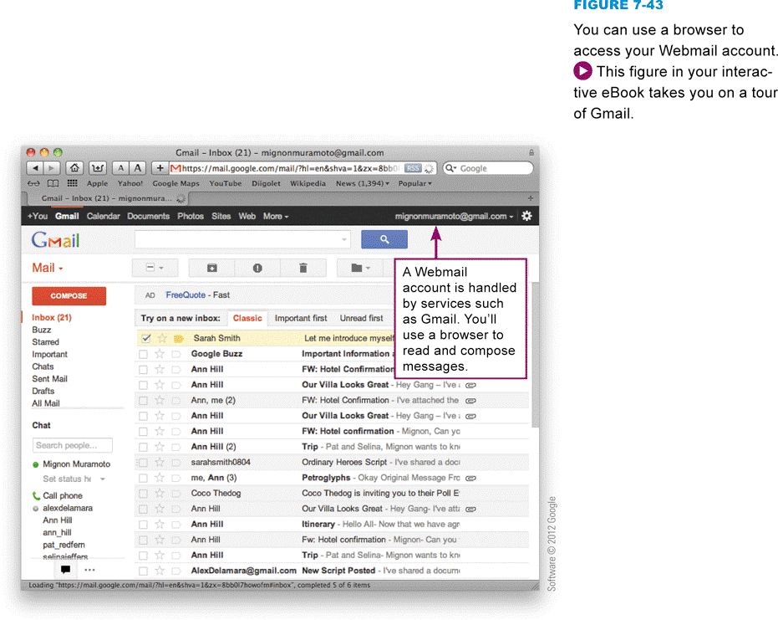
Webmail
Webmail is typically a free service accessed using a browser
Notes:
Figure 7-43

Slide 45
E-Mail Attachments
E-mail attachments are files that travel with an e-mail message
E-mail software converts e-mail attachments using a conversion process called MIME
When working with attachments, keep the following points in mind:
Don’t send huge attachments
Explain all attachments
Don’t open suspicious attachments
You can save attachments
You might have to download a plug-in or player

Slide 46
Netiquette
Notes:
Figure 7-46

Slide 47
Section E: Web and E-mail Security
Cookie Exploits
Spam
Phishing
Fake Sites

Slide 48
Question
072500 Cookies can be exploited by hackers and marketers. What is the best way to handle cookies on your computer to avoid exploits, but maintain adequate functionality for e-commerce and other Web activities?
A. Delete cookies often
B. Block third-party cookies
C. Block all cookies
D. Opt out of cookies

Slide 49
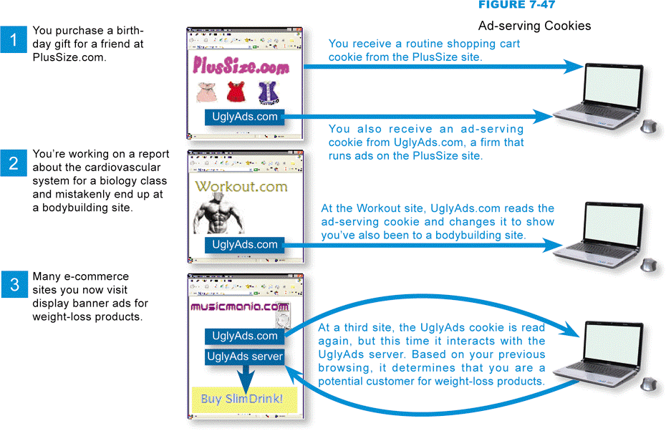
Cookie Exploits
An ad-serving cookie can select and display ads that might interest you
Notes:
Figure 7-47

Slide 50
Cookie Exploits
A Flash cookie, also called a local shared object, is the Flash equivalent of a conventional Web cookie
A Web bug or clear GIF is typically a 1x1 pixel graphic embedded in a Web page or e-mail message. It is almost invisible due to its size and is designed to track who’s reading the Web page or e-mail message
Antispyware is a type of security software designed to identify and neutralize Web bugs, ad-serving cookies, and other spyware

Slide 51
Cookie Exploits
Individuals who prefer not to leave a trail of their Internet activities surf through an anonymous proxy service, which uses an intermediary, or proxy, server to relay Web page requests after masking the originating IP address
Notes:
Figure 7-50

Slide 52
Spam
Spam is unwanted electronic junk mail about medical products, low-cost loans, and fake software upgrades that arrive in your online mailbox
Spam has turned into another major hacking tool for cybercriminals
A spam filter is a type of utility software that captures unsolicited e-mail messages before they reach your inbox

Slide 53
Spam
Notes:
Figure 7-51

Slide 54
Phishing
Phishing is an e-mail based scam designed to persuade you to reveal confidential information, such as your bank account number or Social Security number
If you don’t want to become a phishing victim, be suspicious of e-mail messages that supposedly come from banks, ISPs, online payment services, operating system publishers, and online merchants

Slide 55
Fake Sites
A fake, or fraudulent, Web site looks legitimate, but has been created by a third party to be a very clever replica of a legitimate Web site
Pharming is an exploit that redirects users to fake sites by poisoning a domain name server with a false IP address
Pharming is more surreptitious and tougher to detect than most other hacker schemes
Notes:
Figure 7-53

Slide 56
Fake Sites
Notes:
Figure 7-54

Slide 57
What Do You Think?
073100 Do you think most people believe that their e-mail is private?
A. Yes B. No C. Not sure
073200 Do you agree with CalTech’s decision to expel the student who was accused of sending harassing e-mail to another student?
A. Yes B. No C. Not sure
073300 Should the laws be changed to make it illegal for employers to monitor e-mail without court approval?
A. Yes B. No C. Not sure
073400 Would you have different privacy expectations regarding an e-mail account at your place of work as opposed to an account you purchase from an e-mail service provider?
A. Yes B. No C. Not sure

Slide 58
Chapter 7 Complete

