Slide 1
Chapter 10 Information Systems Analysis and Design

Slide 2
Chapter Contents
Section A: Information Systems
Section B: Systems Analysis
Section C: System Design
Section D: Implementation and Maintenance
Section E: Corporate Data Security

Slide 3
FastPoll True/False Questions Answer A for True and B for False
100100 Tactical and operational planning define long term goals for an organization.
100200 When managers encounter unstructured problems, a transaction processing system can usually supply the answers.
100300 An OLTP system processes transactions in real time as they are entered.
100400 An ad hoc report is a customized report that provides information not available in regularly scheduled reports.
100500 An expert system uses a knowledge base and inference engine.
100600 An SDLC provides a general outline of how an information system evolves.

Slide 4
FastPoll True/False Questions Answer A for True and B for False
100700 System requirements are also called success factors.
100800 DFDs and UML are used to document information systems.
100900 Unit testing is a process that tests all the hardware and software components of an information system to make sure it performs according to specifications.
101000 Throughput refers to the amount of data processed in a particular time interval.
101100 MTBF refers to the average time between failures of a hardware component.

Slide 5
Section A: Information Systems
Information Systems in Organizations
Transaction Processing Systems
Management Information Systems
Decision Support Systems
Expert Systems and Neural Networks

Slide 6
Question
102100 Information systems are classified based on the type of information they collect and provide. What types of information systems are you as an average consumer likely to interact with?
A. Transaction processing systems and expert systems
B. Management information systems and transaction processing systems
C. Decision support systems and executive information systems
D. Expert systems and neural networks

Slide 7
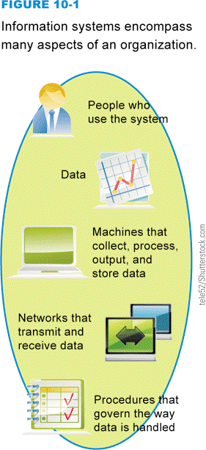
Information Systems in Organizations
An information system collects, stores, and processes data to provide useful, accurate, and timely information
An organization is a group of people working together to accomplish a goal
Business
Nonprofit organization
Mission
Mission statement
Notes:
Figure 10-1

Slide 8
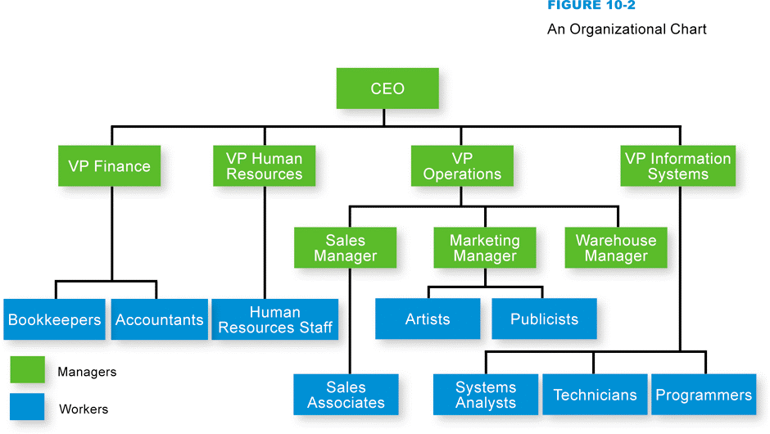
Information Systems in Organizations
Organizational charts depict the hierarchy of employees in an organization
Notes:
Figure 10-2

Slide 9
Information Systems in Organizations
Information systems can:
Automate routine tasks
Make decisions in response to problems
Structured problem
Semi-structured problem
Unstructured problem
Collect and store internal or external information

Slide 10
Transaction Processing Systems
Provide a way to collect, process, store, display, modify, or cancel transactions
Payroll, accounting, airline reservations, inventory, point of sale and cellular phone billing
Batch processing vs. online processing
OLTP system
Commit or rollback strategy
Detail reports

Slide 11
Transaction Processing Systems
Notes:
Figure 10-6

Slide 12
Management Information Systems
Notes:
Figure 10-7

Slide 13
Management Information Systems
Notes:
Figure 10-9

Slide 14
Decision Support Systems
Helps people make decisions by directly manipulating data, analyzing data from external sources, generating statistical projections, and creating data models of various scenarios
Executive information system
DSSs design decision models and make decision queries

Slide 15
Decision Support Systems
Notes:
Figure 10-10

Slide 16
Expert Systems and Neural Networks
Expert systems are designed to analyze data and produce a recommendation, diagnosis, or decision based on a set of facts and rules
Knowledge base
Inference engine
Knowledge engineering
Expert system shell
Fuzzy logic
Neural networks use computer circuitry to simulate how a brain may process info, learn, and remember

Slide 17
Expert Systems and Neural Networks
Notes:
Figure 10-12

Slide 18
Section B: Systems Analysis
System Development Life Cycle
Planning Phase
Analysis Phase
Documentation Tools

Slide 19
Question
102200 If you are participating as a member of a team on a project to upgrade an information system, what can you expect the team to accomplish first?
A. Complete the systems analysis and design according to the systems development life cycle.
B. Complete the planning phase to devise a Project Development Plan.
C. Complete the analysis phase to produce the Systems Requirement document.
D. Complete the documentation of the current system using DFDs or object-oriented documentation tools.

Slide 20
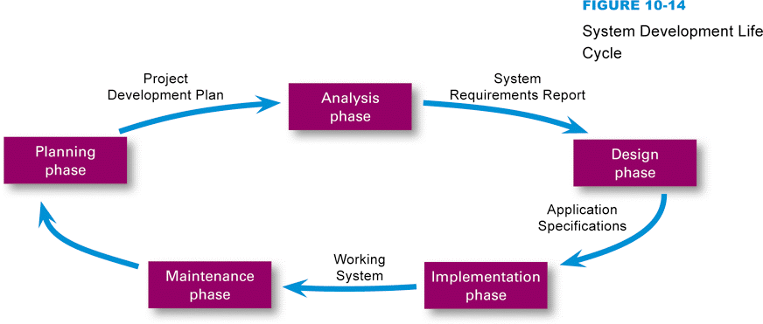
System Development Life Cycle
Systems analysis and design is a discipline that focuses on developing information systems according to the phases of an SDLC
Notes:
Figure 10-14

Slide 21
Planning Phase
Assemble the project team
Justify the project
Choose a development methodology
Develop a project schedule
Produce a Project Development Plan

Slide 22
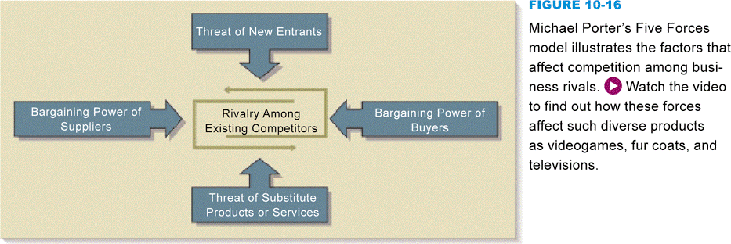
Planning Phase
Justification for new system usually emerges from a serious problem with the current system, a threat to the organization’s success, or an opportunity to improve an organization’s products or services through technology
Notes:
Figure 10-16

Slide 23
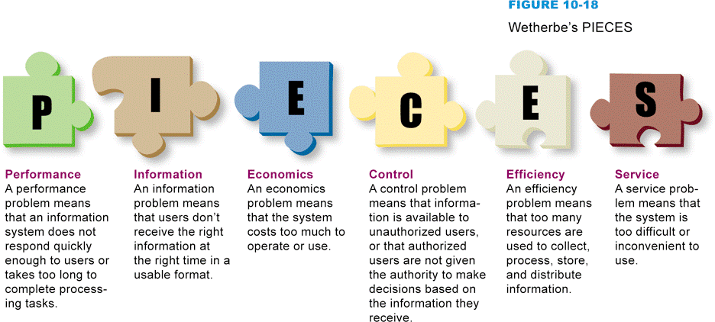
Planning Phase
An organization must be able to:
Make improvements
Change the industry
Create new products
The PIECES framework helps classify problems in an information system
Notes:
Figure 10-18

Slide 24
Planning Phase
Development methodologies
Structured methodology
Information engineering methodology
Object-oriented methodology
PERT (Program Evaluation and Review Technique)
WBS (Work Breakdown Structure)
Gantt chart

Slide 25
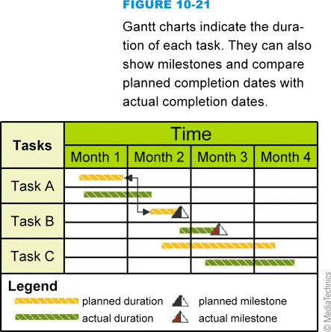
Planning Phase
Notes:
Figures 10-19 and 10-20, and 10-21

Slide 26
Analysis Phase
Produce a list of requirements for a new or revised information system
Analysis phase activities:
Study the current system
Determine system requirements
Write System Requirements Report
System requirements are the criteria for successfully solving problems identified in an information system
Success factors

Slide 27
Documentation Tools
The core documentation tool for project teams using structured methodology is the data flow diagram (DFD)
External entity
Data store
Process
Data flow
Notes:
Figure 10-24

Slide 28
Documentation Tools
Notes:
Figure 10-25

Slide 29
Documentation Tools
Current standard for object-oriented documentation is referred to as UML (Unified Modeling Language)
A use case diagram documents the users of an information system and the functions they perform
Actors
A class diagram provides the name of each object, a list of each object’s attributes, a list of methods, and an indication of the cardinality between objects
A sequence diagram depicts the detailed sequence of interactions that take place for a use case

Slide 30
Documentation Tools
Notes:
Figure 10-29

Slide 31
Section C: System Design
Design Phase
Evaluation and Selection
Application Specifications

Slide 32
Question
102300 Suppose you’ve just heard through the office grapevine that your company is going to be getting a turnkey computer system. What can you expect?
A. The system won’t be operation for quite a long time because lots of programming and setup will be required.
B. You’ll be getting the same system used by business competitors.
C. You might be asked to join a project team to carry out system analysis and design.
D. You might have to change some procedures to match the new information system.

Slide 33
Design Phase
The project team must figure out how the new system will fulfill the requirements specified in the System Requirements Report
Notes:
Figure 10-30

Slide 34
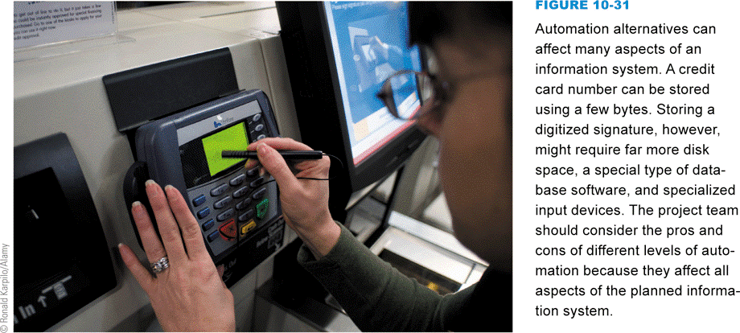
Design Phase
The project team has to consider the overall architecture based on:
Level of automation
Processing methodology
Centralized processing
Distributed processing
Network technology
Notes:
Figure 10-31

Slide 35
Design Phase
Software alternatives
Programming tools
Application development tools
Application software
Turnkey systems
Notes:
Figure 10-32

Slide 36
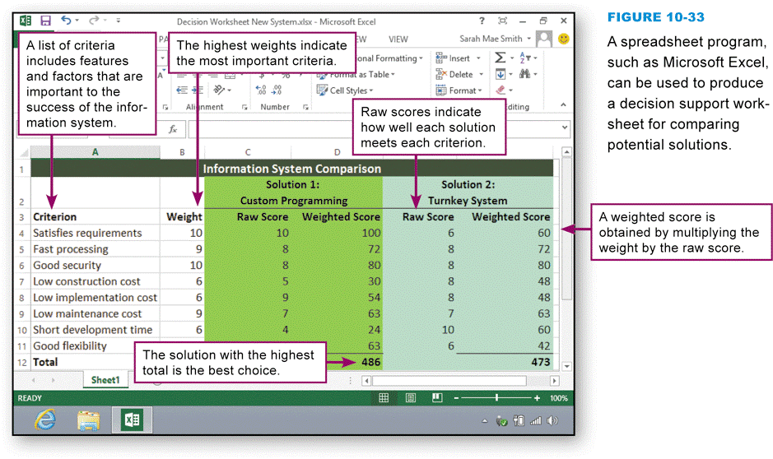
Evaluation and Selection
Decision support worksheet
Notes:
Figure 10-33

Slide 37
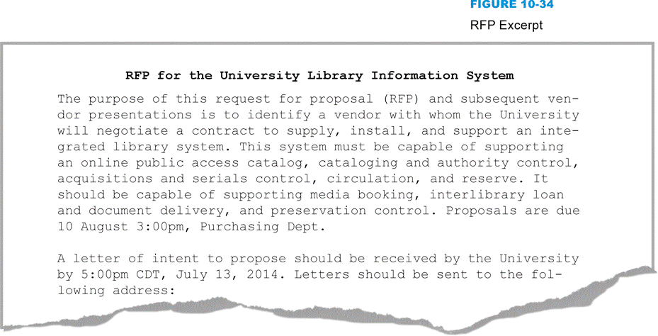
Evaluation and Selection
A request for proposal (RFP) describes the information system problem and the requirements for the solution
Notes:
Figure 10-34

Slide 38
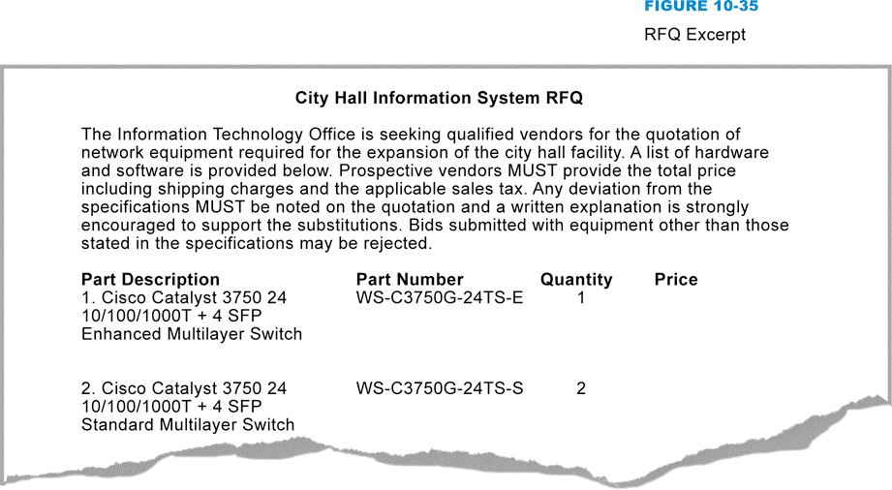
Evaluation and Selection
A request for quotation (RFQ) is a request for a formal price quotation on a list of hardware and software
Notes:
Figure 10-35

Slide 39
Application Specifications
Describe the way the information system’s software should interact with users, store data, process data, and format reports
Feature creep refers to the failure to constrain change
Changes should be managed formally, including written change requests

Slide 40
Section D: Implementation and Maintenance
Implementation Phase
Development and Testing
Documentation and Training
Conversion and Cutover
Maintenance Phase

Slide 41
Question
102400 Suppose you’re the system administrator for a large corporate information system that was installed about a year ago. What is most likely your biggest concern?
A. Feature creep
B. Quality of service
C. Pilot conversion
D. Application specifications

Slide 42
Implementation Phase
Project team supervises the tasks necessary to construct the new information system
Notes:
Figure 10-37

Slide 43
Development and Testing
Software customization is the process of modifying a commercial application to reflect an organization’s needs
Application testing is performed in three ways:
Unit testing
Integration testing
Test area
System testing

Slide 44
Development and Testing
Notes:
Figure 10-38

Slide 45
Documentation and Training
System documentation
Describes a system’s features, hardware architecture, and programming
User documentation
Describes how to interact with the system to accomplish specific tasks
Procedure handbook
Contains step-by-step instructions for performing specific tasks

Slide 46
Conversion and Cutover
System conversion
Deactivating an old information system and activating a new one
Several conversion strategies:
Direct conversion
Parallel conversion
Phased conversion
Pilot conversion
Acceptance testing is designed to verify that the new information system works as required

Slide 47
Maintenance Phase
Involves day-to-day operation of the system, making modifications to improve performance, and correcting problems
The term quality of service (QoS) refers to the level of performance a computer system provides
Notes:
Figure 10-41

Slide 48
Maintenance Phase
The computer operator is responsible for operating the computer on a day-to-day basis
The systems programmer installs new versions of the operating system and modifies settings to maximize performance
The help desk is staffed by technical support specialists who are familiar with the information system’s software

Slide 49
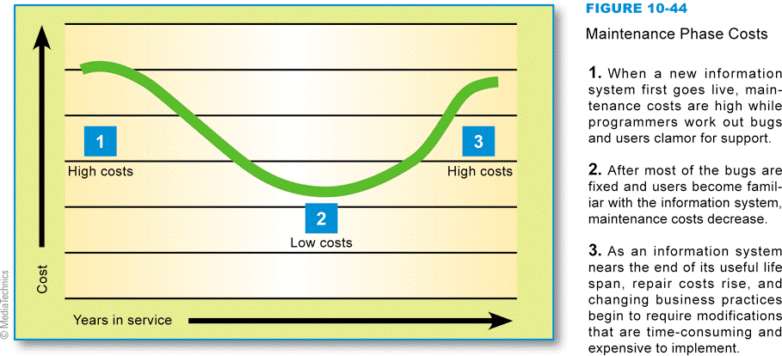
Maintenance Phase
Maintenance phase costs
Notes:
Figure 10-44

Slide 50
Section E: Corporate Data Security
Information System Data Vulnerabilities
Information System Data Security
Corporate Identity Theft

Slide 51
Question
102500 How easy it is to create a fake site that looks like one for a legitimate business?
A. It is very difficult because of all the corporate logos and other art work at legitimate sites.
B. It is very difficult because real Web sites use HTML and HTTPS for security.
C. It is quite easy to change the URL of a legitimate site and then put a fake site in its place.
D. It is easy to cut and paste graphics from a legitimate site to make a fake site at a URL that is similar but not the same as the real site.

Slide 52
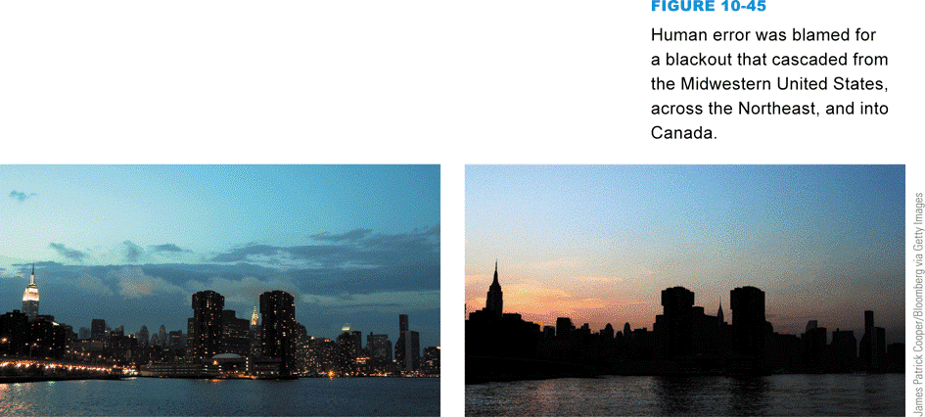
Information System Data Vulnerabilities
Threats to a corporate information system can affect thousands of people
Natural disasters
Power outages
Equipment failures
Human errors
Software failures
Security breaches
Acts of war
Malware
Notes:
Figure 10-45

Slide 53
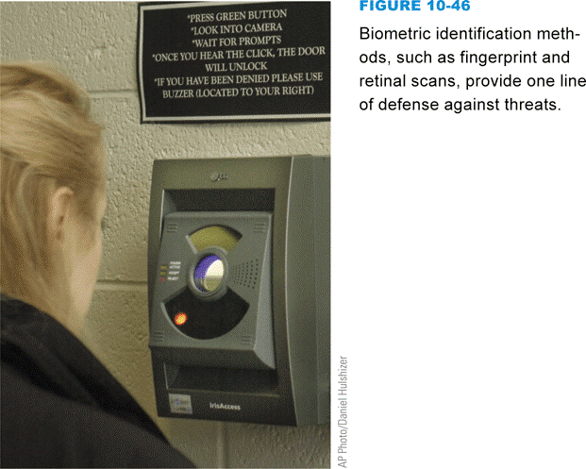
Information System Data Security
No computer system can be completely risk-free, but several proactive measures can protect information systems from threats
Deterrents
Preventative countermeasures
Corrective procedures
Detection activities
Notes:
Figure 10-46

Slide 54
Information System Data Security
A data center is a specialized facility designed to hold and protect computer systems and data
A disaster recovery plan is a step-by-step plan that describes the methods used to secure data against disaster and sets guidelines for how an organization will recover lost data if and when a disaster occurs
Notes:
Figure 10-48

Slide 55
Corporate Identity Theft
When a company’s brand is used without authorization, the company has become a victim of identity theft
The Internet makes it easy to steal corporate identities and use them for phishing scams and fake Web sites
Savvy consumers are on the lookout for phishing attacks and avoid clicking links embedded in e-mail messages

Slide 56
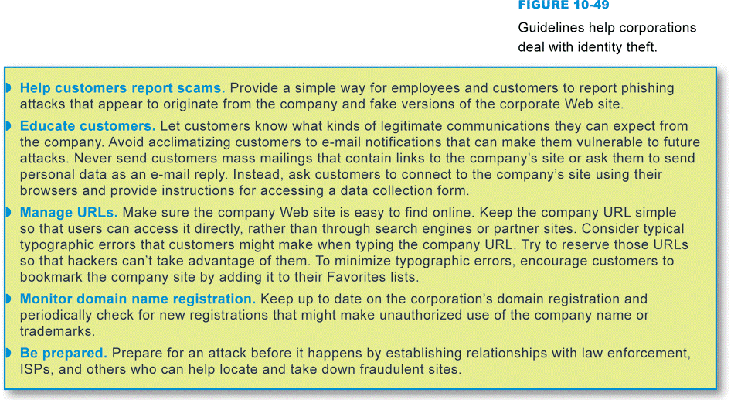
Corporate Identity Theft
Guidelines help corporations deal with identity theft
Notes:
Figure 10-49

Slide 57
What Do You Think?
103100 Would you prefer online voting to voting at a polling place?
A. Yes B. No C. Not sure
103200 Do you think online voters would disproportionately vote for Republicans?
A. Yes B. No C. Not sure
103300 Should online voting be available only to specific groups, such as elderly voters and military personnel stationed abroad, who currently have trouble reaching polling places?
A. Yes B. No C. Not sure

Slide 58
Chapter 10 Complete

