Slide 1
Chapter 11 Databases

Slide 2
Chapter Contents
Section A: File and Database Concepts
Section B: Data Management Tools
Section C: Database Design
Section D: SQL
Section E: Database Security

Slide 3
FastPoll True/False Questions Answer A for True and B for False
110100 Predictive data entry produces data warehouses and OLAPs.
110200 The simplest model for storing data is a flat file.
110300 A fixed-length field contains field names and record types.
110400 An ERD shows relationships and cardinality.
110500 The most popular business database model is based on a relational database.

Slide 4
FastPoll True/False Questions Answer A for True and B for False
110600 Spreadsheet software is optimized for working with relational data.
110700 Database software such as Microsoft Access provides an option to produce HTML formatted reports.
110800 XML is a database model that combines flat files and relational database models.
110900 BLOB and SQL are data types.

Slide 5
FastPoll True/False Questions Answer A for True and B for False
111000 The goal of normalization is to reduce data redundancy.
111100 Sorting a database is the same as indexing it.
111200 Databases transmitted over the Web can be encrypted using HTML.
111300 A database audit can sometimes identify unauthorized intrusion attempts.

Slide 6
Section A: File and Database Concepts
Database Basics
Database Models

Slide 7
Question
112100 The plots for several recent movies revolve around the government’s use of what technology to identify terrorists based on spending habits and other data stored in commercial and government databases?
A. Predictive analytics
B. Executive dashboards
C. ERDs
D. Data cubes

Slide 8
Database Basics
A database is a collection of information
Typically stored as computer files
The tasks associated with creating, maintaining, and accessing the information in databases are referred to as data management, file management, or database management
Notes:
Figure 11-1

Slide 9
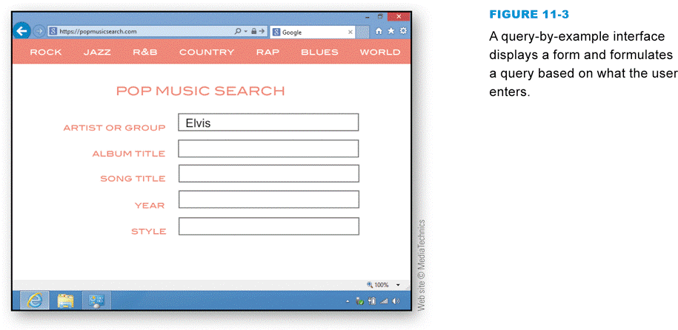
Database Basics
Databases can be used in a variety of ways
Collect and store data
Update data
Organize and output data
Distribute data
Find data
Analyze data
Notes:
Figure 11-3

Slide 10
Database Basics
Data mining refers to the process of analyzing existing database information to discover previously unknown and potentially useful information, including relationships and patterns
Data warehouse
Predictive analytics

Slide 11
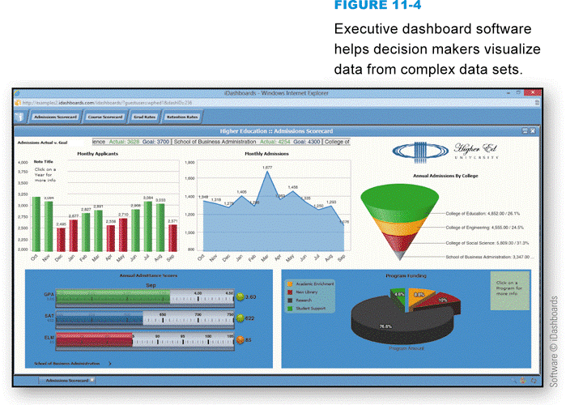
Database Basics
OLAP (online analytical processing) allows decision makers to quickly get answers to complex queries
Executive dashboard software
Big data
Notes:
Figure 11-4

Slide 12
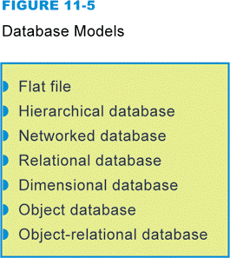
Database Models
An unstructured file has a unique structure and contains different kinds of data
A structured file uses a uniform format to store data
The underlying structure of a database is referred to as a database model
Notes:
Figure 11-5

Slide 13
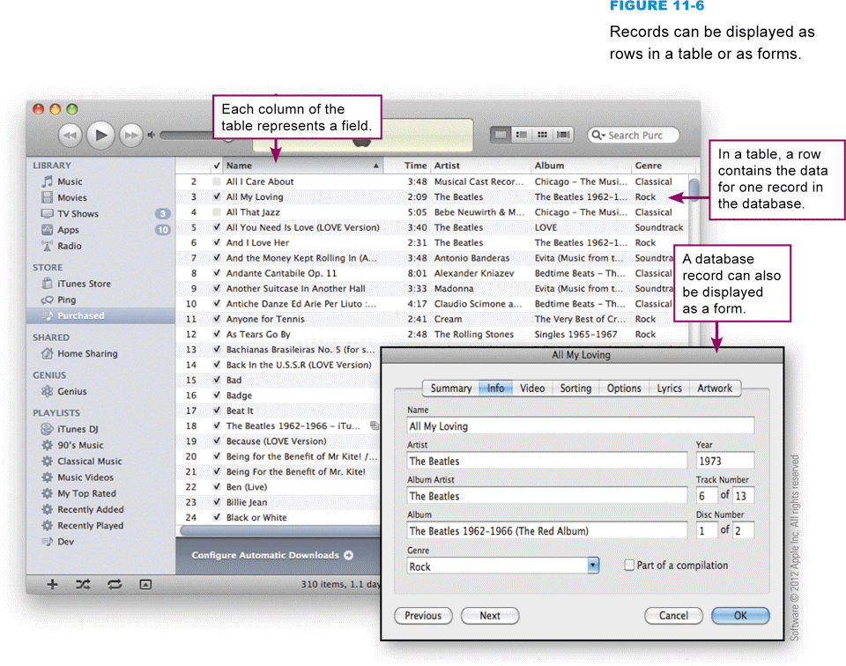
Database Models
The simplest model for storing data is a flat file that consists of a single, two-dimensional table of data elements
Notes:
Figure 11-6

Slide 14
Database Models
A field contains the smallest unit of meaningful information
Each field has a unique field name
Variable-length field vs. fixed-length field
Notes:
Figure 11-7

Slide 15
Database Models
A record is a collection of data fields
The template for a record is referred to as a record type
A record that contains data is referred to as a record occurrence
Notes:
Figure 11-8

Slide 16
Database Models
A relationship is an association between data that is stored in different record types
Cardinality
One-to-many relationship
Many-to-many relationship
One-to-one relationship

Slide 17
Database Models
Cardinality refers to the number of associations that can exist between two record types
The relationship between record types can be depicted graphically with an entity-relationship diagram
Notes:
Figure 11-9

Slide 18
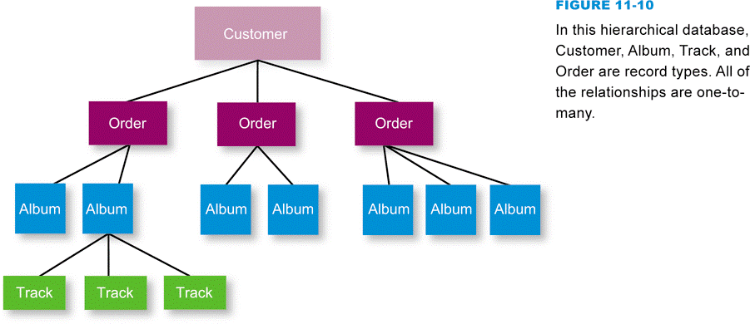
Database Models
A hierarchical database allows one-to-one and one-to-many relationships, linked in a hierarchical structure
Notes:
Figure 11-10

Slide 19
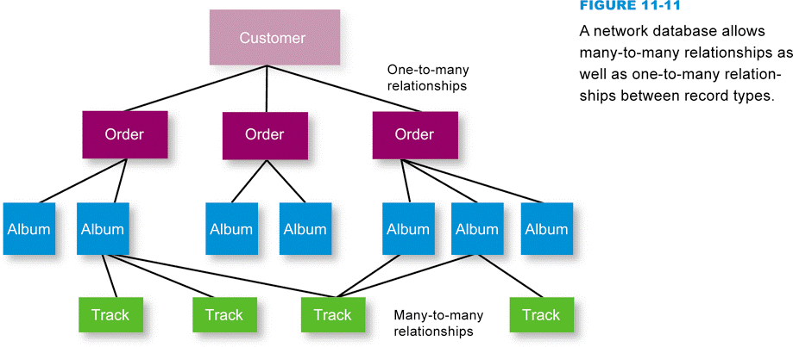
Database Models
A network database uses a mesh-like structure to offer the additional capacity to define many-to-many relationships
Notes:
Figure 11-11

Slide 20
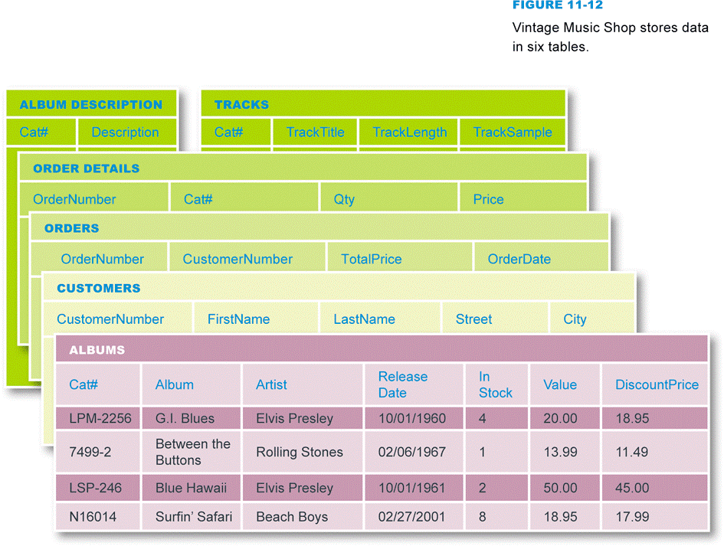
Database Models
A relational database stores data in a collection of related tables
Notes:
Figure 11-12

Slide 21
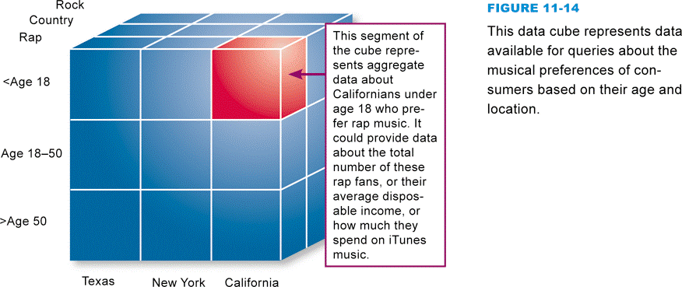
Database Models
A dimensional database organizes relationships over three or more dimensions
Notes:
Figure 11-14

Slide 22
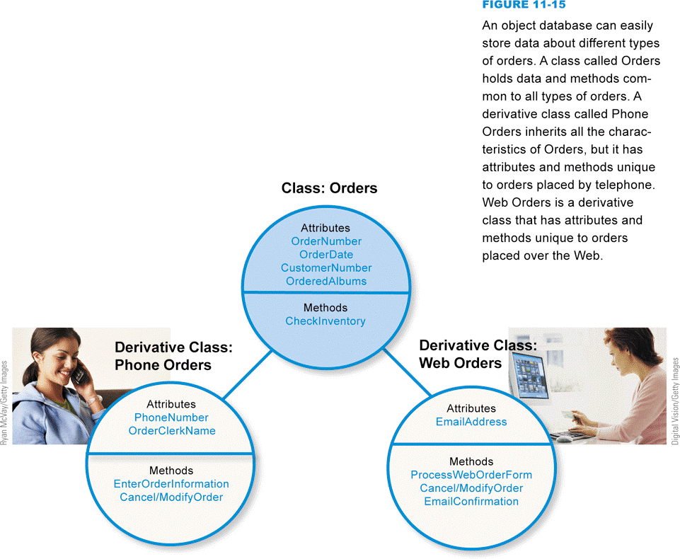
Database Models
An object database stores data as objects, which can be grouped into classes and defined by attributes and methods
Notes:
Figure 11-15

Slide 23
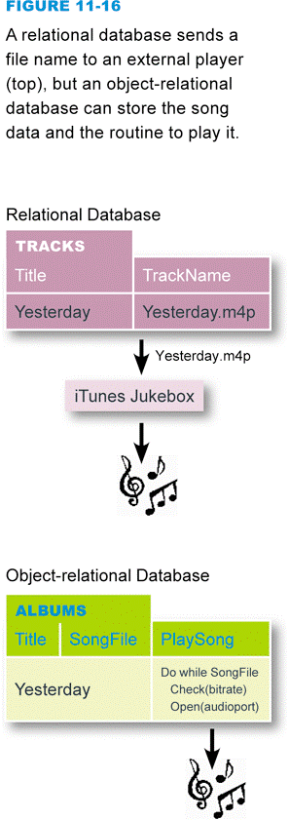
Database Models
The term object-relational database is used to describe a variety of technologies that combine object-oriented and relational concepts
Notes:
Figure 11-16

Slide 24
Section B: Data Management Tools
Data Management Software
Database Management Systems
Databases and the Web
XML

Slide 25
Question
112200 Most people have purchased merchandise from Amazon.com and similar online stores. What technology do these sites use to describe merchandise and handle customer shopping carts?
A. Static Web publishing
B. Spreadsheet data management
C. Server-side programming
D. E-commerce client software

Slide 26
Data Management Software
Notes:
Figure 11-17

Slide 27
Data Management Software
Notes:
Figure 11-18

Slide 28
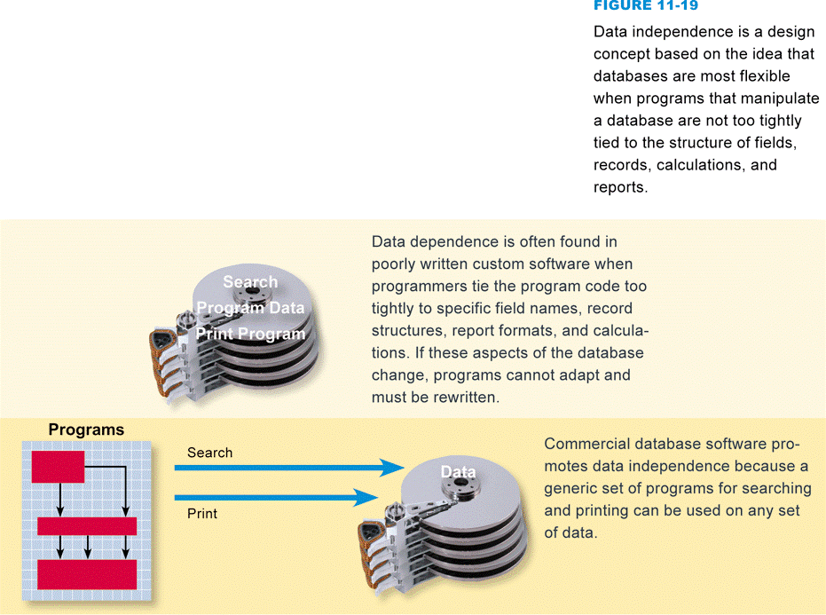
Data Management Software
It is possible to enter data as ASCII text file
Custom data management software
Data dependence vs. data independence
Notes:
Figure 11-19

Slide 29
Database Management Systems
Software designed to manage data stored in a database
XML DBMS
OODBMS
RDBMS

Slide 30
Database Management Systems
Notes:
Figure 11-21

Slide 31
Database Management Systems
Database client software allows any remote computer or network workstation to access data in a database
Notes:
Figure 11-22

Slide 32
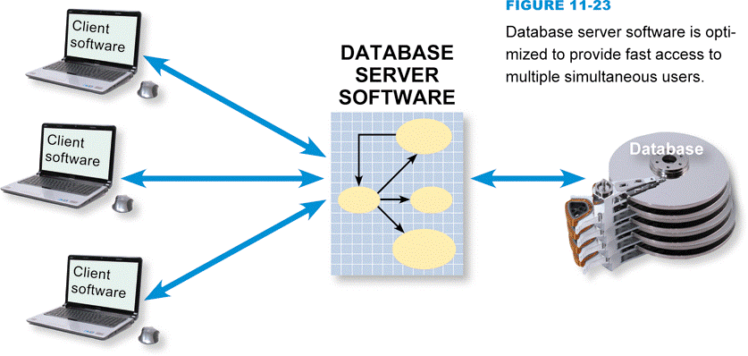
Database Management Systems
Multiple users can interact with the same database
Notes:
Figure 11-23

Slide 33
Databases and the Web
The Web allows access to many databases
Static Web publishing
Dynamic Web publishing
Server-side program

Slide 34
Databases and the Web
Notes:
Figure 11-24

Slide 35
Databases and the Web
Notes:
Figure 11-25

Slide 36
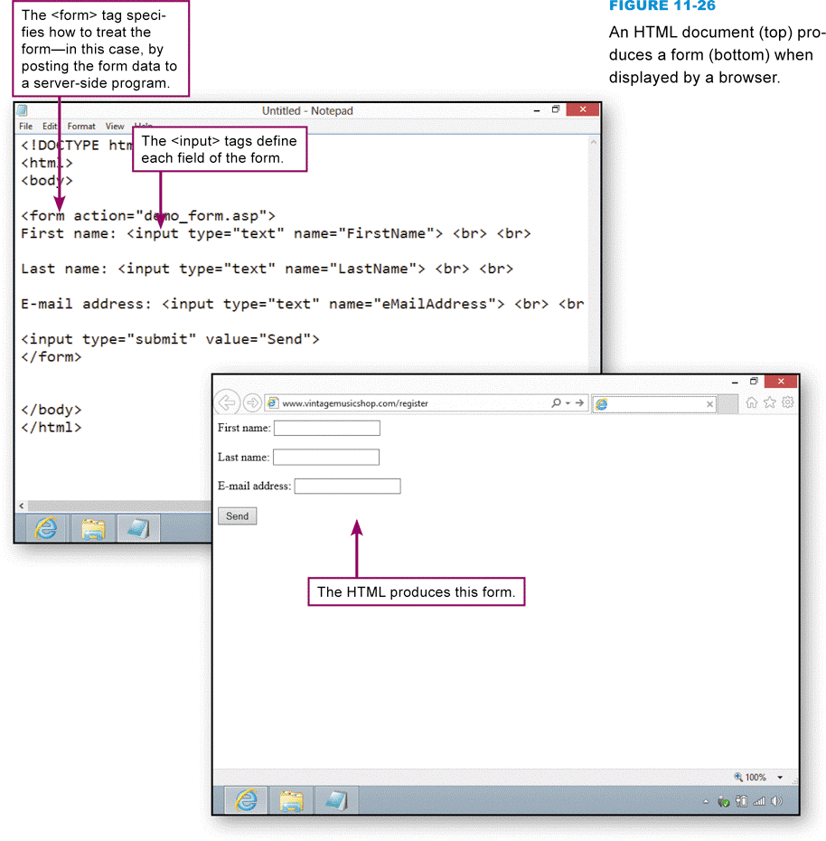
Databases and the Web
HTML forms can collect data, as well as specifications for a query
Notes:
Figure 11-26

Slide 37
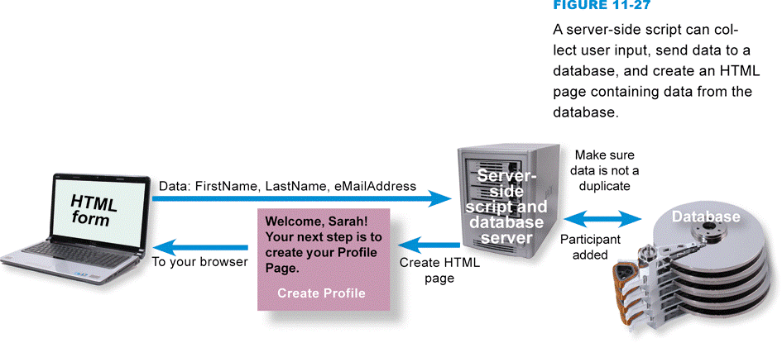
Databases and the Web
The process of sending data to a database requires several data handoffs
Server-side script
Notes:
Figure 11-27

Slide 38
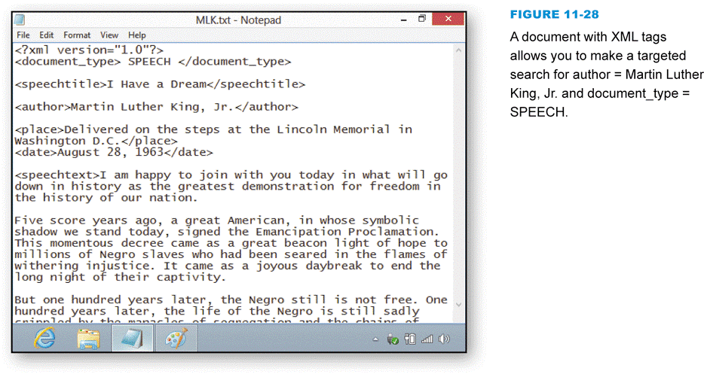
XML
Markup language that allows field tags, data, and tables to be incorporated into a Web document
Notes:
Figure 11-28

Slide 39
XML
Language used to specify a standard structure of fields and records
Data in an XML document is searchable
XML is portable, but not optimized for many common database operations
Consider storing data in a relational database, managing it with RDBMS software, and generating XML documents for exchanging data over the Web

Slide 40
Section C: Database Design
Defining Fields
Normalization
Organizing Records
Designing the Interface
Designing Report Templates
Loading Data

Slide 41
Question
112300 Most commercial databases store data in a series of tables, rather than in a single flat file. Why?
A. To reduce data redundancy
B. To maintain unique sort keys
C. To enable field validation rules
D. To avoid case sensitivity

Slide 42
Defining Fields
The term database structure refers to the arrangement of fields, tables, and relationships in a database
Break data into fields just by using common sense and considering how people might want to access the data
Use a primary key field to make each record unique
Use appropriate data types for each field

Slide 43
Defining Fields
Notes:
Figure 11-33

Slide 44
Defining Fields
A computed field is a calculation that a DBMS performs during processing and temporarily stores in a memory location
Uppercase and lowercase are not always treated the same
Case sensitive database
Use field formats to show what the data is supposed to look like when it’s entered
Use field validation rules to filter data

Slide 45
Normalization
Process that helps save storage space and increase processing efficiency
Minimizes data redundancy
Notes:
Figure 11-38

Slide 46
Organizing Records
Records can be organized in different ways, depending on use
Sorting
A table’s sort order refers to the order in which records are stored on disk
Sort key
Database index
Similar to the index in a book

Slide 47
Organizing Records
Notes:
Figure 11-40

Slide 48
Designing the Interface
Arrange fields in a logical order
Provide visual clues to the entry areas
Entry areas should appear in a consistent position relative to their labels
Provide a quick way to move through the fields in order

Slide 49
Designing the Interface
Use scrolling or create multiple screens, if necessary
Provide buttons or other easy-to-use controls for moving from one record to another
Supply on-screen instructions

Slide 50
Designing the Interface
Notes:
Figure 11-42

Slide 51
Designing Report Templates
Report generators are used to specify the content and format for a database report
A report template contains the outline or general specifications for a report
Notes:
Figure 11-43

Slide 52
Designing Report Templates
Supply only the information required
Present information in a usable format
Information should be timely
Information should be presented in a clear, unambiguous format
Present information in the most appropriate format for the audience

Slide 53
Loading Data
Data can be loaded into a database by:
Using generic data entry tools
Using a customized data entry module
A conversion routine converts the data from its current format into a format that can be automatically incorporated into the new database

Slide 54
Section D: SQL
SQL Basics
Adding Records
Searching for Information
Updating Fields
Joining Tables

Slide 55
Question
112400 How does SQL relate to a typical computer user?
A. Because search engines like Google are databases, you can use SQL to make advanced searches.
B. You can use SQL to get beyond the main menu option on e-commerce sites like the iTunes store.
C. You can use SQL to find music at free file sharing sites.
D. Knowing how a query language works can help you understand how databases work behind the scenes.

Slide 56
SQL Basics
Intermediary between the database client software and the database itself
Notes:
Figure 11-45

Slide 57
SQL Basics
Notes:
Figure 11-46

Slide 58
Adding Records
Notes:
Figure 11-47

Slide 59
Searching for Information
SELECT Album, AlbumCover FROM Albums
WHERE Artist = ‘Jefferson Airplane’
The AND, OR, and NOT Boolean operators are used to perform complex queries
The use of parentheses indicates the part of the query to perform first

Slide 60
Updating Fields
UPDATE Albums
SET InStock = InStock – 1
WHERE Album = ‘G.I. Blues’
Global updates change the data in more than one record at a time
Works only for records with similar characteristics

Slide 61
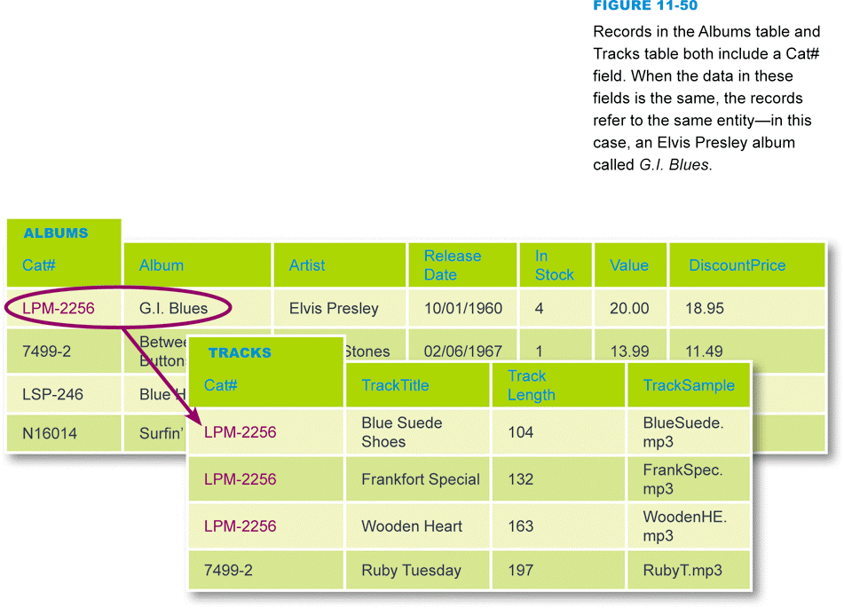
Joining Tables
Joining tables in SQL allows you to create relationships between tables
Notes:
Figure 11-50

Slide 62
Joining Tables
Notes:
Figure 11-51

Slide 63
Section E: Database Security
Database Vulnerabilities
Database Security Measures
Database Security Regulations
What Individuals Can Do

Slide 64
Question
112500 If you are a hacker trying to get your hands on a database with lots of social security numbers, what is the easiest way to do it?
A. Hack into the database of an ATM.
B. Steal a government computer, preferably a notebook that's been left unattended.
C. Tap into HIPAA.
D. Hack into a local business that has an unsecured wireless connection.

Slide 65
Database Vulnerabilities
Databases are vulnerable to physical theft, hacking, and unauthorized access
Databases can be stolen without going missing
There is hardly a person in America who is not in at least one computer database
Privacy is viewed as an inherent right
Importance of data accuracy
Data should be kept secure

Slide 66
Database Security Measures
Today’s computers are under assault from hackers and natural disasters
Security measures include encryption, access controls, data security policies, and intrusion monitoring
Encryption can make data in a database unintelligible to a hacker
The process of decrypting database information in response to a query typically increases the amount of time necessary to process each query

Slide 67
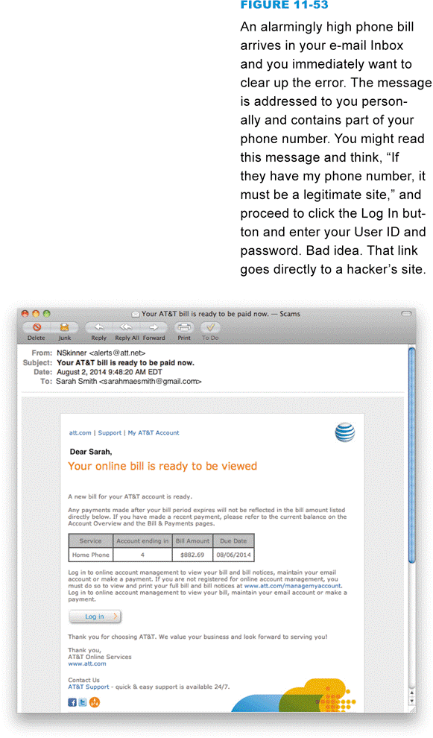
Database Security Measures
An access control limits access to systems, such as computer databases
Control who accesses the database
Control how users interact with the database
User privileges
Data view
Notes:
Figure 11-53

Slide 68
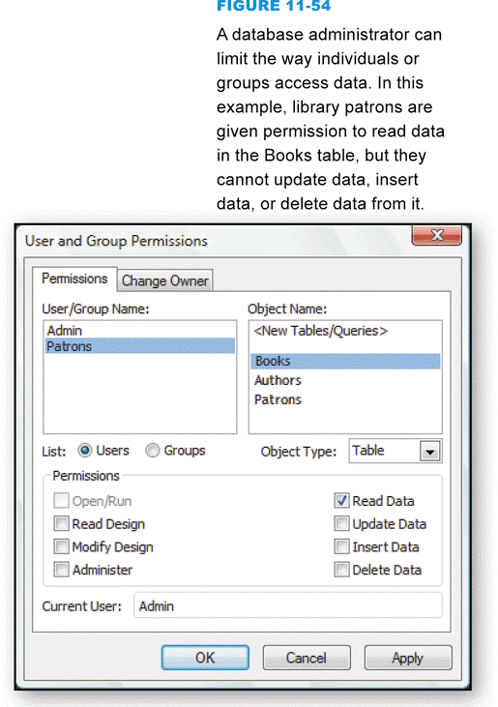
Database Security Measures
To minimize vulnerabilities caused by employee inattention, organizations can formulate database use policies
A database audit is a procedure that monitors and records user activity within a database
Notes:
Figure 11-54

Slide 69
Database Security Regulations
International e-commerce makes database security a global concern; many countries have enacted laws to protect personal data stored on databases
European Union’s Privacy Directive
Canada’s Personal Information Protection and Electronics Document Act
U.S. Privacy Act of 1974
USA PATRIOT Act
Video Privacy Protection Act
Health Insurance Portability and Accountability Act 1996
Gramm-Leach-Bliley Act 1999

Slide 70
What Individuals Can Do
The key to minimizing your risk is to be vigilant about the information you divulge
Know when data is being collected
Find out how data is being used
Find out what data is retained
Supply only the data that is required
Opt-out when possible
Protect your passwords
Don’t trade your privacy
Use antivirus software
Do not reply to spam
Before registering, check the site’s privacy policy

Slide 71
What Individuals Can Do
Notes:
Figures 11-56 and 11-57

Slide 72
What Do You Think?
113100 Should your government continue to develop and deploy data mining techniques designed to identify terrorists?
A. Yes B. No C. Not sure
113200 Are you concerned about your personal data being included in government data mining operations?
A. Yes B. No C. Not sure
113300 Do you think that governments should apologize to and compensate individuals who are inappropriately harmed by data mining operations?
A. Yes B. No C. Not sure

Slide 73
Chapter 11 Complete

