Slide 1
Chapter 12 Computer Programming

Slide 2
Chapter Contents
Section A: Programming Basics
Section B: Procedural Programming
Section C: Object-Oriented Programming
Section D: Declarative Programming
Section E: Secure Programming

Slide 3
FastPoll True/False Questions Answer A for True and B for False
120100 A line of program code typically contains a keyword or command.
120200 BASIC, COBOL, and C are classified as third-generation languages.
120300 Programming paradigms include FORTRAN and Ada.
120400 In a program, a variable represents a value that can change.
120500 VDE is an example of an object-oriented programming language.
120600 A programmer who omits a command word from a line of code has made a logic error.

Slide 4
FastPoll True/False Questions Answer A for True and B for False
120700 Programmers use a tool called an errata to step through a program to locate syntax errors.
120800 Pseudocode is a bug or error in a line of program code.
120900 A control structure specifies the sequence in which a program is executed.
121000 FOR…NEXT and DO…WHILE are examples of commands for loops.
121100 A programmer could define a class called “pizza” to solve the pizza problem using object-oriented programming.
121200 Inheritance, methods, messages, and polymorphism are associated with the declarative paradigm.

Slide 5
FastPoll True/False Questions Answer A for True and B for False
121300 Goals, rules, and instantiation are associated with the agile paradigm.
121400 Java is a declarative programming language.
121500 Prolog facts contain an argument and a predicate.
121600 Buffer overflows are associated with security vulnerabilities.
121700 Programmers can use threat modeling and formal methods to create more secure programs.

Slide 6
Section A: Programming Basics
Computer Programming and Software Engineering
Programming Languages and Paradigms
Program Planning
Program Coding
Program Testing and Documentation
Programming Tools

Slide 7
Question
122100 Computer programming languages have evolved through several generations. Experts are not in agreement about what constitutes a fifth-generation programming language. What is the controversy?
A. Some experts believe that assembly languages should be included, whereas other experts do not.
B. Some experts believe declarative languages are fifth-generation languages, whereas other experts believe that fifth-generation languages are those that allow programmers to use graphical tools to construct programs.
C. Most experts believe that languages like C, BASIC, and Java are fifth-generation languages, but programmers disagree because those languages follow the procedural paradigm.
D. A few experts don’t believe there is a fifth-generation of programming languages, but most experts think that Japanese computer scientists invented fifth-generation languages when they produced C++.

Slide 8
Computer Programming and Software Engineering
The instructions that make up a computer program are sometimes referred to as code
Programs can have millions of lines of code
Developed by computer programmers
Computer programming

Slide 9
Computer Programming and Software Engineering
Notes:
Figure 12-1

Slide 10
Programming Languages and Paradigms
Programming languages are made up of keywords and grammar rules designed for creating computer instructions
Keywords can be combined with specific parameters
Low-level languages typically include commands specific to a particular CPU or microprocessor family
High-level languages use command words and grammar based on human languages

Slide 11
Programming Languages and Paradigms
First-generation languages
Machine language
Second-generation languages
Assembly language
Third-generation languages
Easy-to-remember command words

Slide 12
Programming Languages and Paradigms
Fourth-generation languages
More closely resembles human language
Fifth-generation languages
Based on a declarative programming paradigm
The programming paradigm refers to a way of conceptualizing and structuring the tasks a computer performs

Slide 13
Programming Languages and Paradigms
Notes:
Figure 12-8

Slide 14
Program Planning
The problem statement defines certain elements that must be manipulated to achieve a result or goal
You accept assumptions as true to proceed with program planning
Known information helps the computer to solve a problem
Variables vs. constants

Slide 15
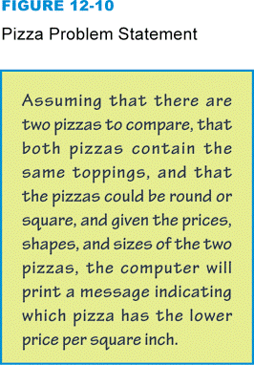
Program Planning
Problem statement:
Notes:
Figure 12-10

Slide 16
Program Coding
Notes:
Figure 12-11

Slide 17
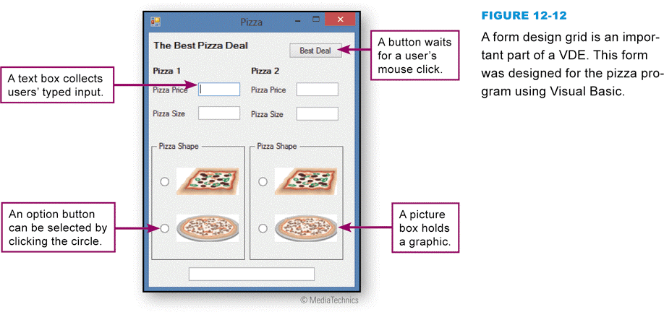
Program Coding
A VDE (visual development environment) provides programmers with tools to build substantial sections of a program
Form design grid
Control
Properties
Event
Event-handling code
Notes:
Figure 12-12

Slide 18
Program Coding
Notes:
Figure 12-13

Slide 19
Program Coding
Notes:
Figure 12-14

Slide 20
Program Testing and Documentation
A computer program must be tested to ensure that it works correctly
Program errors include:
Syntax errors
Runtime errors
Logic errors
A debugger can help a programmer read through lines of code and solve problems

Slide 21
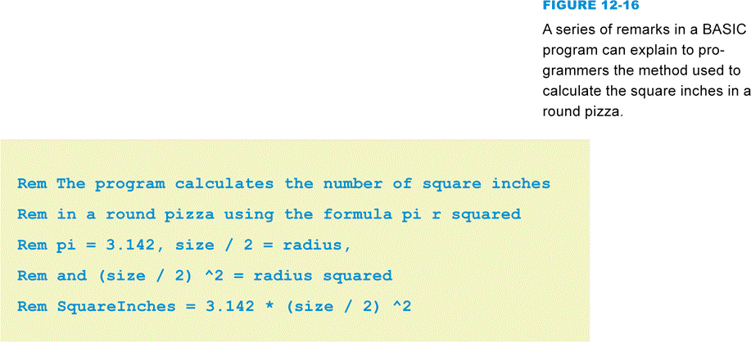
Program Testing and Documentation
Remarks or “comments” are a form of documentation that programmers insert into the program code
Notes:
Figure 12-16

Slide 22
Programming Tools
An SDK (software development kit) is a collection of language-specific programming tools that enables a programmer to develop applications for a specific computer platform
An IDE (integrated development environment) is a type of SDK that packages a set of development tools into a sleek programming application

Slide 23
Programming Tools
A component is a prewritten module, typically designed to accomplish a specific task
An API is a set of application program or operating system functions that programmers can access from within the programs they create
C, Java, and C++ are the most popular programming languages
Microsoft’s XNA framework is a set of tools for creating Xbox 360 games
Objective-C is popular for creating apps for iPhones and iPads

Slide 24
Section B: Procedural Programming
Algorithms
Expressing an Algorithm
Sequence, Selection, and Repetition Controls
Procedural Languages and Applications

Slide 25
Question
122200 Procedural programs are based on a step-by-step algorithm. How do programmers devise the algorithms for their programs?
A. They create objects, classes, and methods, and then figure out the step-by-step way to send messages back and forth between them.
B. They look at APIs and VDEs, which offer templates for common program functions.
C. They think about how a task might be carried out manually and devise flowcharts, structured English, or pseudocode to describe the steps.
D. They first devise facts about the problem, then they come up with the steps based on rules.

Slide 26
Algorithms
Set of steps for carrying out a task that can be written down and implemented
Start by recording the steps you take to solve the problem manually
Specify how to manipulate information
Specify what the algorithm should display as a solution

Slide 27
Algorithms
Notes:
Figure 12-21

Slide 28
Expressing an Algorithm
Structured English
Pseudocode
Notes:
Figure 12-22

Slide 29
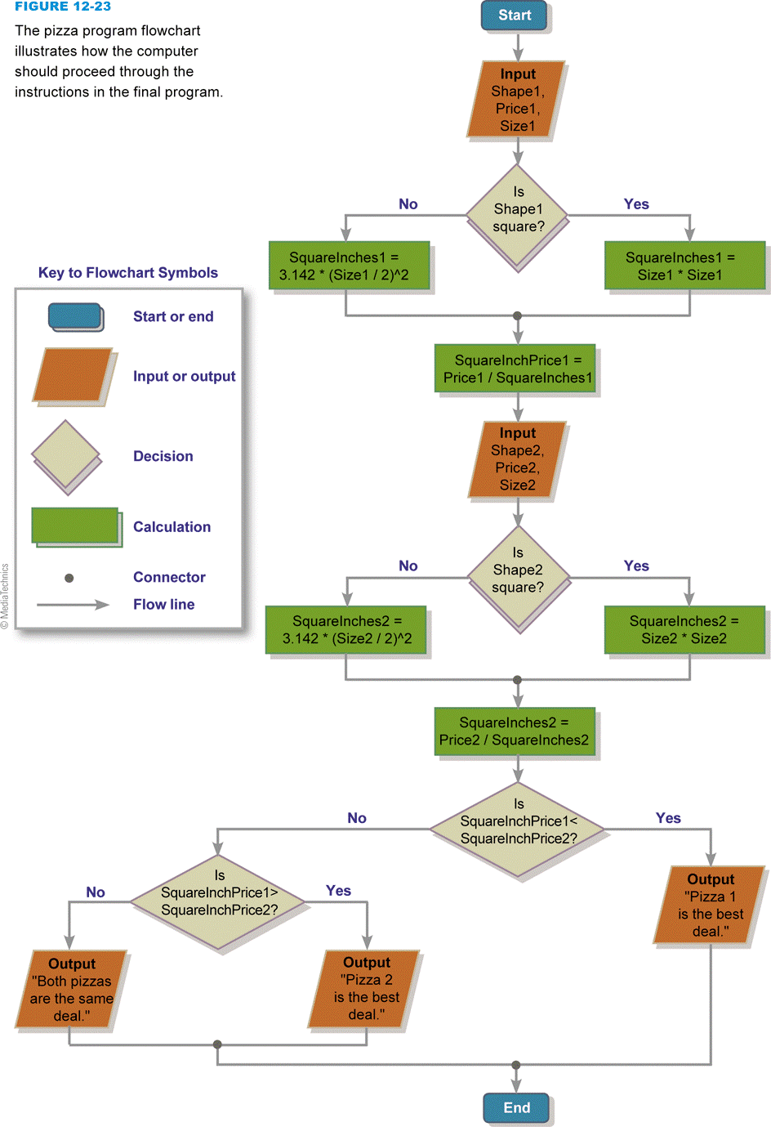
Expressing an Algorithm
Flowchart
Notes:
Figure 12-23

Slide 30
Expressing an Algorithm
Perform a walkthrough to verify that your algorithm works
Notes:
Figure 12-24

Slide 31
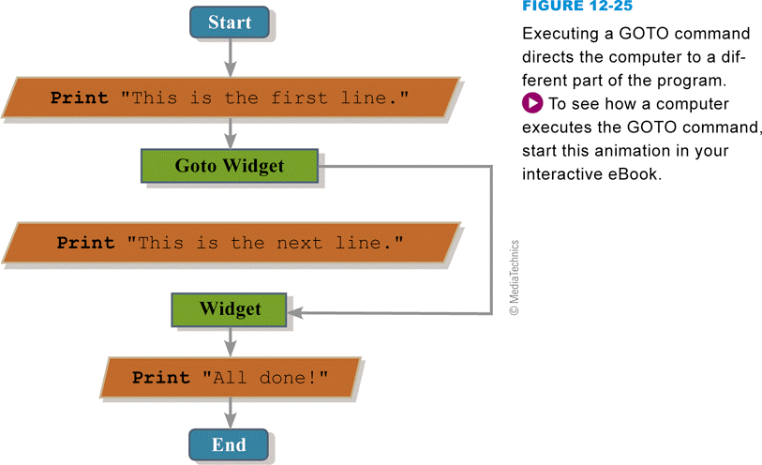
Sequence, Selection, and Repetition Controls
Sequence control structure
Notes:
Figure 12-25

Slide 32
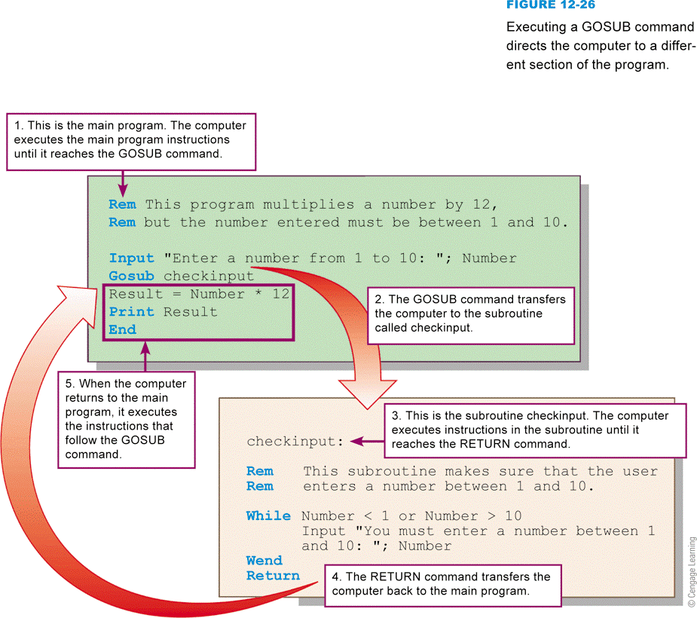
Sequence, Selection, and Repetition Controls
Subroutines, procedures, and functions are sections of code that are part of the program, but not included in the main sequential execution path
Notes:
Figure 12-26

Slide 33
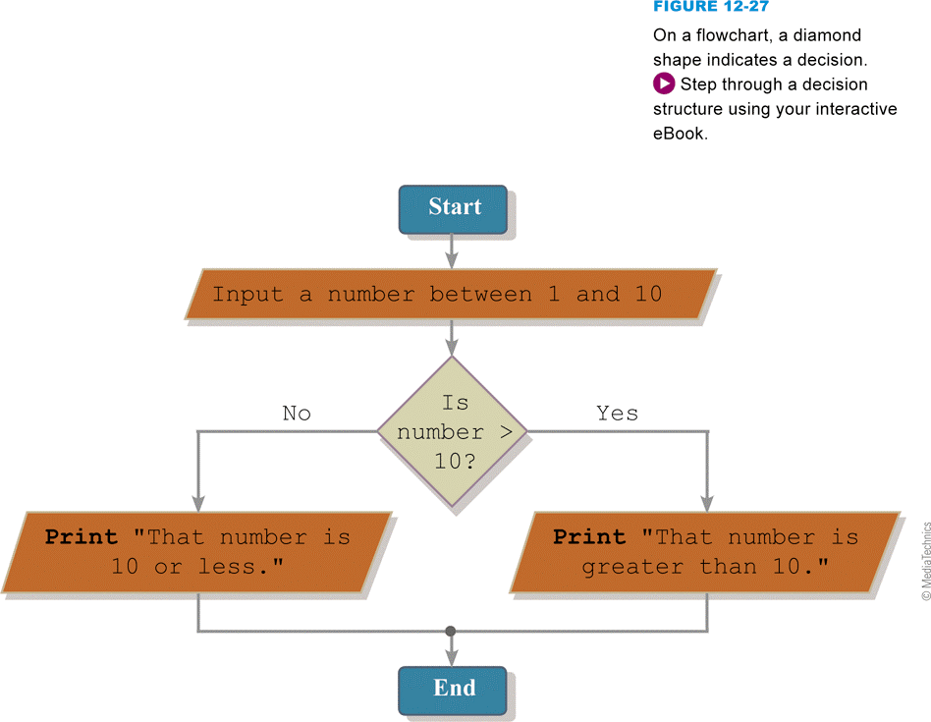
Sequence, Selection, and Repetition Controls
Selection control structure
Notes:
Figure 12-27

Slide 34
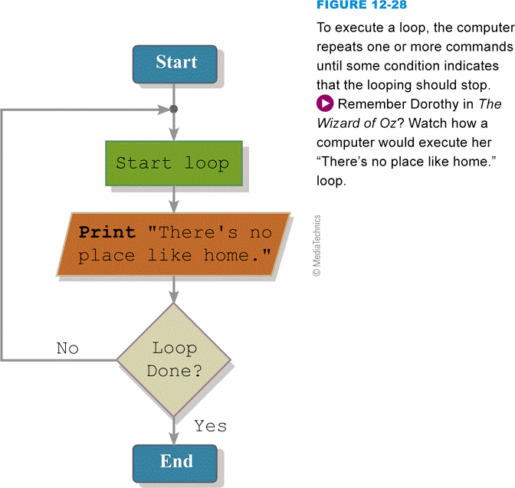
Sequence, Selection, and Repetition Controls
Repetition control structure
Notes:
Figure 12-28

Slide 35
Procedural Languages and Applications
Popular procedural languages: COBOL, FORTH, APL, ALGOL, PL/1, Pascal, C, Ada, and BASIC
The procedural approach is best for problems that can be solved by following a step-by-step algorithm
Produces programs that run quickly and use system resources efficiently

Slide 36
Section C: Object-Oriented Programming
Objects and Classes
Inheritance
Methods and Messages
Object-oriented Program Structure
Object-oriented Languages and Applications

Slide 37
Question
122300 Object-oriented programming has become quite popular. Why?
A. It allows programmers to structure problems in a cognitively similar way as they perceive the real world.
B. Object-oriented programs are the fastest, most efficient type of programs for today’s computer hardware.
C. It creates the most secure programs, with the fewest security holes.
D. It is the best programming paradigm for working with words and concepts.

Slide 38
Objects and Classes
An object represents an abstract or real-world entity
A class is a template for a group of objects with similar characteristics
A class attribute defines the characteristics of a set of objects
Public vs. private attributes
Notes:
Figure 12-30

Slide 39
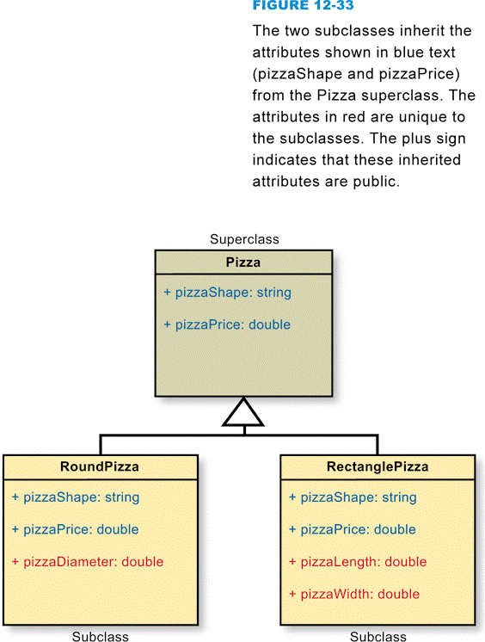
Inheritance
Passing certain characteristics from one class to other classes
Class hierarchy
Superclass
Subclass
Notes:
Figure 12-33

Slide 40
Methods and Messages
A method is a segment of code that defines an action
Collect input, perform calculations, etc.
A method is activated by a message
Can be defined along with the class they affect
Polymorphism refers to the ability to redefine a method in a subclass
Helps simplify program code

Slide 41
Object-Oriented Program Structure
Notes:
Figure 12-39

Slide 42
Object-Oriented Program Structure
Notes:
Figure 12-40

Slide 43
Object-Oriented Program Structure
Notes:
Figure 12-41

Slide 44
Object-Oriented Languages and Applications
SIMULA was believed to be the first object-oriented computer language
The Dynabook project was the second major development in object-oriented languages
Popular hybrid languages today are Ada 2005, C++, Visual Basic, Objective-C, and C# and include both procedural and object-oriented techniques
Facets of the object-oriented paradigm can also increase a programmer’s efficiency because encapsulation allows objects to be adapted and reused in a variety of different programs

Slide 45
Section D: Declarative Programming
The Declarative Paradigm
Prolog Facts
Prolog Rules
Input Capabilities
Declarative Languages and Applications

Slide 46
Question
122400 Declarative languages, such as Prolog, are very powerful for programs that involve words, concepts, and complex logic, but why aren’t these languages a first choice for programming computer games?
A. They don’t execute as fast as programs written with procedural languages.
B. They are too difficult to learn.
C. They have too many security holes.
D. They require expensive compilers.

Slide 47
The Declarative Paradigm
Describes aspects of a problem that lead to a solution
A fact is a statement for solving a problem
Rules describe the relationship between facts

Slide 48
The Declarative Paradigm
A decision table is a tabular method for visualizing and specifying rules based on multiple factors
Notes:
Figure 12-43

Slide 49
Prolog Facts
Notes:
Figure 12-44

Slide 50
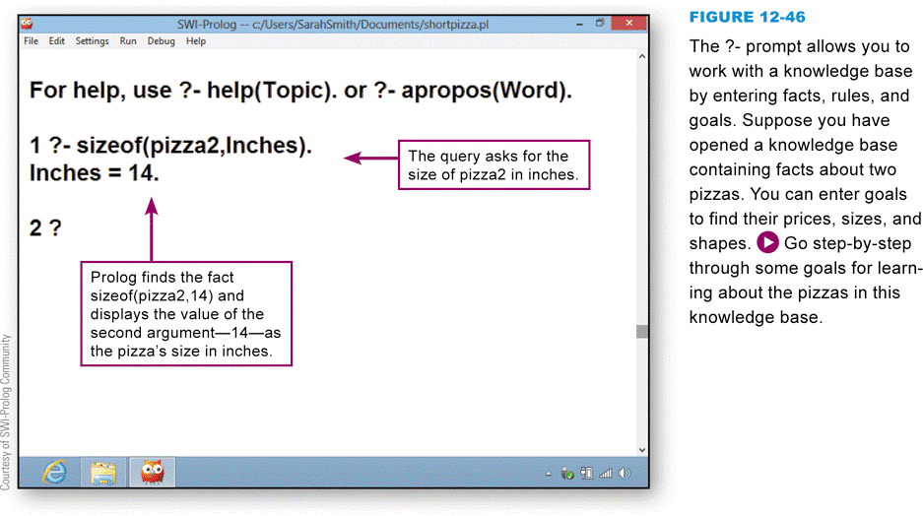
Prolog Facts
You can query a Prolog program’s database by asking a question, called a goal
Notes:
Figure 12-46

Slide 51
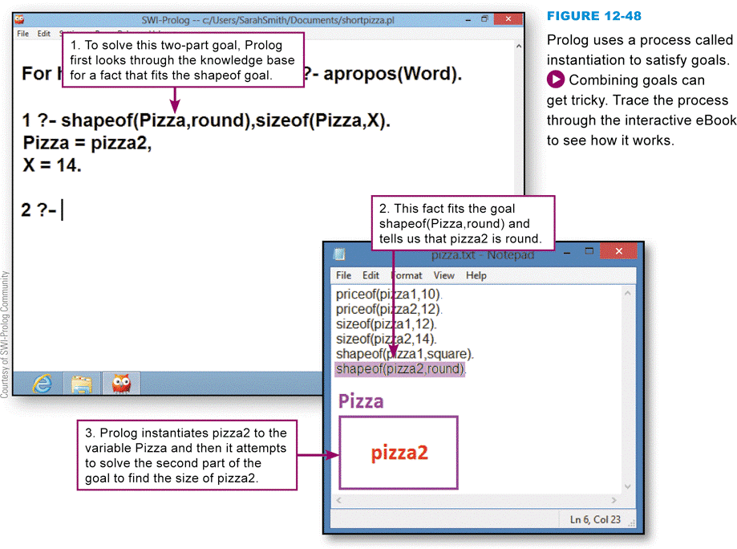
Prolog Facts
Finding a value for a variable is referred to as instantiation
Notes:
Figure 12-48

Slide 52
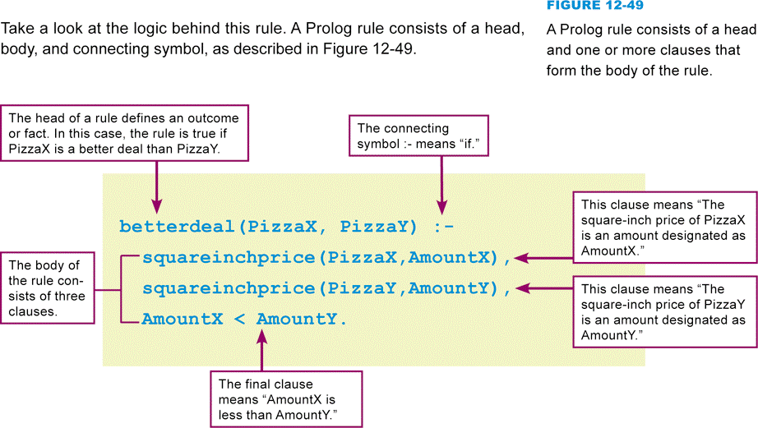
Prolog Rules
The order of program instructions is critically important
Notes:
Figure 12-49

Slide 53
Input Capabilities
Notes:
Figure 12-52

Slide 54
Declarative Languages and Applications
Declarative programming languages are most suitable for problems that involve words, concepts, and complex logic
Highly effective programming environment
Not commonly used for production applications
Minimal input and output capabilities

Slide 55
Section E: Secure Programming
Black Hat Exploits
Secure Software Development
Mitigation

Slide 56
Question
122500 Consumers are told to use security software because their computers are vulnerable to security exploits, but what is the source of security vulnerabilities?
A. Most security vulnerabilities are the fault of the user.
B. Threat modeling causes many of the vulnerabilities in today’s software.
C. Faulty programming that allows buffer overflows is one of the main causes of security vulnerabilities.
D. Operating system patches and DREAD categories are the source of the security vulnerabilities that affect most consumers.

Slide 57
Black Hat Exploits
Viruses, worms, bots, malicious Web scripts, and other exploits creep into computer systems
Black-hat exploits
A buffer overflow (also called a buffer overrun) is a condition in which data in memory exceeds its expected boundaries and flows into memory areas intended for use by other data

Slide 58
Black Hat Exploits
Notes:
Figure 12-54

Slide 59
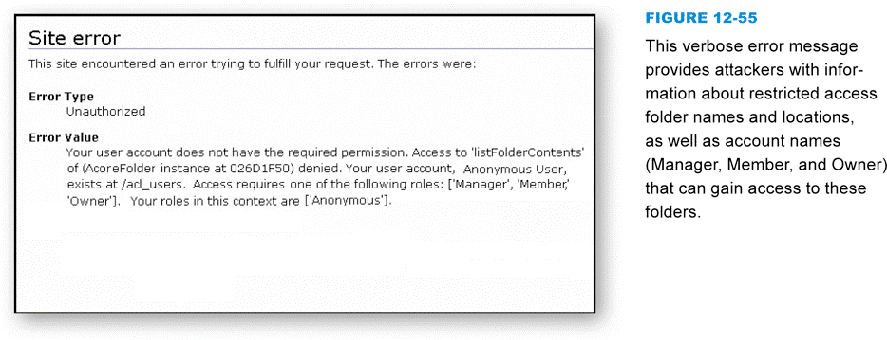
Black Hat Exploits
Error messages can help programmers locate the source of errors if they contain information pertinent to the location of defective code and the state of variables
Notes:
Figure 12-55

Slide 60
Secure Software Development
Most software security problems can be traced back to defects that programmers unintentionally introduce in software during design and development
Formal methods help programmers apply rigorous logical and mathematical models to software design, coding, testing, and verification
Threat modeling (risk analysis)

Slide 61
Secure Software Development
Notes:
Figure 12-56 and 12-57

Slide 62
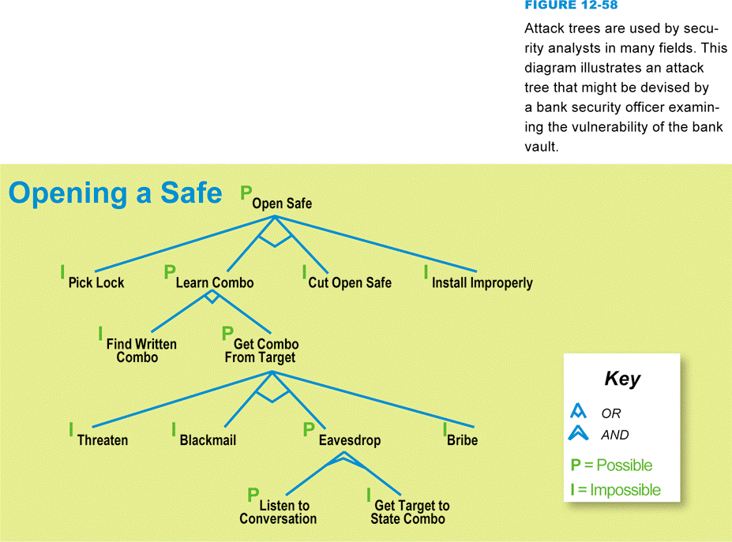
Secure Software Development
An attack tree is a hierarchical diagram of potential attacks against a system
Notes:
Figure 12-58

Slide 63
Secure Software Development
Defensive programming (also referred to as secure programming) is an approach to software development in which programmers anticipate what might go wrong as their programs run and take steps to smoothly handle those situations
Source code walkthroughs
Simplification
Filtering input

Slide 64
Secure Software Development
Signed code is a software program that identifies its source and carries a digital certificate attesting to its authenticity
Notes:
Figure 12-59

Slide 65
Mitigation
Despite defensive programming and other tactics to produce secure software, some defects inevitably remain undiscovered in products that end up in the hands of consumers
When bugs are discovered, the programmer’s remaining line of defense is to produce a bug fix or patch

Slide 66
Mitigation
Take the following steps to avoid security problems that stem from software defects:
Select applications from software publishers with a good security track record
Read reviews of products before you download them
Watch for patches and apply them
Consider using open source software, which has been extensively reviewed by the programming community
Keep your firewall and antivirus software deployed and up to date

Slide 67
What Do You Think?
123100 Have you played violent videogames?
A. Yes B. No C. Not sure
123200 Do you believe that violent videogames contribute to teen violence?
A. Yes B. No C. Not sure
123300 Do you think that states might be able to craft legislation that limits violent videogames without eroding principles of free speech?
A. Yes B. No C. Not sure

Slide 68
Chapter 12 Complete

